Slide 1
New Family Orientation
The Exploris School, 2019-2020

Slide 2
Mission
The Exploris School is a diverse learning community that engages students in a challenging, relevant, relationship-based education. Through experiential, project-based learning we empower students to foster a just and sustainable world.

Slide 3
Vision
Empowering learners to improve our world

Slide 4
Core Values
Notes:
Everything we do is grounded in these values.

Slide 5
Who are we?
We are a program-free school that merges elements from many different approaches.
For example:
Project Based Learning
Global Education
Responsive Classroom
Service Learning
Notes:
Program free means that teachers can design their own approaches from many different resources based on the needs of their particular students.
For example, instead of using a program that tells the teacher what and how to teach each and every day in math, teachers design lessons and activities that teach the curriculum in an approach that is collaborative, student-centered.

Slide 6
Who are we: Key Elements
Collaborative and interdisciplinary
Connectedness of the world
Frequent field experiences, including overnights and regular walking trips
Experiential and change-oriented
Relationships to self, others, and the world
Social-Emotional & academic skills equally important
Aligned with NC standards

Slide 7
Global Issues
Basic Human Needs
Population
Consumption
Poverty and Equity
Human Migration
Conflict and Peace
Discrimination and Justice
Renewable and Nonrenewable Resources
Environment
Notes:
We believe that students do not have to wait until adulthood to make change; all students regardless of age are solving real-world issues in age-appropriate ways.

Slide 8
Food
No cafeteria
Students bring lunch
Option to order a lunch to be delivered. More details to come
No sweets or soda, please
Waste-free Lunch
Notes:
We believe that students do not have to wait until adulthood to make change; all students regardless of age are solving real-world issues in age-appropriate ways.

Slide 9
Transportation
No buses
Students walk when possible
Parent drivers will be needed
Insurance and license on file
Signed forms on file
Notes:
We believe that students do not have to wait until adulthood to make change; all students regardless of age are solving real-world issues in age-appropriate ways.

Slide 10
Arrival
Three Options: Carpool line, Before-Care, Walk Up
Before-Care is 7:00am-7:55am
Drop off/Walk Up is 7:55am-8:13am
Students in the classroom by 8:15am
Carpool notes:
Adults stay in the car
No loading/unloading on Harrington St.
Always turn right into and out of the parking lot!
Notes:
We believe that students do not have to wait until adulthood to make change; all students regardless of age are solving real-world issues in age-appropriate ways.

Slide 11
Dismissal
Three Options: Carpool line, After-Care, Walk Up/Walk Off
After-Care until 6:00pm sharp
Dismissal begins at 3:15pm.
Last Check Out is 2:45pm
Carpool notes:
Always turn right into and out of the parking lot!
Wait at the entrance to be waved in. No loading/unloading on Harrington St.
Helpful, but not required to have a sign in the windshield
Notes:
We believe that students do not have to wait until adulthood to make change; all students regardless of age are solving real-world issues in age-appropriate ways.

Slide 12
What Would Have Been Helpful to Know as an Incoming Parent?
They really do need a good poncho and walking shoes. Also a change of clothes is needed for younger grades.
Volunteer Hours
What does it mean to be a charter school?
So many new words!
The grading system
Electives
Channels of Communication

Slide 13
What Would Have Been Helpful to Know as an Incoming Parent?
They really do need a good poncho and walking shoes. Also a change of clothes is needed for younger grades.
Volunteer Hours
What does it mean to be a charter school?
So many new words!
The grading system
Electives
Channels of Communication

Slide 14
What Does it Mean to be a Charter School
Funding Differences
Our Own School District
Our Own Calendar
No After-Care on Early Release Days (12/20 & 6/12)
Note about inclement weather
Follow state standards and EOG testing

Slide 15
The Exploris Glossary

Slide 16
Assessment: Standards Based Grading
Planning, instruction, and assessment focused on mastery of North Carolina Standard Course of Study
Indicates progress on specific learning objectives rather than calculating averages
Allows for an opportunity to circle back throughout the year
Not a “one and done”
Mastery often not accomplished until the end of the year

Slide 17
Assessment Takes on Many Forms
Check-ins: visual, whiteboards, walk arounds
Exit tickets
Short quizzes
Journals
Tests
Final products
Presentations
See also Standardized Tests chart

Slide 18
You will see:
Periodic graded work sent home (less than you might be used to)
Accomplished - Student has a solid command of the knowledge and skills.
Developing - Student has a partial command of the knowledge and skills.
Beginning - Student has a limited command of the knowledge and skills.
Achievement Reports each trimester
Students typically have several Developing ratings at the end of the 1st and 2nd trimesters
Accomplished is usually a year end goal

Slide 19
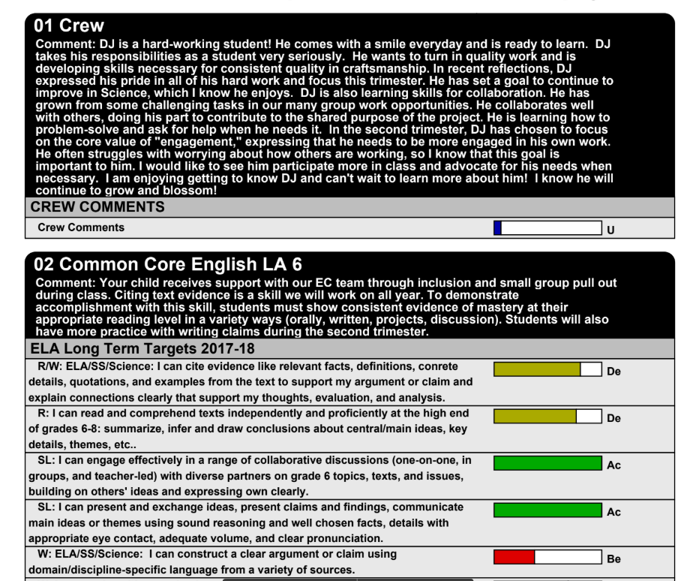

Slide 20
Crew
Provides each student with a smaller core community and one adult for a closer relationship (1:19)
Meets daily
Builds
Relationships and Social Emotional Learning
Group cohesion
School and grade level norms
Student oriented and often student directed

Slide 21
Crew Teachers and Co-Teaching
Who is your child’s teacher???
Crew Teacher - point-person, leads crew activities
Co-Teachers - works equally with your student in core subject areas
Team Teachers - each grade level is a team of 4 crew teachers
EC Teachers for students with IEPs
Intervention teachers for students who need support
Global Arts teachers

Slide 22
Crew Teachers and Co-Teaching
For example:
Joe Smith’s Teachers
Crew: Shawna
ELA: Loren and Devon
Math: Shawna and Kathryn
Expedition: Loren, Devon, Shawna, and Kathryn
Support from: Sharon and Kelly
Global Arts Teachers: Eugene, Jamie, Oliver

Slide 23
Electives
Two 4-6-week sessions per year on Friday afternoons
Example Classes:
Digital Photography, Bike Raleigh, Dance, Cooking Matters, Creative Writing, Model UN, Basketball, Board Games, Movie Lovers, Outdoor Games, Drama, Touch Rugby
Anyone can lead an elective on anything!

Slide 24
Expeditions
Middle School Expedition Example -
The Ripple Effect
Historical context for human rights, Properties of matter, Natural water system

Slide 25
Global Arts
Elementary | Middle
Art Music Movement Connected World | Art Wellness World Cultures

Slide 26
Portfolios
Portfolio Conference Days built into the school calendar
Student required to attend
Feel free to communicate with the crew teacher if the timing doesn’t work for you

Slide 27
Communicating With Exploris
Let us know if your student will be absent -
Email crew teacher AND attendance@exploris.org
Before/After Care Questions
Mary Margaret & Koren
Instruction Things
The teacher(s)

Slide 28
Communicating With Exploris
Grade Level Blog Newsletter
Subscribe to receive weekly emails
Some grade levels also have a Tumblr, Instagram, Bloomz or other account for updates
Monthly School Newsletter emailed
Requests for volunteers, updates, invites, schedule changes, etc
Text/Email/Phone: drills, emergencies, school closings

Slide 29
Communicating With Exploris
School Website
Official social media channels: Facebook, Instagram, Twitter
Unofficial social media channels: Facebook parent group
PTO: website & FB page. School directory, carpool map, weekly newsletter

Slide 30
Our Math Courses
6th, 7th, or 8th grade math - Students study the NC Essential Standards. Opportunities for above grade level enrichment and below grade level support
Math 1 - High school course that requires a move if 1-2 grade levels up. First available for 7th graders
Math 2 - High school course for 8th graders who completed Math 1 in 7th grade.

Slide 31
Don't be fooled by the modest-looking school building and it's awkward location nestled between downtown Raleigh's pubs. Inside those doors lies an innovative laboratory of education!
~ Prakash Bhave, parent of 4th, 6th, and 8th graders

Slide 32
~ Prakash Bhave, parent of 4th, 6th, and 8th graders

Slide 33
I want to give a shout out to the school for how they handled a kindergarten behavior concern. The way it was handled was mind blowing and I am so thankful to have my daughter at a school where her voice is heard, and resolutions are made. Way to go EXPLORIS!
~ Bridget Phillips, parent of kindergartener

Slide 34
The teachers and fellow parents are SO supportive. If you have a question or need help, just ask!!!
~ Kari Williams, parent of 8th and 5th graders

