Slide 1
IDENTIFYING RETALIATION AND AVOIDING CLAIMS
Presented by: Erin McNeil Young
Partner
Hall Booth Smith, PC
eyoung@hallboothsmith.com

Slide 2
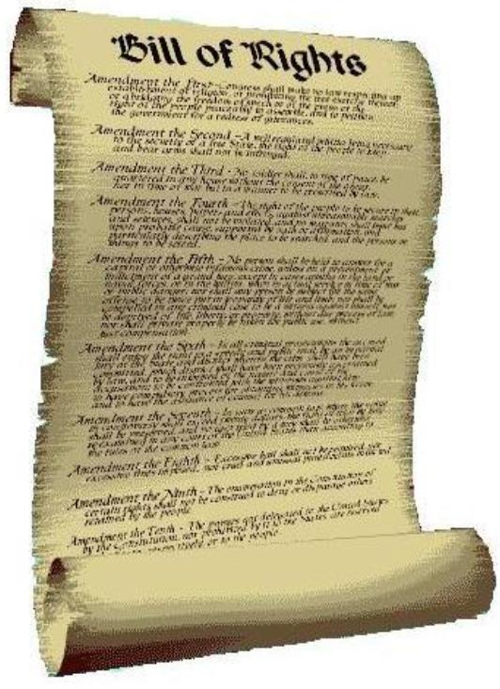
Federal and State laws prevent discrimination.
This Photo by Unknown Author is licensed under CC BY-SA-NC

Slide 3
Section 504 of the Rehabilitation Act of 1973
Applies to the recipients of grants or other financial assistance from the U.S. Department of Education. Essentially, all public school districts are covered by Section 504 because they receive some form of federal financial assistance.
Prohibits districts from discriminating against qualified students with disabilities on the basis of their disability. Public schools are required to provide qualified students with disabilities with a free, appropriate education at public expense (FAPE).

Slide 4
Title II of the Americans with Disabilities Act
Prohibits state and local governments (such as public school districts, public colleges and universities, and public libraries) from discriminating against persons with disabilities.

Slide 5
ANTI-DISCRIMINATION LAWS also prohibit retaliation against individuals who assert their rights UNDER THOSE LAWS.

Slide 6
Section 504 of the Rehabilitation Act of 1973 -- 34 CFR 104.61 (incorporates the retaliation language of the regulations under Title VI)
“Intimidatory or retaliatory acts prohibited. No recipient or other person shall intimidate, threaten, coerce, or discriminate against any individual for the purpose of interfering with any right or privilege secured by section 601 of the Act or this part, or because he has made a complaint, testified, assisted, or participated in any manner in an investigation, proceeding or hearing under this part.
The identity of complainants shall be kept confidential except to the extent necessary to carry out the purposes of this part, including the conduct of any investigation, hearing, or judicial proceeding arising thereunder.”

Slide 7
Title II of the Americans with Disabilities Act -- 28 CFR 35.134:
“(a) No private or public entity shall discriminate against any individual because that individual has opposed any act or practice made unlawful by this part, or because that individual made a charge, testified, assisted, or participated in any manner in an investigation, proceeding, or hearing under the Act or this part.
(b) No private or public entity shall coerce, intimidate, threaten, or interfere with any individual in the exercise or enjoyment of, or on account of his or her having exercised or enjoyed, or on account of his or her having aided or encouraged any other individual in the exercise or enjoyment of, any right granted or protected by the Act or this part.”

Slide 8
What is retaliation?
When school personnel take adverse action against a student, or one who advocates on behalf of a student, in response to a parent’s decision to assert his or her rights under the law.

Slide 9
OCR’S 5-Part Retaliation Test
Has the student/parent engaged in a protected activity?
Is the district aware of the protected activity?
Was the parent/student subjected to an adverse action?
Will a neutral third party decide there is a causal relationship or connection between the protected activity and the adverse reaction?
Can the district offer legitimate, nondiscriminatory reasons for the adverse action, which a neutral third party will not consider to be pretextual (i.e., a false pretense)?

Slide 10
1. Has the parent/student engaged in a protected activity?
Initiating due process proceedings
Making a FOIA request
Filing suit in Court
Filing a Complaint with OCR
Filing a Complaint with the District

Slide 11
2. Is the district aware of the protected activity?
Rumor or verified action?
Emails or other correspondence
Requests for IEP meetings and evaluations
How and when did the district receive notice of the protected activity?

Slide 12
3. Was the parent/student subjected to an adverse action?
Considerations:
Did the action significantly disadvantage the complainant as to his/her status or ability to access the benefits of the program?
Did the action preclude the individual from pursuing discrimination claims?
Might the action dissuade a reasonable person from engaging in a protected activity?
Did the action make it more difficult for the individual to engage in a protected activity?

Slide 13
Some examples of adverse action:
Suspensions/expulsions of the student
Meeting cancellations
Refusing to communicate with parents
Not allowing parents to have access to school records
Barring parents from school property
Calling DSS/CPS on parents

Slide 14
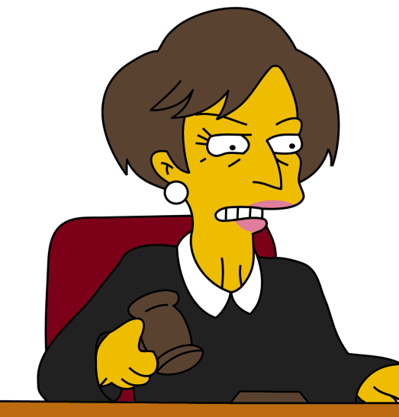
4. Will a neutral 3rd party decide there is a causal relationship or connection between the protected activity and the adverse action?
Knowledge
There can be no causation without knowledge
Timing
Did the adverse action occur immediately prior to or after or simultaneously with the protected action? – i.e., “fresh is bad, old and stale is good.”
This Photo by Unknown Author is licensed under CC BY-NC-ND

Slide 15
Before taking an “adverse action,” ask yourself:
How long ago did the protected activity occur?
Remember fresh is bad, old/stale is good.
Who is recommending/implementing the adverse action?
If the action is being recommended by someone who was named or implicated in a charge or complaint, it's a good idea to assign someone else to independently investigate and make a decision about what should be done.
Is this student/parent being treated differently than others with the same issue?
Self-explanatory
How airtight is the basis for the adverse action?
Documented behavioral issues supporting suspension/expulsion

Slide 16
5. Are there legitimate, nondiscriminatory reasons for the adverse action?
The reason for the adverse action is true
The reason is enough to have motivated the adverse action
Ex. Report to CPS based on legitimate “good faith” suspicion of abuse or neglect
Ex. Suspension/expulsion supported by documented disciplinary infractions
All similarly situated parents/children received the same treatment

Slide 17
Avoiding Retaliation Claims
Put your self in the parents’ shoes. They may be anxious, exhausted, and worried about their child’s future.
Everyone is entitled to due process. Even rude parents are sometimes right.
Document. Document. Document.
Unprofessionalism should always be met with professionalism.

Slide 18
IDENTIFYING RETALIATION AND AVOIDING CLAIMS
Presented by: Erin McNeil Young
Partner
Hall Booth Smith, PC
eyoung@hallboothsmith.com

