Slide 1
MWA CEO Report
MWA Board Meeting
January 31, 2019

Slide 2
General MWA and MWAS Updates/Highlights
Move went well (US staff & students to new MS #2); good spirits despite the disruption
Shift to ending Semester 1 in Dec. went well
FY 20 budget process kick-off started this month
Talent Team made 5 hires in one day before Dec. break!
WASC accreditation process has started

Slide 3
Additional Updates/Highlights
Plans in the works to take 11th graders to tour colleges in CA this spring to help them expand their sense possibilities about more than state schools.
Did not receive the New School Venture Fund grant award for expanding charter schools & not quite yet eligible for the federal grant.
Will be eligible for the state grant for CA charter schools for planning and start-up if Pittsburg is approved and the feds fund the state program again.

Slide 4
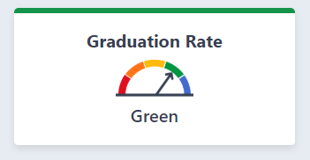
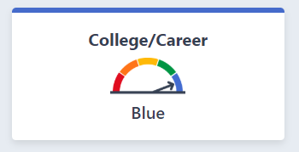
CDE Dashboard Elements to Celebrate for MWA
Graduation rate is high (GREEN)
The College/Career ranking is in the highest band (BLUE)

Slide 5
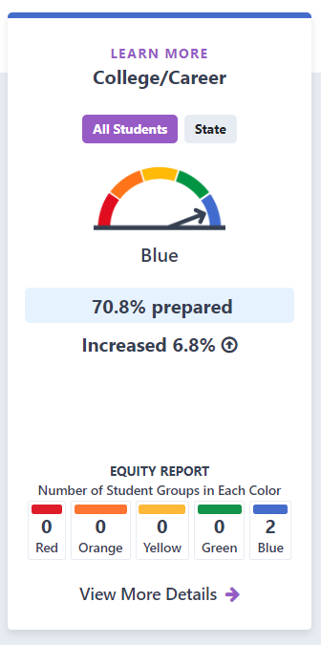
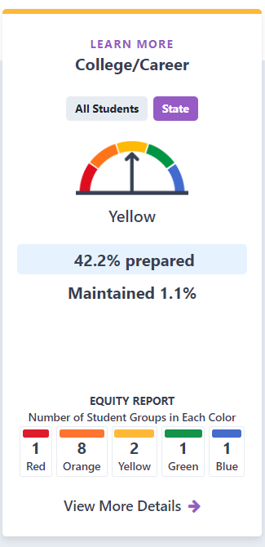
Dashboard College/Career – MWA vs. CA Avg.

Slide 6
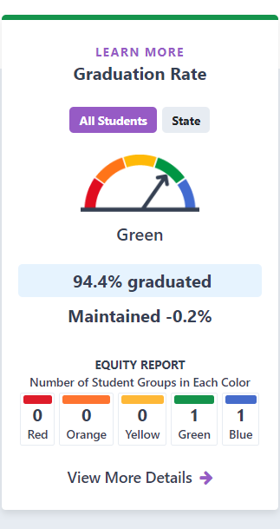
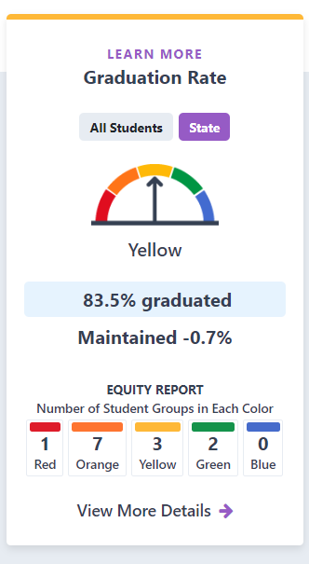
Dashboard Graduation Rate – MWA vs. CA Avg.

Slide 7
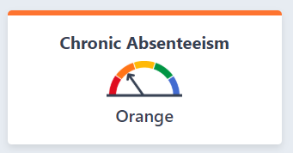
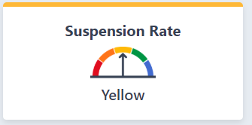
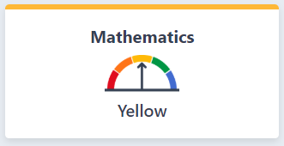
CDE Dashboard Elements Growth Areas
Chronic Absenteeism
Suspension Rates
Math Growth
English Growth (not shown because strong overall)

Slide 8
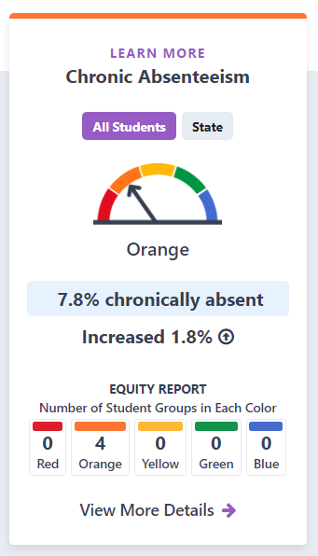
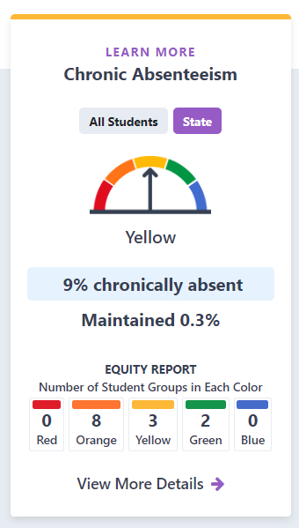
Dashboard Absenteeism – MWA vs. CA Avg.
(Had a slight increase in chronically absent students; a “Decline” is the goal here)

Slide 9
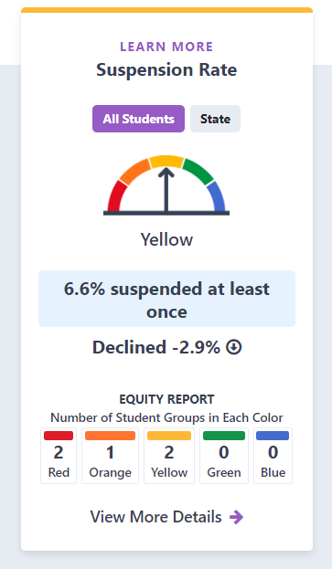
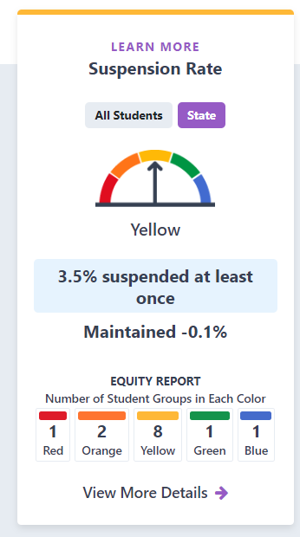
Dashboard Suspension Rate – MWA vs. CA Avg.
(Comparable to CA and had a “Decline” in suspensions which is good overall).

Slide 10
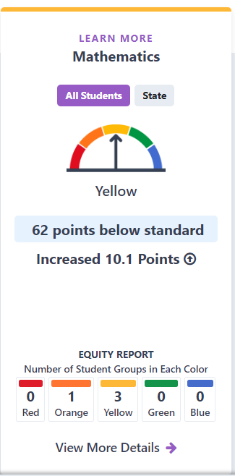
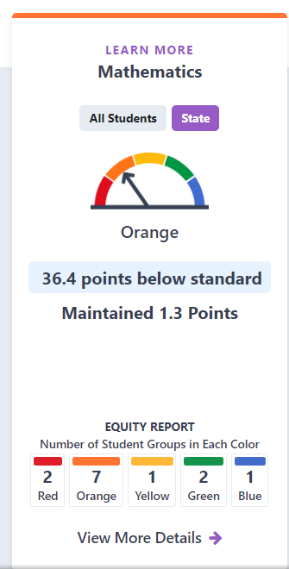
Dashboard Mathematics – MWA vs. CA Avg.
(Higher than CA & with a 10.1 Points increase versus 1.3 Points increase for CA).

Slide 11
Demand: MWA Lottery Highlights for 2019-20
Lottery Enrollment Summary (as of 1/22/19):
987 TOTAL applications submitted
446 only applied to MWA (45.1% of all applications submitted)
80 sibling applications (would equal 33.9% of the 5th grade class)
This % is less than the historical 50% or more = more spaces for new stus.
2 employee children applications (.01% of the incoming class)
765 eligible for Free & Reduced Price Meals (FRPM) (77.5%)
not necessarily equal to the % that ultimately enroll

Slide 12
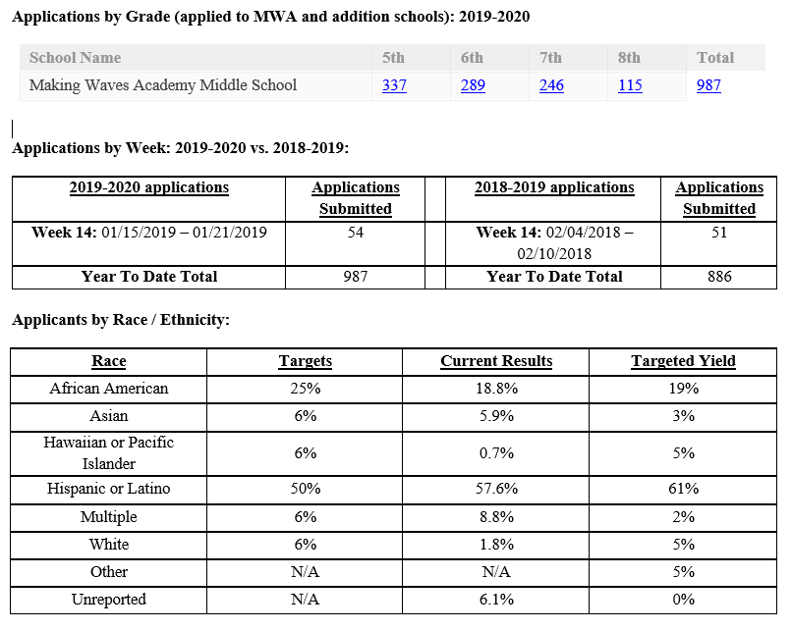
Other MWA Lottery Highlights
(101 more students applying than last year through the first 15 weeks of the process)

