Slide 1
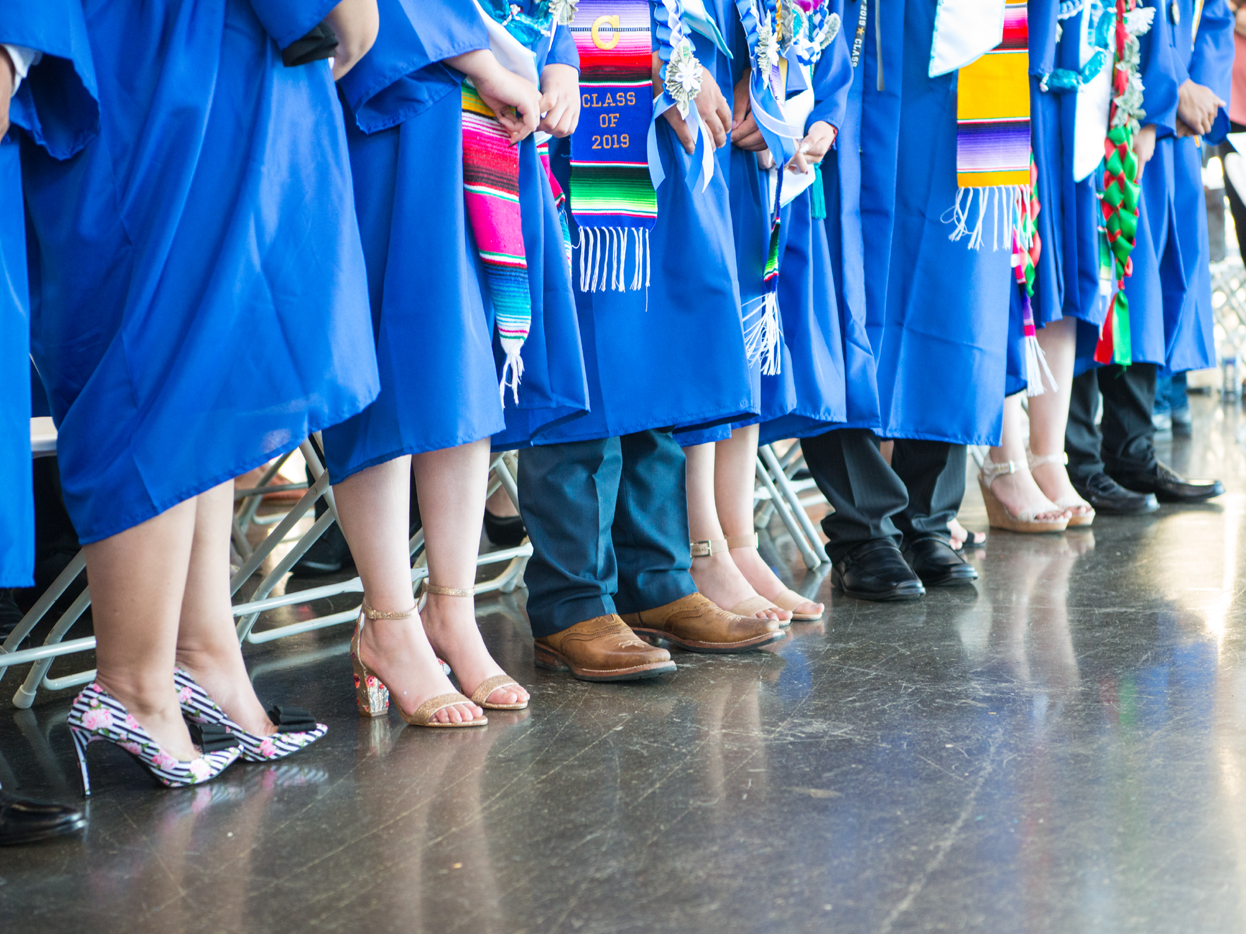
ASB Board Report - May 6th 2024
ASB Members: Leilah Howard & Dipika Thajali
Notes:
Name, Grade, Roll?
Thank you for this opportunity to present to you today.

Slide 2
Successes
Challenges
Priorities
Questions & Conversation
Table of
Contents
Notes:
Simren

Slide 3
Successes
Notes:
Jenissa

Slide 4
Successes
Club Fair
We raised $4,329 which is the highest amount we have fundraised.
Last ASM
We had a student performance.
We gave important end-of year information: Last day to turn in late work, Prom, AP Testing.
We had students and teachers engage in a game of musical chairs.
Student recognition for winter sports.
ASB Elections
We had the highest amount of applicants ever; 18 candidates

Slide 5
Challenges
Notes:
Simren

Slide 6
Challenges
Walkout Follow Up Email
We want to address the needs in a conversation with leadership; emailing back and forth feels like a dead end.
Board Meeting Public Comment
We want to follow up on what Nasira Akbar and Jurnee Brown said during the public comment section two Board Meetings ago.
Examples; After school events/activities, social services, and lack of field trips.
Notes:
Simren

Slide 7
Priorities
Notes:
Jenissa

Slide 8
Priorities
ASB Elections
We have finished the recruiting process and are now in campaign season.
Ballots go out on Monday, May 13th-14th.
Senior Send off
How can we celebrate our seniors?
APIA Extended Lunch
Notes:
Jenissa

Slide 9
Questions & Conversation
Notes:
Simren

