Slide 1
MWA Board Meeting
May 4, 2023

Slide 2
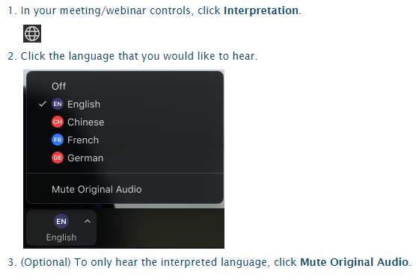
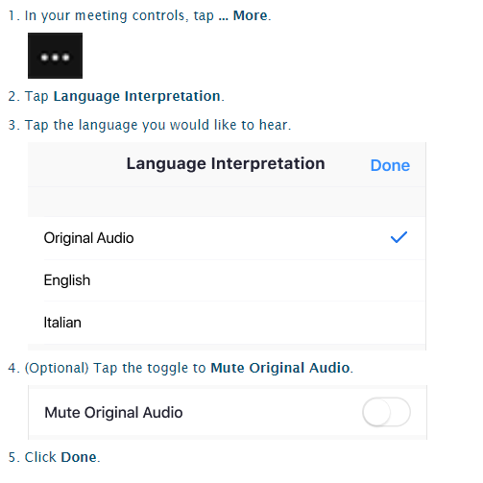
Activating Interpretation / Activar Interpretación
Computer
Cell Phone

Slide 3
Public Comment
Use the raise hand function when your name is called.
Computer
Cell Phone
Notes:
This will be great practice because we are using this feature in the upcoming board meeting.

Slide 4
Mission Connection

Slide 5
ASB Board Report - May 4th, 2023
ASB Members: Yoltzin Wallace + Melanie Leon
Notes:
Name, Grade, Roll?
Thank you for this opportunity to present to you today.

Slide 6
Successes
Challenges
Priorities
Questions & Conversation
Table of
Contents
Notes:
Simren

Slide 7
Successes
Notes:
Jenissa

Slide 8
Successes
Pep Rally
The Rally was very inclusive. There was multiple performances from Theater and Cheer.
Audience was more engaged and enthusiastic
Spring Festival
Clubs made a decent amount of money
There was more variety of games, food, beverages, and homemade/DIY crafts
Surround sound made the event better
ASB Election Season
A lot of interest in ASB this year
Notes:
Jenissa

Slide 9
Challenges
Notes:
Simren

Slide 10
Challenges
Spring Festival:
The weather was no great for an outside gathering. Plan to have club fairs on warmer days.
No that many middle school students at the festival.
Pep Rally
Ran out of time. Maybe will need to extend in the future
Notes:
Simren

Slide 11
Priorities
Notes:
Jenissa

Slide 12
Priorities
ASB Elections
ASB Retreat
Planning out future fundraising ideas
Notes:
Jenissa

Slide 13
Questions & Conversation
Notes:
Simren

Slide 14
2023-24 LCAP Public Hearing
Presenter(s): Molly Moloney, Alton Nelson
Date: May 4, 2023

Slide 15
LCAP 3 year cycle
Year 0 (20-21)
Finish implementing previous LCAP
Create new 3-year LCAP
Year 3 (23-24)
Year 1 (21-22)
Finish implementing LCAP;
Create new 3-year LCAP to start following year
Implement LCAP Actions, Update metrics to monitor Progress, Revise Actions for following year
Year 2 (22-23)
Implement LCAP Actions, Update metrics to monitor Progress, Revise Actions for following year

Slide 16
WASC and LCAP Alignment
Support for All Learners: Develop and refine vertically-aligned programs to support all learners.
LCAP Goal 1: Basic Conditions
LCAP Goal 2: Academic Standards
LCAP Goal 3: Family Partnerships
LCAP Goal 8: Academic Growth
College and Career Readiness: Refine holistic support for college and career readiness that build all students’ capacity for graduation and success beyond high school.
LCAP Goal 4:
College & Career Readiness
LCAP Goal 7: Course Access
Diversity, Equity, and Inclusion: Create a safe, inclusive, and high-performing environment for all students and adults that are informed through the lens of diversity, equity, and inclusion.
Priority 2:
State
Standards
LCAP Goal 5: Student Engagement
LCAP Goal 6: School Climate

Slide 17
LCAP Educational-Partner Engagement
October 6
December 1
February 2
March 23
March 17, 27, 28 30
May 4
LCAP Advisory Group launch
LCAP Advisory Group: Present updates, receive input on Goals
1, 3, 5, 6
LCAP Advisory Group, Present updates, receive input on Goals 2, 4, 7, 8
LCAP Advisory Group reviews initial drafts of key sections of 2023-24 LCAP
ELAC, Students, and Staff LCAP review sessions
LCAP Public Hearing (Board Meeting)

Slide 18
Educational Partner feedback areas
Curriculum: A need for updated curriculum and/or additional support and training around using curricular materials. Course Offerings: Recommendations for more course options, especially electives and AP courses. Student Engagement: Requests for more support for clubs in the middle school, more field trip offerings, and more direct support for cultural celebrations at the school. Parent/Family Involvement: A desire among parents for more opportunities for involvement, volunteering, and leadership; recommendations to revive the “Parent Wave” role of previous years. School Climate: More consistency in responses to student behavior, and more examples of celebrations and positive incentives to motivate students.

Slide 19
Programmatic Revisions/Additions
Goal 1 | Adopt and implement new curriculum in multiple subject areas.
Goal 2 | Support for curriculum implementation as a major focus of professional development and instructional coaching next year.
Goal 3 | Volunteer opportunities and strengthening our commitment to revive the role of “Parent Wave Representatives.”
Goal 4 | Expanding AP course offerings (in 2023-24 and over the next 3 years)
Goal 5 | Expand field trip opportunities in 2023-24 Integrate Attendance supports with broader PBIS system.
Goal 6 | Plans to strengthen and align our system of Multi-tiered support and services (MTSS), along with Positive Behavior Interventions and Supports (PBIS) more cohesively, so that many different “silos” of work at the school can be brought together into a more unified system, and so that this work is aligned to our educational goals in a sustainable way. A new action to more directly support and fund cultural celebrations at the school next year.
Goal 7 | Plans to continue expanding elective course offerings in the upper school.
Goal 8 | A focus on curriculum alignment and implementation for 2023-24. Distinguishes between middle school and upper school intervention plans and use of the ‘flex period.’

Slide 20
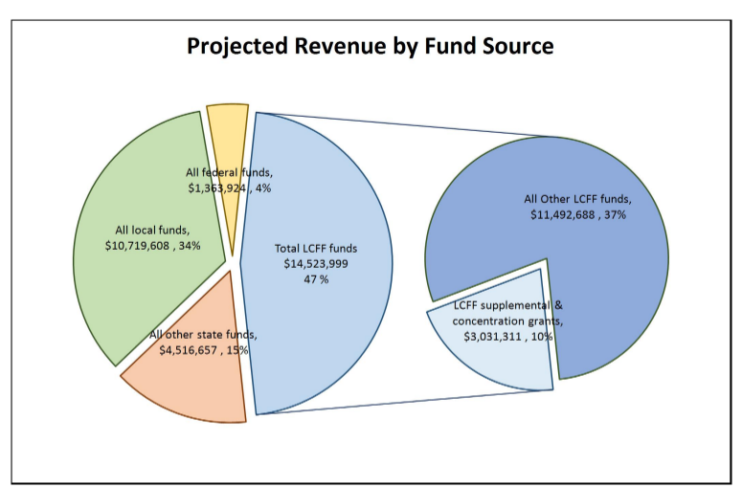
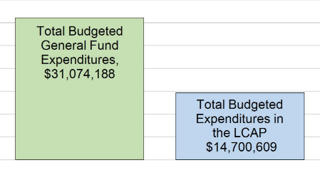
Budget Context

Slide 21
Guiding Question
What feedback, refinements, or questions do you have related to 23-24 LCAP? (goals, metrics, actions, or expenditures?)
If you have found any typos or other small corrections, you can send those directly to Molly Moloney to correct.

Slide 22
Thank You!

Slide 23
Break…

Slide 24
Closed session in progress...

