Slide 1
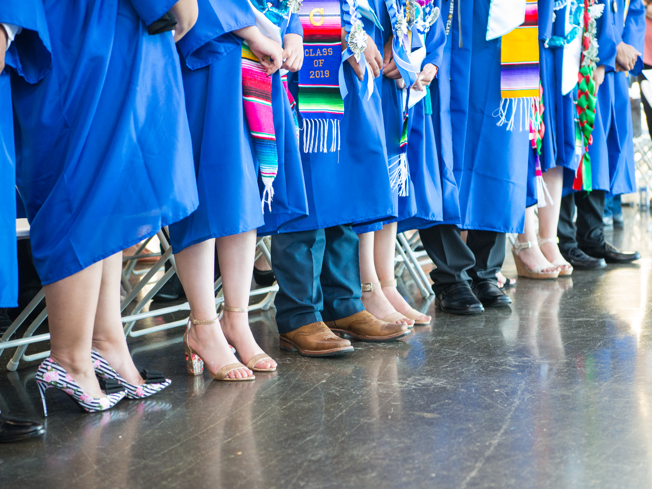
MWA Board Meeting
March 16, 2023

Slide 2
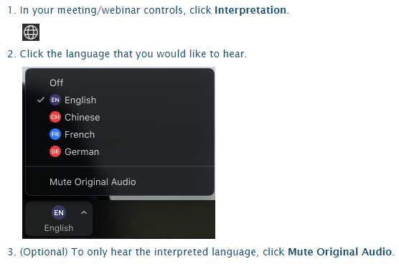
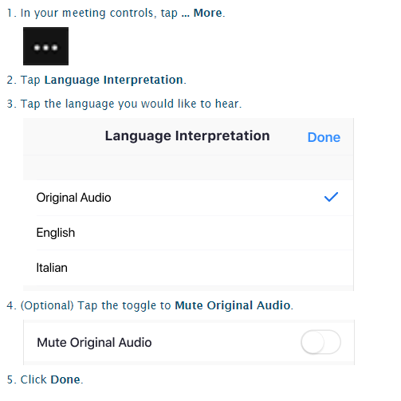
Activating Interpretation / Activar Interpretación
Computer
Cell Phone

Slide 3
Public Comment
Use the raise hand function when your name is called.
Computer
Cell Phone
Notes:
This will be great practice because we are using this feature in the upcoming board meeting.

Slide 4
Standing Reports

Slide 5
Mission Connection- BSU

Slide 7
ASB Board Report
Notes:
Name, Grade, Roll?
Thank you for this opportunity to present to you today.

Slide 8
ASB Board Report - March 16th 2023
ASB Members: Jenissa Godinez, Simren Sandhu, Yoltzin Wallace
Notes:
Name, Grade, Roll?
Thank you for this opportunity to present to you today.

Slide 9
Successes
Challenges
Priorities
Questions & Conversation
Table of
Contents
Notes:
Simren

Slide 10
Successes
Notes:
Jenissa

Slide 11
Successes
Overall School Events & Activities
Winter Dance, Pep Rally + Spirit Week
Fundraising Efforts
In one year, ASB has raised almost $6,000. We are currently planning how to allocate the money
Notes:
Jenissa

Slide 12
Challenges
Notes:
Simren

Slide 13
Challenges
Attendance at Winter Formal
We had a learning moment as our theme may have come off as couple-centered
Internal Challenges
We are facing challenges with attendance as this point in the school year becomes hard to manage for our members
Notes:
Simren

Slide 14
Priorities
Notes:
Jenissa

Slide 15
Priorities
Spring Festival
Election Season
FInal ASM / Senior Sendoff
Notes:
Jenissa

Slide 16
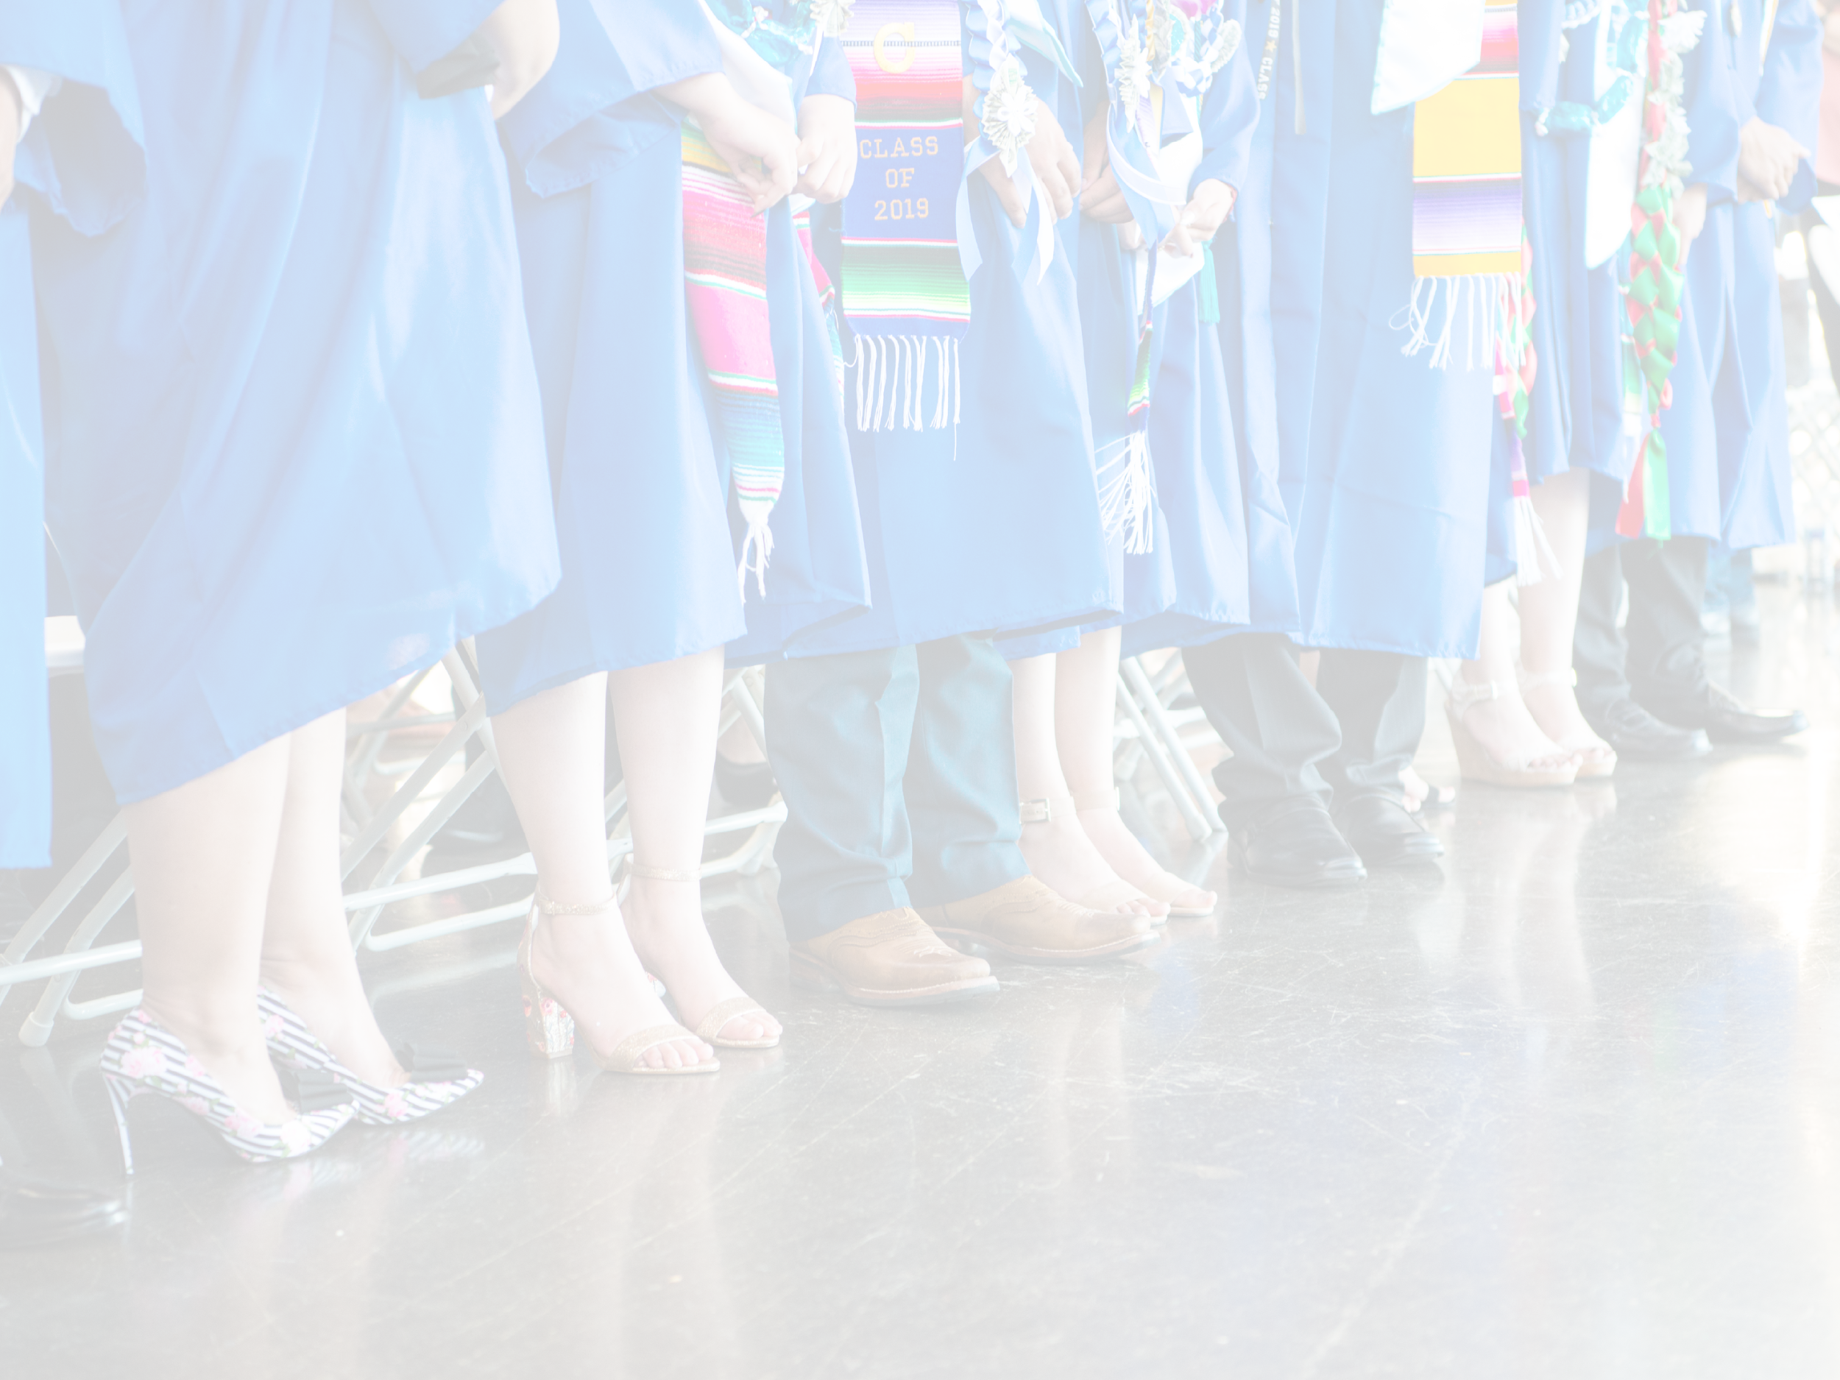
Questions & Conversation
Notes:
Simren

Slide 17
Deep Dive: Board Book

Slide 18
Break…

Slide 19
Closed session in progress...

