Slide 1
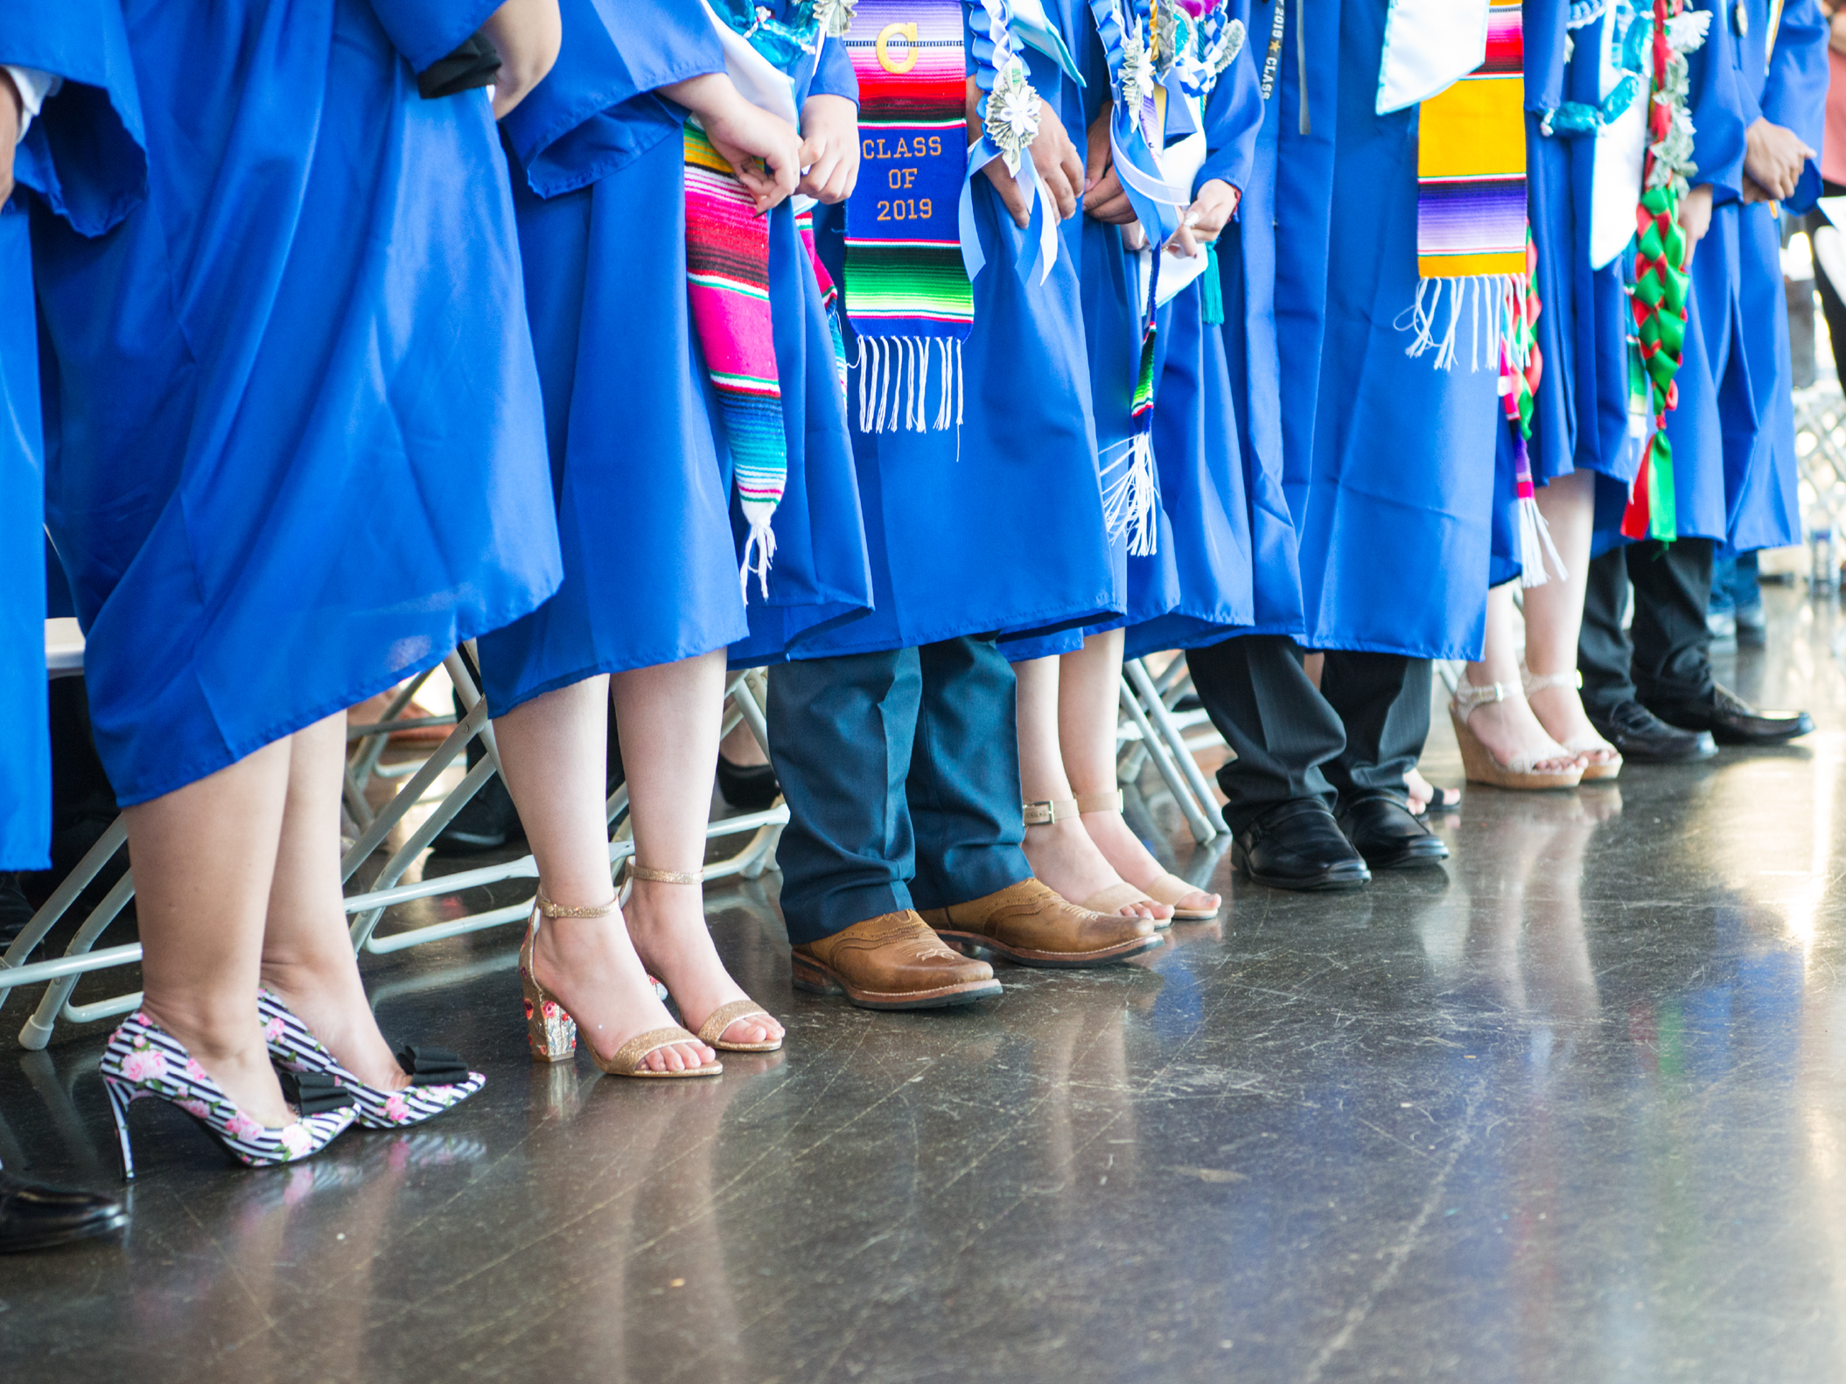
ASB Board Report - March 16th 2023
ASB Members: Jenissa Godinez, Simren Sandhu, Yoltzin Wallace
Notes:
Name, Grade, Roll?
Thank you for this opportunity to present to you today.

Slide 2
Successes
Challenges
Priorities
Questions & Conversation
Table of
Contents
Notes:
Simren

Slide 3
Successes
Notes:
Jenissa

Slide 4
Successes
Overall School Events & Activities
Winter Dance, Pep Rally + Spirit Week
Fundraising Efforts
In one year, ASB has raised almost $6,000. We are currently planning how to allocate the money
Notes:
Jenissa

Slide 5
Challenges
Notes:
Simren

Slide 6
Challenges
Attendance at Winter Formal
We had a learning moment as our theme may have come off as couple-centered
Internal Challenges
We are facing challenges with attendance as this point in the school year becomes hard to manage for our members
Notes:
Simren

Slide 7
Priorities
Notes:
Jenissa

Slide 8
Priorities
Spring Festival
Election Season
FInal ASM / Senior Sendoff
Notes:
Jenissa

Slide 9
Questions & Conversation
Notes:
Simren

