Slide 1
MWA Special Education
Karen Snider, Director of SPED
12.8.22

Slide 2
Warm Up and Student Connection
SPED Program
Academic Achievement
Successes & Challenges
Trends in SPED and Looking Forward
Table of
Contents

Slide 3
Uor stdns wth indidlue lrarng neds aer wav makrs.

Slide 4
Dyslexia
1:5 people struggle with dyslexia; 1:20 are diagnosed
Dyslexia is characterized by difficulty with learning to read fluency, phonological awareness, phonological decoding, processing speed, orthographic coding, auditory short term memory, language/verbal comprehension and rapid naming skills
Students can read but it takes a lot of concentration
Impacts fluency which can make comprehension challenging
Students require targeted, systematic phonological instruction
Students develop strategies such as guessing or avoidance
Considered to be a receptive language based learning disability but can also affect expressive language skills

Slide 5
Students with IEPs are…
Athletes-varsity soccer players, softball, soccer, cross country, and baseball
Artists
Photographers
Chefs
AP students
ELD students
In student clubs
In yearbook
General education students

Slide 6
What the students want you to know…
What does having an IEP mean to you? | “That means I just can't learn as fast as everyone else” “It means that you'll get a better understanding of whats being said to you” “it helps with making a goal” “It gives me more time to work. On my stuff and i really need it it helps me so much.” “it means i learn slower and i need more help”
How has being in special education helped you? | “It has helped me by letting me receive the extra help that I need to complete my work to the school's expectations. This class has also helped me keep my grades up.” “i can have more time on my work” “it has gotten me farther than i shouldve” “i feel better mentally knowing someone is there if i need help” “gives me time to work”
What do you wish people understood about special education? | “I wish people understood that because you are in this class/program, it doesn't mean that you are stupid or dumb or any other slur people might use.” “its just extra help.” “That it doesn't mean were dumb or sped or “retarded” were just here for more supportwith our work and more time.” “its not just autism”
How do your special education teachers help you? | “They use things to guide me and they help me.” “They help my by giving me a place to work when i want a quiet spot and talking to my teachers for me when i need something.” “They constantly remind me to do my work, and they will help me. Even when i'm not in there specific period at the time, if I go to there class they will help me with whatever is needed. They are also very positive and motivative for you, they will acknowledge the good work that you do.”

Slide 7
Special Education Program

Slide 8
SPED Population
Currently 88 students with IEPs at MWA. 8.5% of overall student population.
Projected to be at 100 students by EOY. MWA will move out of “small schools”.
Students with specific learning disabilities (SLDs) make up 65% of student primary eligibility category. Followed by other health impairment (OHI) at 15%.
MWA serves students with: specific learning disabilities, other health impairment, orthopedic impairment, emotional disturbance, autism, speech and language impairments, and intellectual disabilities.
The department has held over 82 IEP meeting since the start of the school year.
Absences are negatively impacting student progress.
Population growth
110% growth in the number of students in SPED program since 2015
Department staffing growth
5 FT SPED staff in 2015
12 FT SPED staff in 2022 (+ part time contracted staff)
Chronic Absences
SPED | General Education | ELD
27.3% | 20.2% | 20.1%

Slide 9
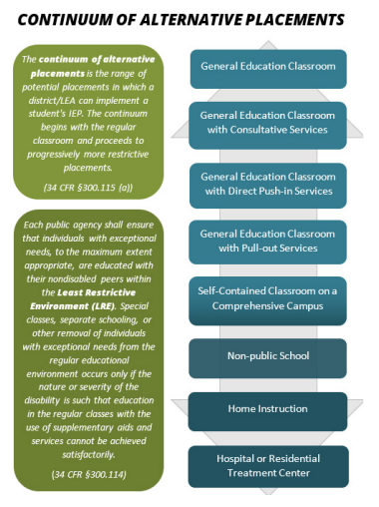
MWA’s Special Education Continuum of Services
General Education | GE teacher implement accommodations and modifications per students IEP in the general education classroom.
Direct Push In Services | SPED instructional aides and teachers push directly into the GE classroom to support students with accessing the GE curriculum. MWA offers shared push in support, 1:1 behavioral support services, and intensive push in support services for students on modified curriculums.
Specialized Academic Instruction Pull Out Services | MWA offers student support period as an elective in the US and during Flex Period in the MS. In the US, students have additional opportunities for Flex Period support. Pull out services for speech therapy, occupational therapy, physical therapy, counseling, adaptive PE
Self Contained Classroom on a Comprehensive Classroom | MWA does not currently have a traditional special day class self contained classroom model. However, we do have students who require this level of instructional service so students are pulled out more extensively for reading and math instruction in the special education room.
Non-public./Counseling Enriched schools | MWA has two students currently placed at NPS and counseling enriched programs. School is likely to see an increase in outside Level 3 placements by EOY.

Slide 10
Student Support Period
Middle School Flex Period
Reading/writing intervention 2x’s a week
Math intervention 2x’s a week
5th and 6th grade (likely split needed to increased number of students for S2)
7th grade Flex
8th grade Flex
Additional Pull Out (during advisory and/or core day)
Small group reading intervention 3-4x’s week.
Pull out support for ELA/core day instruction for students on modified curriculum.
Upper School Support Period
9th grade RSP period
10th-12th grade RSP period
Reading, writing, and math intervention
Remediation and GE curriculum practice
Flex Period Mon-Thurs
HW/assignment support
Executive functioning support

Slide 11
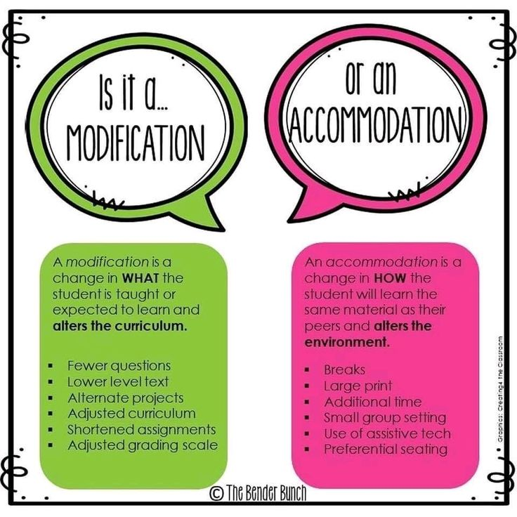
Modified Curriculum Support
Instructional aide support for students on modified curriculum with accessing GE modified work.
GE teachers modifying grade level course work.
Students in US participating in 2 support periods plus flex period (⅓ of day spent in special education).

Slide 12
Behavior Specialist Support
Addition of behavior specialist at MWA.
Re-establishing Tier 1 behavior systems, supports and protocols for students. Teacher coaching on classroom management and PD.
Tier 2 supports including training for social groups and skill building groups.
Tier 3 supports
Check In/Check Out
Behavior observations
Data tracking and collaboration with DOS
SPED supports
Behavior intervention plans (BIPs)
Collaboration on Functional Behavior Assessments (FBAs)
Direct behavior intervention service minutes

Slide 13
Academic Achievement

Slide 14
Background
MWA was identified for performance improvement (special education plan or SEP) in 2020.
Identified due to the gap in academic performance for students with IEPs and their general education peers for ELA and Math (SBAC scores)
MWA developed SEP plans for improving reading and math outcomes for students with learning disabilities.
SPED department started implementing reading and math interventions in 2021-22.
Continuing small group reading and math intervention in support period 2022-23.

Slide 15
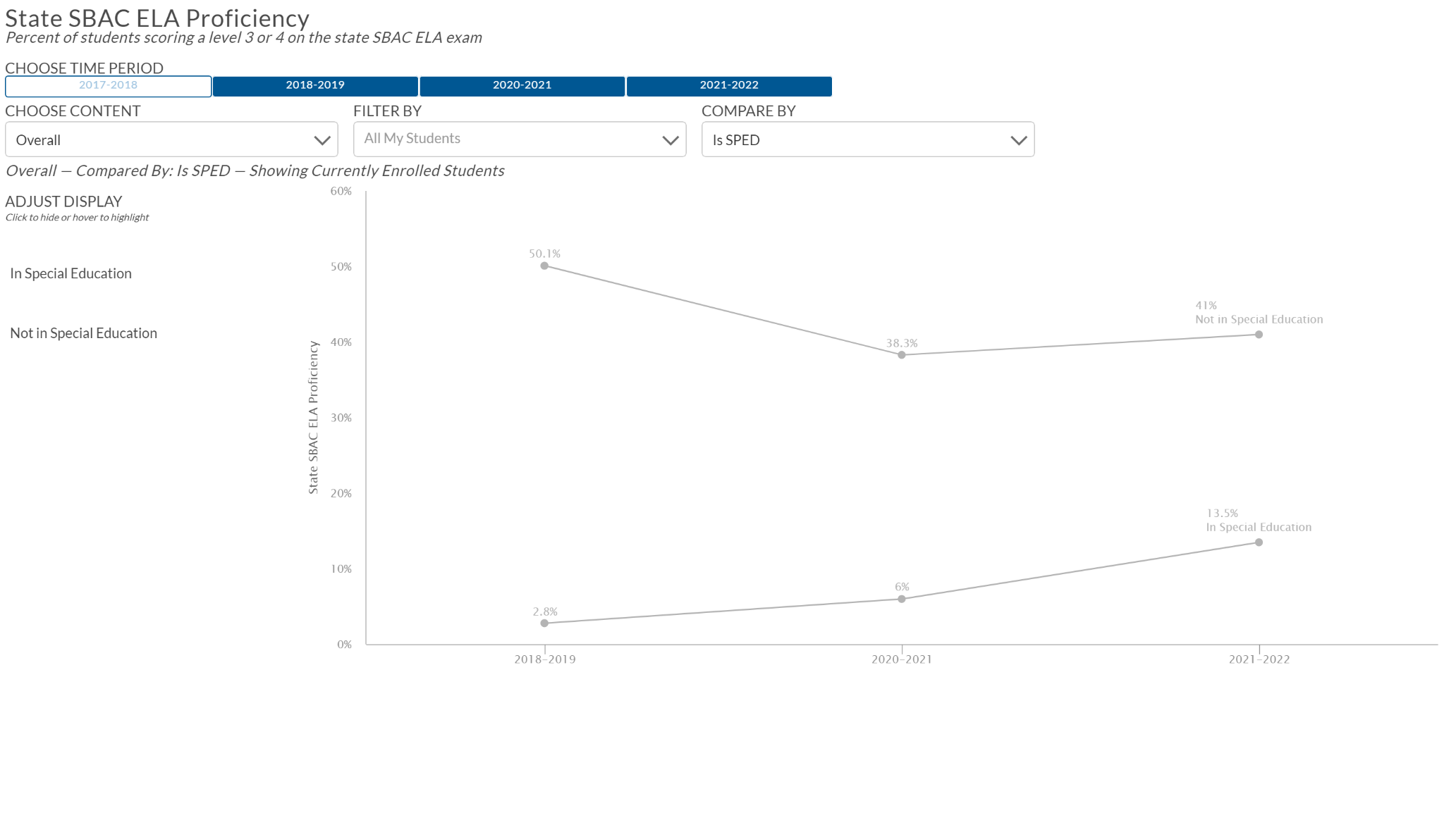
SBAC ELA Proficiency 2021-22
SPED | General Education | ELD
13.5% | 41.0% | 6.1%

Slide 16
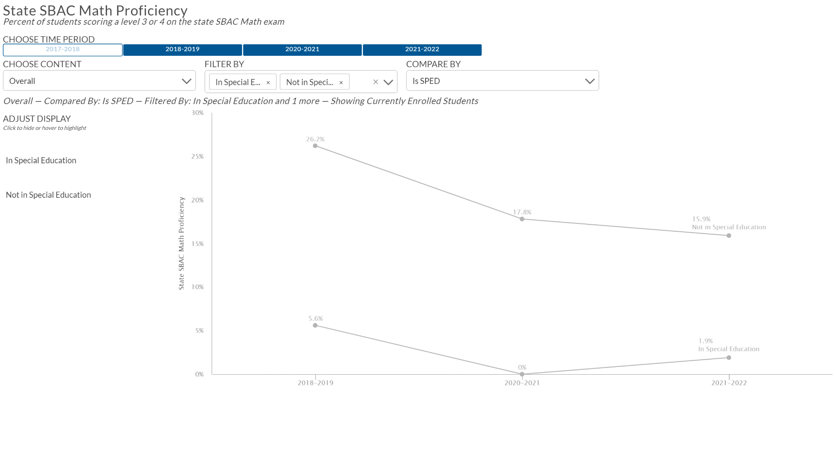
SBAC Math Proficiency 2021-22
SPED | General Education | ELD
1.9% | 15.9% | 1.0%

Slide 17
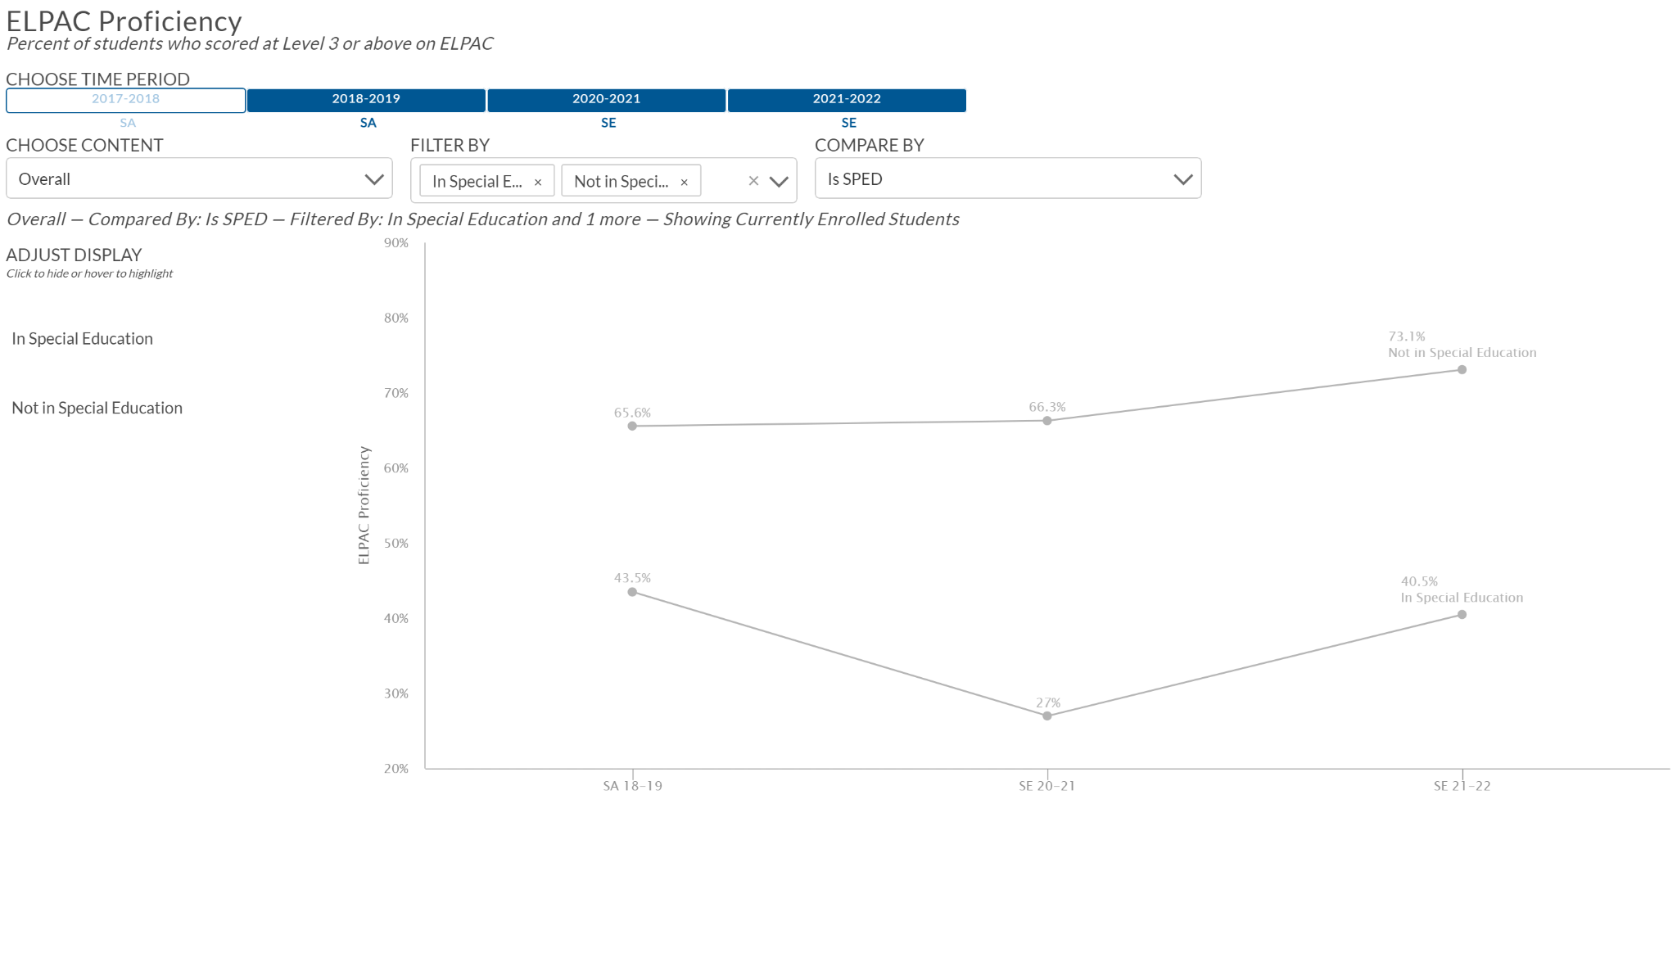
ELPAC Proficiency 2021-22
SPED |  | General Education (ELD)
40.5% |  | 73.1%

Slide 18
Special Education Focus Areas 2022-23
Curriculum and instruction during student support period.
Targeted reading intervention
Piloting writing intervention (Rewards Writing)
Math intervention to address skill gaps and remediation/practice of grade level math concepts.

Slide 19
Successes

Slide 20
Reading Interventions
Rewards
Research based multisensory structured phonics, reading, writing, and spelling program
Students who are reading around the 3rd grade level who are in grades 4-12 and struggle with reading multisyllabic words, comprehension, and fluency
2x’s a week in small groups
Sonday
Orton-Gillingham based program
Students with significant phonological awareness and reading skill gaps
3-4 x’s week in small groups
Additional Reading Instruction
Reading A-Z and Read Naturally in 5th/6th grade
Novel study in 7th/8th grade
SBAC Interim Assessment Blocks (IAB) ELA Proficiency Fall 2022
SPED | General Education | ELD
31.6% | 73.8% | 48.9%

Slide 21
Successes Continued
Behavior intervention support
Increased support for students with IEPs behavioral needs.
MTSS general education behavior interventions and support with Child Find.
Expanding specialized academic instruction in the Upper School despite staffing challenges.
Additional supports and service minutes for students who are struggling with completing assignments.
Wider range of individuals programs for students based on need.

Slide 22
Successes Continued
NWEA MAP Math at or above 50th percentile Fall 2022
SPED | General Education | ELD
6% | 24.7% | 4.9%
Math interventions and curriculum in SPED.
Use of Transmath- math intervention curriculum for middle/high school students who lack foundational math skills necessary for entry/success in algebra and who 2+ years below grade level in math
IXL use during support period
NWEA MAP Math Growth Percentile Fall 2022
SPED | General Education | ELD
51.6% | 59% | 59.3%
SBAC Interim Assessment Blocks (IAB) Math Proficiency Fall 2022
SPED | General Education | ELD
43.1% | 62.6% | 54.2%

Slide 23
Challenges

Slide 24
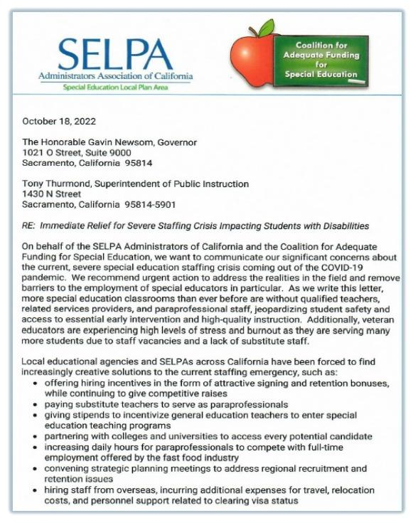
SPED vacancies and staffing challenges
3 SPED teacher vacancies, 1 instructional aide vacancy
Increased caseload sizes
Outside non-public agency support with some vacancies
Statewide/National staffing challenges in special education
State SELPA association filed letter on behalf of LEAs to Governor and Superintendent suggesting ways in which the CDE can provide immediate relief to address school’s significant staffing challenges for students with disabilities
SPED Staffing Challenges

Slide 25
Scheduling limitations
Middle School cohorting and pull out services during Flex Period
Growing population sizes
Increased high academic need students
Increased behavioral challenges and educationally related mental health service (ERHMS) needs.
Pandemic learning loss
Prior to covid students with IEPs were on average entering MWA 3-5 years below grade level.
Currently many students are entering 4-5+ years below grade level in reading and math.
Challenges continued

Slide 26
Trends in Special Education

Slide 27
Increase in other health impairment eligibility
Attention deficits
Depression
Anxiety
Behavioral challenges
Increased students with behavior intervention plans
Direct behavior intervention services
1:1 behavioral aides
Functional behavior assessments
Emotional disturbance eligibility
SLD for math calculation
Increased social emotional and mental health needs

Slide 28
Educationally Related Mental Health Services (ERHMS)
Increased social emotional needs and high mental health needs.
CEO Council (SELPA) decided to move forward with direct funding for 2023-24.
Funding is disbursed to LEA monthly $50/ADA and adjusted at P1 and P2.
No filing of mental health plans and level 2 budget requests
No counting services in SEIS for budget reasons
SELPA will continue to provide mental health support for partners and CPI behavior training/certification.
SELPA administer a Level 3 ERHMS funding pool.
Residential (RTC) room and board covered at 100%
NPS mental health services covered at 90%
Site-Based therapeutic covered at 80%
Note- SELPA fund pool covers ERHMS services but not academic services.

Slide 29
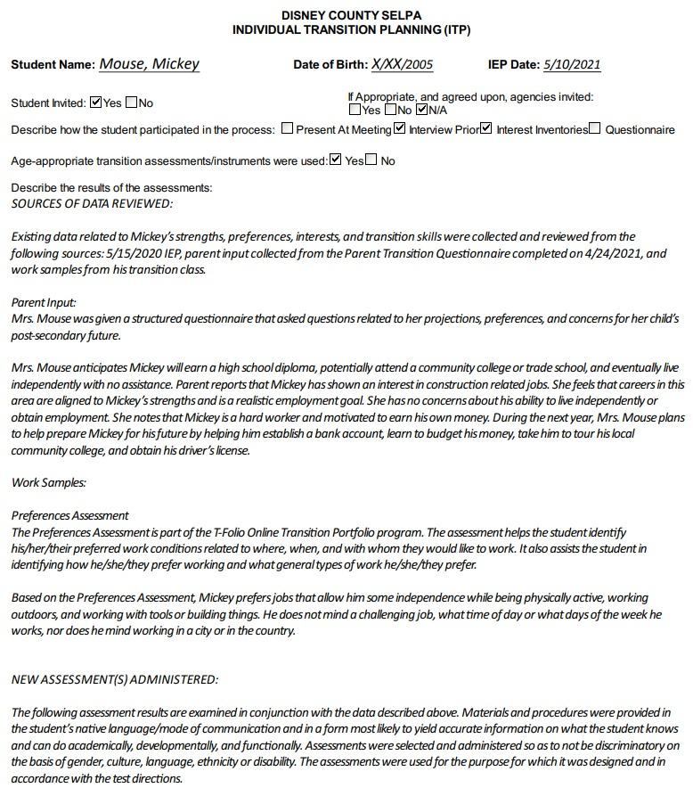
Transition Plan for Students with IEPs
New guidelines from SELPA for students transition plans.
Schools to provide post secondary transition support and preparation for education, career, and independent living.
MWA has implemented structured questionnaires and interviews for student AND parent/guardian.
Updated transition plans in accordance with YMC and SELPA recommendations for compliance.

Slide 30
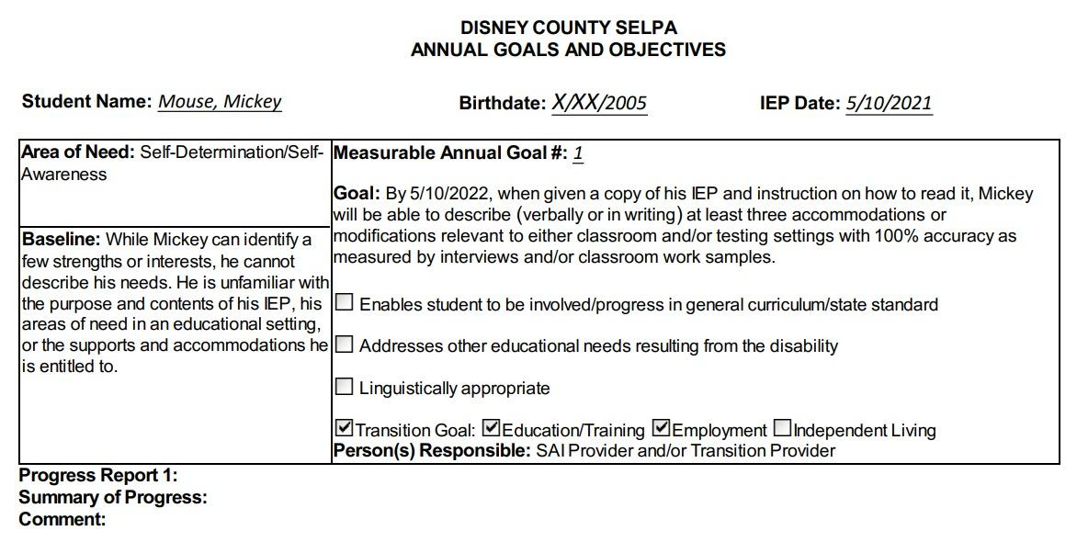
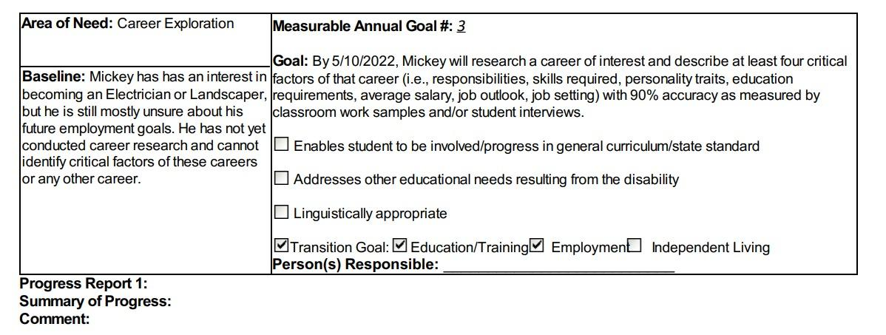
Transition Plan for Students with IEPs
Students must have post secondary transition goals and a transition plan by age 16 (MWA starts with all 9th graders at first IEP in US).
IEPs must include transition services.
CCC/SPED is working on expanding relationships with adult transition services such as regional center, CCCOE transition programs, workability.
Goal to increase community based experiences, career technical education, and vocational options and career exploration.
Transition IEP goals in the areas of post secondary education, employment, and if appropriate independent living.

Slide 31
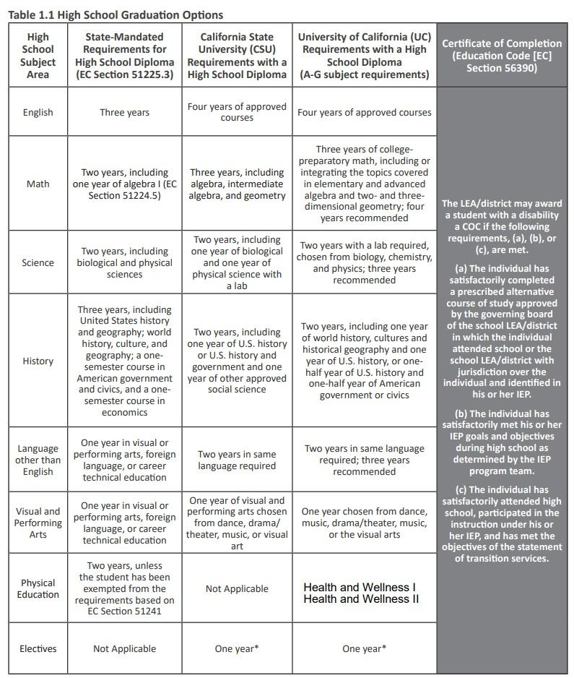
Graduation Pathways for Students with IEPs
Currently MWA has the standard diploma A-G and a certificate of completion track for students with IEPs.
Need for expanded pathways for students with IEPs
Section 51225.31 CDE guidelines for alternate assessments
Only applies to students with significant cognitive disabilities who are on alternate assessments and participate in modified instruction primarily in the general education.
CDE workgroup to explore expanding pathways for students with disabilities.
Explore potential other options for students with IEPs for diploma track in non A-G courses who are not significantly cognitively impaired.
Update MWA graduation guidelines to include students at nonpublic schools taking non A-G courses.

Slide 32
Continuum of Services and Instruction
Semester 2 focus
Continue reading interventions with fidelity.
Push reading programs in Upper School student support with fidelity.
Progress monitoring effectiveness of programs.
Continue/increase efficacy of math curriculum interventions.
Collaborate with math interventionist.
Continue pragmatic expansion of continuum of learning environments (LREs).
Increase support service minutes in MS 2023-24.

Slide 33
Questions?

Slide 34
Contact Information
Karen Snider, Director of SPED
ksnider@mwacademy.org
510-551-9988

