Slide 1
CAASPP Results (final/comparative) 2022
Presenter(s):Molly Moloney, Alton Nelson
December 2022

Slide 2
Comparison Summary
From 2019-2022 there were declines in ELA and Math scores statewide, county-wide, and at most schools.
However, MWA’s scores declined more than average over this time period and more than most schools/districts in our comparison group.
Overall, MWA’s SBAC results are below state-wide proficiency scores (39% vs. 47% proficient for ELA and 14.5% vs. 33% for math).
These patterns vary considerably by grade level– with 5th grade underperforming, 8th grade getting closer to average, and 11th grade outperforming state, county, and local WCCUSD district and charter schools.
Looking at subgroups, we see some strengths when comparing results to the same subgroups statewide or in neighboring district.

Slide 3
Statewide trends, change over time

Slide 4
Headlines:
SBAC results declined across the state.
MWA aggregate results declined more than average.

Slide 5
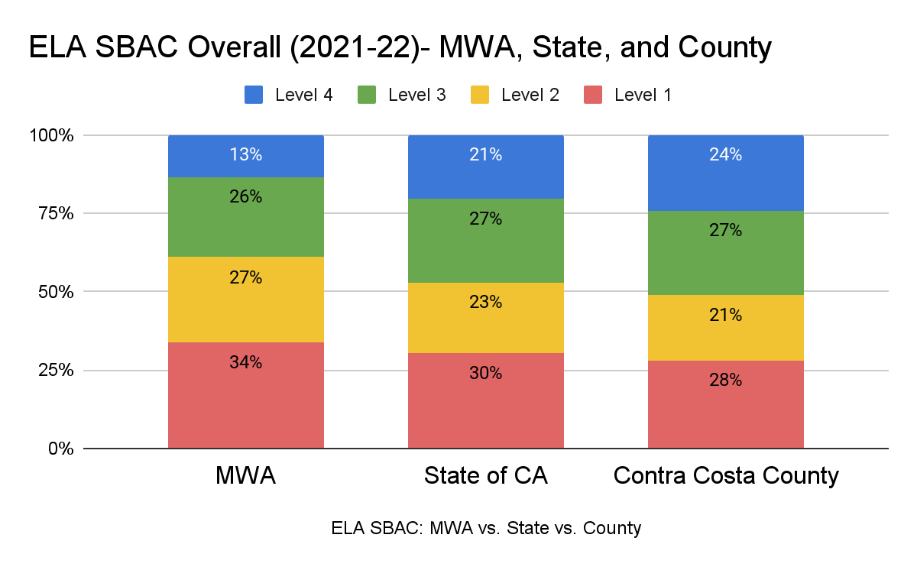

Slide 6
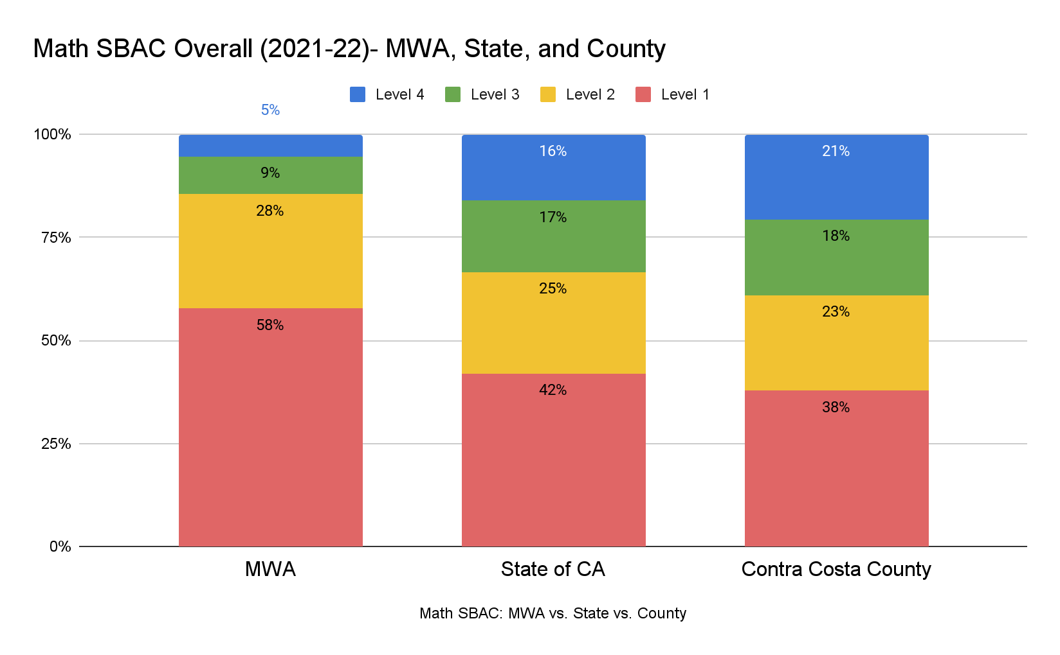

Slide 7
Grade-level Comparisons

Slide 8
Headlines:
These results vary significantly when broken down by grade level.
11th grade made a big rebound (especially in ELA) and continues to be our strongest grade.

Slide 9
ELA

Slide 10
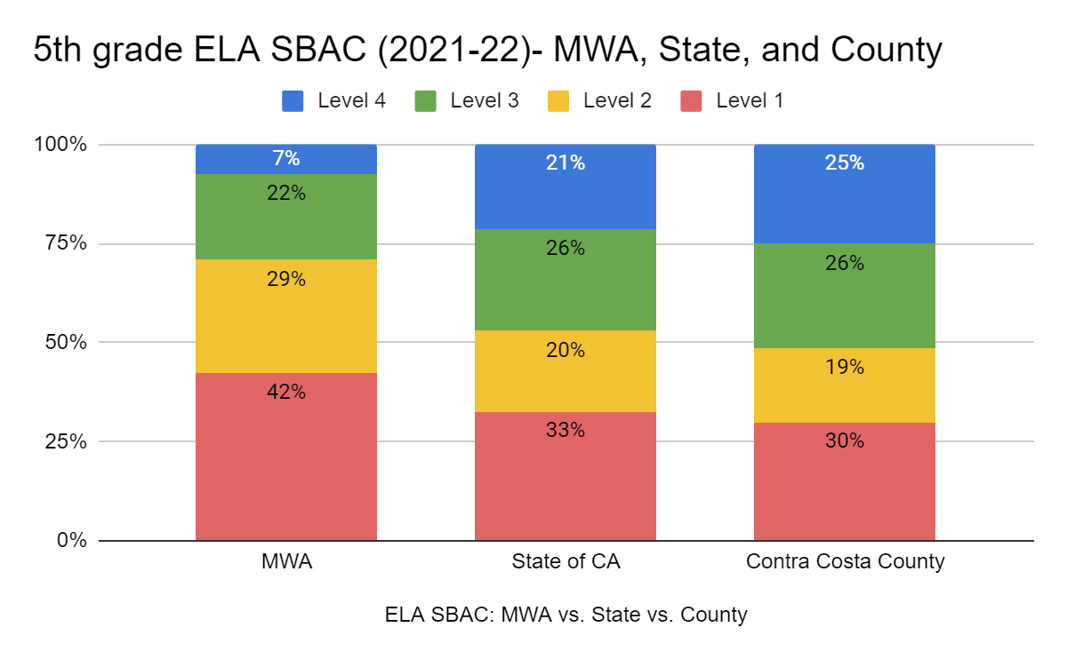

Slide 11
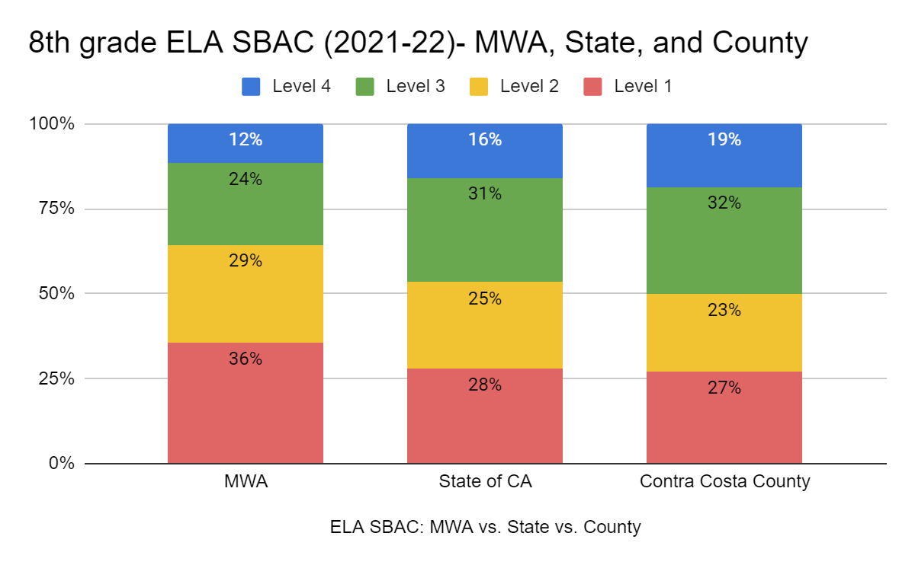

Slide 12
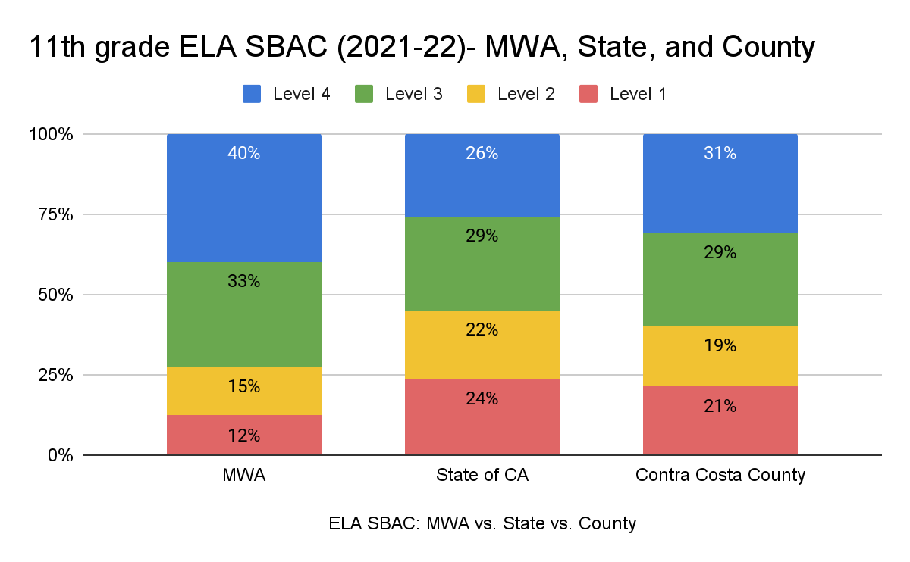

Slide 13
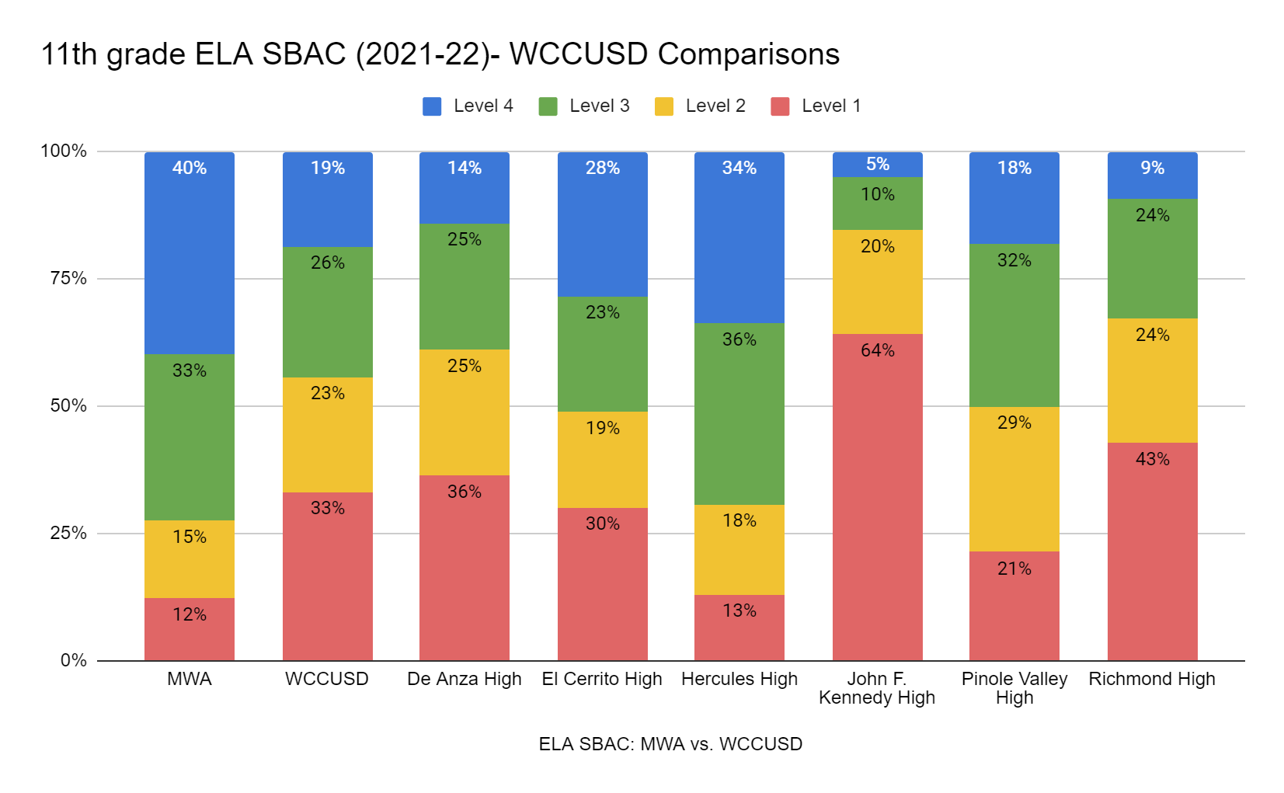
Notes:
preread

Slide 14
Math

Slide 15
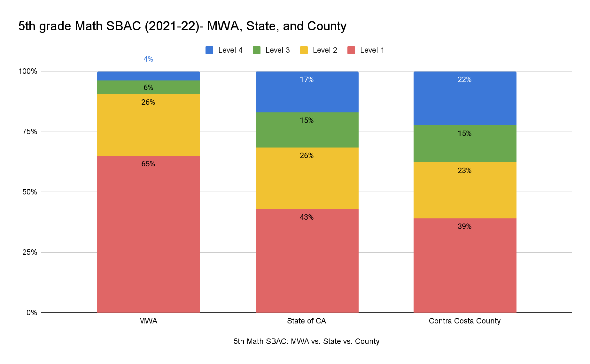

Slide 16
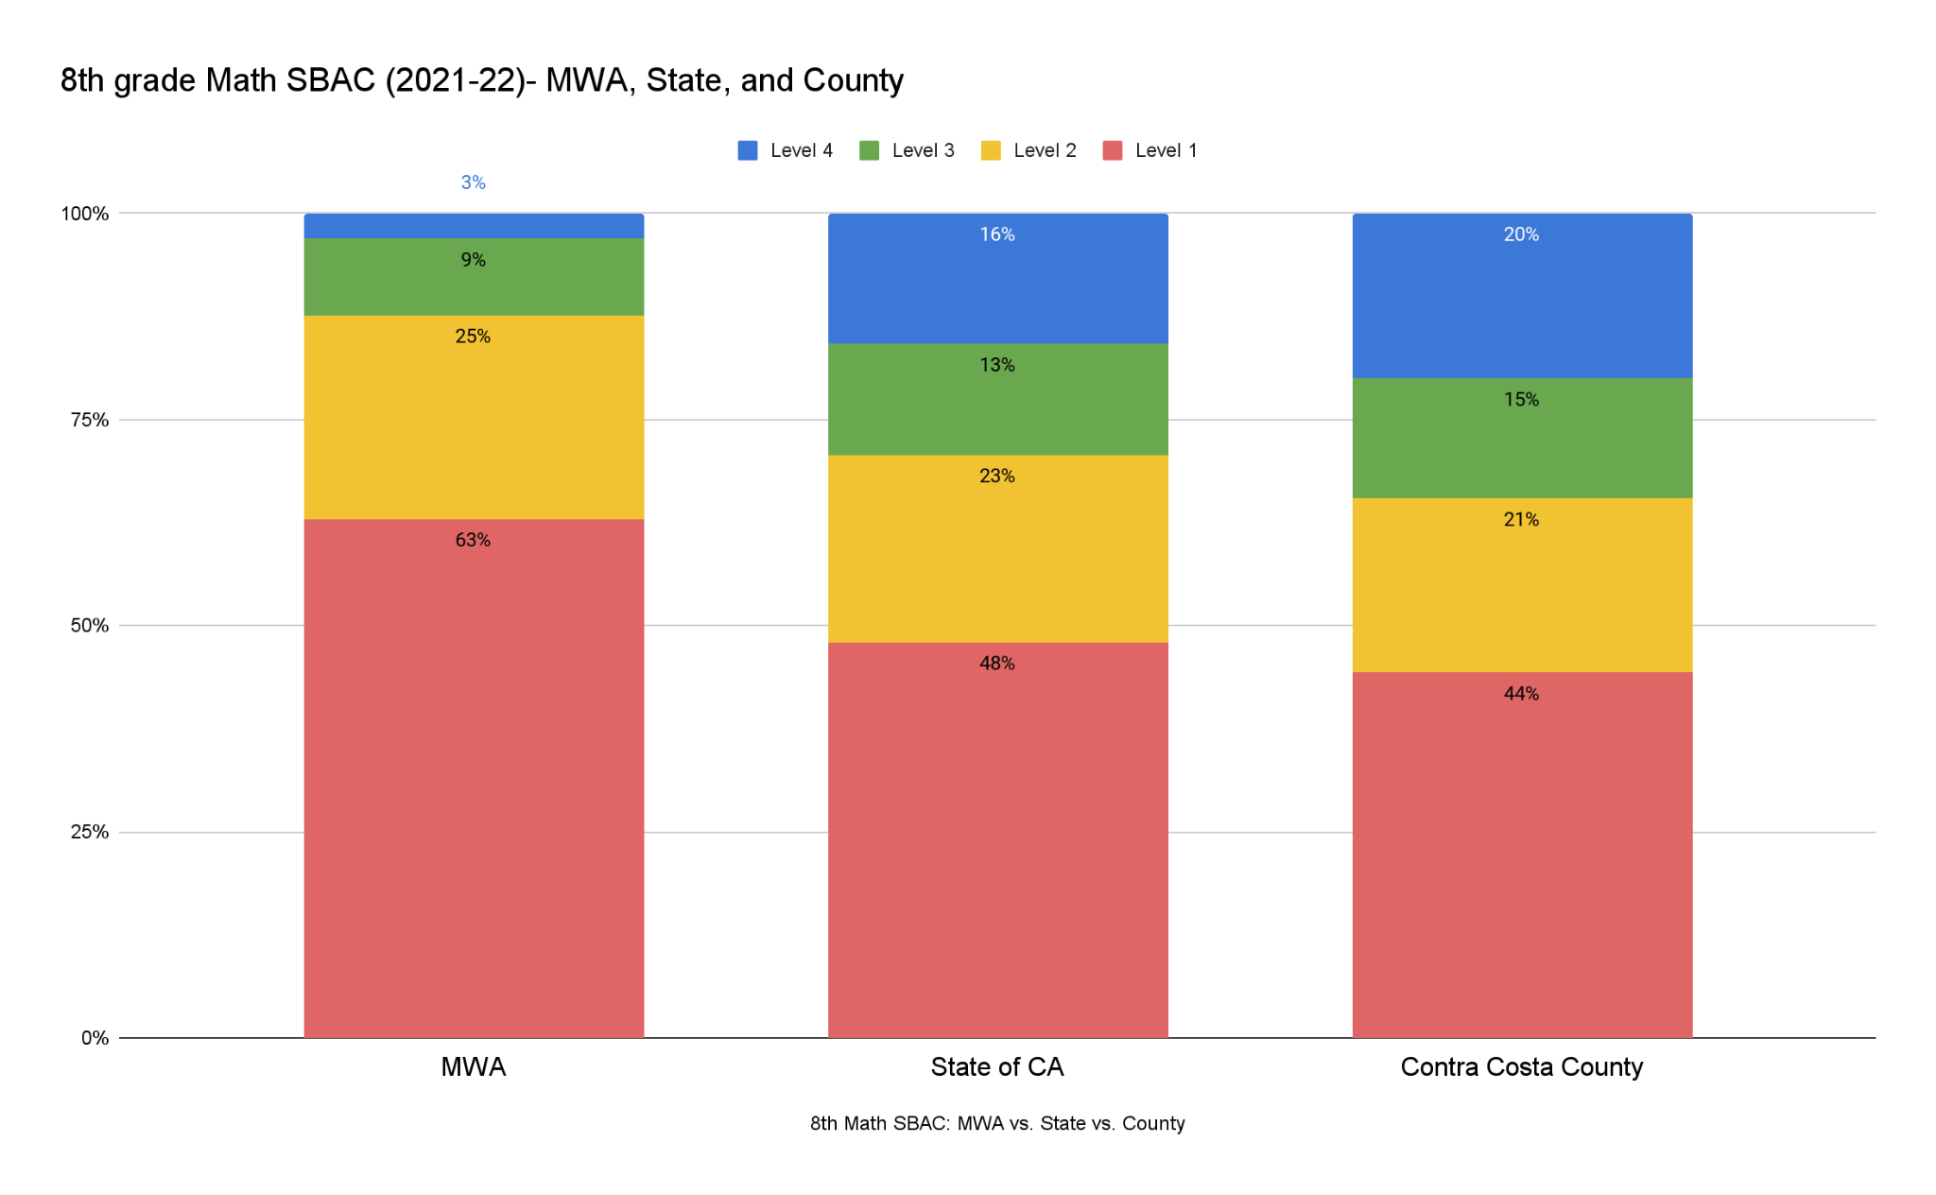

Slide 17
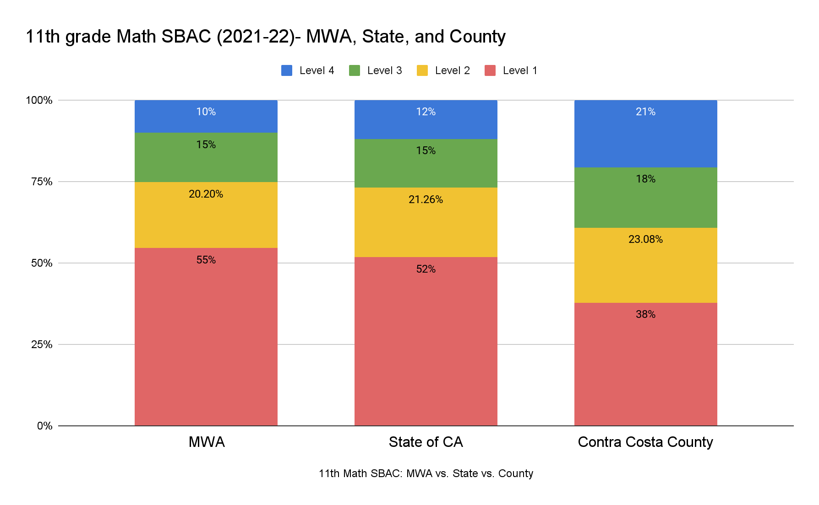

Slide 18
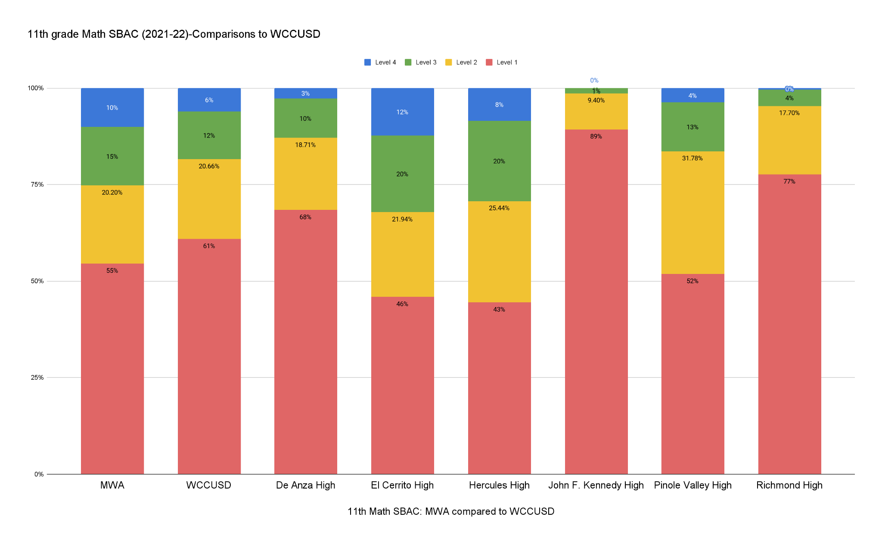
Notes:
pre

Slide 19
Student
Group Comparisons

Slide 20
Headlines:
We see strengths when comparing results for specific student groups to same groups at state, county, or WCCUSD level, especially for African American students.
Students with disabilities outperformed SWD peers in ELA, but underperformed in Math

Slide 21
Discussion Questions
What clarifying questions do you have? What additional data (if any) would you like to see?
What suggestions do you have for how we should respond to this data?

