Slide 1
Deep Dive: SBAC Results (Preliminary) 2022
Presenter(s): Alton B. Nelson, Jr. & Molly Moloney
September 2022

Slide 2
Table of
Contents
Introduction & Context
2. ELA & Math SBAC; Science CAST Results
3. Response to Data, Questions, and Discussion
Notes:
Molly

Slide 3
Guiding Questions
What questions do you have about the data?
What might we be missing, as we think about root causes or next steps?
Is there any additional data that you would find helpful that we can provide?

Slide 4
Special Considerations
This data is preliminary– to be used by MWA staff and board for planning purposes.
We do not yet have the public state release data, could be some minor changes.
We do have over 99% of scores, so we do not anticipate major changes.
Comparative data (from other schools, districts, or the state averages) is not yet available; it will be released with the California State Dashboard in December.

Slide 5
Headlines
Over 98% of our eligible students completed the CAASPP assessments.
Our overall proficiency levels on SBAC in 2021-22 are very similar to those of the previous year (2020-21, distance learning).
11th grade showed considerable gains compared to last year on SBAC, approaching some pre-covid levels, especially in ELA.
Middle school scores declined slightly from last year, though 7th grade showed growth in both math and ELA, and 5th grade made gains in science.

Slide 6
ELA

Slide 7
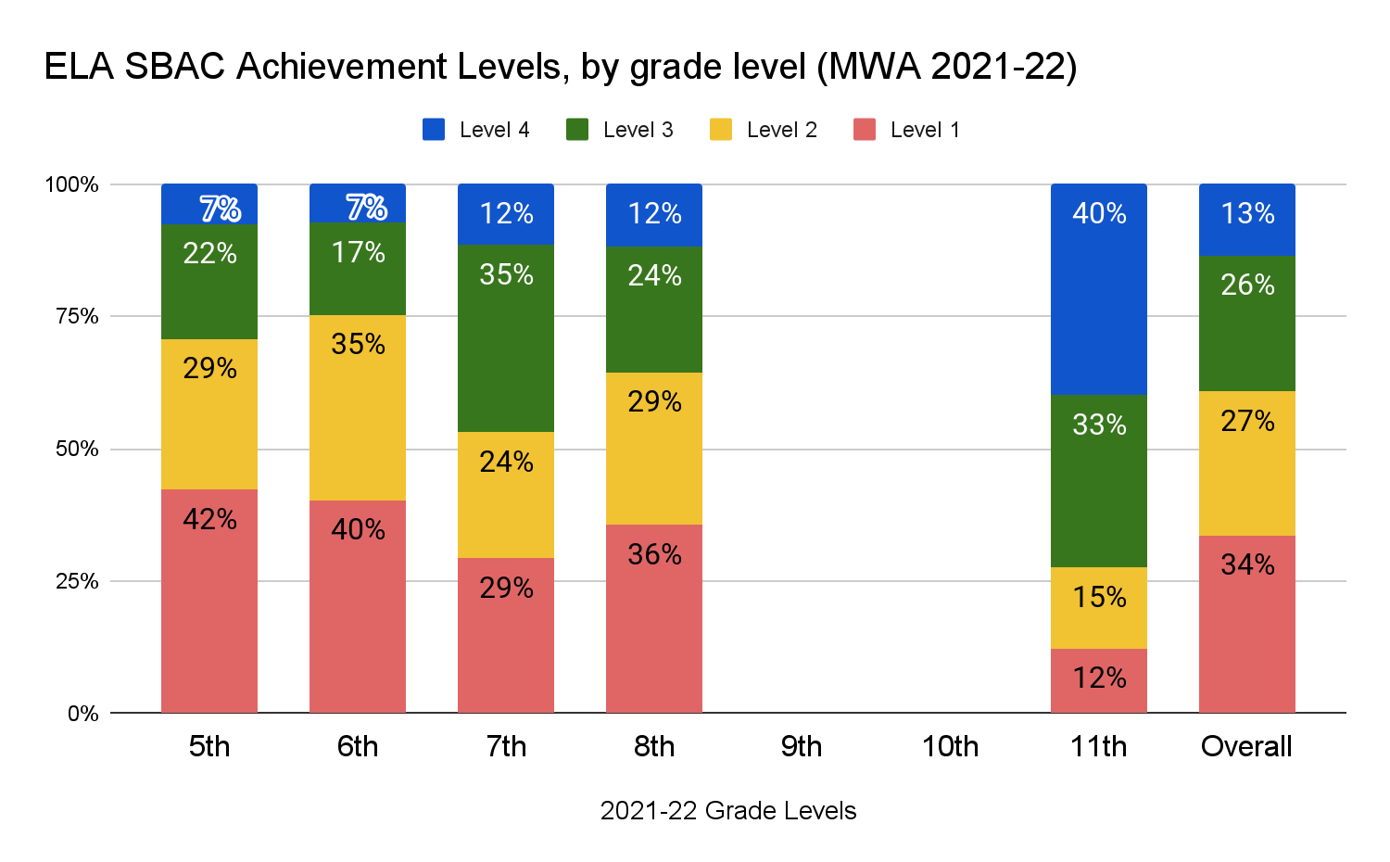

Slide 8
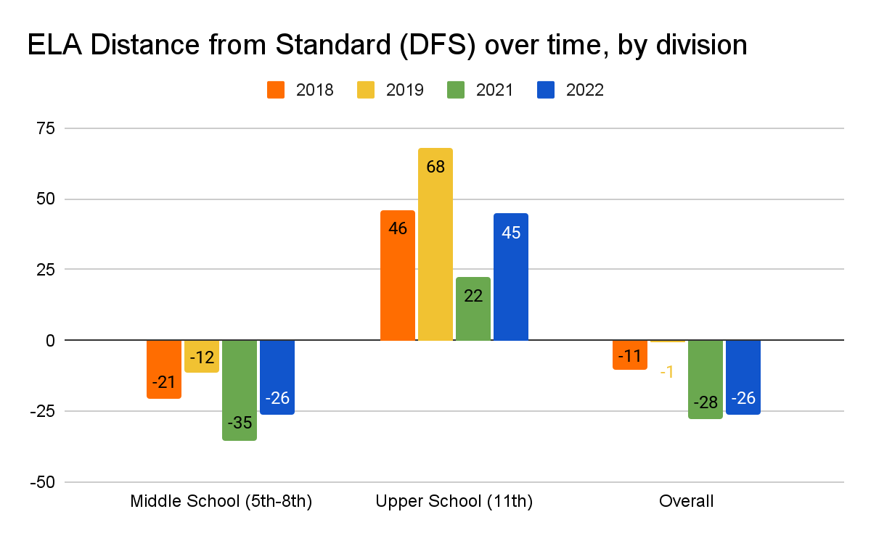
“Distance from Standard” over time
Distance from standard measures how far above or below students are from the proficiency threshold. Positive numbers represent scores above the standard for grade-level standard (level 3) and negative numbers represent average score below.

Slide 9
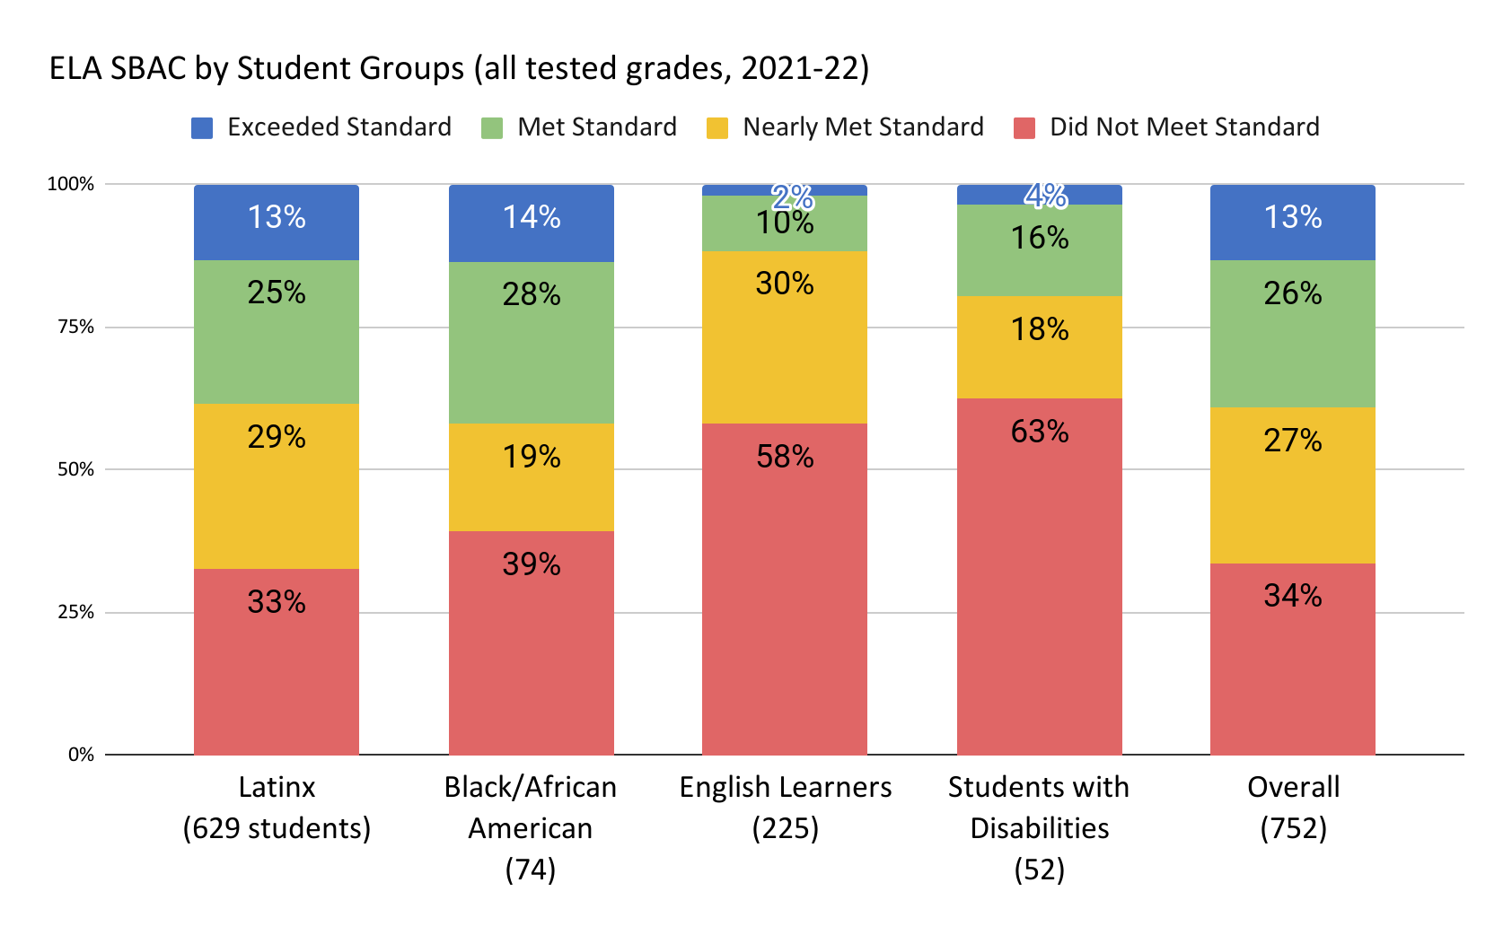
Notes:
Data pulled from Schoolzilla 8/9/22, SWD & EL Data updated to preview site data 8.29

Slide 10
Math

Slide 11
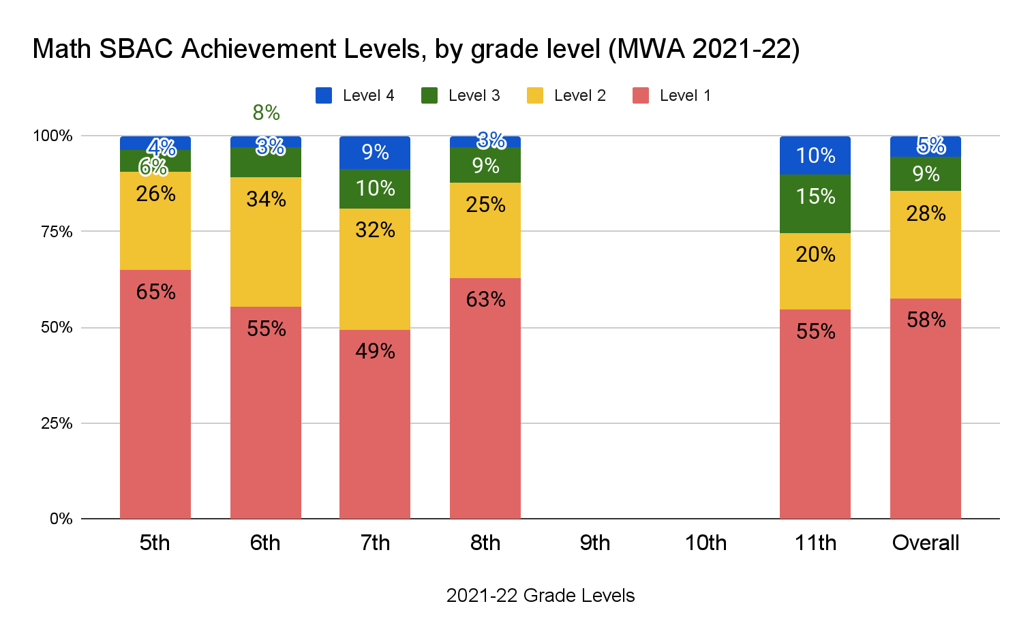

Slide 12
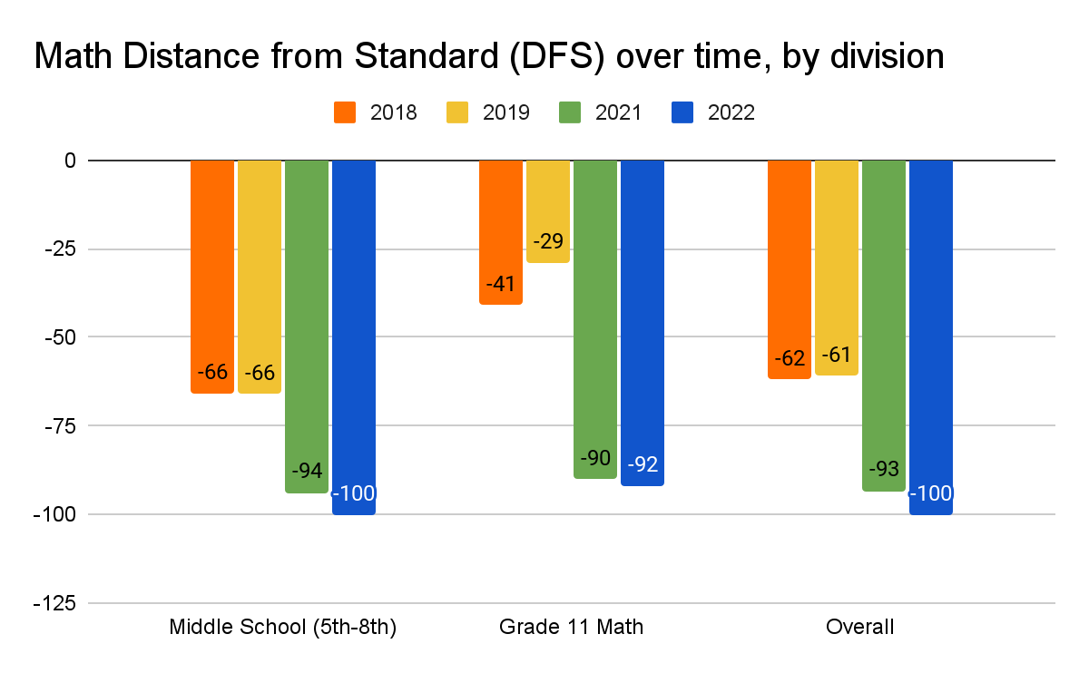
Distance from Standard, over time

Slide 13
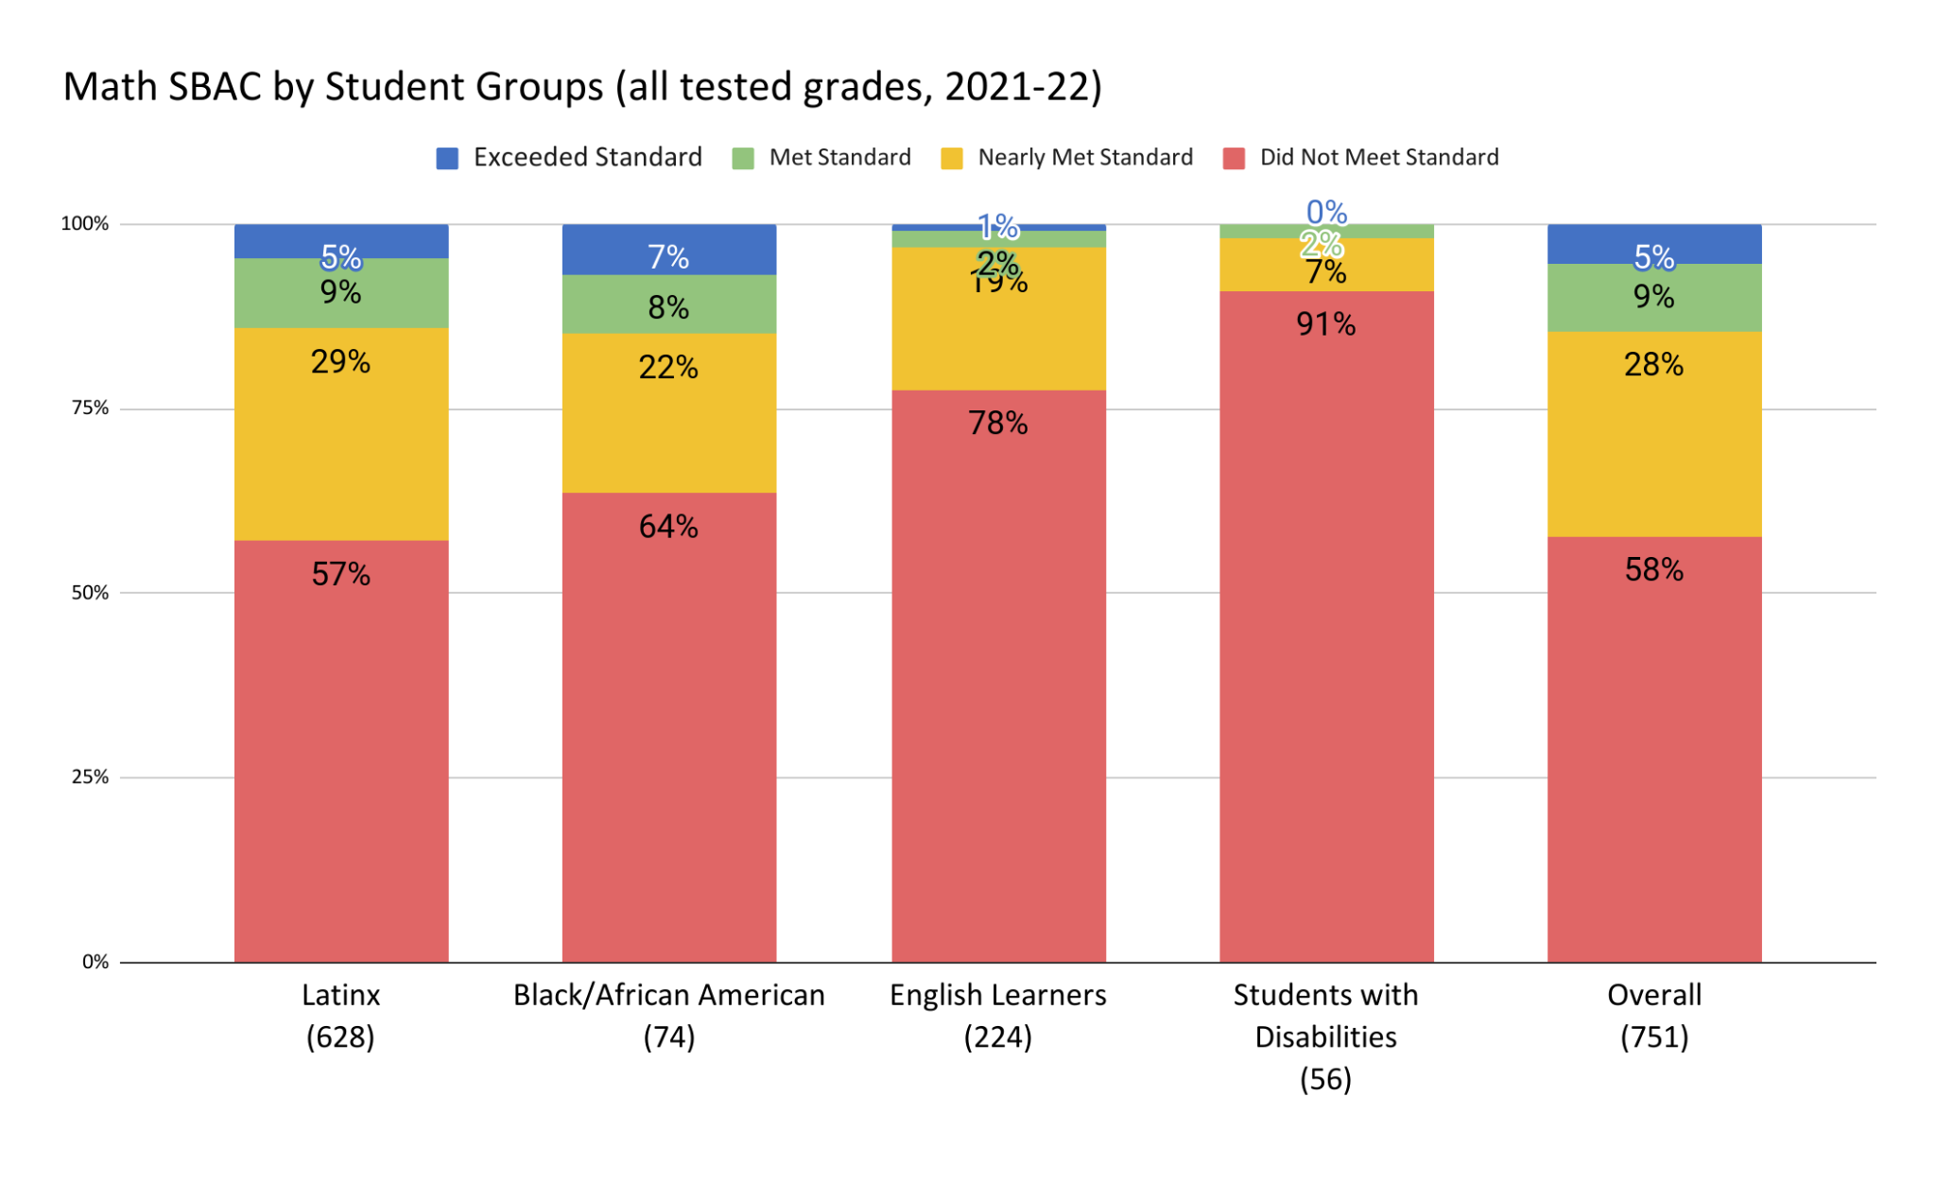

Slide 14
Science
(CAST)

Slide 15
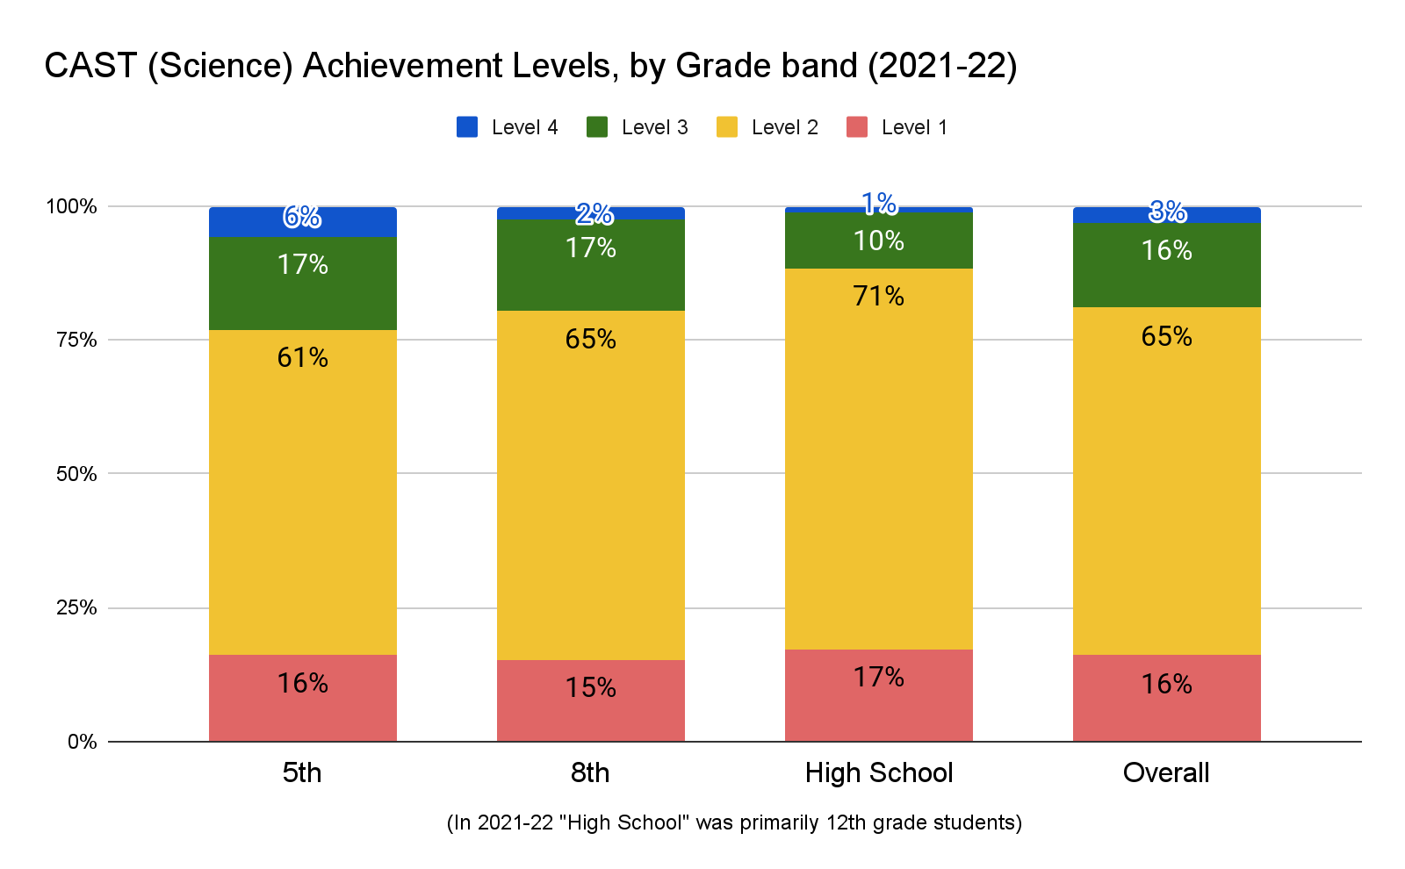

Slide 16
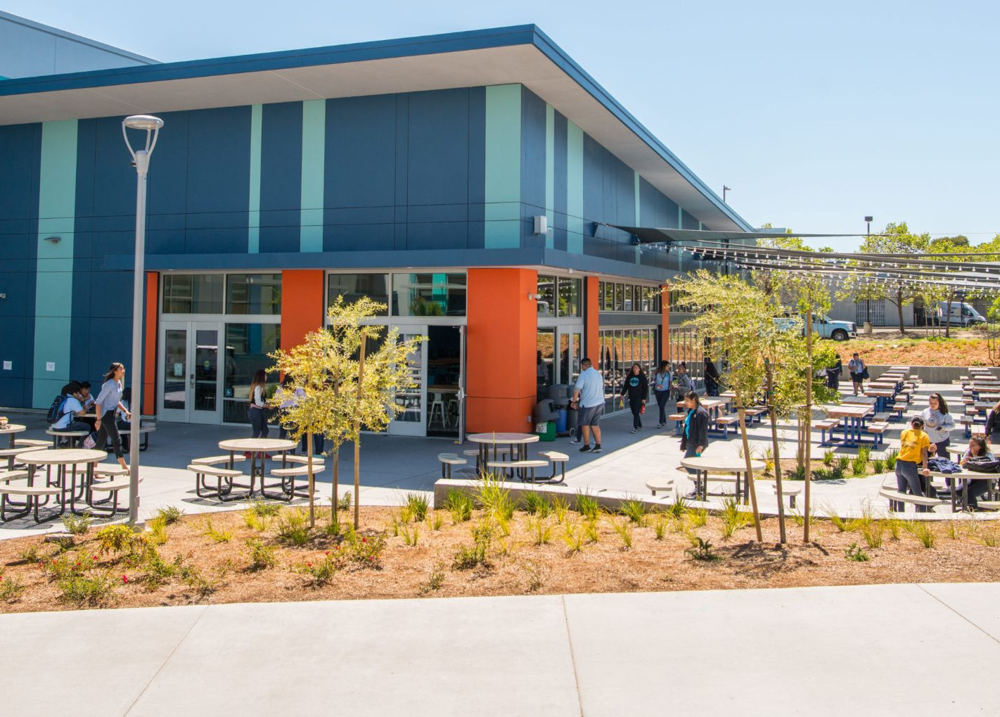
Response to Data-- Questions and Next Steps

Slide 17
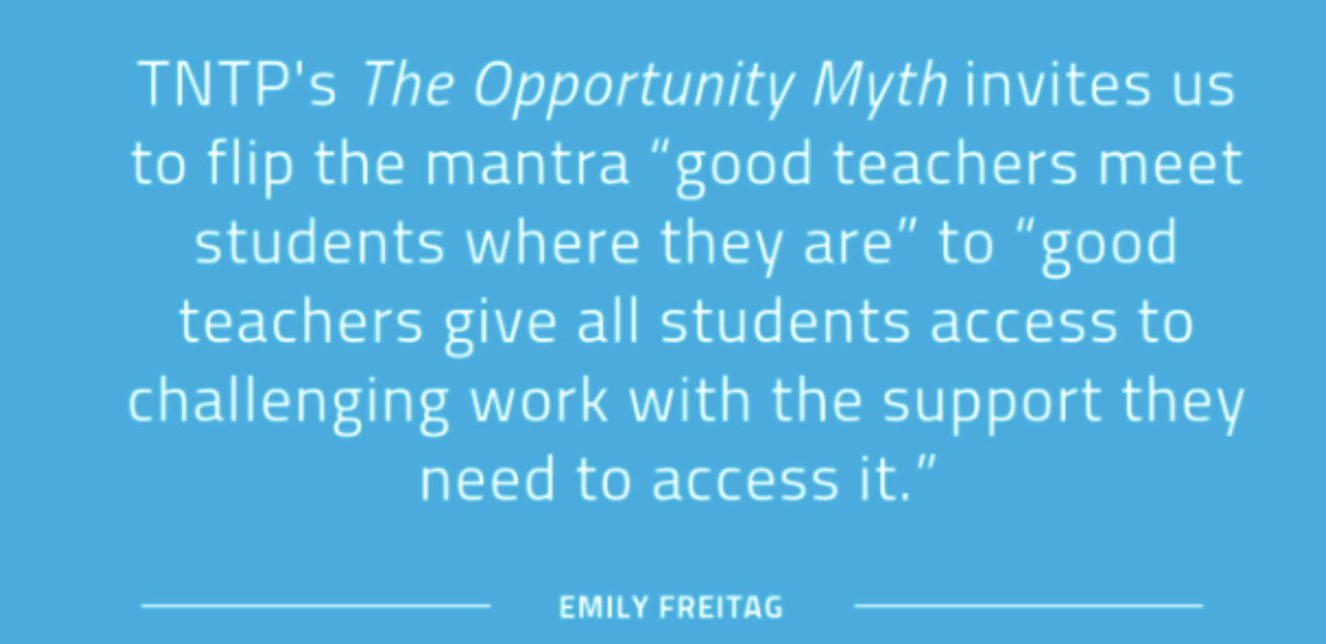

Slide 18
How are we using this data to guide assessment and data work this year?
Assessment priorities:
Use standards-aligned assessments, utilizing different assessments for different purposes. (We are using MAP/STAR diagnostics and IAB Interim Assessments to monitor our progress)
Commit to clear, school-wide dates for some assessments (state assessments, interim and summative assessments).
Prioritize data analysis/use of assessment data (align PD calendar and assessment calendar). (The first two data dives have happened already, including working with teachers around setting achievement goals.)
Notes:
(For more details, see the board report)

Slide 19
Discussion Questions
What questions do you have about the data?
What might we be missing, as we think about root causes or next steps?
Is there any additional data that you would find helpful that we can provide?

Slide 20
Thank you.

