Slide 1
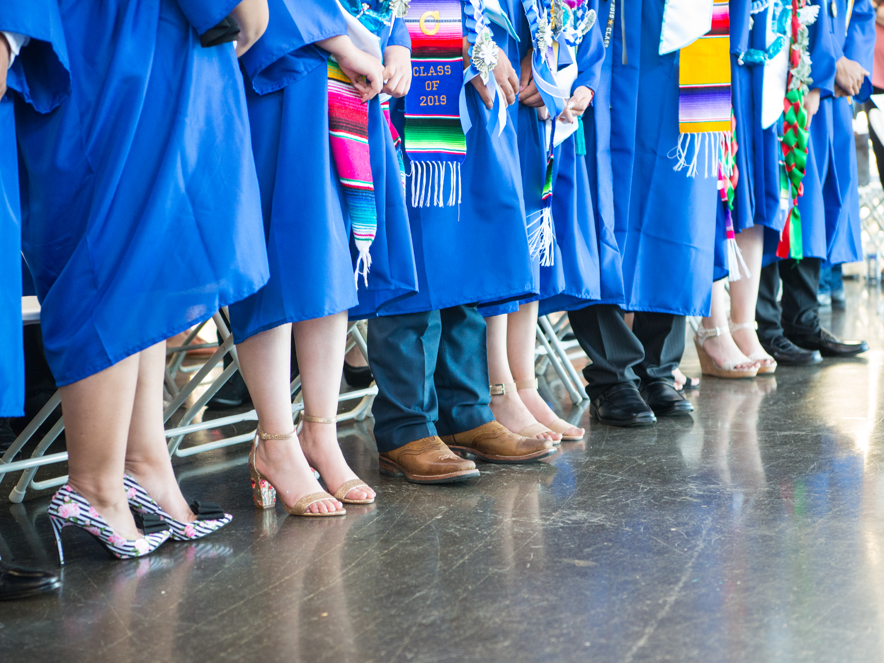
ASB Board Report - May 2022
ASB Members June 16, 2022
Notes:
Name, Grade, Roll?
Thank you for this opportunity to present to you today.

Slide 2
Successes
Challenges
Priorities
Questions & Conversation
Table of
Contents
Notes:
Simren

Slide 3
Successes
Notes:
Jenissa

Slide 4
Successes
ASB Elections
Lots of campaigning
Sense of community
Student body involvement
New members elected (261 votes for executive positions, 168 votes for Wave rep. positions)
Students more familiar with ASB + its role
Better communication bc of new Student Activities Coordinator
First All School Meeting
Positive feedback from students + staff
Engaging
Fun games
A lot of content fit in
Senior walk in/walk out
Games
Introductions of ASB candidates
Members practiced speaking in front of audience w/ confidence
ASB President - Jenissa G.
ASB Vice President - Simren S.
ASB Secretary - Valeria V.
ASB Treasurer - Imuntinyan A.
ASB Marketing Coordinator - Melanie L.
ASB Student Activities Liaison - Yoltzin W.
20th Wave Reps - Joshua C. & Stephany S.
21st Wave Reps - Bryant G. & Ariana H.
22nd Wave Reps - Andrea M. & Fatima C.
Notes:
Jenissa some successes we have had this year has been ASB elections which really filled the school with a sense of leadership and student culture with all the campaigning made. We are also very excited for our newly elected members and happy to see what we come up with for this upcoming year!
Finally, we had our first all school meeting lead by ASB where we received a lot of positive feedback from students and staff.

Slide 5
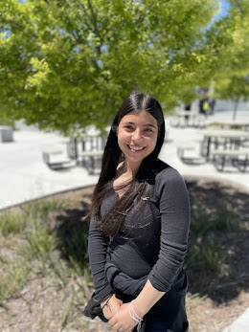
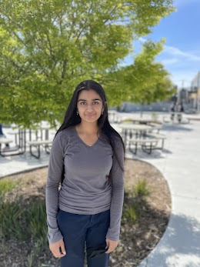
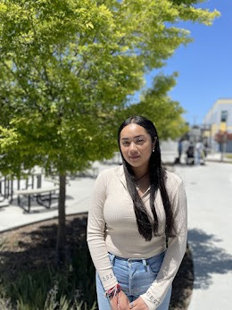
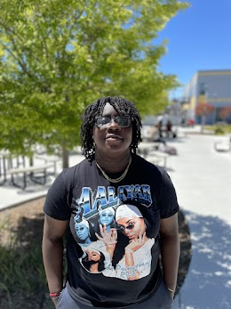
Jenissa: My name is Jenissa and I am running for ASB President for the next school year. I can assure you that I am one of the well qualified candidates and have been in ASB for 3 years. During this time, I have learned alot from past presidents. One of the things that inspired me was taking initiative in planning school events and expressing students' voices. I can guarantee you a fun, memorable and epic highschool experience if you vote Jenissa for ASB President!! Thank you!
Simren: Hi everyone! I’m Simren and I’m running to be your next ASB Vice President! If you all elect me, my main priority will be to have more fun school events and celebrations and to center students’ voices and feedback! My experiences leading various clubs makes me sure that I’ll be able to accomplish this for you all. So, if y’all want an enjoyable next school year and a Vice President who can get things done, make sure to vote for SIMREN as your Vice President! :)
Valeria: As ASB Secretary I ensure that I will keep the student body in order. I will make sure to serve as the bridge between students and staff, in order to have proper communication. I will make sure to pass information from students to ASB, so students can be heard and have a voice as well. Being ASB Secretary is not only about having to keep the student body in place, but also having good advocacy with everyone, in order for ASB and I to plan and organize fun school-wide events!
Imuntinyan: Hello, my name is Imuntinyan. Some fun facts about me is I’m the middle child out of 7 kids and I play basketball, volleyball, and softball. I’m running for Treasurer because I know that I can make a difference in this position. I want to use my leadership skills to make this upcoming school year a better and more inclusive experience for everyone because I know how hard this year has been on our community.
ASB Executive Board
School year 2022-23

Slide 6
Challenges
Notes:
Simren

Slide 7
Challenges
ASM
Sound system
Wired mics
Short notice before planning
Minimal student involvement throughout year
Scheduling student events due to disrupted school year
Notes:
Simren Although the ASM was a huge success overall, there were some challenges that we encountered such as
Some more challenges we have had i
Also acclimating to in-person planning has been challenging since we had been online for 2 years and this transition has been very difficult with all the demands needed now.
Finally,

Slide 8
Priorities
Notes:
Jenissa

Slide 9
Priorities
ASB Summer Retreat
Community Building
Prepare for Upcoming Events
Brainstorm ways to increase student participation
Work with Ms. Martinez on Master Calendar
Notes:
Jenissa Inspirit of all these challenges one of our biggest priority currently is our ASB Summer Retreat where we will be able to get a head start in planning school events and building community within ASB. Another of our priorities has been increasing student participation and spirit throughout this upcoming school year with many fun activities like dances, spirit weeks, and rally's.

Slide 10
Questions & Conversation
Notes:
Simren

