Slide 1
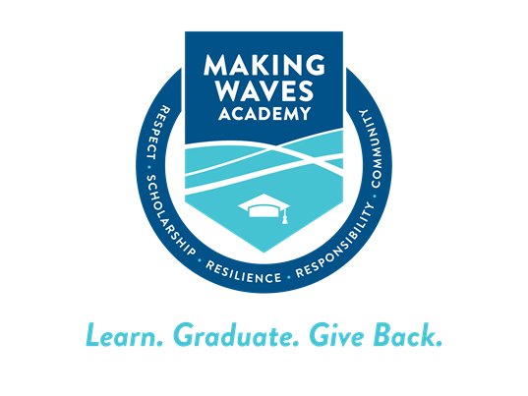
College Admissions Data and
Other Post-secondary Plans

Slide 2
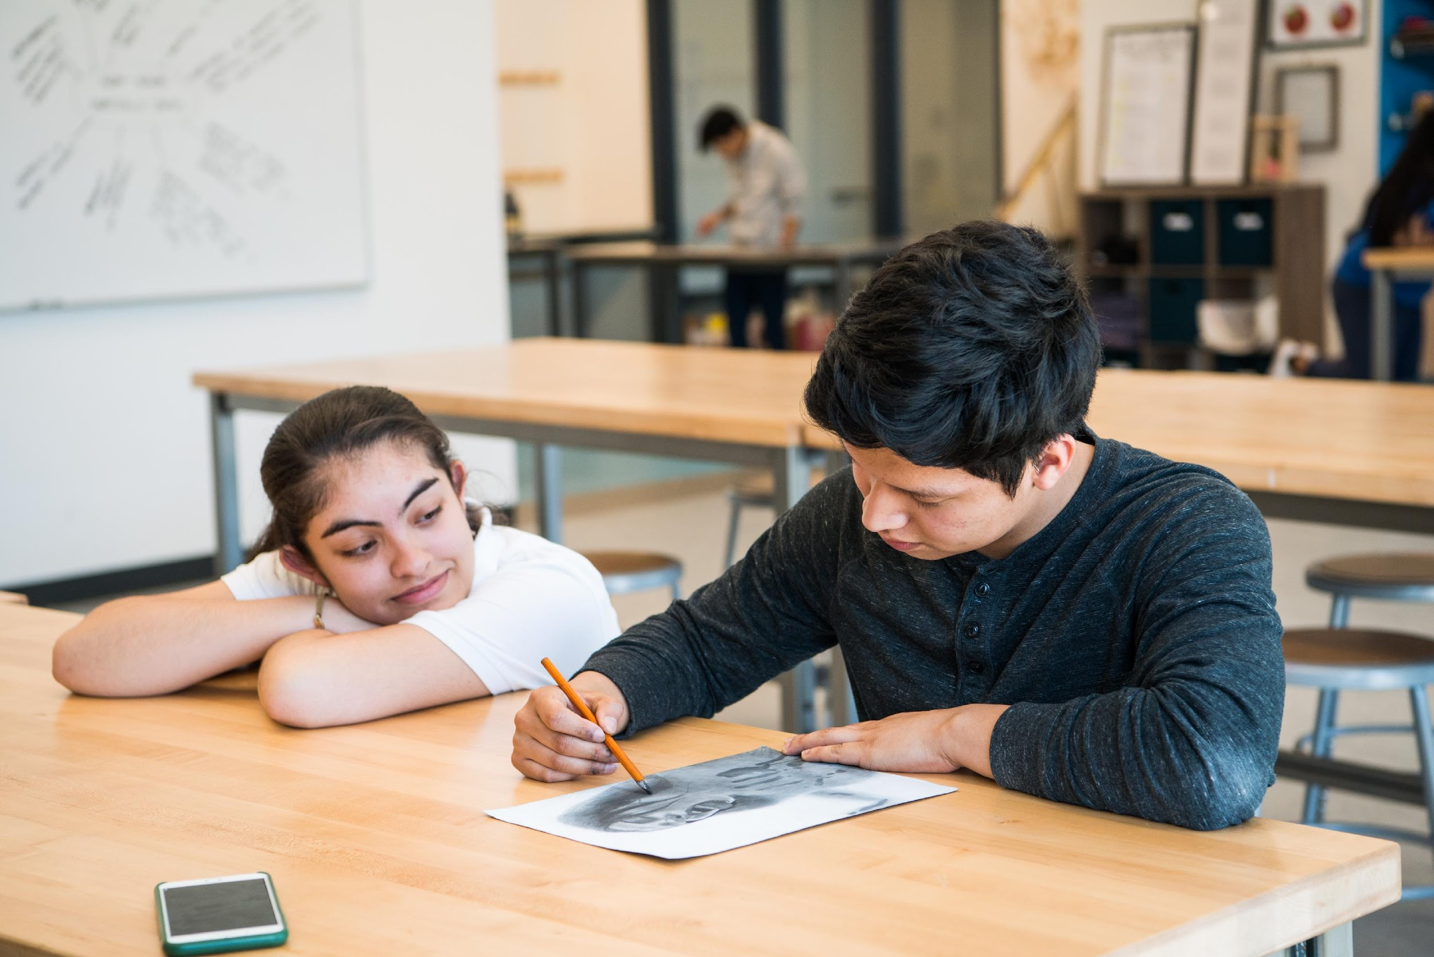
Agenda
Admissions and Commitment Data
Learnings and insights (post-pandemic norms)
Discussion and Q&A

Slide 3
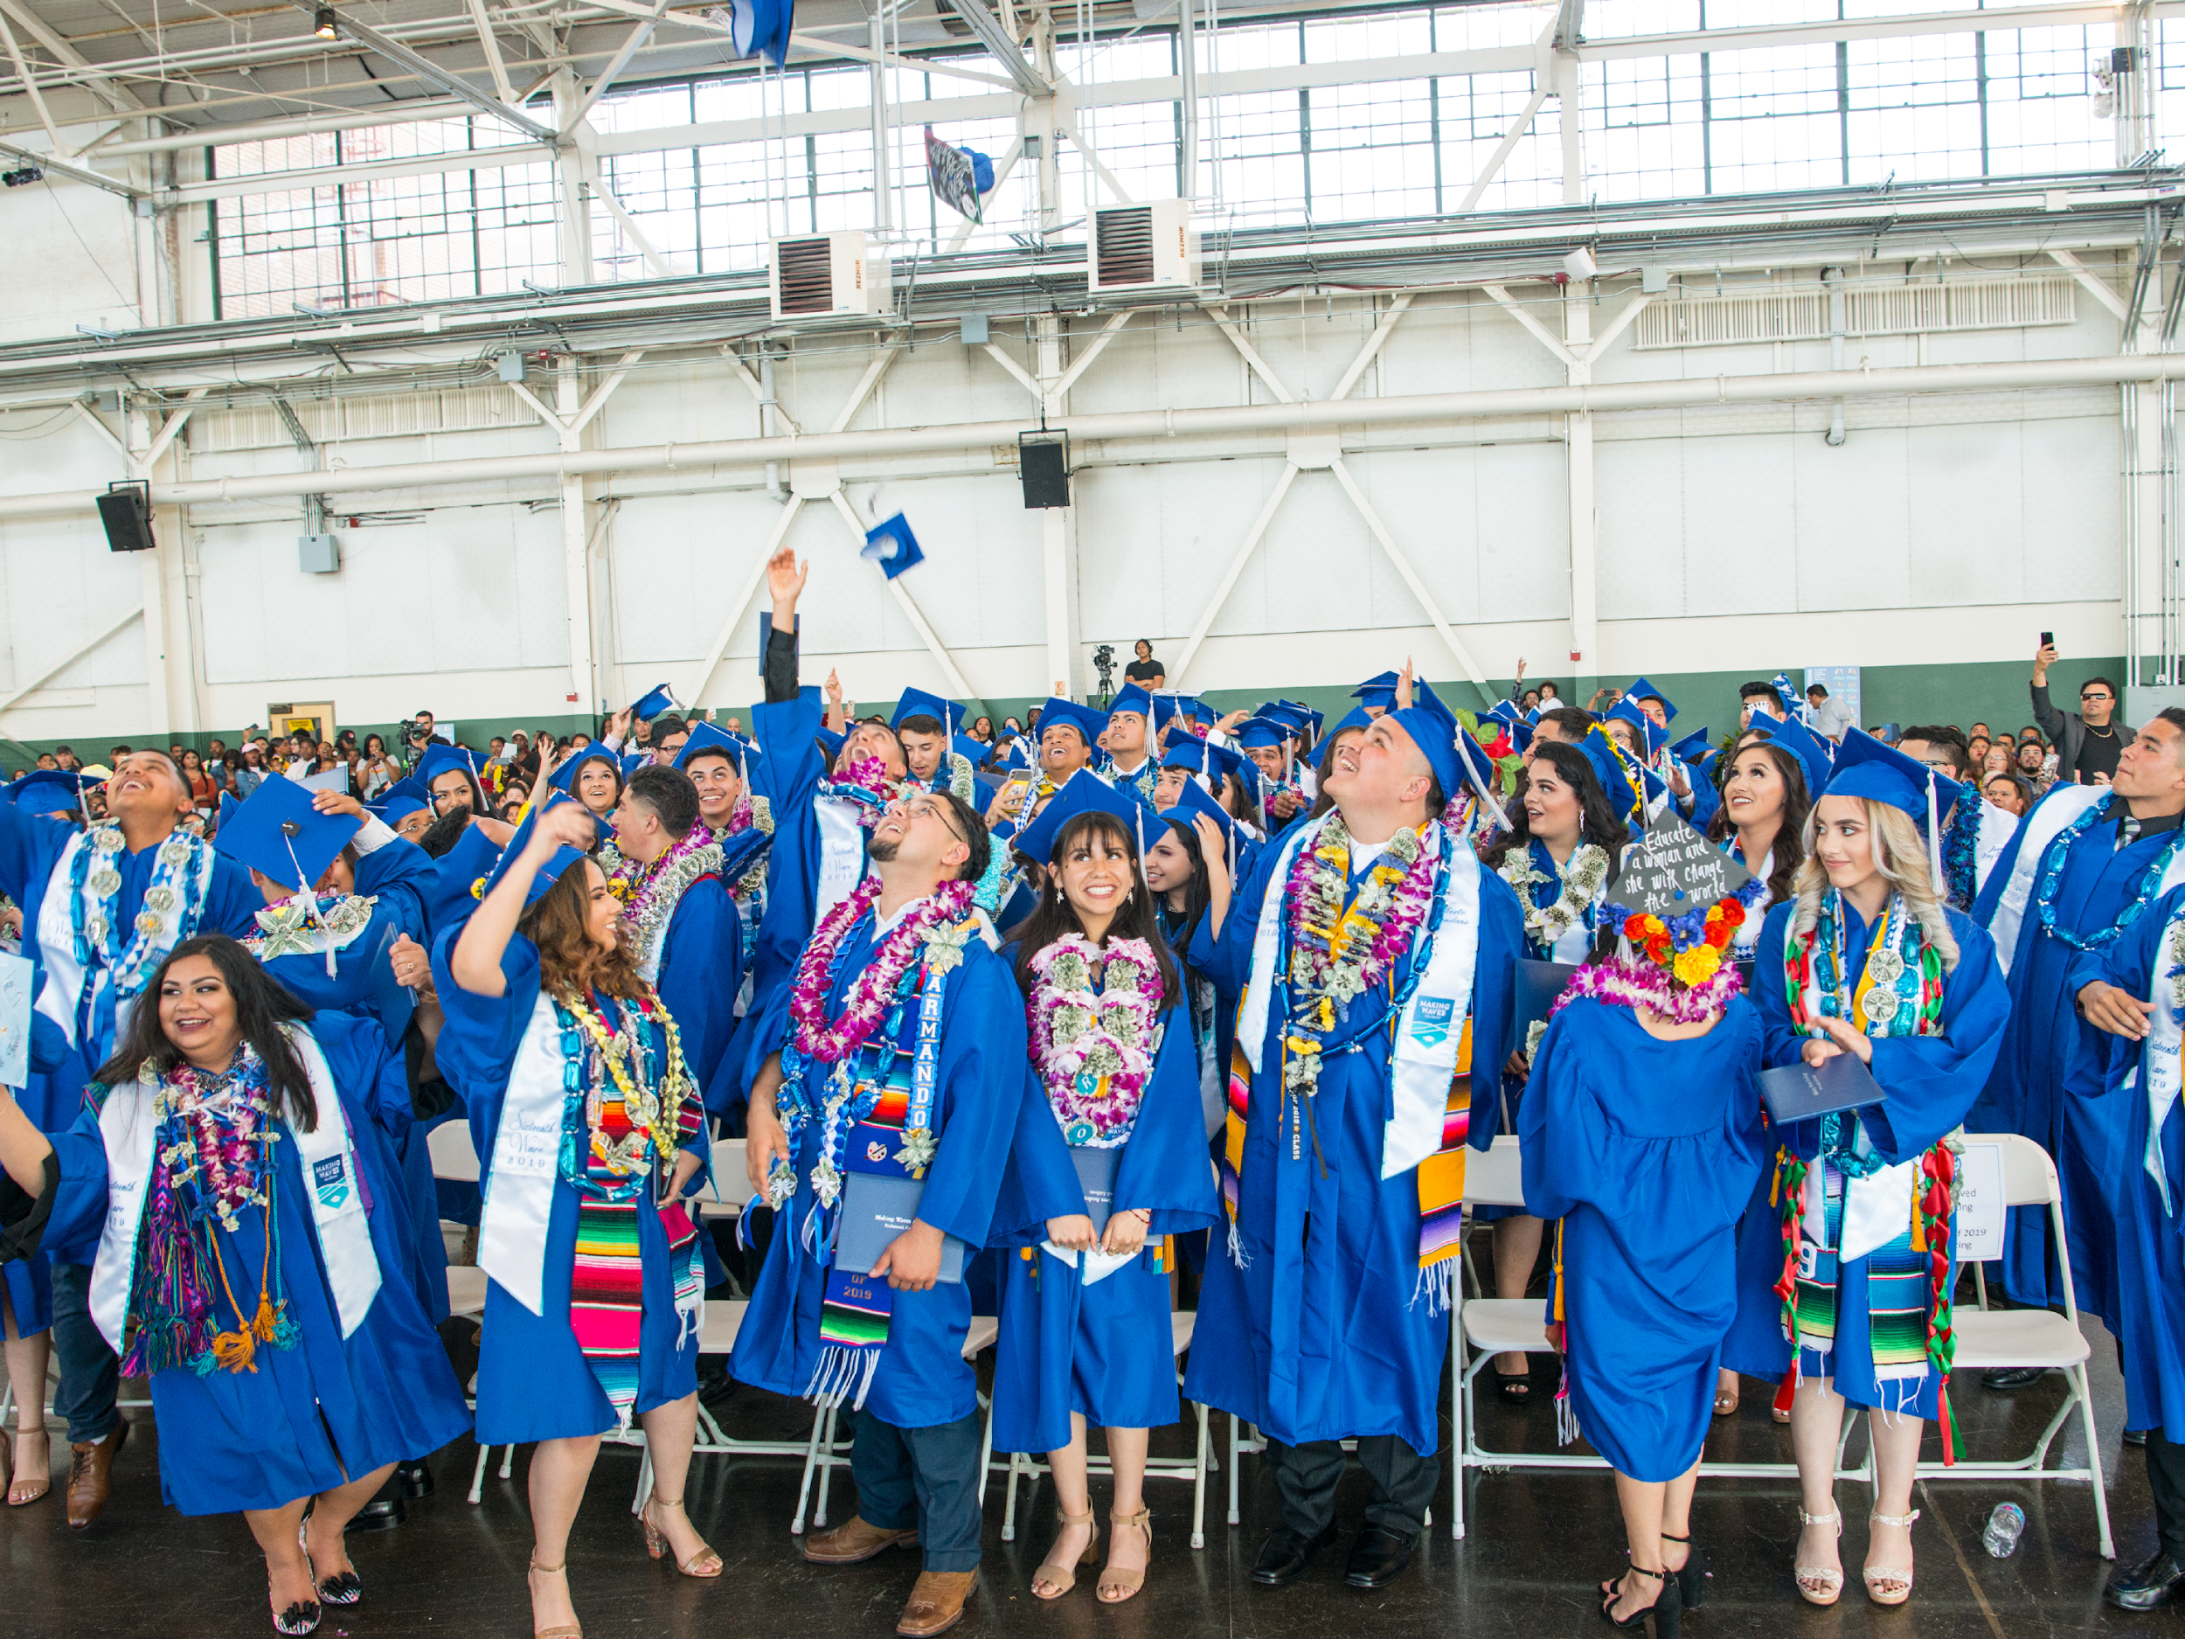
Admissions and
Commitment Data

Slide 4
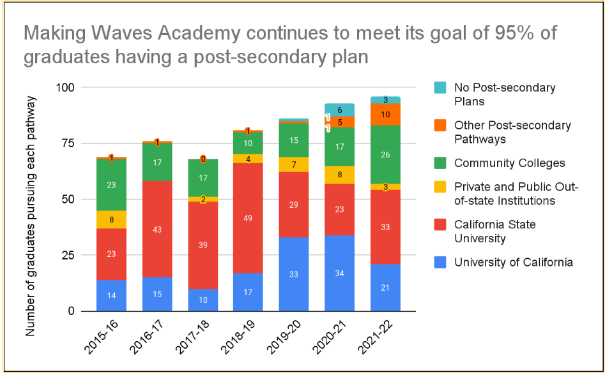
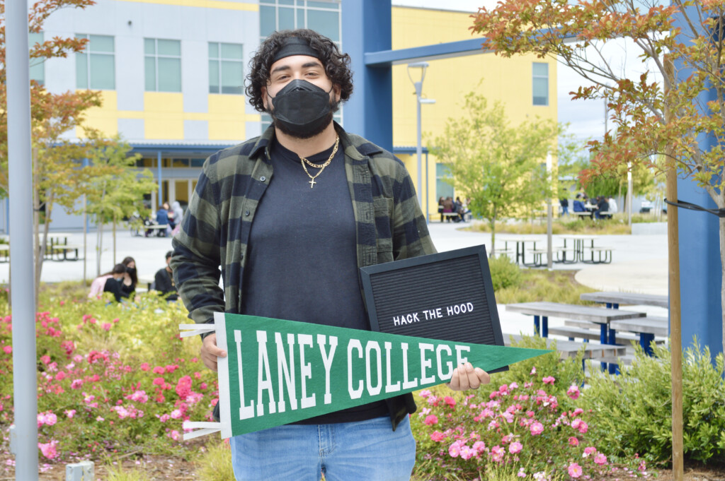
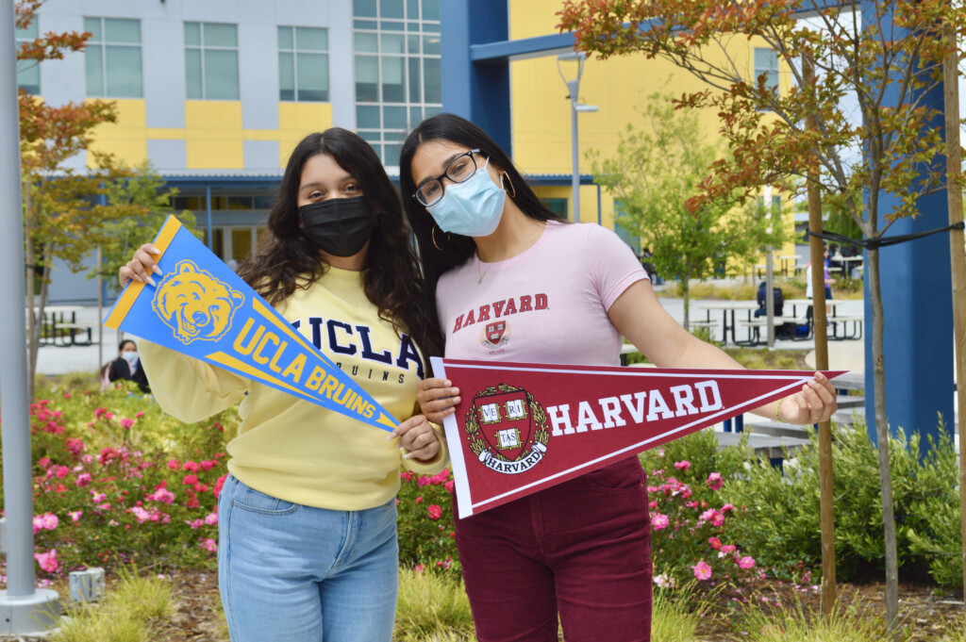
We affirm that there are multiple ways that a person can become a valuable contributor to the workforce or to their community
Notes:
I want to start by saying that The 19th Wave experienced a great deal of hardship and sacrifice two years prior as they entered a world unknown to all of us. Virtual school during the pandemic impacted our 19th wave academically, socially, and our students’ mental health has been a priority for us at the academy. Returning to campus after being away for almost two years was also challenging. Despite this, we held true to our belief in supporting our wavemakers achieve their life dreams. I began this year by meeting with 100% of seniors to discover their intended post-secondary pathways. We created application strategies and worked together throughout the fall to complete college applications. We partnered with CAP to ensure our students’ college applications were paid for and submitted by the CSU/UC priority deadline and had over 81% of the 19th wave submit college applications to 4-year colleges.
Making waves supports a continuum of post-secondary pathways, with an emphasis on college. Each year, it is our goal that 95% of graduates have a post-secondary plan. As of today, we can confidently say that we have met that goal. Specifically:
For the first time, Harvard has admitted one of our seniors! Harvard College accepted just 3.19 percent of applicants this year – the lowest rate in the school’s history – as it saw a record high number of candidates apply for the second straight year.
In the 19th Wave, 74* students have been admitted to a 4-year college.
Of the 11 11th graders in 18th Wave eligible to graduate, 7 are committing to college.
We have admission offers from all 9 undergraduate UC campuses.
5* students were admitted to Hack the Hood, a paid job training program in tech.
Admits to top-tier institutions include:
Harvard University
University of Southern California
Middlebury College
Scripps College
Smith College
Pitzer College
25% of Students who were initially deemed ineligible for CSU (19% of all rising graduates) were accepted under the Educational Opportunity Program (EOP).

Slide 5
We have increased post-secondary support for all students
 | Rising Graduates
 | 12th Graders | 11th Graders* | Totals
Total rising graduates at the start of AY 2021-22 | 85** | 11 | 96
Projected graduates by June 2022 | 77 | 2 | 79
Projected graduates attending the June 14, 2022 ceremony | 75 | 2 | 77
Projected graduates by August 2022 | 84 | 10 | 94
Post-secondary plans among projected graduates
Projected graduates with a post-secondary plan | 82 | 11 | 93
Projected graduates committing to college | 76 | 7 | 83
Projected graduates committing to four-year college | 57 | - | 57
Projected graduates committing to community college | 19 | 7 | 26
Projected graduates committing to a job or job offer | 2 | 1 | 3
Projected graduates committing to a trade program | 2 | 3 | 5
Projected graduates committing to an apprenticeship | 1 | - | 1
Projected graduates committing to a gap year program | 1 | - | 1
Projected graduates with no post-secondary plan | 3 | - | 3
Projected graduates who have opted-in to CAP | 79 | 9 | 88
Projected graduates who have not opted-in to CAP | 6 | 2 | 8
Reasons why projected graduates have not opted-in to CAP
Projected graduates who have not opted-in to CAP | 6 | 2 | 8
No post-secondary plan | 3 | - | 3
Committing to a job or job offer | 1 | - | 1
Committing to an apprenticeship | 1 | - | 1
Committing to a trade program | - | 2 | 2
Committing to a gap year program | 1 | - | 1
At the start of 2021, we improved services for different segments:
high-achievers
students on the cusp of college eligibility
students pursuing military enlistment, jobs, trade programs, and apprenticeships
Notes:
I want to show the raw data for the previous graph because I want to highlight a few things:
At the start of 2021, Making Waves Academy began accelerating its efforts to increase post-secondary support for ALL segments of students: we improved services for our highest-achievers, yes, but also ramped-up efforts for our students on the cusp of college eligibility, and for those pursuing military enlistment, jobs, trade programs, and apprenticeships. We affirm that there are multiple ways that a person can become a valuable contributor to the workforce or to their community.
This year we had a high number of students select the community college route for a number of reasons which include:
Low academic standing
High EFC
Confidence
Familial Support
Wanting to transfer into a UC or school with higher ECC
77% of our students who have selected community college as a pathway intend to transfer to a four-year institution, and we have provided guidance to CAP with notes on every wave maker so that heir CAP coach can immediately support their transfer plan.

Slide 6
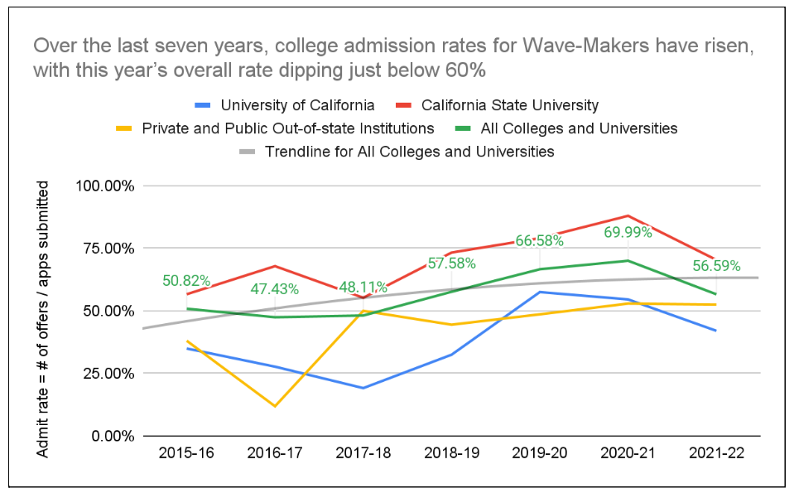
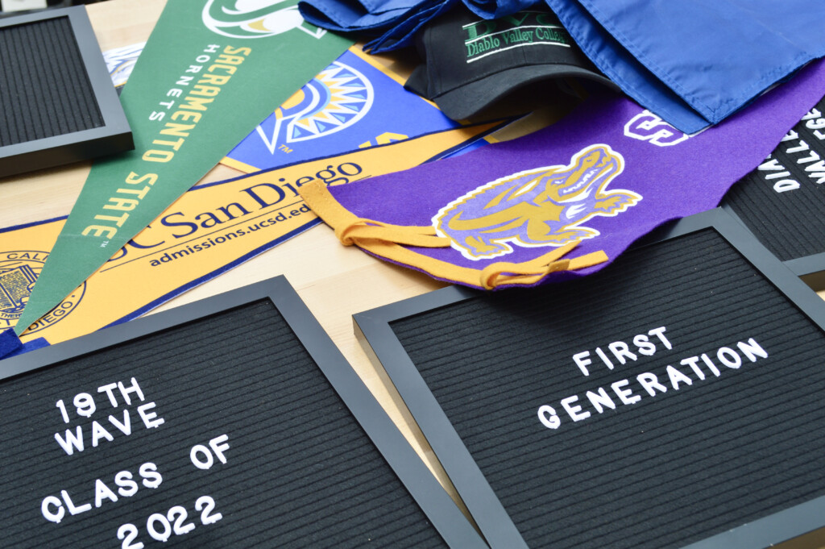
Seniors received a favorable mix of offers from target, reach, and safety schools
Notes:
Over the last seven years, college admission rates for Wave-Makers have risen, with this year’s overall rate dipping just below 60%, which still indicates a favorable mix of offers from target, reach, and safety schools.
This year the 19th wave submitted a total of 698 college applications to four-year institutions. Of those who submitted applications - 395 were offered admission, providing us with the 56% admission rate this year.
Supporting our students is an integral part of this work. While this year may have dipped below the past three years, we are confident that as we continue in-person instruction and our students, faculty and staff acclimate to education post-pandemic we see a rise in the 20th wave.

Slide 7
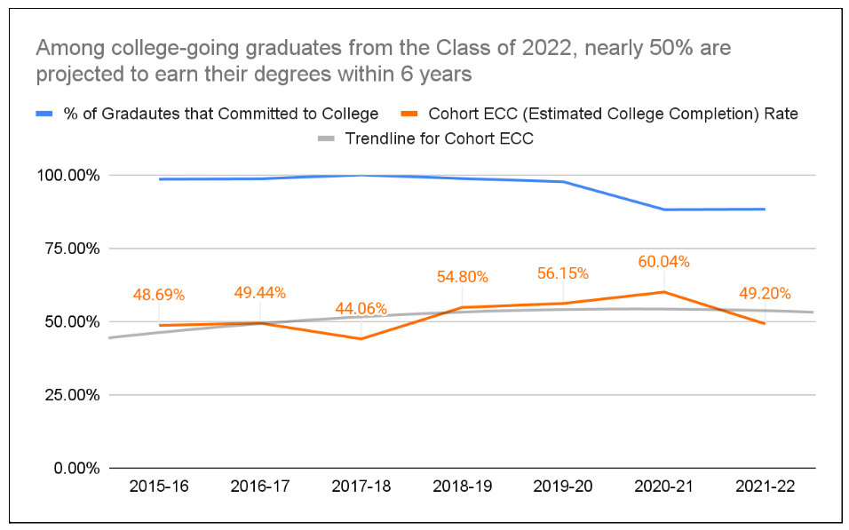
Our growth expectations for cohort estimated college completion rates have slightly slowed
Notes:
Among college-going graduates from the Class of 2022, nearly 50% are projected to earn their degrees within 6 years, slowing our growth expectations for cohort estimated college completion (ECC) rates.
Some of the factors that are contributing to this:
# of students choosing to start their 4-year journey at q Community College
Students choosing closer options like Sacramento State, where we have 12 wave makers committing to next year. (of these wave makers they turned down options such as UC Santa Cruz, and UC Merced, UC Riverside,
Slight decline in UC admissions this year. All UC’s received record number applications making it even more competitive for our students.

Slide 8
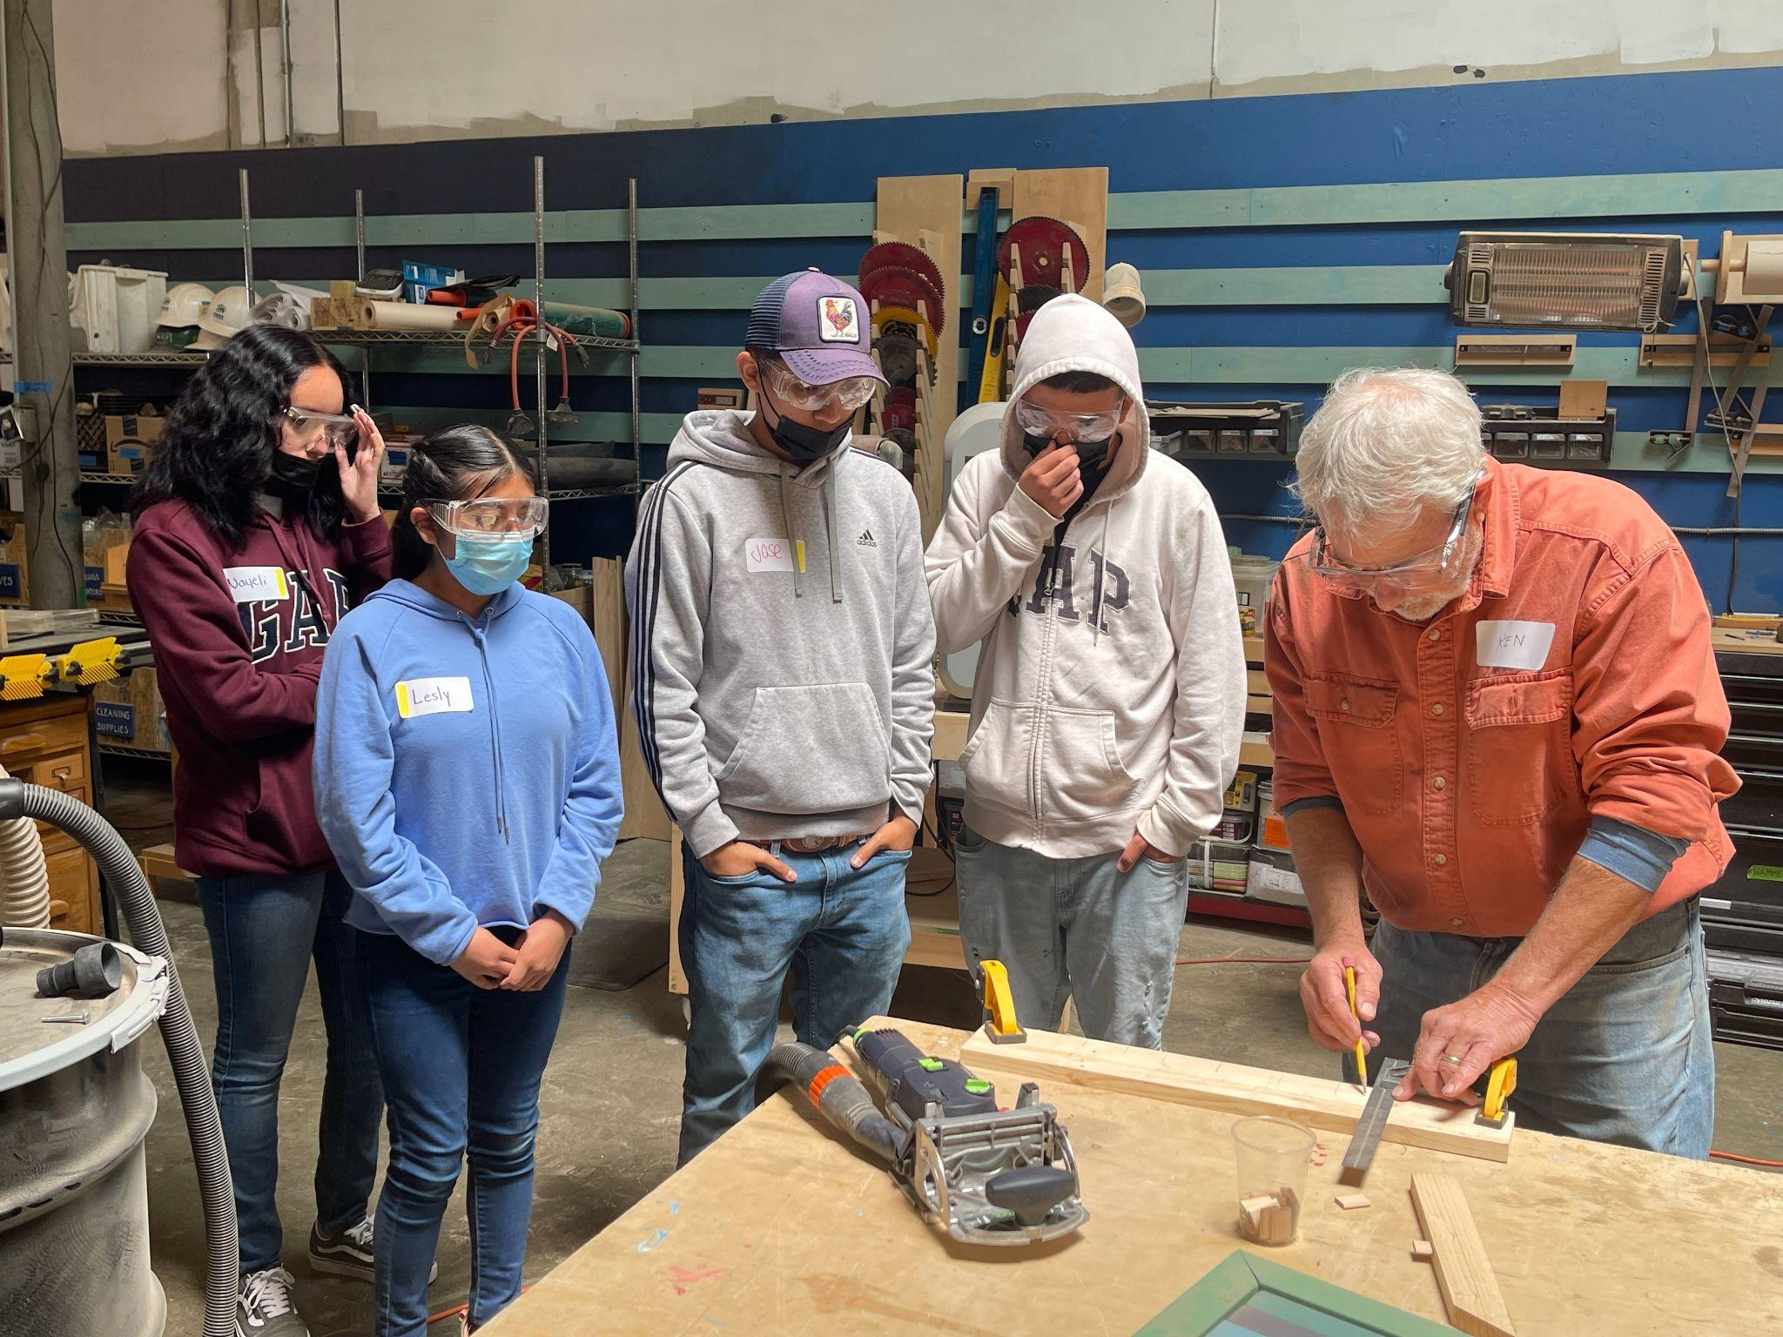
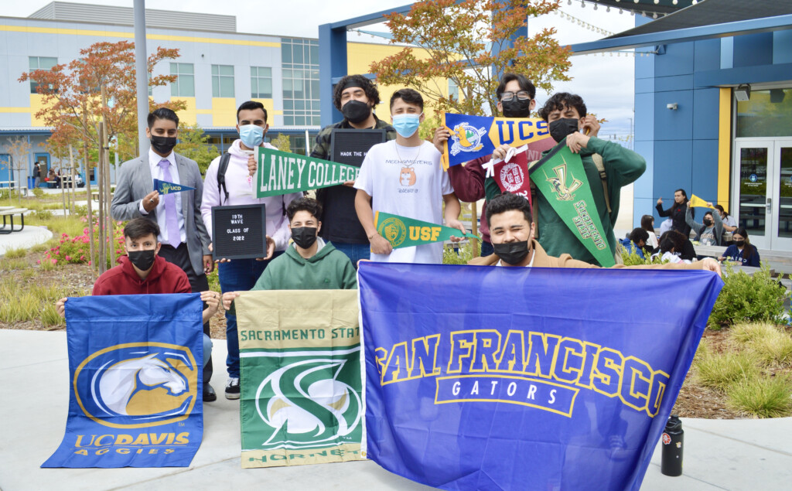
Learning and insights
Wave-Makers are considering robust post-secondary options to achieve their life dreams.
The 19th wave faced unprecedented challenges in college admissions this year which impacted their college admissions, and ECC rates.
Popularity in trade programs and transfer pathways are continuing to rise - matching the national trend.
Supporting students in accessing and exploring multiple post-secondary options has developed more student-buy in.
At MWA we need to continue to focus on the holistic well being of our students, especially rising graduates.
Strength of curriculum along with extracurricular involvement and exposure to leadership opportunities will provide Wave-Makers leverage in selective college admissions.
Notes:
The 19th wave faced unprecedented challenges in college admissions this year which impacted their college admissions, and ECC rates.
This year, admissions across the country changed quite a bit. From testing policy changes, increase interests in the UCs, to academic preparation, specifically around writing essays impacted our students.
Popularity in trade programs and transfer pathways are continuing to rise - matching the national trend.
Popularity around skilled trades are rising as large companies are headed towards the future. Amazon, Google, are two examples that provide students with apprenticeships that lead into lucrative careers
Supporting students in accessing and exploring multiple post-secondary options has developed more student-buy in.
Students are also realizing their desire to pursue alternative options as we continue to expose them to more opportunities in the CCC. This year we took students to
Mental health and anxiety around planning for the future has impacted student decision-making.
Mental health and anxiety around planning for the future has impacted student decision-making.
We saw a large number of students utilizing mental health services on campus. Our Social workers and deans have been pivotal in ensuring students feel like they are in control.
Students struggled to make difficult decisions this year
Sacramento State example
Leaving 4-year offers on the table because they do not feel like they are ready to start.
Extracurricular involvement and exposure to leadership opportunities will provide wavemakers access to top-tier institutions.
Our student who was accepted to Harvard provides an opportunity for us to encourage replicable elements in her application profile. I’d like to share what those are:
Demonstrated Interest: Extracurricular activities ladder up to intended major or career - Environmental Social Justice, and this was prevalent throughout her involvement in HS.
Extracurricular activities: Highlighting leadership in extracurricular activities: Lizbeth had internships, Youth Versus apocalypse and established a substantial social media presence (which we actually highlighted in one of her supplements by providing the link).
She was also a leader in two clubs on campus: ASB, and Climate Justice Club

Slide 9
Discussion and Q&A

Slide 10
Thank you.

