Slide 1
Local Indicator Data
Carmen Velarde
June 13, 2022

Slide 2
Local Indicator Overview
LCFF Priority 1 Summary
LCFF Priority 2 Summary
LCFF Priority 3 Summary
LCFF Priority 6 Summary
LCFF Priority 7 Summary
Table of
Contents

Slide 3
Local Indicator Overview

Slide 4
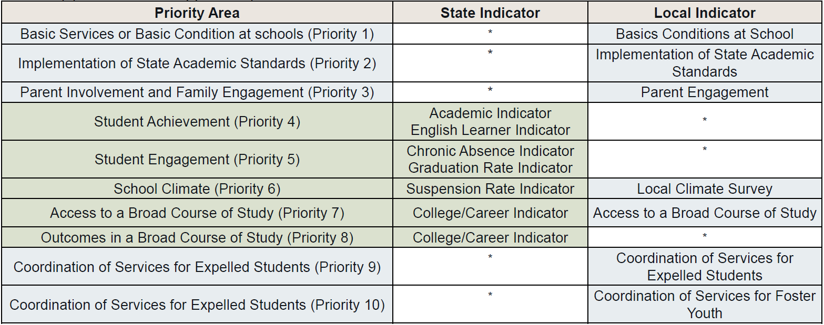
Overview

Slide 5
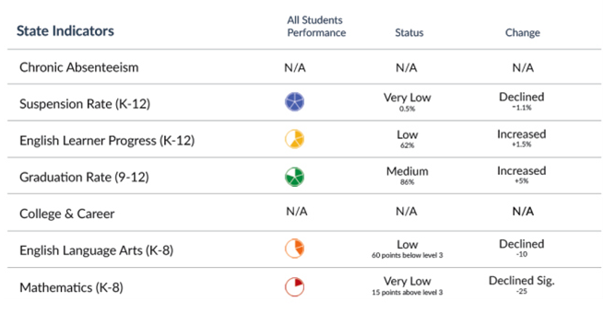
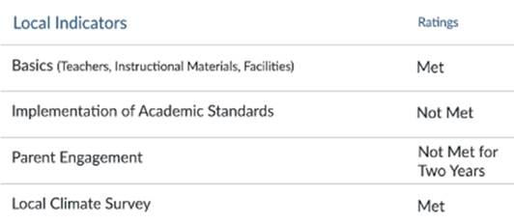
State versus Local Performance
 | State | Local
Performance Levels |  | Met Not Met Not Met for Two or More Years
Performance is determined by… | Performance is determined by the state, and is “calculated using percentiles to create a five-by-five colored table (giving 25 results) that combine data from the current and prior years.”¹ | Performance is determined by the LEA based on the three state-created standards: Annually measure its progress in meeting the requirements of the specific LCFF priority; and Report the results as part of a non-consent item at a regularly scheduled public meeting of the local governing board/body in conjunction with the adoption of the LCAP; and Report results to the public through the Dashboard utilizing the SBE-adopted self-reflection tools for each local indicator.
Example
1. CDE’s “California School Dashboard and System of Support” webpage: https://www.cde.ca.gov/ta/ac/cm/

Slide 6
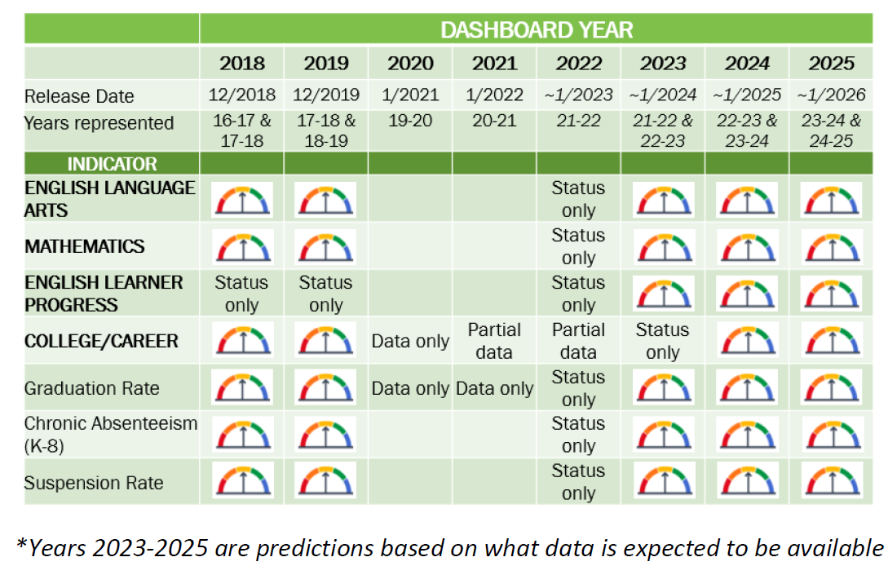
CA School Dashboard Reporting
Annice Weinstein, EdTec Budget and Accountability Update, May 25, 2022

Slide 7
LCFF Priority 1 Summary

Slide 8
Appropriately Assigned Teachers
Data Source(s)
Big Takeaway(s)
California Commision on Teacher Credentialing (CTC)
School Accountability Report Card (SARC)
Teacher assignments
Maintaining similar number of teachers who are “credentialed and appropriately assigned” (~74 or 75% each year)
How data informed analysis
The Human Resources Department (HR) monitors compliance to CTC and AB1505 requirements to support the internal credentialing process of mission-aligned new and aspiring teachers:
Actively participating in the hiring/screening of MWA faculty candidates to assess valid teacher credentials.
Supporting presently employed educators to make adequate progress towards their credential by guiding them through applications/requirements for permits and/or waivers that allow them to teach in the State of California.
For those who do not yet hold a "clear" credential status, HR monitors the issuance of the credential, permit, or waiver types until the educator reaches clear credential status, and supports teachers with obtaining a mentor as part of the Teacher Induction Process. In the event that an educator is unable to meet certain milestones towards earning a clear credential on their own, HR creates a teacher plan that outlines milestones, deadlines, and expectations that must be met to continue employment at MWA.

Slide 9
Access to Curriculum-Aligned
Instructional Materials
Data Source(s)
Big Takeaway(s)
Textbook distribution lists
All students have access to their own textbook (where appropriate)
Possible next steps: school leaders conduct analysis of what curricular materials are actually being used in classes
Planning upcoming curricular pilots (e.g., upper-school math)
How data informed analysis
Operations team conducts annual inventory of textbooks and curricular materials each summer, and cross-references this with enrollment numbers, to make sure there are sufficient numbers of books so that all students have access.

Slide 10
Safe, Clean and Functional School Facilities
Data Source(s)
Big Takeaway(s)
The Facility Inspection Tool (FIT)
Regular walkthroughs
We continue to score highly on the FIT tool.
Next FIT inspection with the county will be in July.
How data informed analysis
The FIT tool, along with maintenance ticket requests, alerts the Operations team to areas in need of repair.

Slide 11
LCFF Priority 2 Summary

Slide 12
Implementation of Academic Standards
Data Source(s)
Big Takeaway(s)
PD Calendar
Walkthroughs/Observations
Unit planning
We maintaining standards-based curricular materials, lesson plan format, and teaching expectations
There is a need for more regular cadence of observation/feedback cycles and student-data analysis/instruction cycles, which were not consistently/fully implemented this year
Alignment between assessment calendar and PD calendar for next year should help with this; requires follow-through
How data informed analysis
These data sources and the reflection tool allowed us to identify good practices that have been consistent at MWA this year and others that need reinforcement next year.

Slide 13
LCFF Priority 3 Summary

Slide 14
Parent Engagement
Data Source(s)
Big Takeaway(s)
Meeting attendance/participation information
Parent School Climate Survey (end of year)
Calendar of Events
Educational Partner feedback events
Maintained consistent calendar of Saturday events, coffee-talks/chat & chew, advisory committees (SSC, ELAC, BAASAI), LCAP events
Families desire opportunities for interaction with other parents, forums for sharing their voices, and on-campus events
The organizational restructure for next year may be bring new opportunities for family/school engagement
How data informed analysis
This data allowed us to see strengths– consistency of a variety of virtual parent events– and areas for growth– ongoing desire by parents for more opportunities to interact with other parents, on-campus events when possible, and opportunities to share their voices.

Slide 15
LCFF Priority 6 Summary

Slide 16
School Climate
Data Source(s)
Big Takeaway(s)
California Healthy Kids Survey (CHKS)
Overall results were in alignment with our pre-covid trends; however, we experienced a decrease in students' perception of school safety (in the middle school) and having caring adult relationships at the school (in both middle and upper school). These outcomes mirror the feedback the school has received from other student culture and climate surveys as well as anecdotal feedback collected over the course of the school year. Students like many adults experienced anxiety and uncertainty related to returning to campus due to the ongoing pandemic.
How data informed analysis
We utilized the “school report cards” from the CHKS survey to pull out trends related to school connectedness, academic motivation, and school safety. Where possible, we compared results from this year’s survey to prior survey (2019) and to state averages when available.

Slide 17
LCFF Priority 7 Summary

Slide 18
Access to a Broad Course of Study
Data Source(s)
Big Takeaway(s)
Course Schedule
Enrollment data (from PowerSchool)
Students continue to have access to full range of A-G courses
New courses for next year in visual and performing arts; mathematics, and plans to implement dual enrollment program in the future
Desire from community for more electives, especially in the middle school. Staffing challenges remain a potential barrier to expanding course offerings in new directions.
How data informed analysis
Course schedule and enrollment data allow us to confirm that students are taking a broad range of courses, aligned with our graduation requirements. Feedback from educational partners highlights potential new courses desired by the community.

Slide 19
Contact Information
Carmen Velarde
cvelarde@mwacademy.org
510-368-4292

