Slide 1
Curriculum and Instruction Review Committee
Making Waves Academy
Alicia Klein and
Esther Hugo
Spring 2022
Notes:
Semi-annual update
Most critical element of our program- the curriculum that excites students about learning
And provides the avenue for them to develop dynamic postsecondary plans.

Slide 2
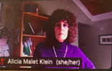
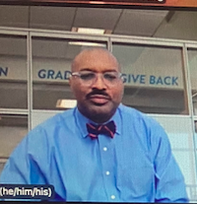
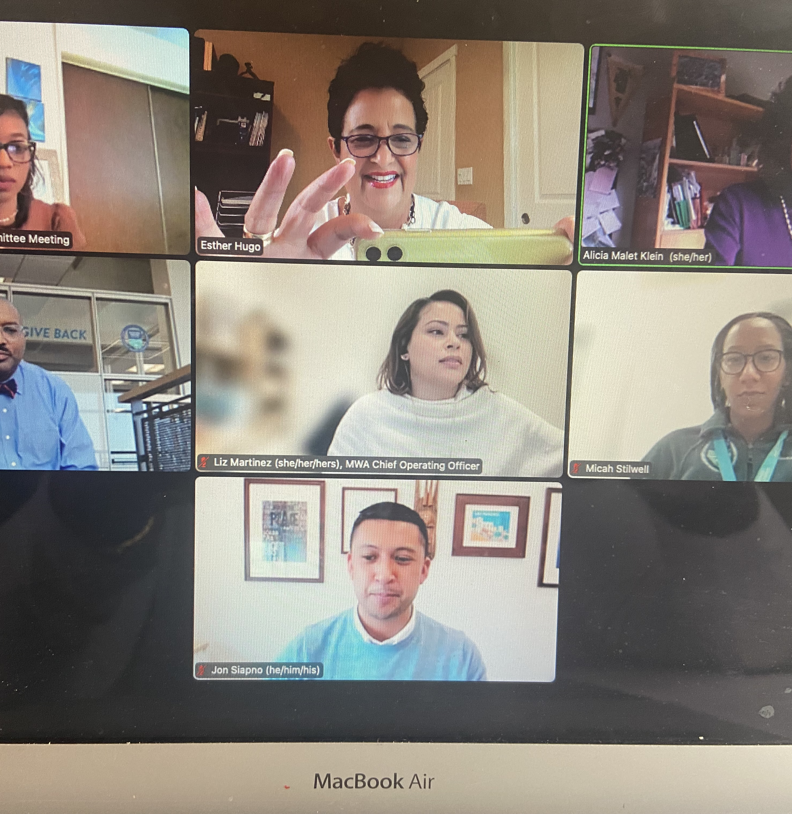
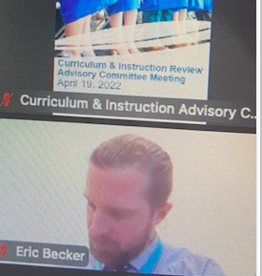
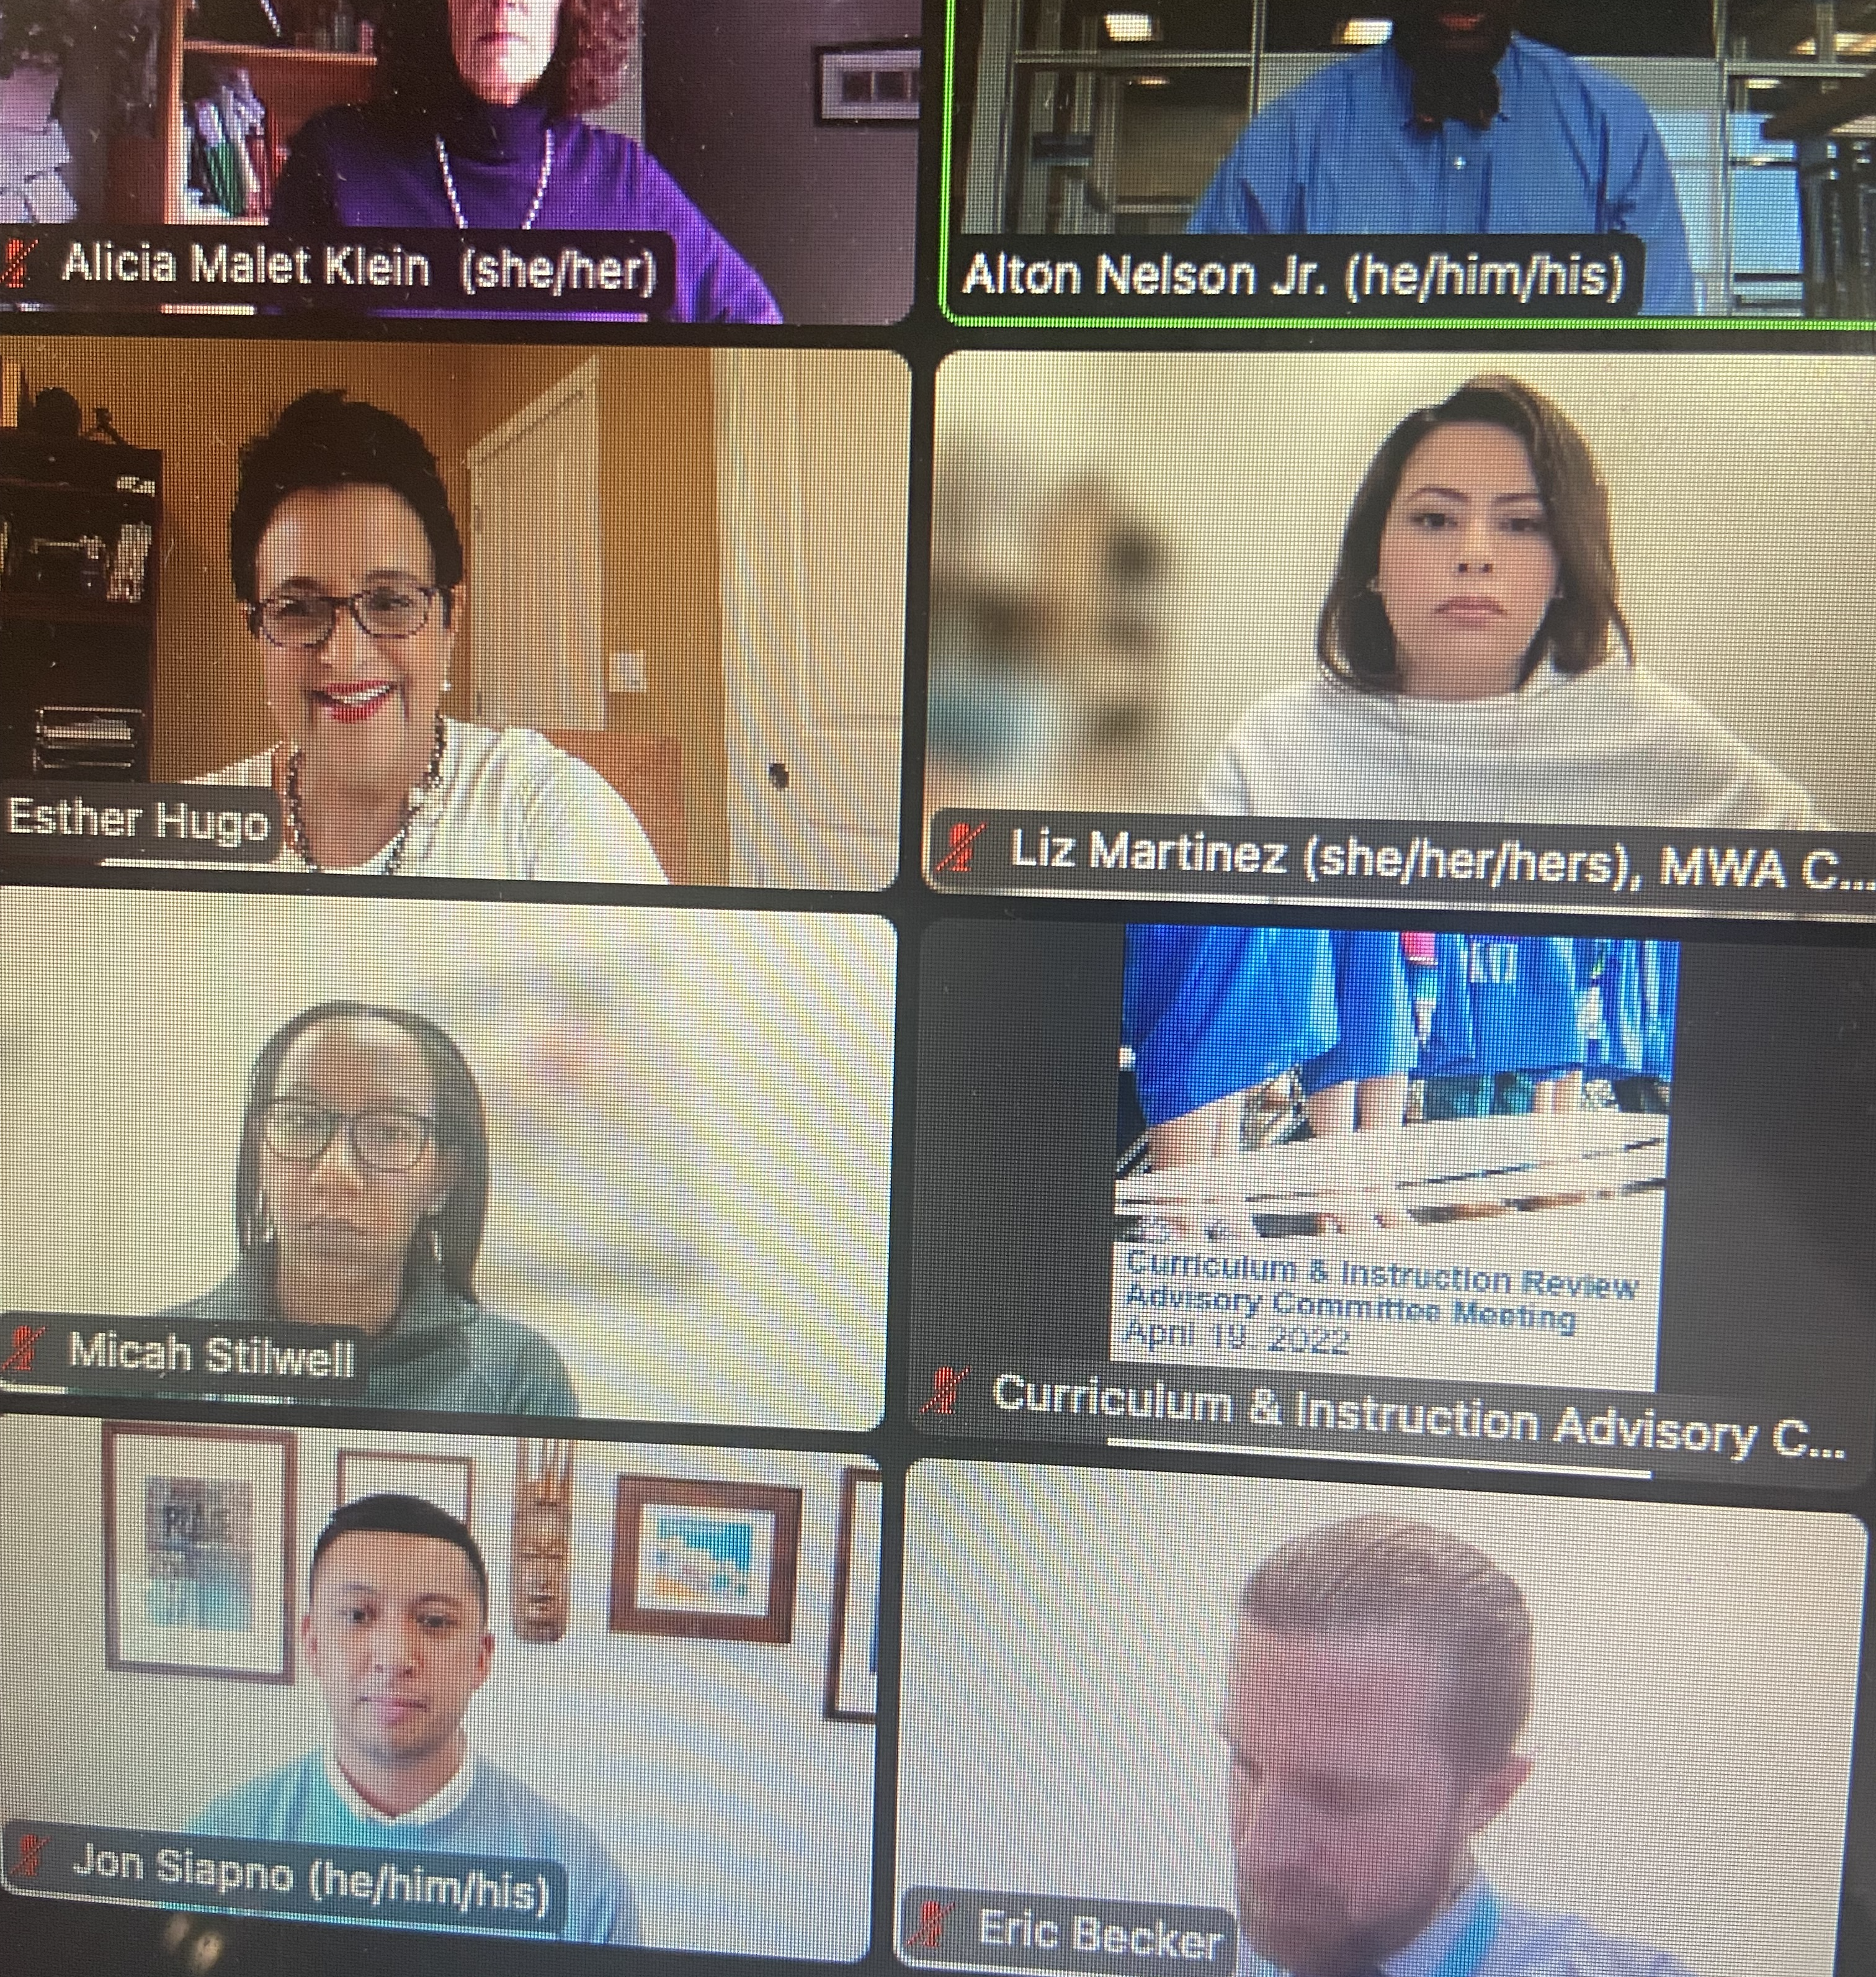
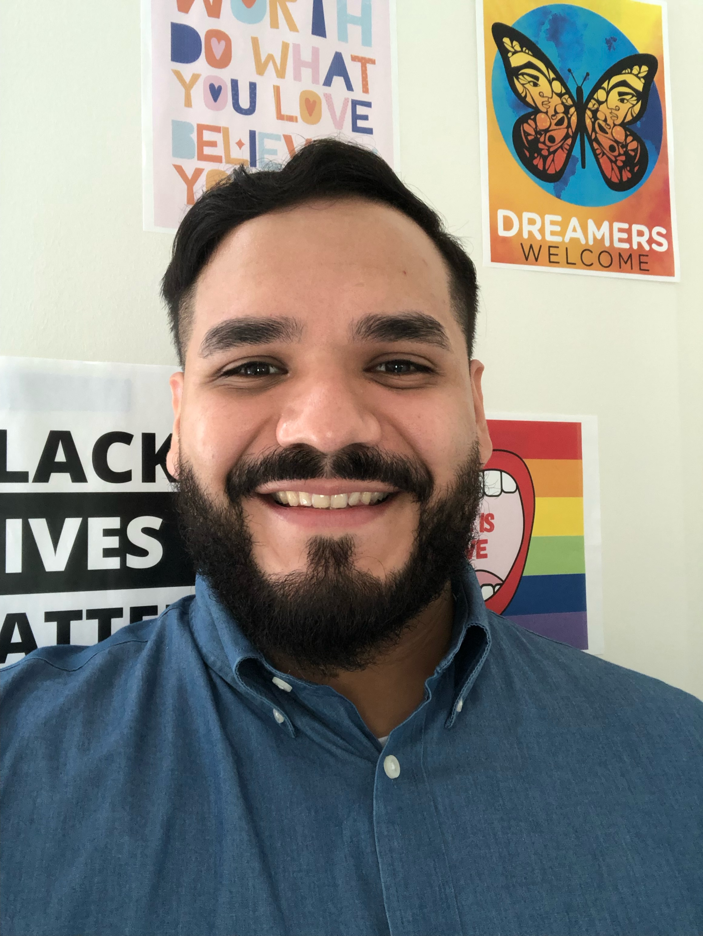
Who’s on the Screen? Who’s at the Table?
Notes:
Member of the CRC, now called the
Curriculum and Instruction Committee, since I joined the MWA Board in 2013.
We’ve seen a lot of changes and it’s a pleasure to share them with you.
Who’s on board –
You’re represented by Alicia and me.
Mr. Nelson, Micah Stillwell, and a shout out and welcome to
Eric Becker, who is the new Director of Academic Instruction in the Humanitis.
His Math/Science counterpart quit in December.

Slide 3
Presentation Overview
Notes:
Here are our topics – wide-ranging and riveting

Slide 4
Curriculum and Instruction Topics
Setting the Scene
Current Priorities
Focus on Teacher Support
Curriculum Changes
Ethnic Studies Plans
Bell Schedules and Master Calendars
College and Career Counseling Update
Notes:
Mr. Nelson sets the scene,
What’s new
Teacher Support biggest focus
New course offerings
Logistics about schedules and calendars
College and Career

Slide 5
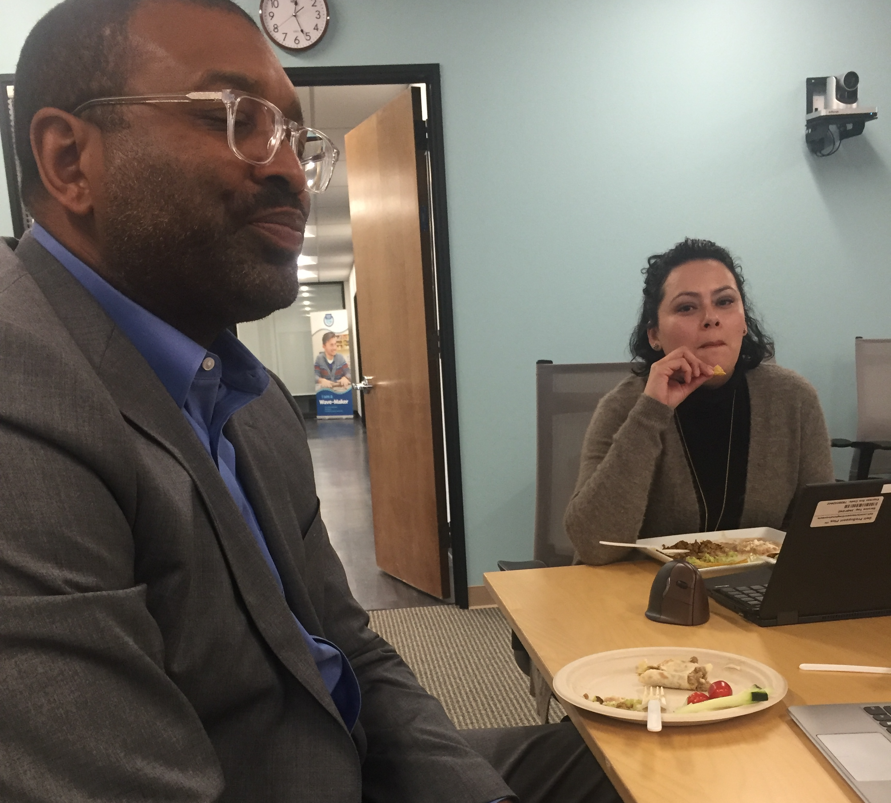
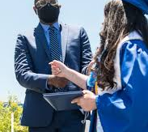
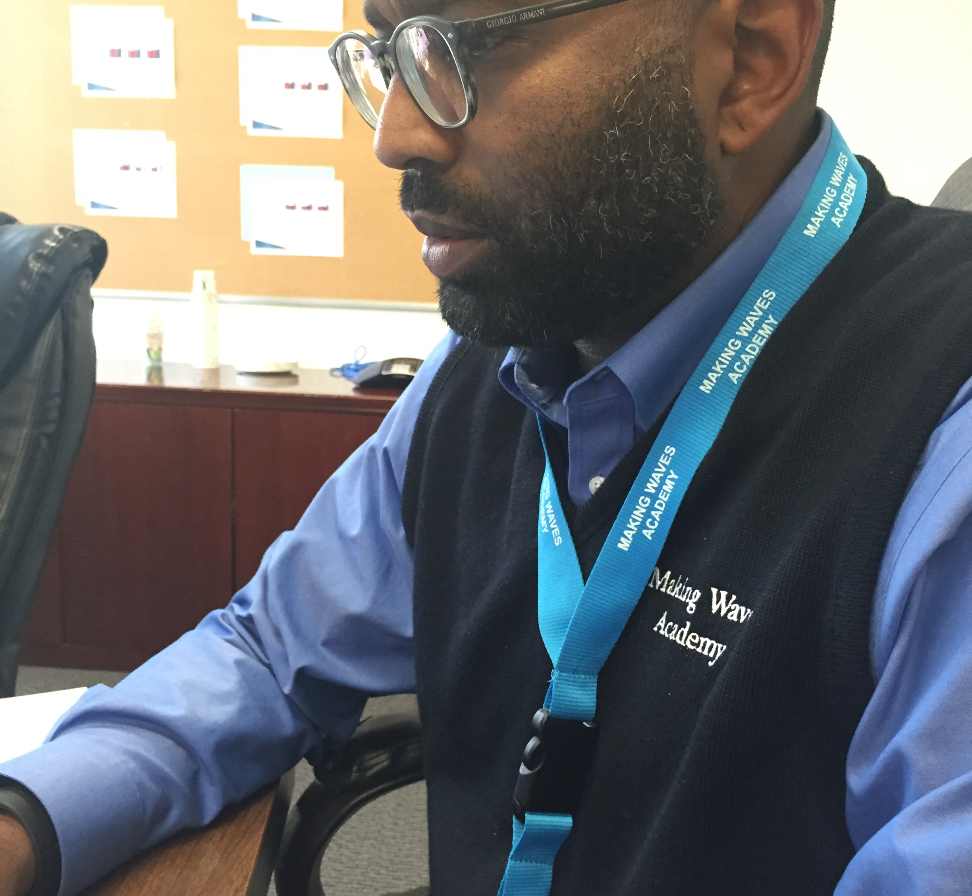
CEO Nelson Provides Context and Perspective
LPAC Testing Started mid-April
Mid-Year Resignations
Contact tracing and COVID testing
“Being Distanced”
Stresses of Return to School
Staff Shortages
Predictability?
Notes:
Mr, Nelson sets the scene
These are very challenging issues
Staffing
Adjustments
Lack of predictability
Pressures of COVID testing, etc.
“Agenda doesn’t fully capture the context under which the instructional leaders have been able to lay out a plan of action for the coming year.”
--Mr. Nelson

Slide 6
Priorities – Instructional Support
Teachers – 53% of faculty are new teachers or new to MWA
Staffing and Coverage
Stress Testing our Systems
Need for customized professional development
Culture and Climate Issues
Notes:
Ms. Stillwell
Prioritized staffing
Considering how we “stress test our systems”
Instructional Support team pulled away to cover classes
Trying to get to a place where teachers are seen and heard.
Startling statistic which makes the challenges obvious
53% of faculty are new teachers, or are new to MWA.
Increased support for teachers and intentional professional development.
Refine assessment and Professional Development calendars
Make sure the calendars are compatible with pace of instruction.
Curriculum – reach out to diversity, equity and inclusion to make sure there is consistent programming and messaging.
Curriculum – not a silo of excellence
Collaborating with DEI
“High Quality instruction is the best tool for classroom management.”

Slide 7
Teacher Observations – Goal is 100%!
All Staff will be observed monthly
Debriefs and feedback
”Intent to Return” survey submitted
Peer Observations
Maximize Classroom Presence
Notes:
This is Aspirational!
Instructional Support Priorities
Complete observation – 100 % of staff observed monthly
Stabilized faculty - staff intent to return survey
Alton – teachers feel adrift. What’s the commitment if you’re not coming to my class.
Observation and debrief –
Peer observations

Slide 8
Curriculum Updates – Pilots and changes
Notes:
Piloting new curriculum
New staff will require more support
Key to teacher retention
Teachers like their ability to have a “say” into the curriculum.

Slide 9
Math Curriculum Templates Provide Consistency for Evaluation
Notes:
Shared templates for Math Curriculum.

Slide 10
Curriculum Template Covers a Range of Topics
Accessibility
Curriculum
Data
Online Access
Student Engagement
Assessments
Staff Development
Notes:
Math’s Upper School Pilot –
Have a subset of teachers to try both Open UP and Carnegie Learning.

Slide 11
Textbooks Orders Enrich Curriculum & Instruction
Notes:
Buy Psych and Spanish textbooks

Slide 12
Textbook Orders - Proposals
Novels for English Classes
Parable of the Sower, by Octavia Butler (11)
Animal Farm (8) by George Orwell
6th – 8th Grade Social Science
Timelines ensure teachers have buy-in and can get textbooks in advance.
Notes:
Timelines,
Examples of Textbooks
Want to make sure teachers have their textbooks early in the summer.

Slide 13
New Curriculum Pilots and Proposals
Discovery Education for Social Studies, 6-8
Pilot 5th Grade Social Studies
Pilot Upper School Math Curriculum
Plan for Ethnic Studies
Notes:
5th grade Pilot for Social Studies – not a lot of choices.
Use Discovery Education as the Social Studies Curriculum,6-8th.
Update 5th Grade Science based on NGSS Develop a Rubric to evaluate curriculum for academic rigor and cultural relevance.
And student outcomes.
Curriculum + Textbooks

Slide 14
Ethnic Studies – California Innovation
State-oriented framework
Options – Copy an approved course or develop our own course?
AB 101 – California first state for semester-long course in Ethnic Studies to earn a high school diploma
Mandate: Class of 2029-30
Notes:
Start date 2025-2026 school year
UC/CSU proposing to mandate a half semester of ethnic studies for high school students applying to the UC system.
New course would add the letter “H” –
A-G would become A-H

Slide 15
Aspirational GOAL for 2022: Higher Performance on Math and Reading Growth Assessment --compared to 2021.
Notes:
Great goal – ask Stillwell to comment.

Slide 16
Bell Schedules and Master Calendars
Notes:
Liz Martinez leadership
Master Calendar - Bell Schedule
Input solicited from teachers and staff.
We endorse the recommendation
We have the mindset to try for more instructional days as time goes by.

Slide 17
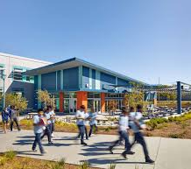
Staggered Dismissal
Universal start time
Simple to follow
Adds a break to Fridays
Same end-time for Community-building Fridays
Length of Advisory – 30 minutes for upper and middle
Notes:
Everyone starts together

Slide 18
Full Staggered Dismissal
Alleviates traffic
Early dismissal on Fridays
Challenging for families with kids in middle and upper schools
Athletes don’t miss core classes
Lunch not long enough
Notes:
FULL STAGGER
Would alleviate traffic
Maintains early dismissals on Fridays
Challenging for families to have different arrival/dismissal times if they have kids in the middle and upper school
Lunch is not long enough.

Slide 19
Master Calendar Two Years ahead!
Notes:
More instructional minutes
Close the gaps in their learning
How can we provide more instructional experiences for our students.

Slide 20
Master Calendar Changes
Two-Year Projection
181 Instructional Days
Quarterly Parent Meetings
Teacher Saturdays – 3
Back to School
SAT/PSAT
Case Study
Notes:
Is this the year where I can squeeze out more instructional days?
Build a strong foundation to launch – where can we be innovative
Where can we stretch?
We are looking at two years at a time – that’s a huge leap forward.

Slide 21
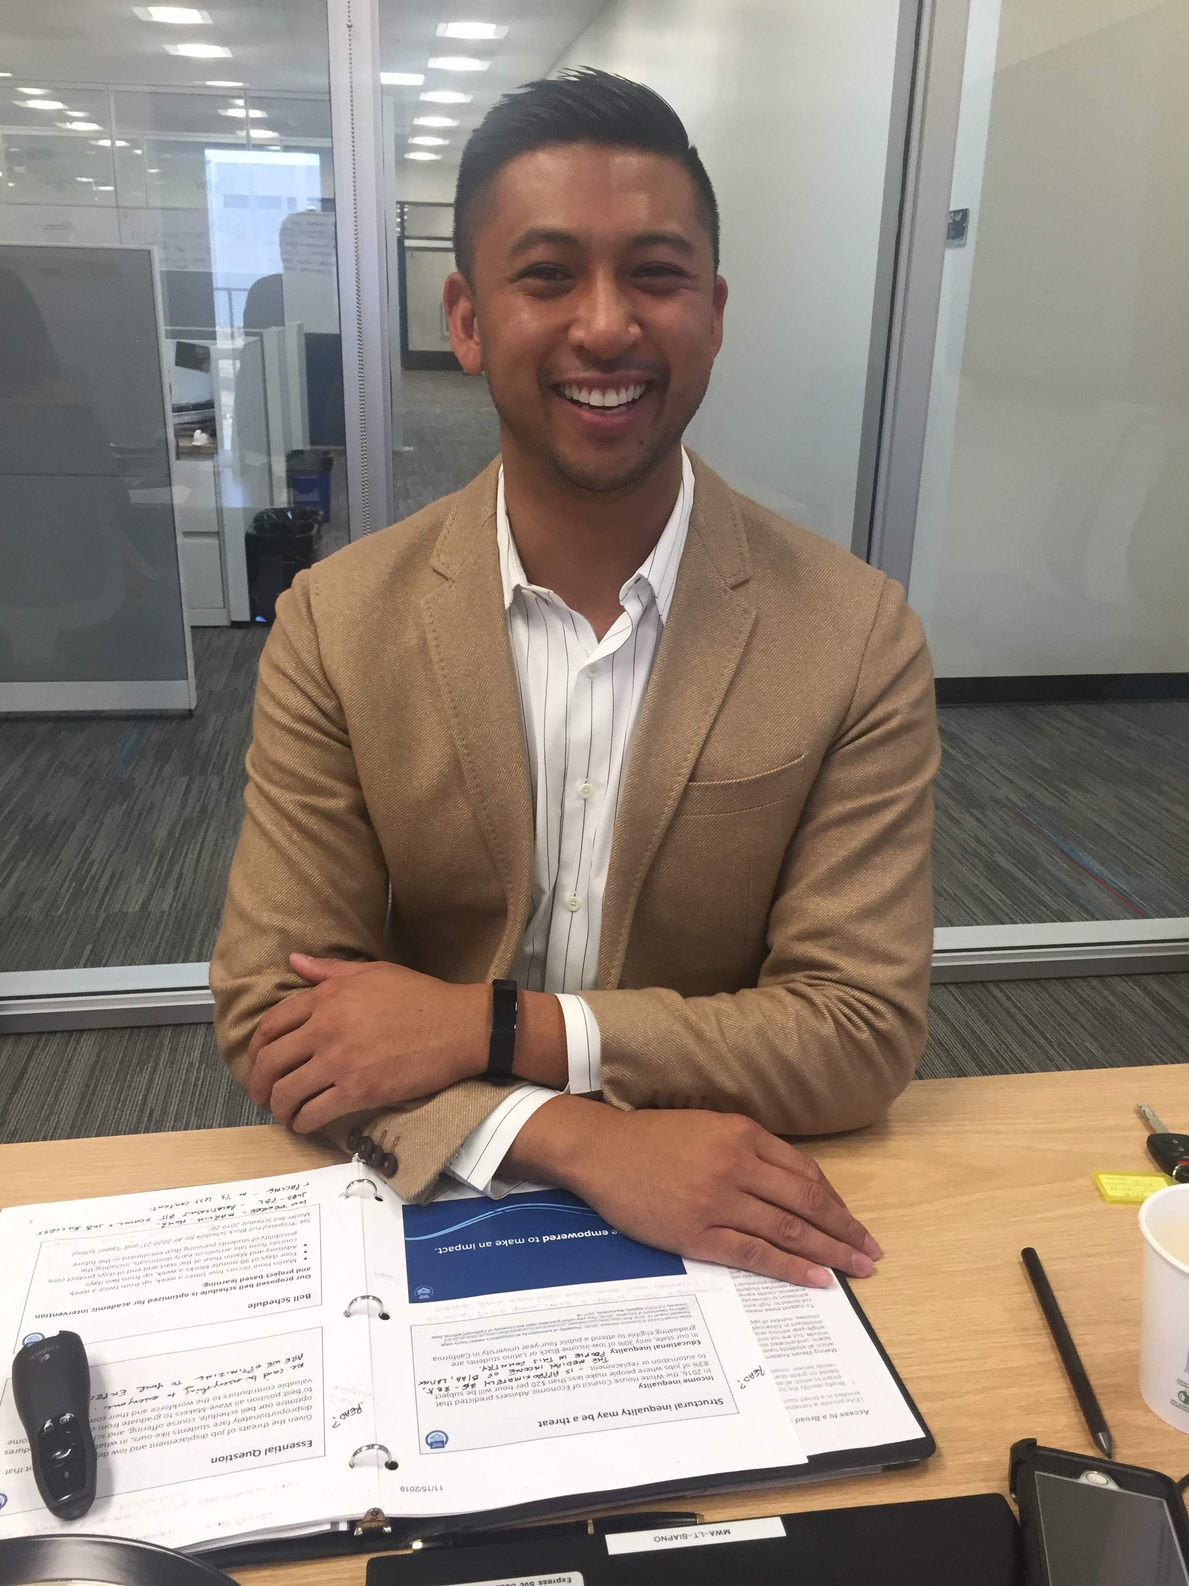
College and Career Counseling Update
Jon Siapno, Director
And
Esau Molina, Associate Director

Slide 22
College and Career Counseling Topics Overview
Senior Postsecondary Plans
Course Offerings
Launch of Dual Enrollment Program
Notes:
Overview
Snapshot of Seniors Postsecondary Plans
Course Offerings – ask
Launch of Dual Enrollment Program.

Slide 23
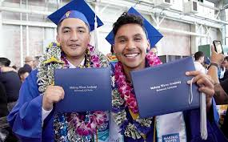
19th Wave! Success!
95% of Graduates have a plan
Class size is 83 students
74 students admitted to four-year colleges
Admission offers from all UC campuses
Increase in selective colleges – Harvard, USC, Middlebury, Smith, Pitzer, Scripps
‘Hack the Hood’ Computer Science
Notes:
Snapshot
So proud of the 19th Wave
Result of many people doing good work over time
Goal 95% of grads having a plan
83 students in class
74 students admitted – to four-year colleges.
Almost 94 %
Admission officers from all UC’s
Hack the Hood- computer science training program – 5 students.
12-month

Slide 24
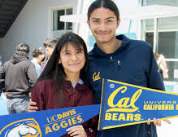
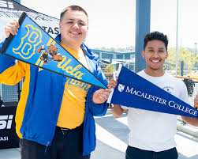
Key Takeaways – Support Improved for All Sectors
Improved services for highest achievers
Improved for those “on the margins”
Improved for those headed to the workforce and Military
Notes:
3 Key elements
Opportunity
Resilience
Support
Key Takeaways in Admissions
Test-optional policies have provided leverage.

Slide 25
ASB President Admitted to Harvard University !
Took as many AP Classes as possible
Demonstrated Interest
Extra-curricular Activities and Leadership
Climate Justice Club
Youth vs. Apocalypse – Social Media Profile
Strong Writing Skills
Notes:
Academic Profile – grades –
Took as many AP classes as she could throughout the year.
Extra-curricular activities – demonstrated interest.
Major – environmental social justice.
Leadership – ASB – internship
Youth vs. Apocalypse. – social media profile
Climate justice club.
Her writing skills played a great role.
Rigorous courses
Writing skills
Writing workshop for UC-eligible 20th Wave.

Slide 26
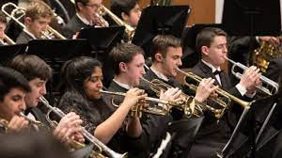
Changes and Exciting New Courses
Principles of Finance
Beginning Band
Two Performing Arts:
Beginning Band
Introduction to Drama
CTE Pathway condensed to 2 Years
Notes:
Course Offerings
Principles of Finance – Ms. Mohammed.
Alternative to Pre-Calculus
Beginning Band , depending on talent recruitment.
Changes
Condensing CTE Pathway from 3 to 2 years.
Discontinuing Anatomy and Physiology
Increasing minimum enrollment of course sections from 13-18 students
Initiating planning for Ethnic Studies.
CTE Pathway – students not committed to a four-year college pathway
Traditional biology, chemistry, physics
Gave them a pathway to meet the CTE criteria.
Researched it – service provider – their pathway was 2 years.
We now have Introduction to Drama – will keep that
Beginning Band -4 sections and the subsequent year,
Concert Band –
1 Visual
1 Performing Arts
Keep two existing arts teacher and add 1 more.
Hire a teacher who can offer upper division electives.
Unanimous in its recommendation to approve the course offerings.

Slide 27
Dual Enrollment Program Launch

Slide 28
Dual Enrollment Program Advantages
Students demonstrate capability for college-level work
Exposes students to college rigor
Broadens the MWA Curriculum
Opportunities for MWA Teachers
Students earn high school AND college credit
Notes:
Review the advantages of the program, generally.

Slide 29
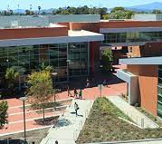
Dual Enrollment Program - Pilot
Students take college classes while in high school
Full-time Dual Enrollment Coordinator needed
Classes to be taught at MWA
Only Wavemakers
Contra Costa College provides instructors
Funded by A-G Completion Improvement Grant
Notes:
Dual Enrollment
Value – way to increase college completion through early accumulation
Benefit – partnering with other institutions to find talent to teach.
Early credit accumulation for college-going.
A-G Completion Improvement Grant.
See the Screenshot.
Check for unintended consequences.
Track the percent of college-goers who are accumulating college credit.
FTE – Leadership Public Schools
#1 Recommendation to have a full-time facilitator.
Building a school within a school.
Provide support for incoming faculty member
Easing the transition.
Classes taught at MWA.
Pursue our CCAP agreement – closed to the public.
Just Wavemaker students.
Professor at Contra Costa College teaches.
Hybrid – have our own faculty member teach the course.
Program administrator – advise students on their own time.

Slide 30
Test and Learn Model for Launch
6-12 months to develop program
Communications Course – to start
Questions for Consideration include:
Metrics that program is working
Which courses should we select?
Notes:
Metrics to see if it is working – whether or not students are passing the classes
Question - If by August 1st, we don’t have x,y,z in place, we can’t get this done.

Slide 31
Questions and Feedback
Notes:
Ask for Questions, Feedback and Comments.

