Slide 1
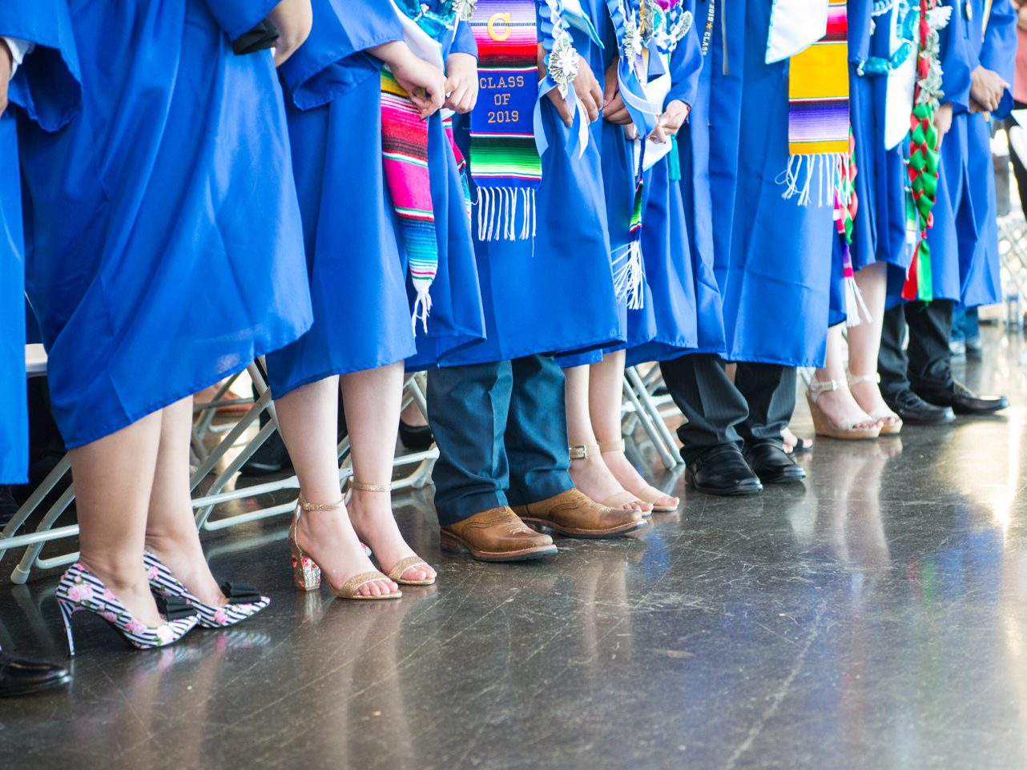
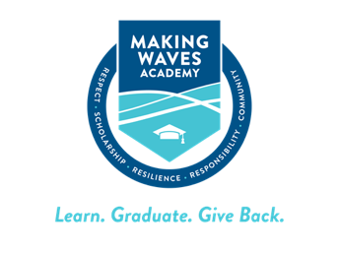
Talent Team Data
Lisa Dodson, Scott Pullman, and Joanella Mendoza
May 5, 2022

Slide 2
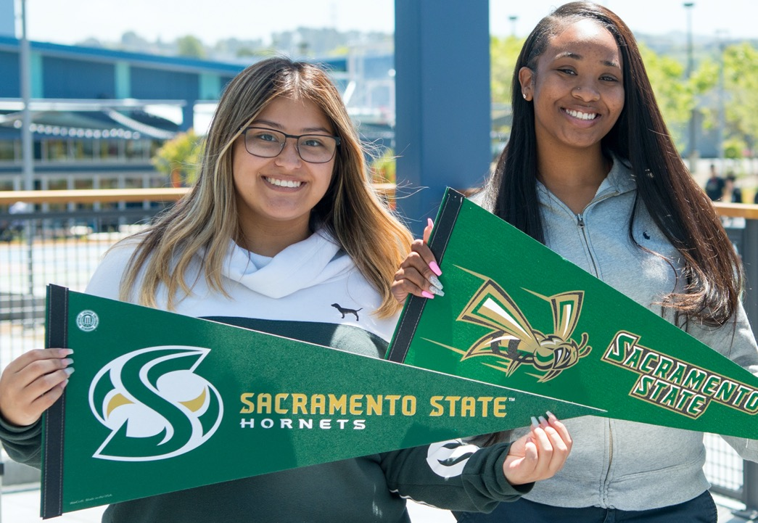
Agenda
New Hire Profiles
MWA New Hires
MWA New Teachers
Teacher Residency Program

Slide 3
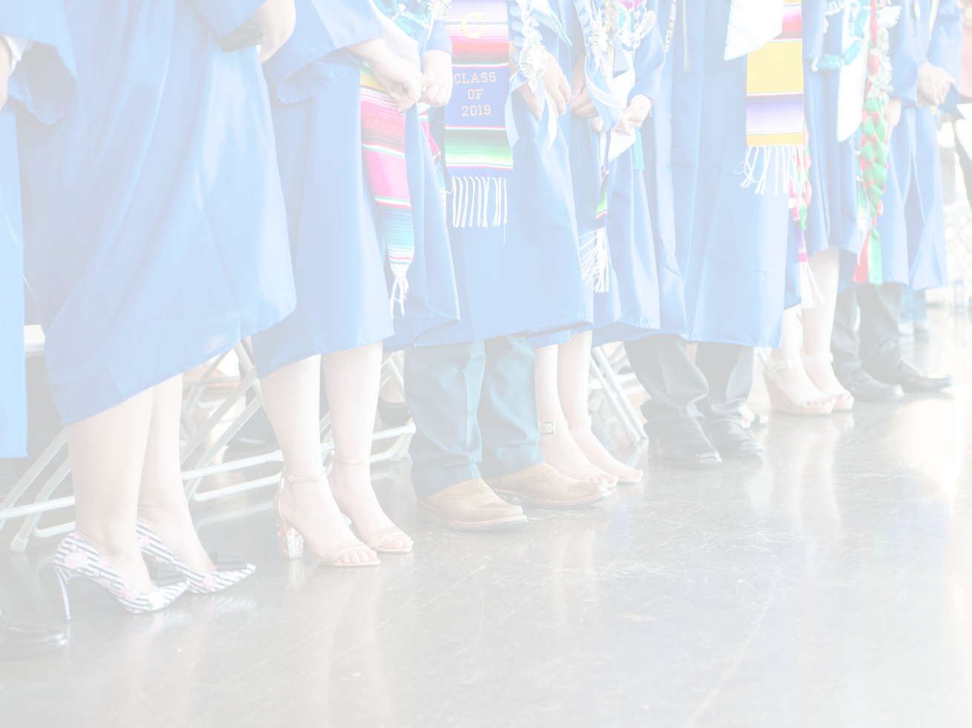
“Being a Making Waves Alumna had a positive impact on my education and continues to support my dream of becoming a teacher. I wanted to serve my community through Making Waves Academy and represent what it is to be a Wave-Maker.”
-Jazmelina Salas-Ledesma On-Site Substitute Teacher 14th Wave

Slide 4
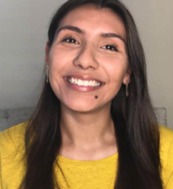
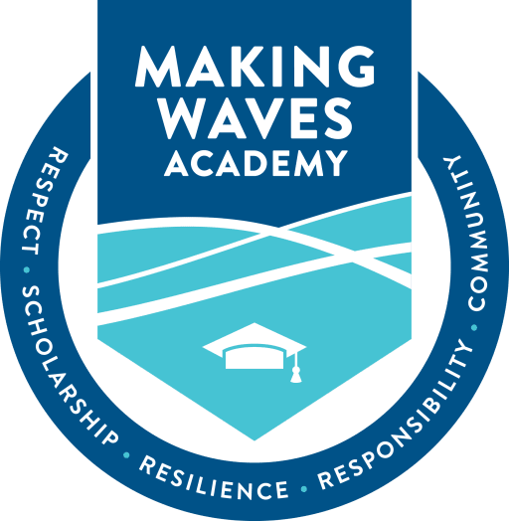
Jazmelina Salas-Ledesma (WM)
On-Site Substitute
San Francisco State University Bachelor of Arts, Economics Class of 2021
Making Waves Academy 14th Wave
Jazmelina Salas-Ledesma is a Making Waves Alumna from the 14th Wave. She went on to graduate from San Francisco State University with a Bachelor's in Economics. Coming back to Making Waves, she aspires to give back to her community. Jazmelina has worked within the West Contra Costa Unified School District since 2018. She found a passion in education that she hopes to pursue as an incoming resident in Making Wave’s Teacher Residency Program. In her free time, Jazmelina likes to spend time with her family.
View More MWA Mid-Year Hires

Slide 5
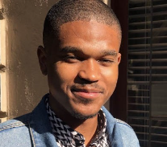
Michael Matthews
Math and Science Teacher
University of the Pacific Masters of Arts, Education Class of 2020
Ohio University Bachelor of Arts, Linguistics Class of 2017
Michael Matthews (he/him/his) is a Cleveland native. He comes to Making Waves Academy as an alumna of Ohio University and the University of the Pacific where he obtained his Master of Arts in Education as an Alder Resident. Before Making Waves, he taught English in Ecuador and worked as a Literacy Tutor. Mike is most passionate about all things music, DC & Marvel, and languages.
View More MWA Mid-Year Hires

Slide 6
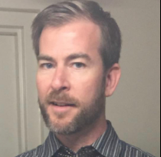
Darin Little
ELD Coordinator
California Institute of Integral Studies Master of Arts, Counseling Psychology
University of Maryland- Baltimore Bachelor of Arts, Photograph
Darin Little is originally from West Virginia and attended the University of Maryland in Baltimore for Photography. He began teaching Spanish in Catholic schools and came to the Bay Area in 2001. He earned a Master’s Degree in Counseling Psychology from the California Institute of Integral Studies and worked in counseling for a number of years before returning to the classroom at Sacred Heart Cathedral Preparatory in San Francisco. Most recently, he worked at Galileo High School teaching English Language Development where he became passionate about helping Newcomers adapt culturally and emotionally as well as academically to life in the U.S. In his free time, he very much enjoys hiking, yoga, soccer, biking, karaoke, stand-up comedy, and other people’s dogs.
View More MWA Mid-Year Hires

Slide 7
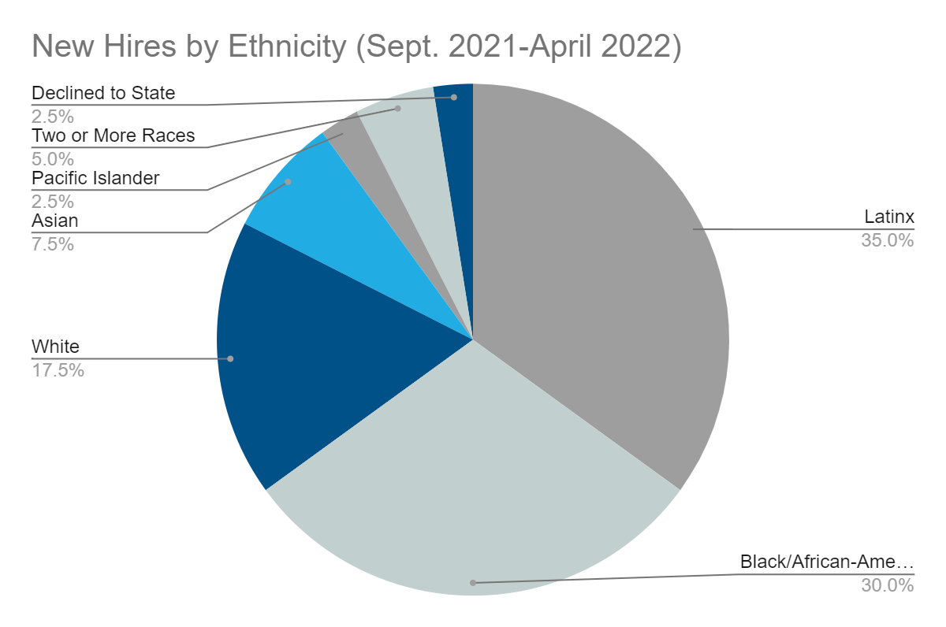
New Hires by Ethnicity (Sept. 2021-April 2022)
Ethnicity | Number of New Hires
Latinx | 14
Black/African-American | 12
White | 7
Asian | 3
Two or More Races | 2
Pacific Islander | 1
Declined to State | 1
New Hire Total | 40

Slide 8
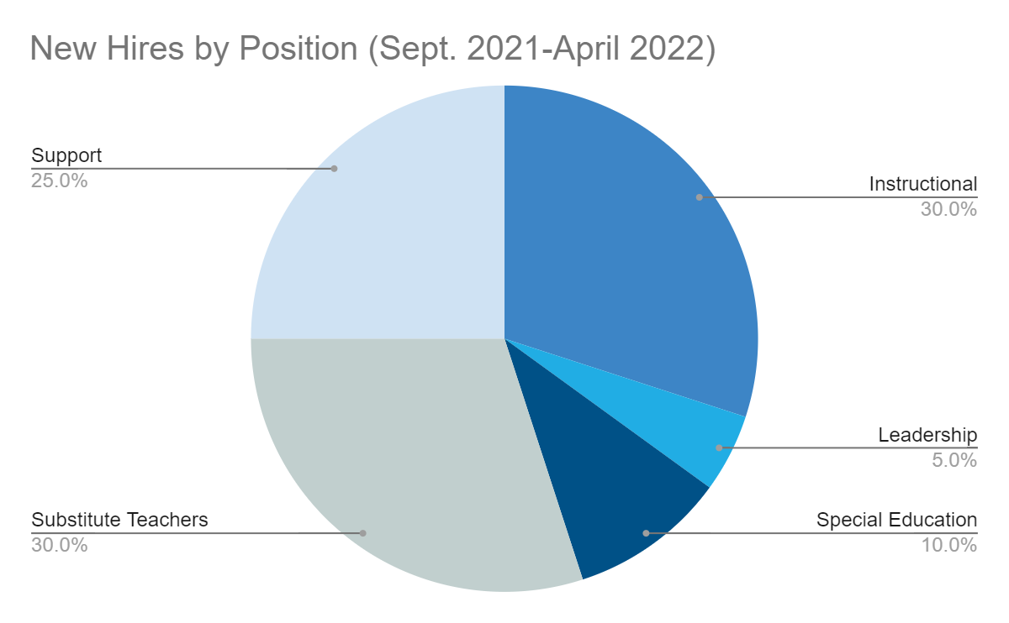
New Hires by Position
(Sept. 2021-April 2022)
Position | Number of New Hires
Instructional | 12
Leadership | 2
Special Education | 4
Substitute Teachers | 12
Support | 10

Slide 9
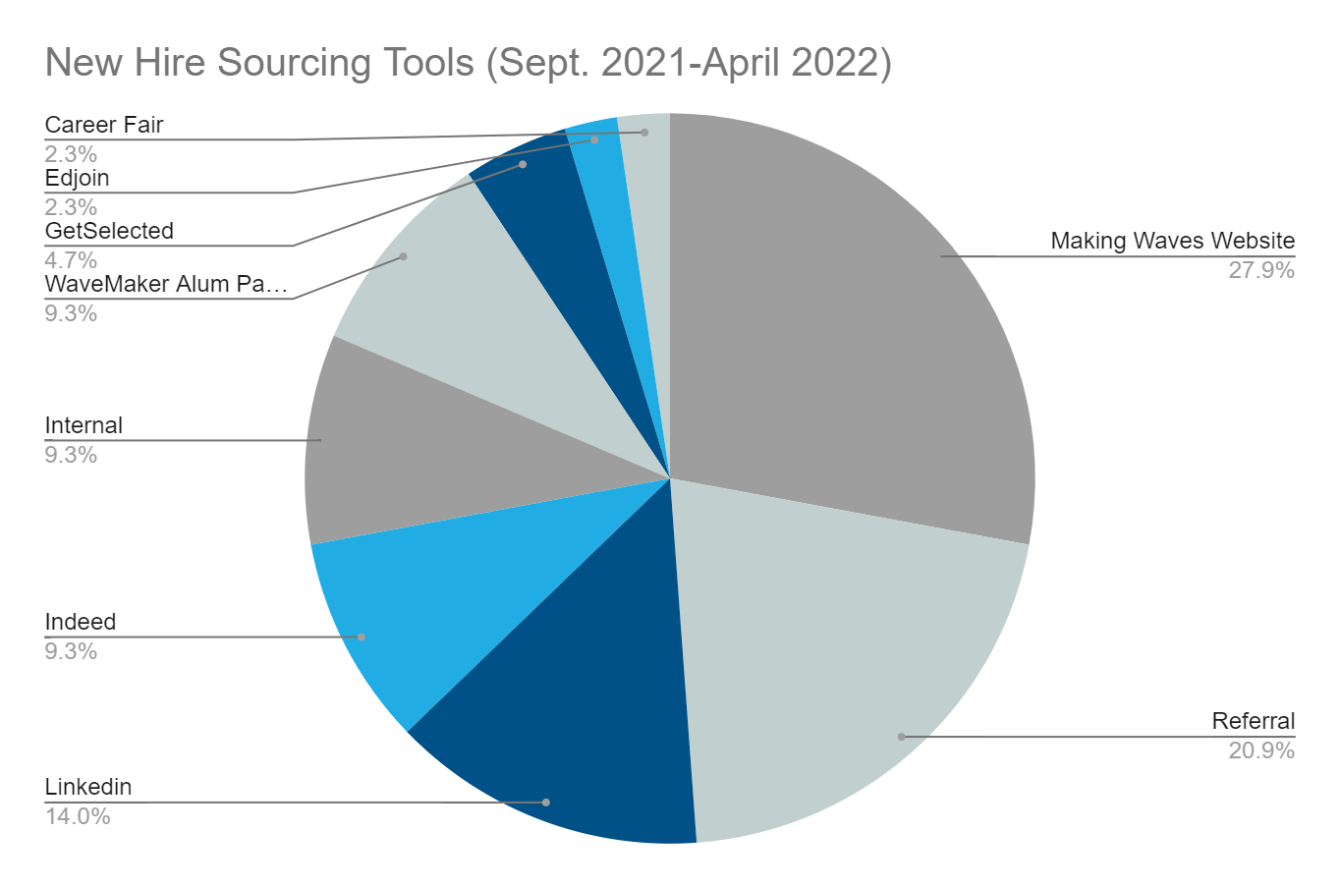
New Hire Sourcing Tools
(Sept. 2021-April 2022)

Slide 10
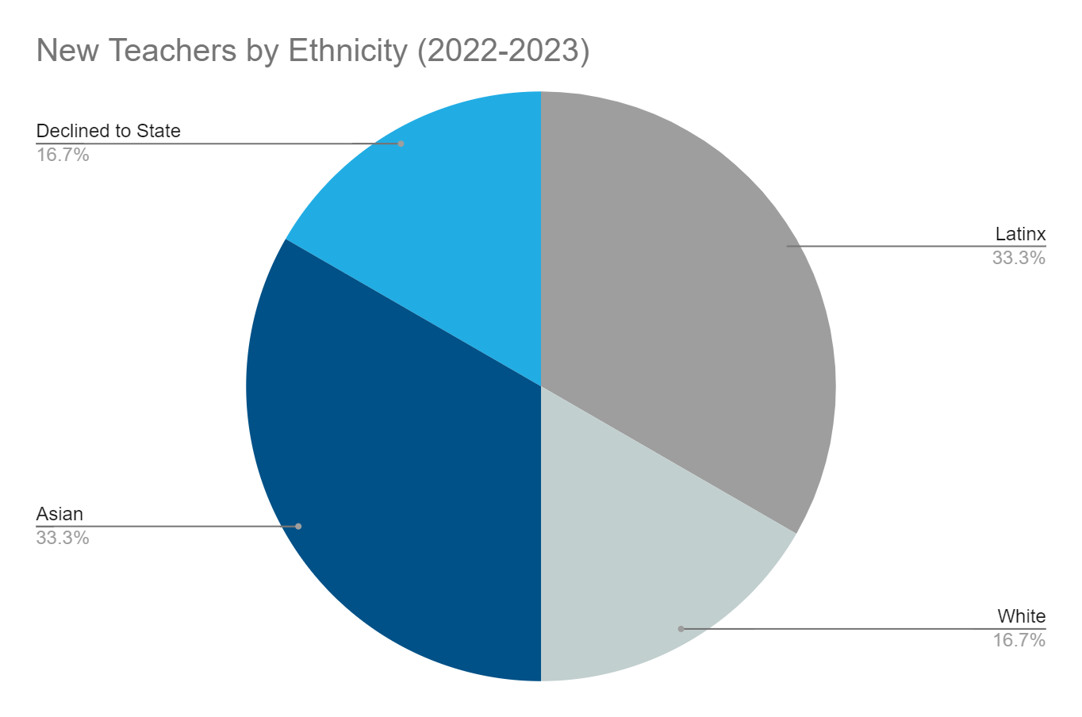
New Teachers by Ethnicity
(2022-2023)
Ethnicity | Number of New Hires
Latinx | 2
Asian | 2
White | 1
Declined to State | 1
New Teacher Total | 6

Slide 11
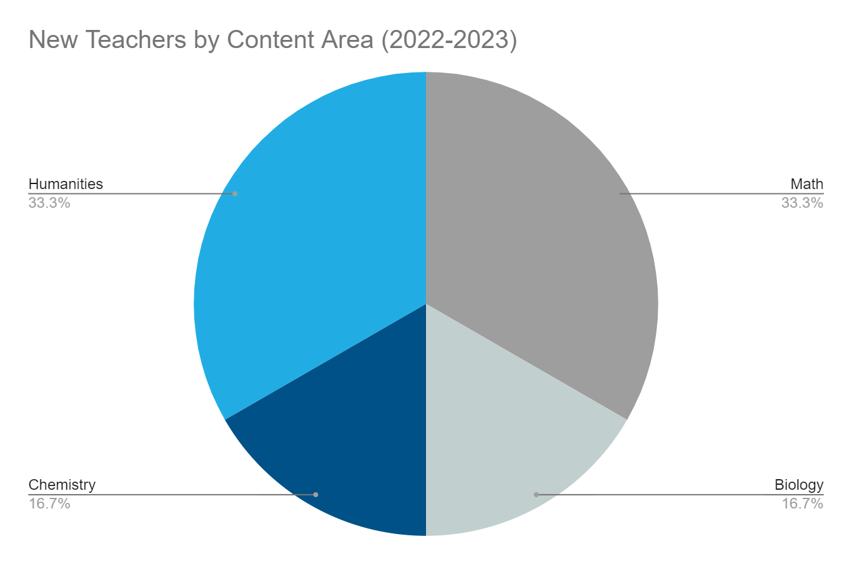
New Teachers by Content Area
(2022-2023)
Position | Number of New Hires
Math | 2
Biology | 1
Chemistry | 1
Humanities | 2

Slide 12
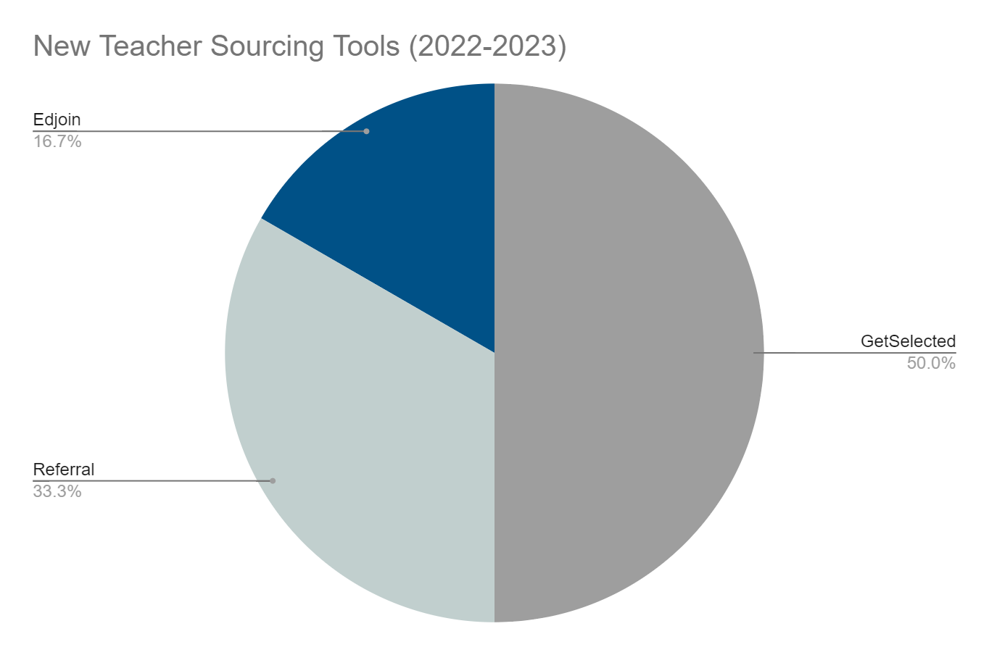
New Teacher Sourcing Tools
(2022-2023)

Slide 13
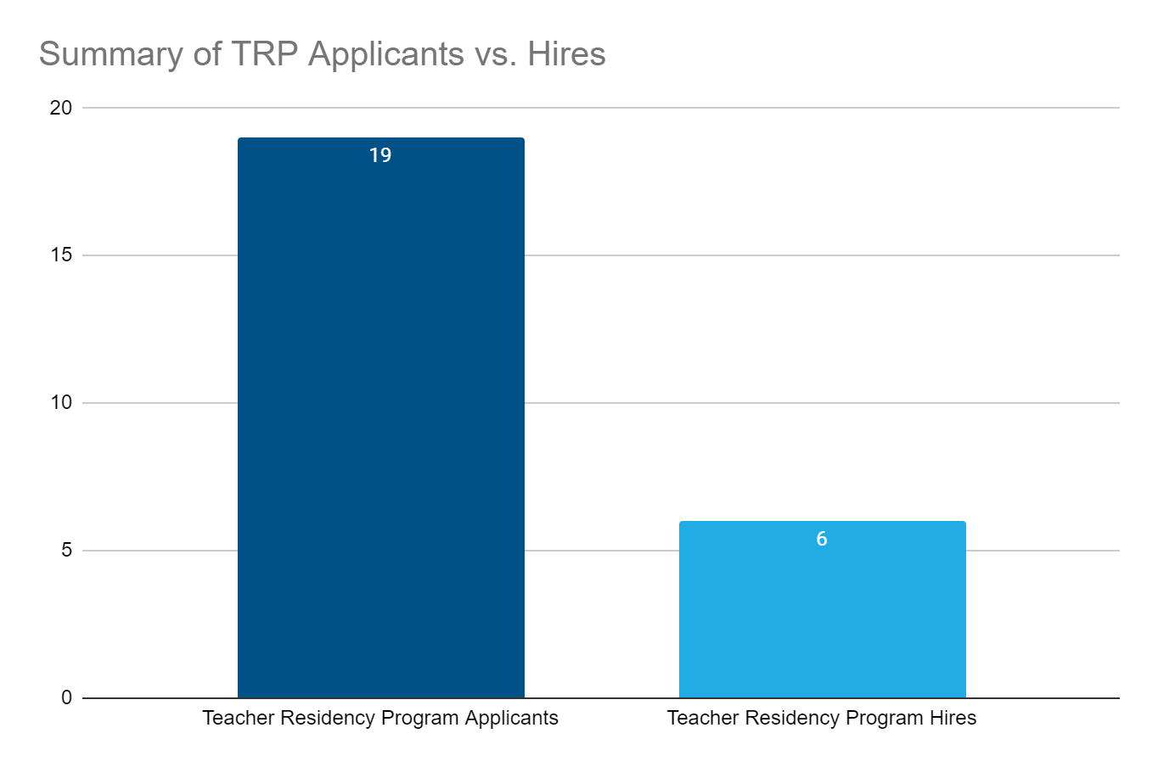
Teacher Residency Program
Hiring Report

Slide 14
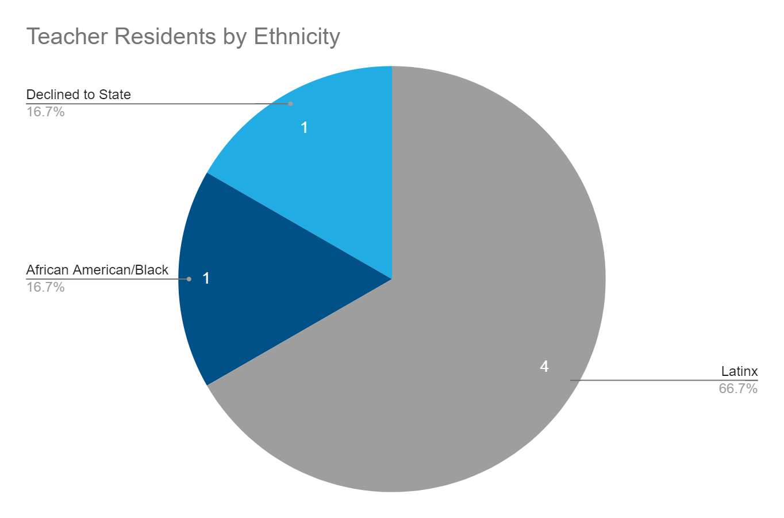
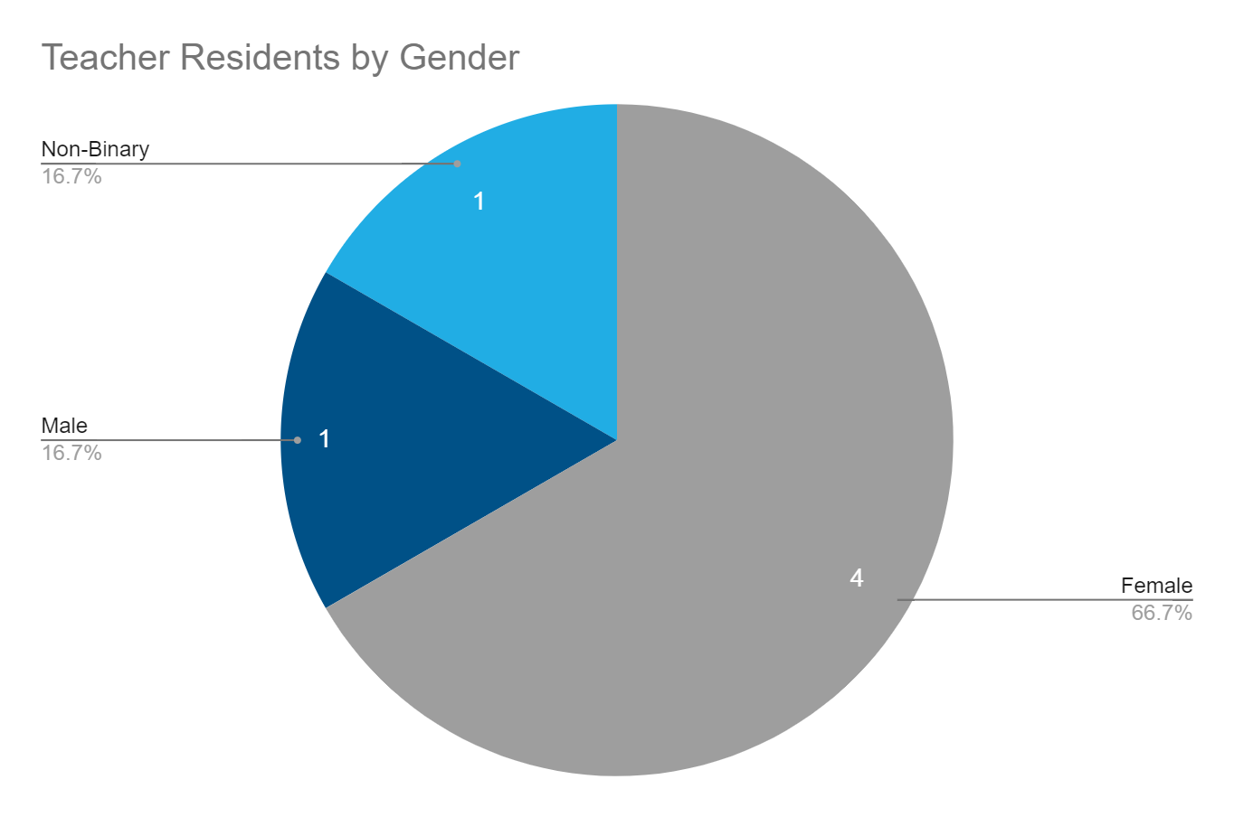
Incoming Teacher Residents
By Ethnicity and Gender

Slide 15
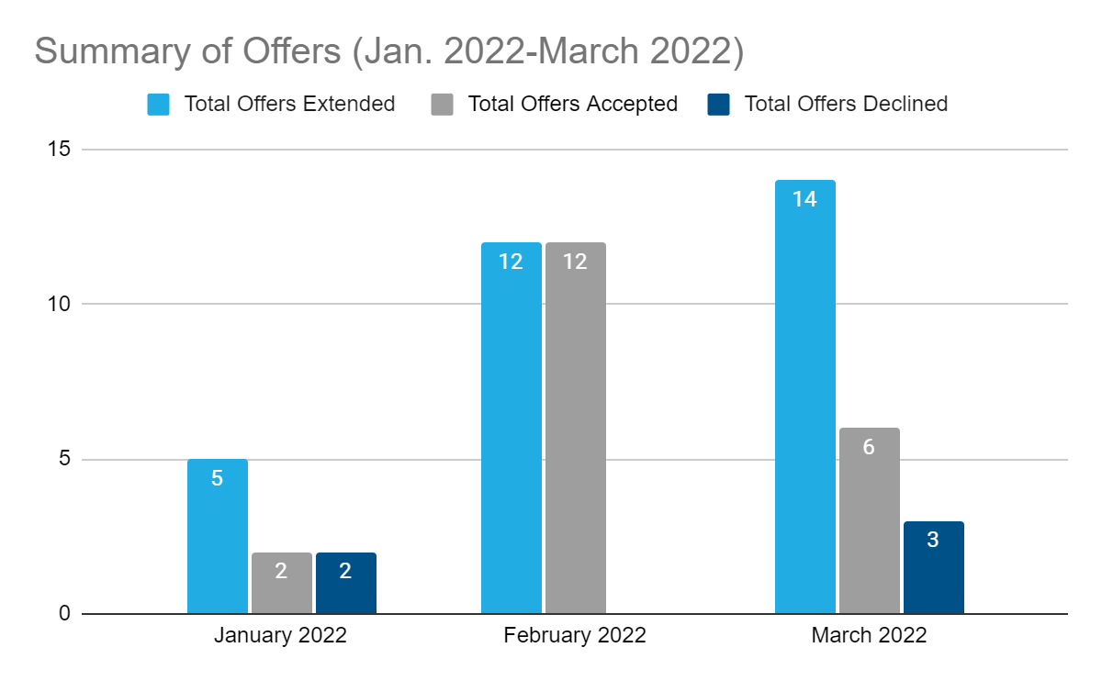
Summary of Offers (January 2022-March 2022)

Slide 16
Contact Us:
Talent Team
ldodson@mwacademy.org
spullman@mwacademy.org
jmendoza@mwacademy.org
Thank You!

