Slide 1
2022-23 LCAP Public Hearing
Presenter(s): Dr. E. Ward-Jackson and Ms. Micah Stilwell
Date: May 5, 2022
Notes:
Ward-Jackson

Slide 2
Table of
Contents
LCAP Context
22-23 LCAP Highlights and Revisions, Budget
Educational Partner Engagement
Discussion
Notes:
W-J

Slide 3
Framing the LCAP
The LCAP development process serves three distinct, but related functions:
Comprehensive Strategic Planning
Meaningful Engagement of Educational Partners
Accountability and Compliance
Development
Implementation
Adoption
Review and Approval
Notes:
(Borrowed this slide from CDE)

Slide 4
Overview of this year’s requirements
–2nd of 3-year LCAP cycle. Annual update is now folded into the main LCAP document.
–In addition to our state LCFF funding, the MWA LCAP incorporates our federal Title funds (folding the SPSA requirements into the LCAP).
–New direction from the state around the tracking and explanation of use of “contribution actions” to “increase and improve services for English Learner, foster youth, and low-income students.”
–The LCAP supplement presented in January is also submitted along with the main LCAP, as required.
–Today’s meeting is a public hearing, in which board members and general public can still give feedback. At the next board meeting (in June) the board will have the opportunity to vote to approve the 22-23 LCAP, which we must adopt by July 1.

Slide 5
3 year cycle
2020-21
Write new 3-year LCAP (2021-24), including desired outcomes for 2023-24
2023-24
2021-22 (now)
–Add in 23-24 Annual Updates
–Reflect on progress in 23-24
–Write new 3-year LCAP for 2024-27
–Add in 21-22 Annual Updates
–Reflect on progress in 21-22
–Make revisions for and submit 22-23 LCAP
2022-23
–Add in 22-23 Annual Updates
–Reflect on progress in 22-23
–Make revisions for and submit 23-24 LCAP

Slide 6
Guiding Question
What feedback, refinements, or questions do you have related to 22-23 LCAP? (goals, metrics, actions, or expenditures?)
Notes:
Framing question, which we will ask for the board to discuss, at the end of the presentation.

Slide 7
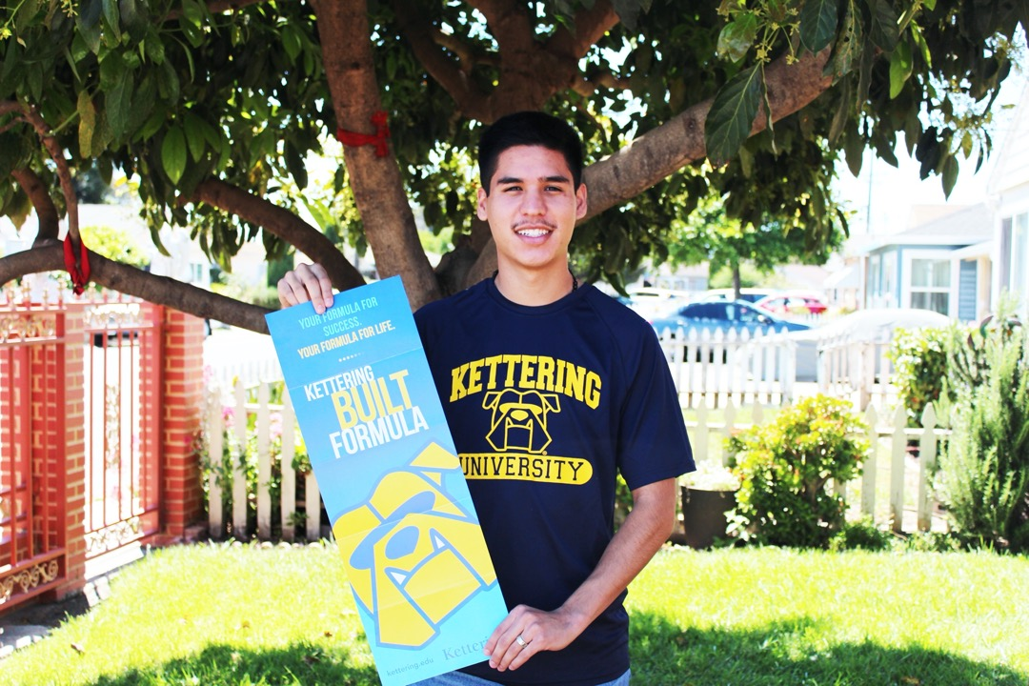
2022-23 LCAP Highlights and Revisions
Notes:
Ward-Jackson

Slide 8
Our 8 LCAP Goals continued to be are aligned with the 8 state priorities:
Priority 1: Basic Conditions
Priority 3:
Parent Involvement
Priority 4:
Pupil Achievement
Priority 2:
State
Standards
Priority 5:
Student Engagement
Priority 6
School Climate
Priority 7
Course Access
Priority 8
Other Pupil Outcomes

Slide 9
New Goal Language
Goal 1: Basic Conditions: Provide an effective infrastructure and systems to support basic conditions of learning (credentials, facilities, and instructional materials) to be met or exceeded.
Goal 2: Implementation of Academic Standards: Build teacher and leader capacity to effectively develop, implement, and refine vertically-aligned, standards-based learning for all students, including English Learners.
Goal 3: Family Partnerships: Promote, increase, and deepen participation in family engagement events and opportunities for parent and guardian engagement through intentional and mission-aligned opportunities for involvement and expanded avenues for family input on school decision-making.
Goal 4: Student Achievement for College and Career Readiness: Support student achievement across multiple measures so that each learner can make progress towards high school completion and have opportunities to demonstrate college and career readiness.
Notes:
This year we changed our goals to not just list the state priorities, but to articulate what we are trying to achieve in each of the 8 priorities. How our school interprets and responds to the 8 state priorities. So, use this as legend for understanding the metrics and actions in each goal. (Don’t read out each goal)

Slide 10
New Goal Language
Goal 5: Student Engagement: Support student engagement, increased student attendance, and retention of students at Making Waves Academy from 5th grade through high school graduation.
Goal 6: School Climate: Create a safe and inclusive environment of achievement and student success, informed through the lens of diversity, equity, and inclusion, to holistically support students and adults, and maintain a healthy school climate.
Goal 7: Course Access: In order to prepare all students for college and career, we will maintain and expand access to a broad course of study.
Goal 8: Academic Growth: Support all learners to enable growth in academic student outcomes.

Slide 11
Programmatic Revisions/Additions
Goal 1 | New metric to track teacher retention
Goal 2 | New metrics and actions related to teacher PD, including math PD, specifically (Actions 2.5 and 2.6)
Goal 3 | –Parent participation and planning opportunities (Action 3.1) –Reorganization of Parent Engagement efforts, under the new roles of Assistant Principals who will engage with parents for their respective grade-bands. (Action 3.2) –New communication tool Bloomz (Action 3.5) –Affirming our continued commitment to providing interpretation and translation (3.6)
Goal 4 | –New metric related to post-secondary planning, inclusive of multiple post-secondary paths –Integration of academy-wide scope and sequence for college and career readiness (action 4.4)
Goal 5 | –Integrating a PBIS (Positive Behavior Intervention and Supports) program into proactive attendance plan (Action 5.1) –Highlighting and further specifying the role of the SARB/SART process in improving attendance (Action 5.2) –Highlighting the work of the Student Activities Coordinator as another contributor to student engagement (Action 5.4)
Notes:
Here we are highlighting some of the more substantive changes made, to highlight new plans for next year, or in some cases to highlight current practices that were not as explicit or visible in previous LCAP. [Don’t read these line by line (they are in the packet), but are here to refer to as needed]

Slide 12
Programmatic Revisions/Additions
Goal 6 | –New metrics (social worker survey and holistic services referrals) –Plan to provide a new advisory curriculum (Action 6.2) –Implementing revised campus supervisory role, with increased number of supervisors (Action 6.6) –New behavior data system to track behavior incidents and PBIS supports (Action 6.7)
Goal 7 | –Create a plan to expand course offerings through a dual enrollment partnership with a post-secondary institution (Action 7.3)
Goal 8 | Added in a number of actions to more clearly delineate our tiered instructional approach: These new actions are not new practices at MWA, but ones that we plan to continue to refine and improve 8.1- Tier 1 instruction 8.2- Academic Interventions 8.3- Educational software 8.4- Assessment tools 8.5- Progress monitoring and data analysis 8.6- Extended learning. 8.7- Piloting a new reading intervention program in Special Education department
Notes:
Here we are highlighting some of the more substantive changes made, to highlight new plans for next year, or in some cases to highlight current practices that were not as explicit or visible in previous LCAP. [Don’t read these line by line (they are in the packet), but are here to refer to as needed]

Slide 13
Technical Changes (to support compliance)
Reorganized some goals (changed placement of some metrics and actions) to increase alignment with WASC organization
Revised some metrics (corrections to baseline data, made some more measurable, added some required metrics, adjusted desired outcomes based on previous board feedback)
Revised some actions to ensure they reflect current/planned practices.
More substantial discussion of “increased & improved services” requirements and how “contributing actions” were selected/designated.
[All changes are discussed in more detail in the “Goals Analysis” section for each goal]
Notes:
We also made a number of technical changes to the LCAP to ensure that we are in compliance with all LCAP requirements and correct some errors in previous LCAP. All changes are discussed in detail in the “Goals Analysis” section for each goal.

Slide 14
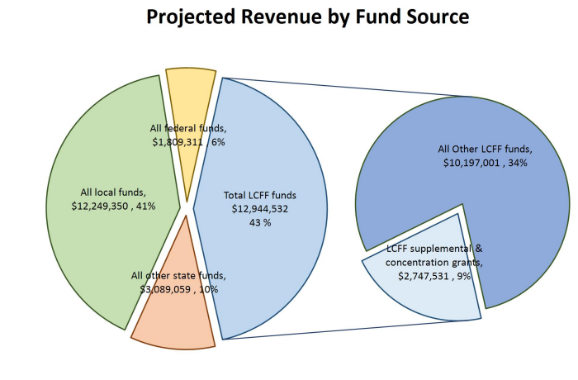
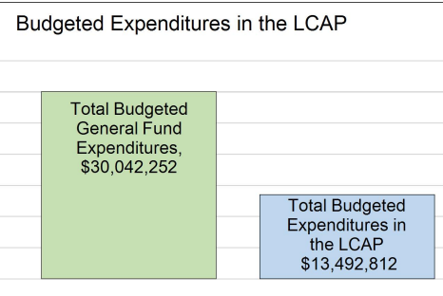
Budget Context

Slide 15
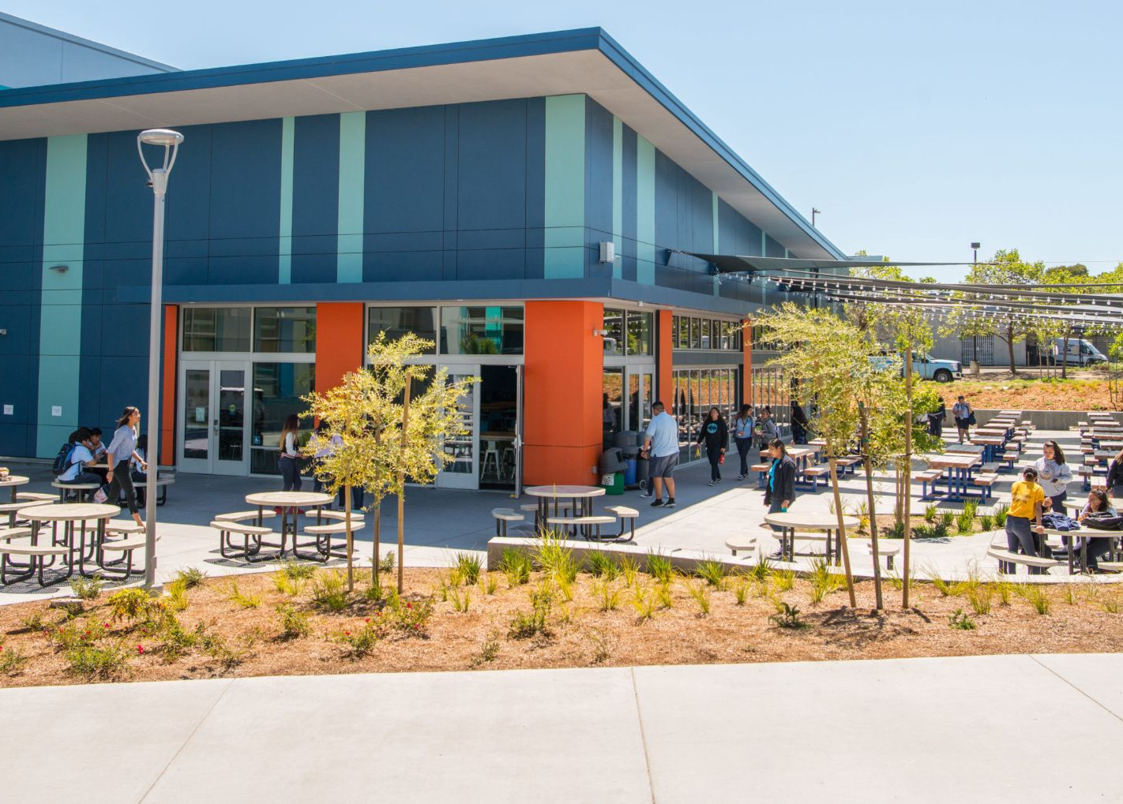
Educational Partner Feedback
Notes:
Ward-Jackson

Slide 16
LCAP Educational-Partner Engagement
Spring 2022
January 20
March 31
April 12
April 12
April 14
English Language Advisory (ELAC) LCAP Feedback Session
Black/African American Parent Advisory Committee Feedback
LCAP Mid-year updates and input at SSC
LCAP kick-off event sponsored by SSC (families, staff, students)
Faculty/Staff LCAP Feedback Session
Notes:
We had a variety of LCAP feedback events to get feedback and input on our LCAP.

Slide 17
Multiple inputs from educational partners throughout the year
Board listening sessions
Consultations
Focus group discussions with different staff groupings
Consultation with SELPA, trainings and resources from state and county
Funding- feedback sessions
Pulse Check Surveys
Sessions related to ESSER III and other new funding sources to gather feedback on how to prioritize funds
Brief family and staff surveys to get input on successes, challenges, and priorities of the year
Needs Assessment
LCAP Feedback Events
LCAP Working Group Needs Assessment looking at disaggregated data for different student groups
Official LCAP feedback events with different groups of educational partners
Notes:
In addition to the “official” LCAP feedback events, we have engaged with educational partners throughout the year and the priorities and ideas they have shared with us, heavily influenced our initial draft of the LCAP and many of the new actions and metrics in it.

Slide 18
Educational Partner feedback areas | LCAP Actions written or revised in response to this feedback
Support teacher recruitment and credentialing | Action 1.4 (Teacher residents and teacher induction)
Enhance teacher coaching and PD | Actions 2.5 (Instructional Coaching and PD) and 2.6 (Math PD and Coaching)
Increase opportunities for family participation, input, and engagement | Actions 3.1 (Participation opportunities), 3.2 (Family engagement), 3.4 (Parent leadership), 3.5 (Communication tool), 3.6 (Translation).
Expose students to various college and career paths, starting in middle school | Action 4.4 (Post-secondary planning)
Provide additional opportunities for clubs and activities, including in middle school | Action 5.4 (Student activities coordinator)
Use student incentives and other motivators to increase engagement | Action 5.1 (Attendance) and 6.7 (Behavior Data System)
Provide advisory curriculum | Action 6.2 (Advisory curriculum)
Focus on student safety | Action 6.6 (Campus Supervisors)
Increase course offerings | Action 7.3 (Expand course offerings)
Challenges with Marlin Hour/DTI | Action 8.2 (Academic interventions)
Notes:
Summary of educational partner feedback and how we are responding to it. (Don’t read these individually, just talk about overall process, etc)

Slide 19
Next Steps
–LCAP Working Group will review board/public hearing feedback and make revisions as needed
–Re-present LCAP to the board (with any needed revisions) and ask the board to take action (vote to approve) June 16, 2022
–Submit board-approved LCAP to county authorizer and post final version to website before July 1, 2022

Slide 20
Questions and Discussion
Notes:
Ward-Jackson

Slide 21
Guiding Question
What feedback, refinements, or questions do you have related to 22-23 LCAP? (goals, metrics, actions, or expenditures?)
Notes:
Framing question, which we will ask for the board to discuss, at the end of the presentation. Remind that we can still revise, based on their feedback, and the final, final version will be presented in June for their vote.

Slide 22
Thank You!

