Slide 1
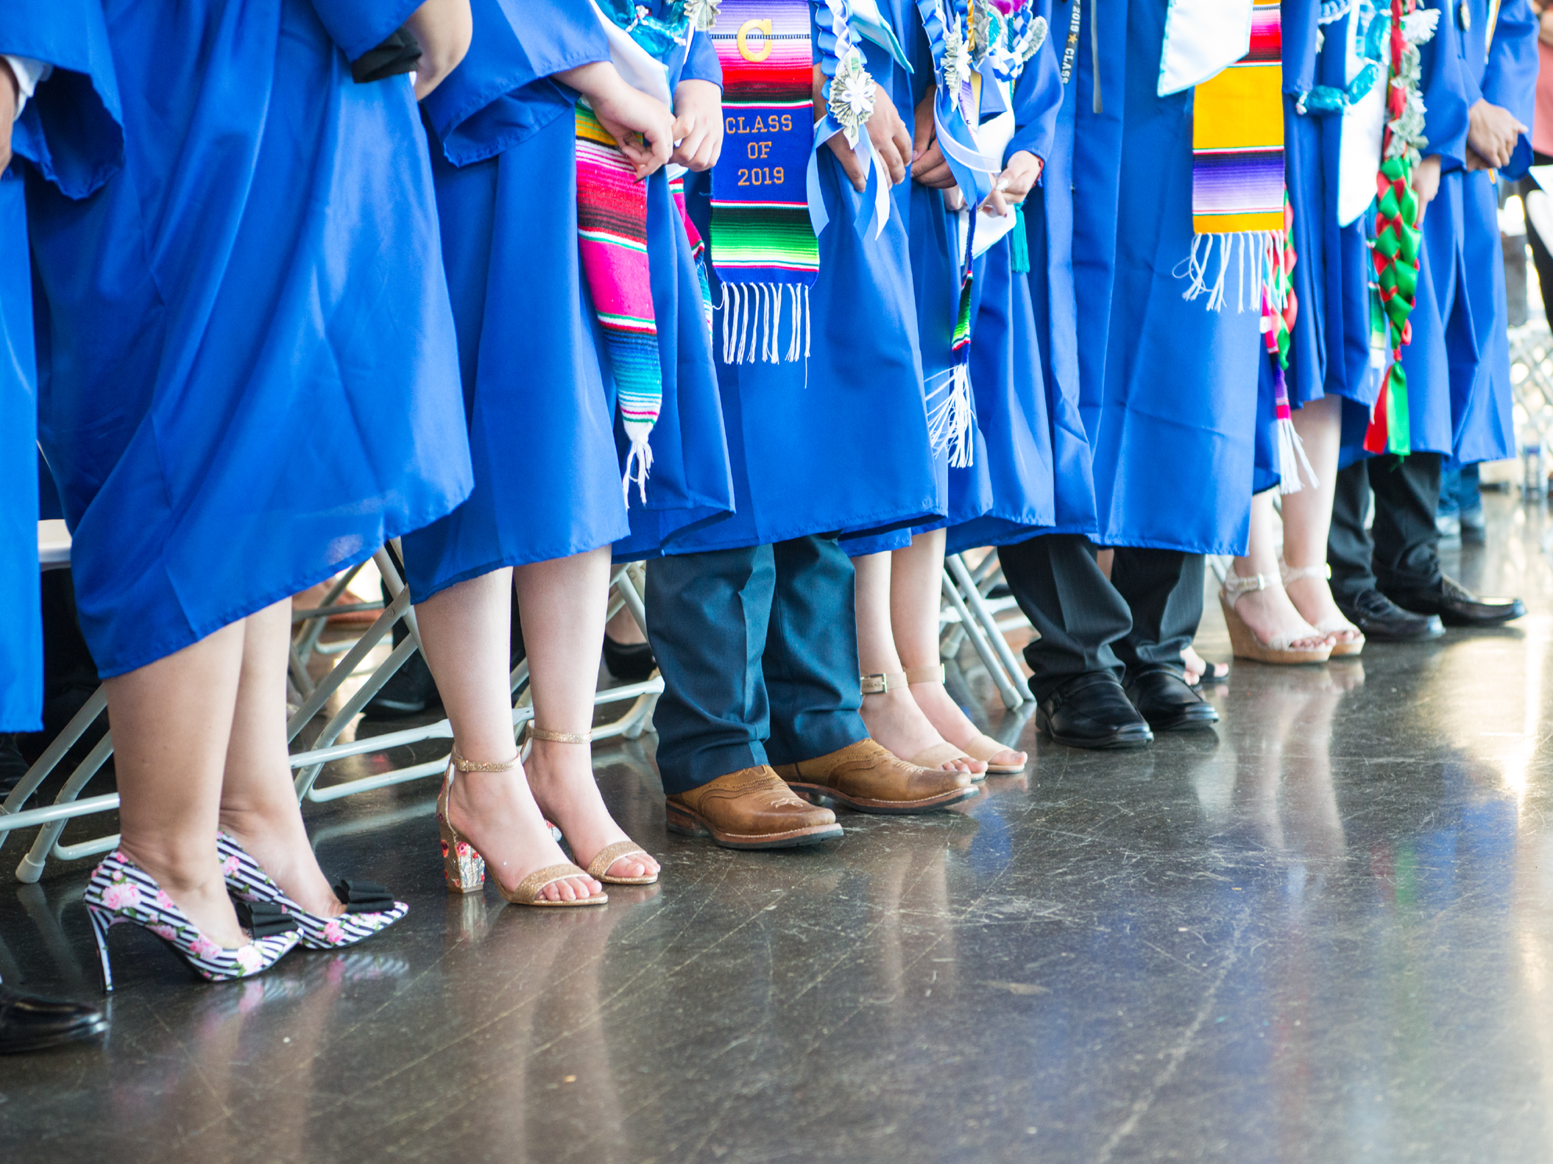
ASB Board Report - May 2022
ASB Members May 5, 2022

Slide 2
Successes
Challenges
Priorities
Questions & Conversation
Table of
Contents

Slide 3
Successes

Slide 4
Successes
Spirit Week
Student advocacy/voice
Meeting directly and communicating professionally with school leadership
Building community
Advisors and Student Coordinators
Announcements
Elections/Campaigning are starting

Slide 5
Challenges

Slide 6
Challenges
Lack of communication
Pep rally and spirit week
Bureaucratic obstacles that don’t center student experience
Big ask for student flexibility and no flexibility in return from school leaders
Not having an effective Master Calendar
Testing
Rough transition for advisors and students activities coordinator
Acclimating to in-person planning
Transition from online to in-person event planning
Cancelling Student Pep Rally
Long checklist of demands of requirements not previously needed to plan a pep rally in past event
9th and 10th graders not understanding ASB due to lack of in-person events

Slide 7
Priorities

Slide 8
Priorities
ASB Elections
Senior Send Off
ASB Transition of Power
Setting Master Calendar with Spirit Week, Pep Rallies, and ASB events

Slide 9
Questions & Conversation

