Slide 1
CIRAC - Academic Instruction

Slide 2
Table of
Contents
Instruction at MWA
Current Curriculum and Textbooks
Recommendations and Rationale

Slide 3
Prioritization of Instructional Support
Essential Question: Based on your understanding of the current climate in education, how do you recommend we “stress test” our systems to assess our instructional support priorities next year?
53% (34/63) of our faculty are either new teachers or new to MWA
Consistent faculty feedback include a request for increased classroom observation/support and intentional professional development
High quality instruction is the best tool for classroom management

Slide 4
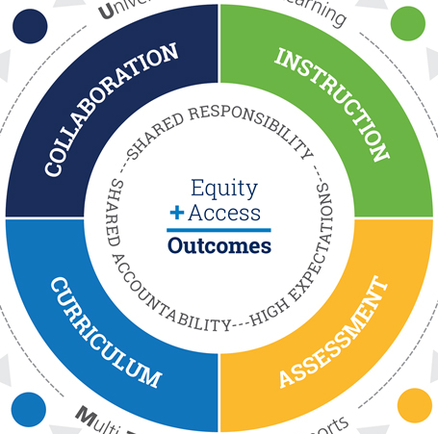
Back to the Basics
Instruction: Increase classroom observations and new teacher support (lesson planning and delivery)
Assessment: Reinforce the teaching and learning cycle
Curriculum: Develop a rubric to evaluate curriculum for rigorous instruction, cultural relevance, and student outcomes
Collaboration: Deepen partnership between faculty and holistic services to maximize universal goal of high-levels of learning for all students

Slide 5
Curriculum + Textbooks
Discussion Question: As we look to pilot new curriculum for next year in US math and 5th grade social science classes, what best practices should we keep in mind to guide both the selection and implementation processes?
Current Curriculum + Textbooks for AY21/22
Increase fidelity of middle school implementation of social studies curriculum (Discovery Education)
Explore curricular options to update 5th grade science curriculum based on NGSS
Develop rubric to evaluate current and future curriculum for academic rigor, cultural relevance, and student outcomes

Slide 6
Curriculum + Textbooks
Discussion Question: As we look to pilot new curriculum for next year in US math and 5th grade social science classes, what best practices should we keep in mind to guide both the selection and implementation processes?
Curriculum + Textbook Recommendations for AY22/23
Pilot 5th Grade Social Studies
Pilot Upper School Math Curriculum
Purchase Upper School Psychology Textbook
Purchase Upper School Spanish Textbooks
Planning Ethics Studies

Slide 7
Social Studies: 5th Grade Pilot
Rationale:
LCAP for AY21-22 indicated new Social Science curriculum for Middle School, grades 6-8 adopted Discovery Education; 5th grade curriculum requires an official update. A collaborative selection process will give faculty an opportunity to evaluate current curriculum, select to use an updated version of current curriculum or choose a new curriculum (all approved by CDE), and increase staff buy-in.
Teachers’ Curriculum Institute (TCI) - Social Studies Alive! California Series (currently in use)
Pearson Scott Foresman and Prentice Hall - California History-Social Science: myWorld Interactive
McGraw-Hill School Education - Impact: California Social Studies

Slide 8
Math: Upper School Pilot
Rationale: Implementation of the board approved (spring 2021) pilot for a new upper school math curriculum.
Recommend Curriculum for Pilot (spring 2021)
Carnegie Learning -Standards-aligned -Meets Expectations (EdReports) -Offers digital and print resources | Open Up Resources -Standards-aligned -Meets Expectations (EdReports) -Offers continuity from grades 6-11 -Offers digital and print resources
Updated ASK for Pilot
Pilot Carnegie Learning OR Open Up Resources during AY2022-23 Purchase professional development for math curriculum for summer 2022

Slide 9
Ethnic Studies: Planning
Recruit Planning Committee
Use CA framework and AB101 for launch
Gather Educational Partner Input
Parents/ guardians, students, staff + draft proposal CRC meeting
Finalize
Finalize framework and curriculum adoption by Spring CRC
Spring
2022
Fall 2022
Spring 2023
Summer
2022
Winter
2023
2022
Planning
Develop a plan to acquire and incorporate input
Seek A-G Approval
Internal Review & UC CMP Submission

Slide 10
Prioritization of Instructional Support
Essential Question: Based on your understanding of the current climate in education, how do you recommend we “stress test” our systems to assess our instructional support priorities next year?
Key Performance Indicators
Completion of observation/ debrief cycles - 100% of staff observed on a monthly basis
Stabilization (or improvement) of staff intent to return survey (compare to 2021-22)
Higher performance on math and reading growth assessments, MAP & STAR (compare to 2021-22)

Slide 11
Thank you.

