Slide 1
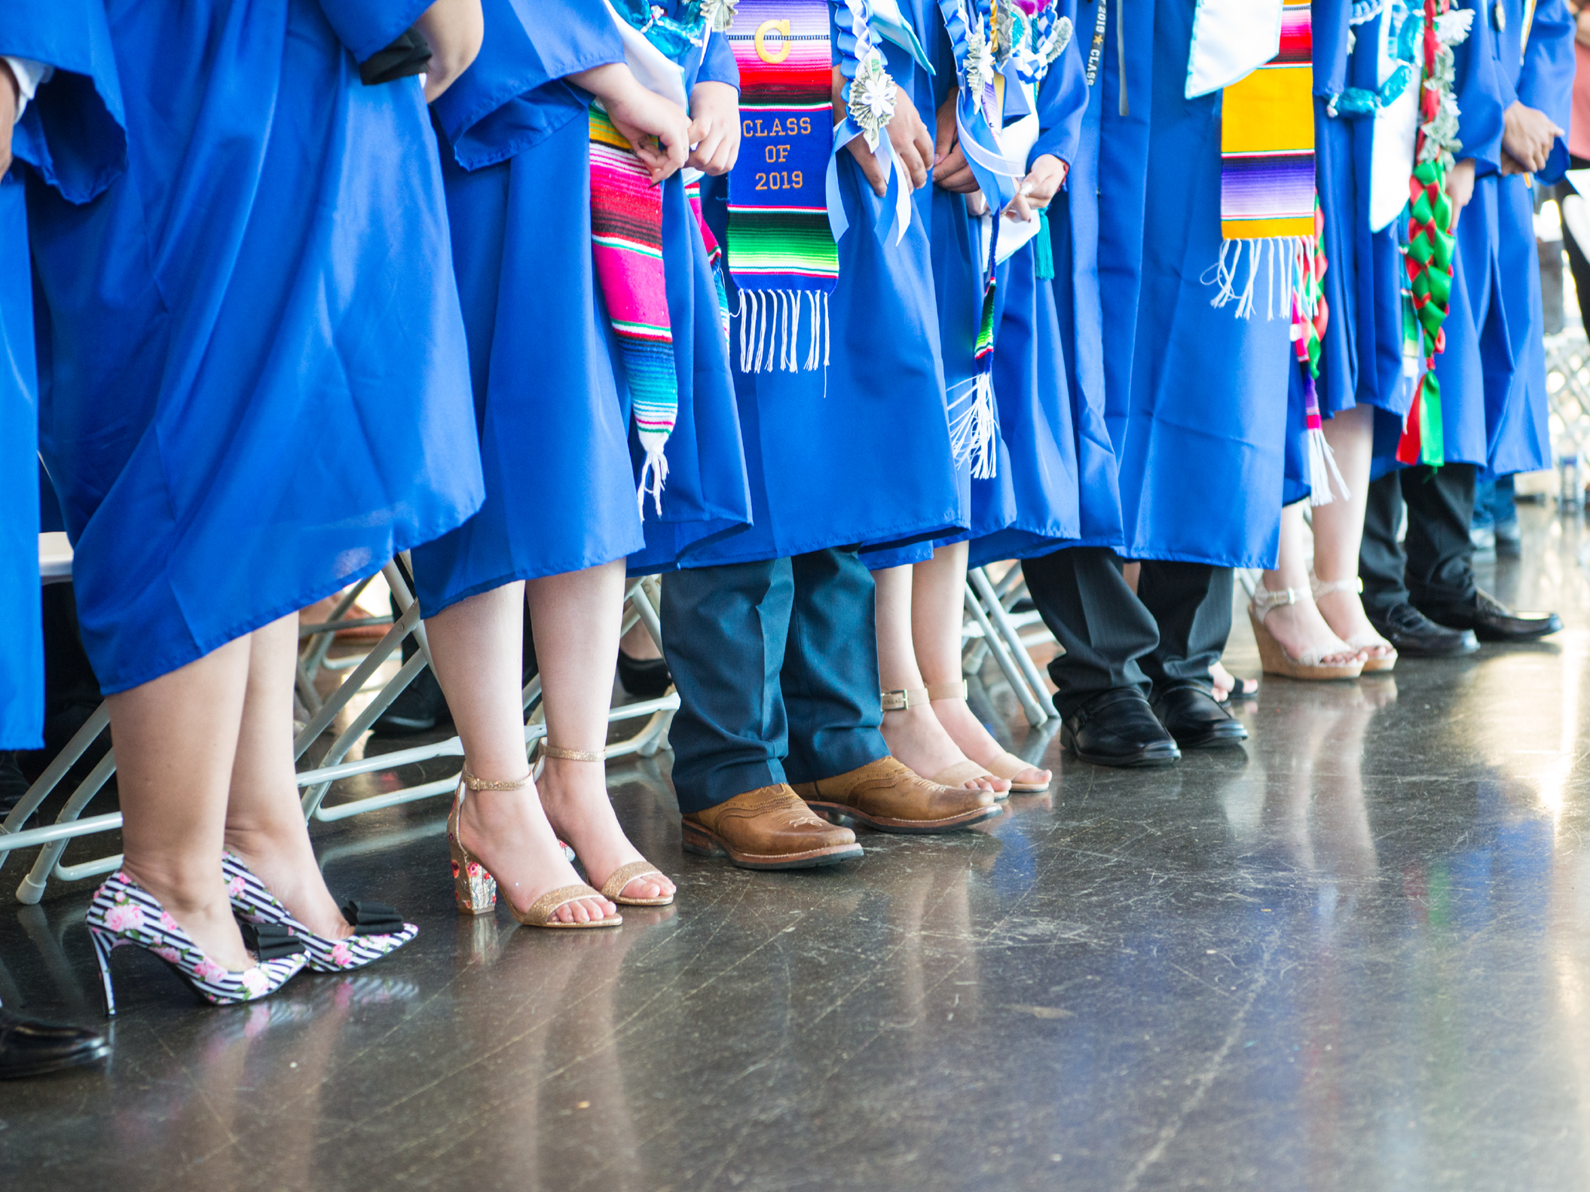
ASB Board Report - March 2022
ASB Members March 10th, 2022

Slide 2
Successes
Challenges
Priorities
Questions & Conversation
Table of
Contents

Slide 3
Successes

Slide 4
Successes
ASB Was A Part Of The Interview Process For A New Advisor
We now have 2 co-advisors
Clubs/Student Led Activities
Students are trying to make the best of the situation/ perseverance
Notes:
budget????

Slide 5
Challenges

Slide 6
Challenges
Adjusting To No ASB Advisor
Communication
Unclear consensus on Senior activities
Graduation, Grad Night, 100 Days until Graduation
Lack of funding ($400 Grad Night)
COVID-19 Updates
Concern for Student Safety
Transparency on all issues against student and teacher safety
Student Behavior
No structured disciplinary measure to set expectations for student
Inappropriate and disruptive behavior is normalized
Notes:
lack of funding

Slide 7
Priorities

Slide 8
Priorities
Spring Spirit Week & Outdoor Pep Rally
First Pep Rally In 2 Years
Staff Retention
Community Building
Spring Festival
Senior Activities
ASB Elections
Notes:
lack of funding

Slide 9
Questions & Conversation

