Slide 1
Curriculum Review Committee Update
December 10, 2021 Meeting – October 2021
Fall Semester Review Presented by Alicia Mallet Klein and Esther Hugo

Slide 2
Curriculum Review Committee Presentation Overview
Committee Members
Leadership Priorities
Staffing Issues
COVID-impacts on Curriculum and Campus Return
College and Career Update
Robot – Use of AI to respond to College & Career Issues - demo

Slide 3
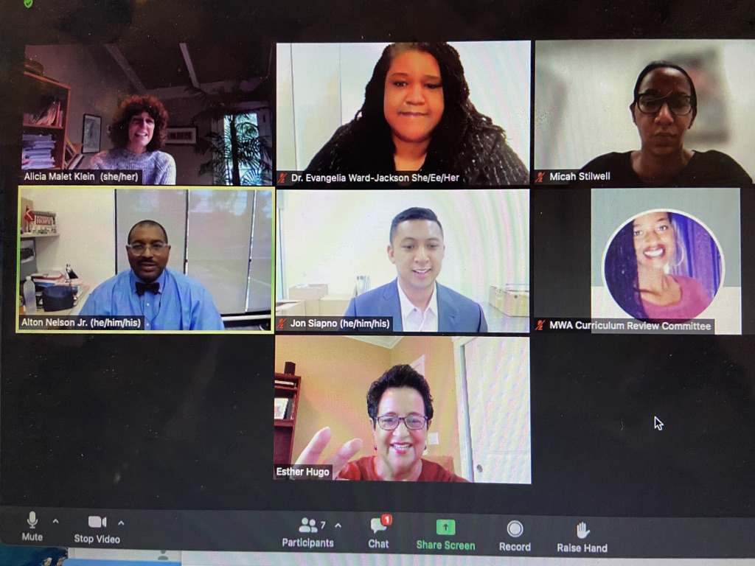
The CRC Team

Slide 4
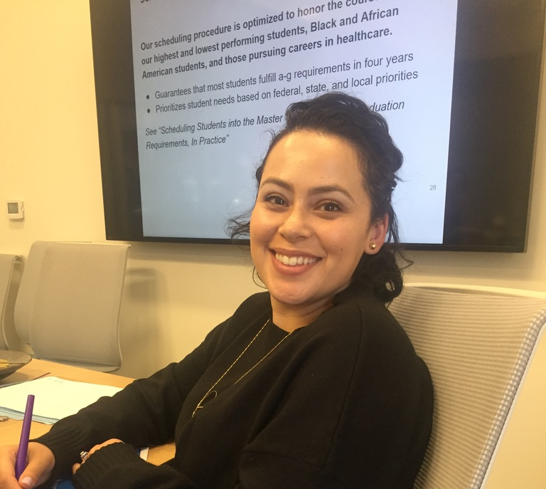
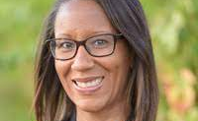
CRC Members

Slide 5
CEO Mr. Nelson Sets Tone and Focus

Slide 6
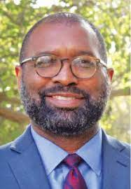
Context and Information: Climate and Culture Update
8th Year of CRC Committee!
Dialogue encouraged
COVID impact and physical plant changes
Current population – majority new to campus.
Middle School – half new students

Slide 7
Staffing is Challenging
Year started with 11 vacancies
In October, 10 vacancies; 8 onsite subs
Instructional leaders provide classroom coverage – and still need support.
Academic Instruction Team and Senior leaders covering daily absences.
Notes:
Staff asked to cover faculty vacancies
primary role
Desire to provide high-quality support for students.

Slide 8
Pivots and Responses
Multiple modes of communication
Using Slack, - group text and portals
Model accountability for real-time errors
Culture and climate Reboot
Prioritize PD Fridays
Alternate substitute coverage
PD Sessions for on-site Substitute team

Slide 9
College and Career Update : Overview
What’s Next in College Readiness
AB 104 Legislation
Expanding the Curriculum
19th Wave Preview
ROBOT Demonstration

Slide 10
AB 104 – California Legislation
Allows high school graduation flexibility in state requirements
Students able to opt for ”Credit” instead of a grade
Might impact Cal Grant, which is dependent on GPA
Consideration: How will colleges view the transcript?

Slide 11
Curriculum Expansion through Community Colleges

Slide 12
Community College - Dual Enrollment Benefits
Exposure to College
Community-Building
Academic Advancement
No additional staffing needed

Slide 13
More Curricular Options
Use of UC Scout for missing A-G and AP classes
Codesters – CISCO coding program
Follows students through graduation
CTE Pathway
Students can earn a certification and
a six-figure job

Slide 14
Pandemic Impact: Testing Optional, Yes or No?
ACT/SAT/PSAT
Cultural and experiential impacts of not taking the test
Testing as a Tool to build Aspiration
Value in taking the PSAT

Slide 15
PSAT Values for Wave-Makers
Exposure to college testing
Gives colleges exposure to students
AP Potential
National Merit Scholarship eligibility
Student Search
Rich Data about our instructional program

Slide 16
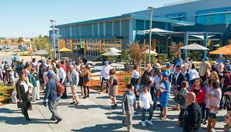
19th Wave Preview: Having the Best Year?
Challenging Wave – known as “high crisis”
Class experienced:
Most teacher turnovers
High trauma
Highest percentage of SPEDS
Most homeless students

Slide 17
19th Wave Transformation
Students enjoying ”structure” of returning to campus
Students with multiple F’s are now earning straight A’s
70% of 19th Wave are CSU and/or 4-year College Eligible

Slide 18
The ROBOT offers more “inclusive” approach
Five modernization efforts to reach students
Effective mass-communication tool
Online appointment system
Artificial Intelligence Chatbot

Slide 19
ROBOT Uses
390 unique users to the Website
Information goes direction to student
Available for 8th graders to learn about high school
Helps parents and students get connected
Question bank is limitless – we can design, create and customize it

Slide 20
Creating an aspirational culture by explaining options, giving information, providing guidance

Slide 21
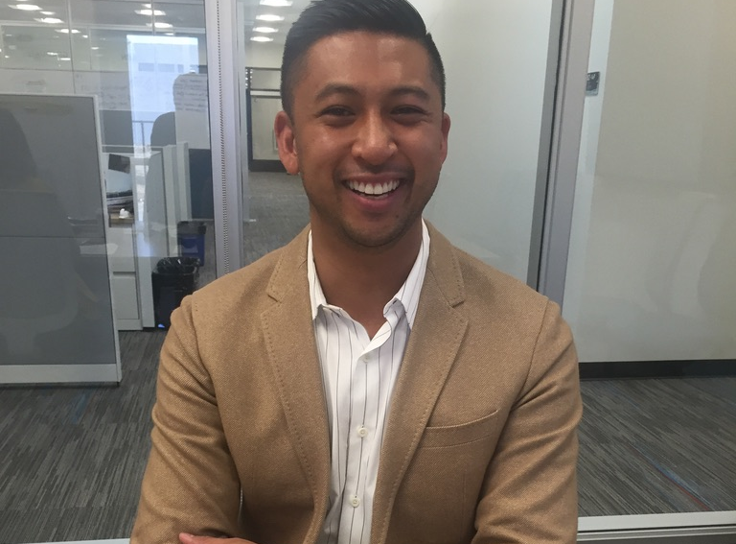
Robot Demonstration -Mr. Siapno, Director, College and Career Counseling

Slide 22
Questions, Feedback, and Comments

