Slide 1
ELD Deep Dive
Aurelio Garcia
Thursday, December 9, 2021

Slide 2
ELD Programming
Reclassification and ELPAC
ELAC
Board Member Feedback
Table of
Contents

Slide 3
ELD Programming

Slide 4
English Language Development (ELD) Overview
School Wide Objectives
Aligned with Intervention Services All English Learners (EL) students are enrolled in our ELD program Provide ELD instructional support for faculty Case manage English Learners (EL) Facilitate ELAC meetings Oversee state ELPAC testing and EL Parent Outreach Work with various education partners to achieve positive EL student outcomes Reclassification!
“I joined ELAC to understand and be aware of families that share the experience of their child reclassifying and to work together to help the school, community and the teachers ”
“Having the privilege of being bilingual opens many doors”

Slide 5
ELD Enrollment Data
English Learners at Making Waves
ELs are 28% of the student body
33% of students at MS are ELs
21% of students at US are ELs
9% of ELs are SPED students
84% of ELs are LTELs*
49% of students at MWA are RFEP*
*LTEL- Long Term English Learners: 5 years as EL
*RFEP- Reclassified (Fluent English Proficient )
Grade | ELD Students
5th | 57
6th | 60
7th | 51
8th | 47
9th | 52
10th | 23
11th | 19
12th | 5
School | Total ELD students
Middle School | 215
Upper School | 99
Total | 314

Slide 6
Reclassification and ELPAC

Slide 7
Reclassification
Reclassification: The process through which students who have been identified as English Learners are reclassified to Fluent English Proficient (RFEP) after meeting various linguistics and academic criteria set by the state and district.

Slide 8
Reclassification Criteria
ELD Reclassification 21-22
California Requirements | Acceptable Standard
English proficiency demonstrated on the ELPAC in Listening, Speaking, Reading, and Writing | ELPAC: Overall Proficiency Level (OPL) of Level 4 with at least two subset levels of 3 or 4 and domain performances at level 2 or 3
2. Basic Skills - Demonstrates average proficiency on the ELA SBAC or ICA or Demonstrates proficiency on STAR Reading | ELA Standardized Tests: Performance Level of 3 or higher STAR Reading: Performing within one bandwidth of grade level; equivalent to average of native speakers
3. Teacher Recommendation | Teacher may use student work such as writing samples or GPA to support their recommendation.
4. Parent Consent | After above requirements are met, Parent/Guardian is consulted and given an opportunity to provide input regarding programs to further increase prospects for academic achievement
*Reclassification SPED Criteria -
If the SPED student does not meet the criteria, the IEP team determines that the primary reason the student does not meet reclassification criteria is due to the disability rather than limited English proficiency.

Slide 9
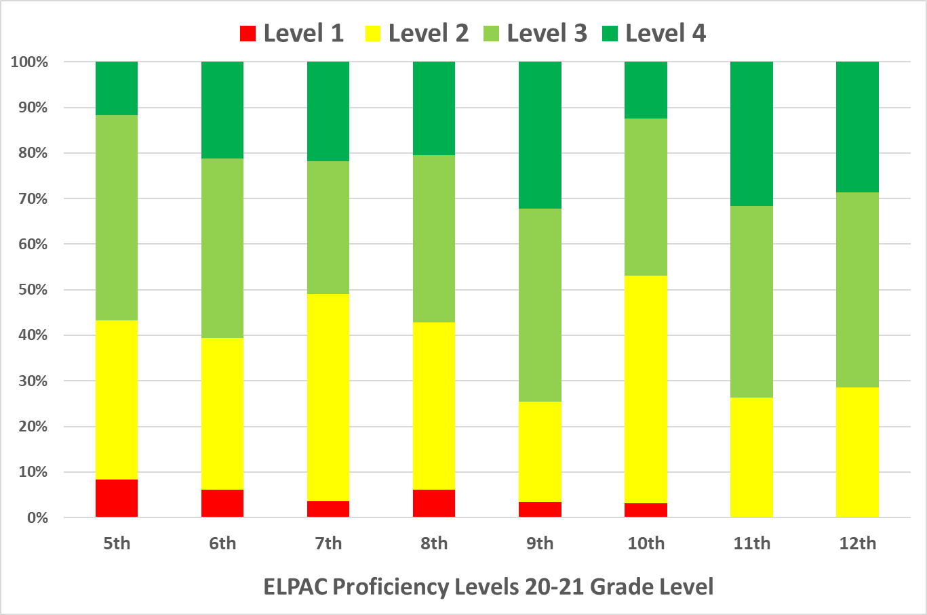
ELPAC Overall Scores 20-21

Slide 10
ELPAC Deep Dive
Students Identified for Reclassification
Division | Total ELD students
Middle School | 24
Upper School | 9
Total | 33
Overall, 24% of our students scored a Proficiency Level of 4 (which is needed to Reclassify).
This is an impressive jump in comparison to 2018-2019! 14.9% MWA and 16.4% statewide K-12 in 2018-2019.
97% (282/289) of all ELs at MWA completed the remote Summative ELPAC in 20-21.
33 students have been identified to reclassify!

Slide 11
ELAC

Slide 12
English Learners Advisory Committee (ELAC)
ELAC has continued to strongly serve our parents and community.
Parent engagement is high.
Focus on the following:
Advising and recommendations for our EL Master Plan and School Site
School Needs Assessments
Attendance updates
Meetings held usually First Tuesday 6pm of the month.

Slide 13
Discussion Prompts
How can we continue to keep a sense of urgency in
our support of English Learners?
What additional factors must we consider to make sure our English Learners are given the appropriate support towards reclassification and beyond?

Slide 14
Contact Information
Aurelio Garcia
agarcia@mwacademy.org
(510) 262-1511

