Slide 1
SBAC Deep Dive
Presenter(s): Micah Stilwell and Molly Moloney
Date: October 14, 2021

Slide 2
Table of
Contents
Administering the SBAC virtually
2.Special Considerations
3. SBAC Results
4. Response to Data

Slide 3
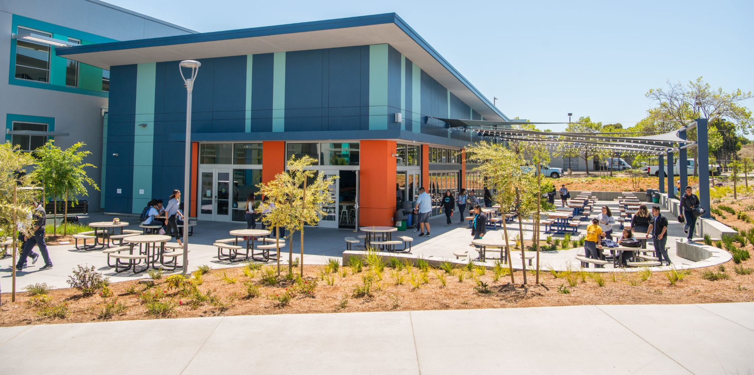
Administering the CAASPP Virtually

Slide 4
Virtual SBAC Testing Hub
Virtual Testing: Quick Facts
Completion Goal Submission Goal
95% 4,948
Total Completed Percentage Completed
4,714 96%
Total Not Complete Percentage Not Completed
220 4%
Notes:
What it was like testing virtually for the first time ever

Slide 5
Special Considerations

Slide 6
No “Apples to Apples” comparisons to previous years
New “adjusted” (shorter) testing blueprint
Measured the same content/claims, but with fewer questions (CAT portion of SBAC was cut in half; the Performance Task was still full-length).
We do not get “claims” data (for sub-areas) for individual students (and aggregate claims data is not yet released).
SBAC was administered virtually.
Students tested from home in varying testing conditions.
So, comparisons to previous years’ data should be approached with caution.

Slide 7
Limited ability to make comparisons to state or other schools/districts
SBAC was made optional in 20-21 if districts deemed it not “viable”
most local districts and charters did not take SBAC (instead used “locally determined” assessments)
The state has not yet released final public data
no access to any state-wide or other school/district data yet
So, we can not yet make ANY direct comparisons of 2020-21 results, and we will remain limited on this front even when final/public results are released.

Slide 8
A new launching pad?
This 20-21 data is like our new launching pad-- it gives us insight into students’ academic levels and unfinished learning, after over a year of the pandemic and distance learning. It is data from which we can launch future growth.
The data will allow us to explore opportunities for growth.

Slide 9
SBAC
Results- ELA

Slide 10
39%
Percent Proficient (level 3 or 4) on ELA SBAC 20-21

Slide 11
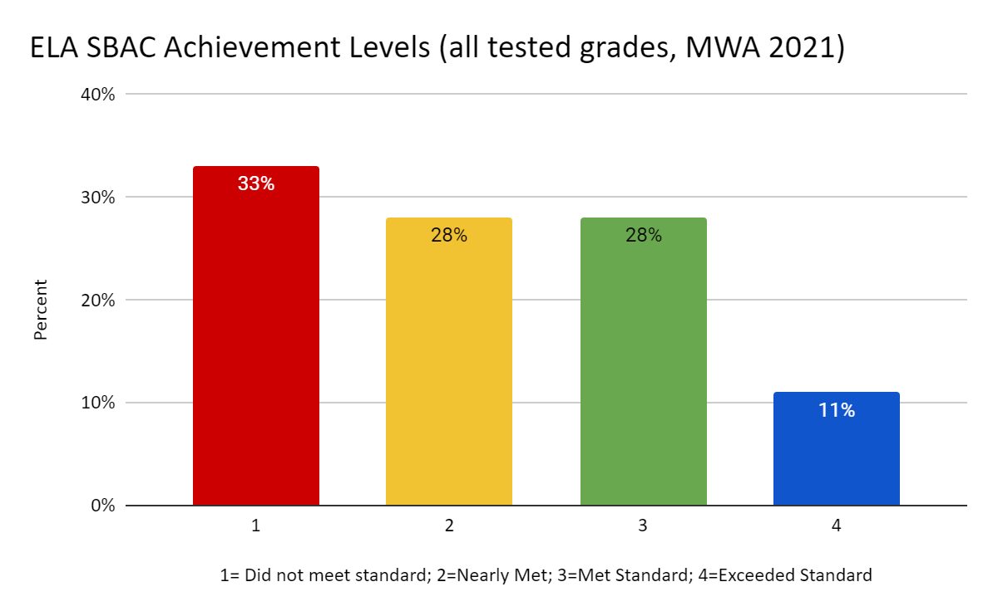

Slide 12
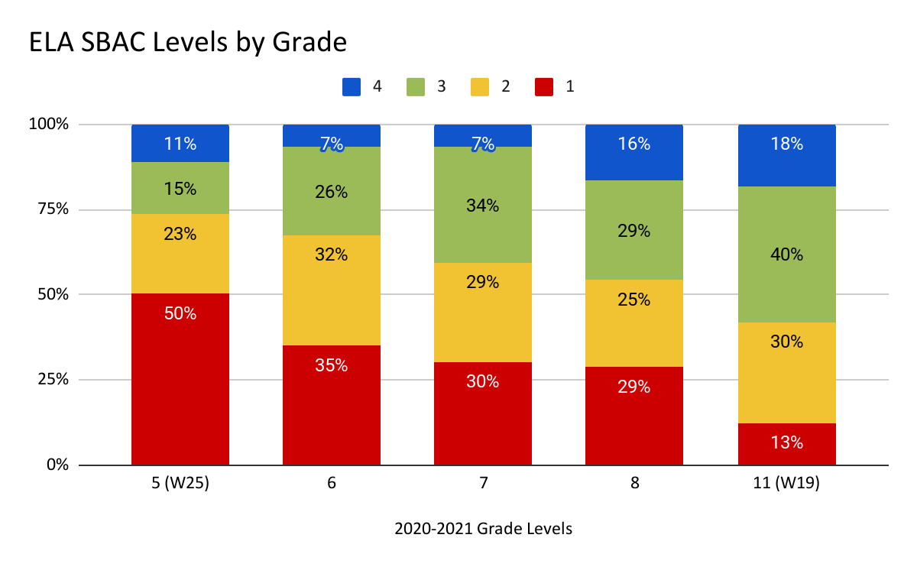

Slide 13
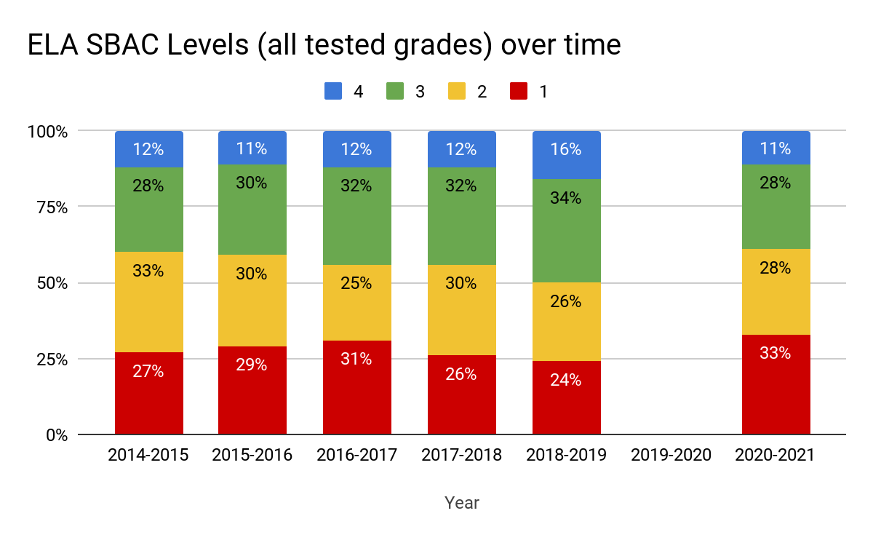

Slide 14
SBAC ELA by Subgroup (MWA, all tested grades)
SBAC ELA by Subgroups | Did Not Meet Standard (Level 1) | Nearly Met Standard (Level 2) | Met Standard (Level 3) | Exceeded Standard (Level 4)
All students | 35% | 27% | 27% | 11%
Black/African American | 35% | 32% | 27% | 7%
Latinx | 34% | 28% | 27% | 10%
English Learners | 64% | 24% | 11% | 1%
Students with Disabilities (IEP) | 80% | 18% | 2% | 0%

Slide 15
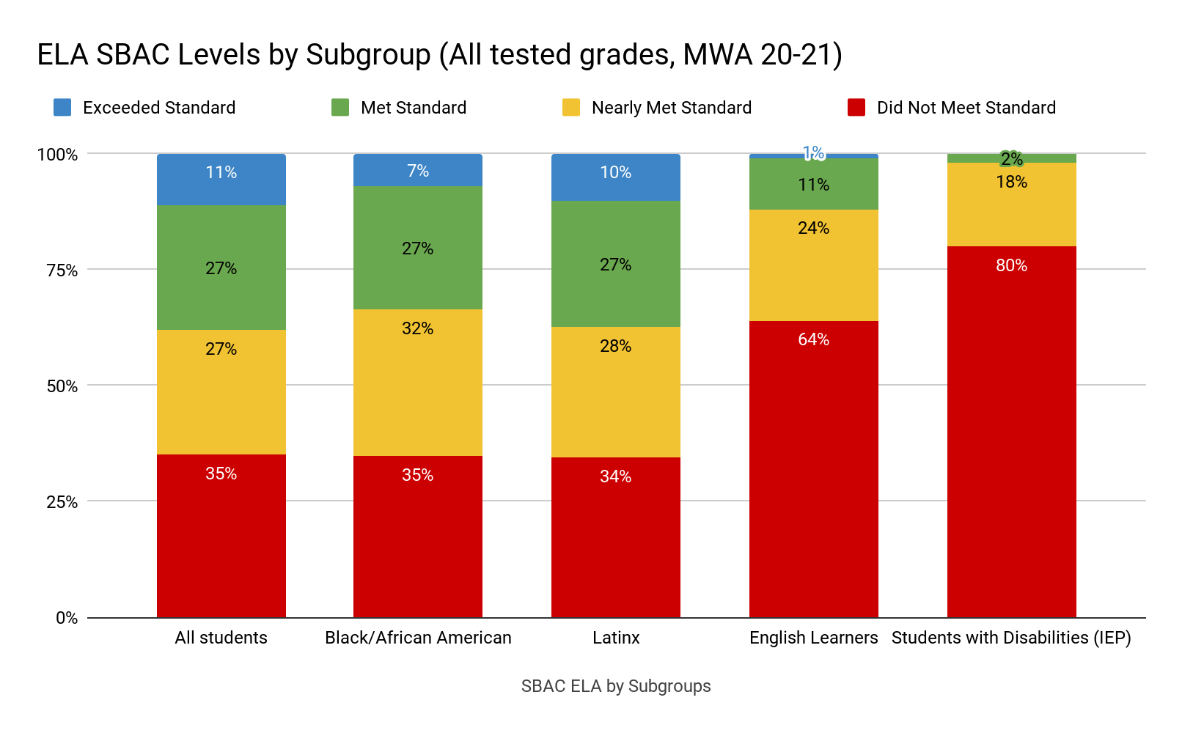

Slide 16
SBAC
Results- Math

Slide 17
16%
Percent Proficient (level 3 or 4) on Math SBAC 20-21

Slide 18
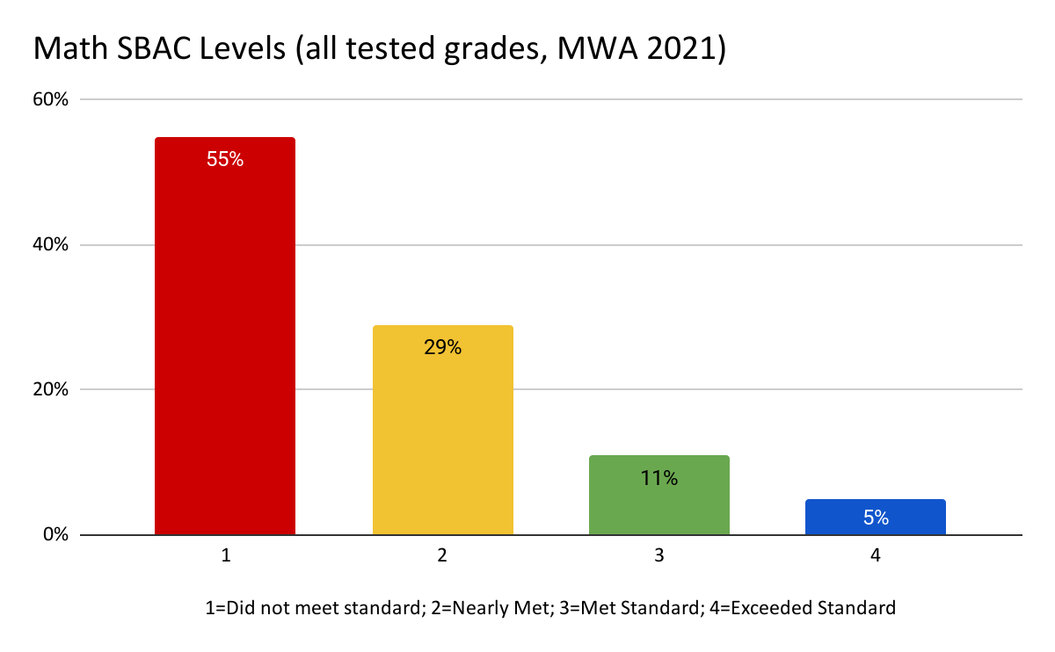

Slide 19
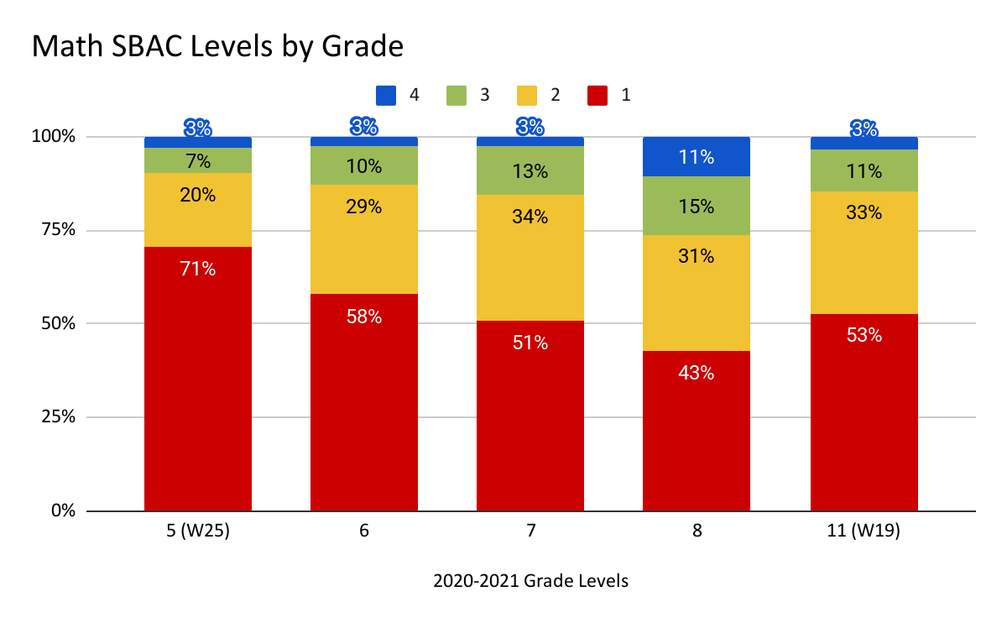

Slide 20
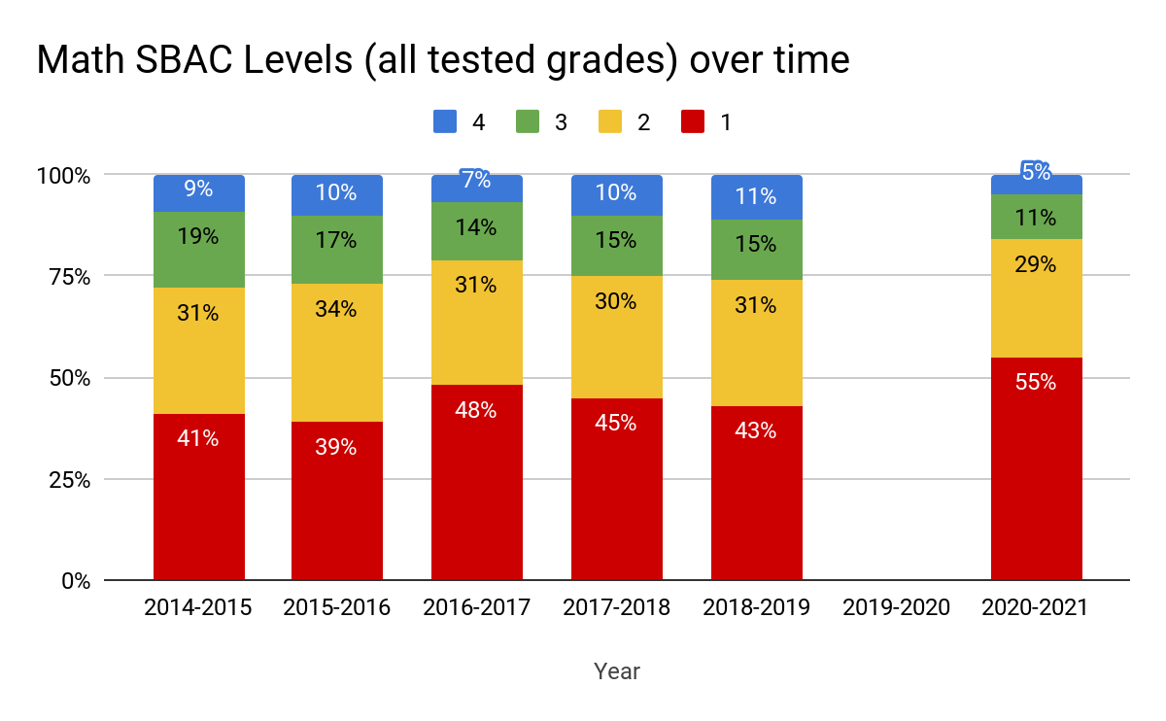

Slide 21
SBAC Math by Subgroup (MWA, all tested grades)
SBAC Math by Subgroups | Did Not Meet Standard (Level 1) | Nearly Met Standard (Level 2) | Met Standard (Level 3) | Exceeded Standard (Level 4)
All students | 56% | 28% | 11% | 5%
Black/African American | 62% | 21% | 12% | 5%
Latinx | 55% | 30% | 11% | 4%
English Learners | 80% | 18% | 2% | 1%
Students with Disabilities (IEP) | 83% | 17% | 0% | 0%

Slide 22
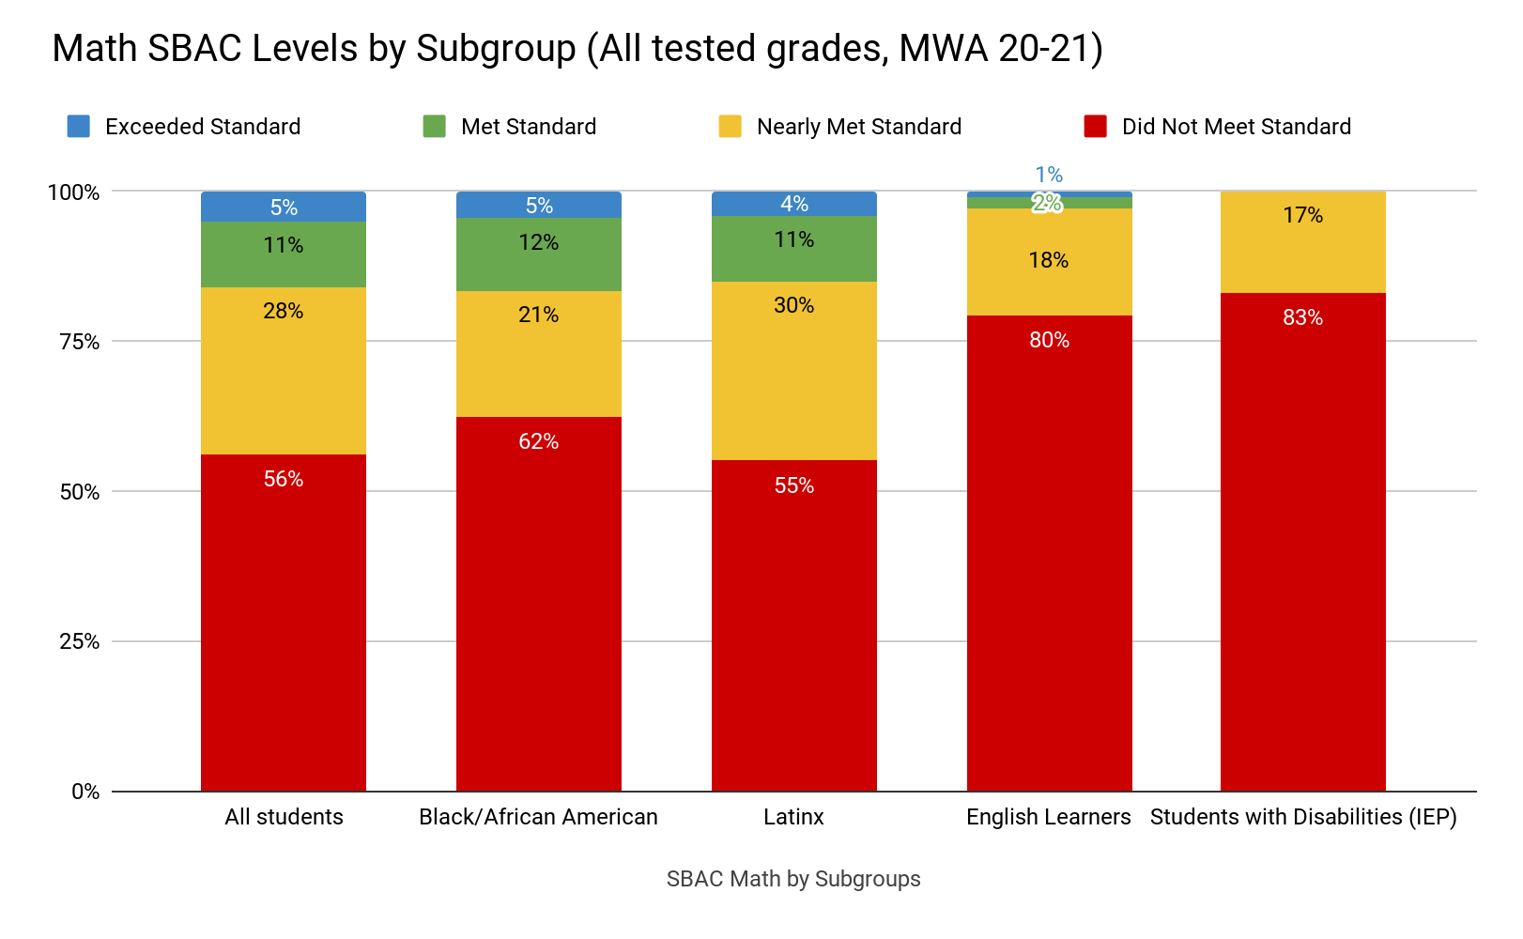

Slide 23
CAST
Results- Science

Slide 24
Special Considerations (CAST/Science)
The first official year of CAST with results was 2018-2019. Students did not take the CAST in 2019-2020 due to COVID closures. Statewide data for 2020-2021 will be released in the fall (for the school that did administer the CAST, which is not all schools). So, we are extremely limited in comparisons we can make at this time.
The CAST is administered to 5th grade, 8th grade, and once in High School. High School students can take the CAST in 10th, 11th, or 12th grades.
In 2018-2019 MWA students took the test in 11th grade (17th Wave cohort), and in 2020-2021, MWA students took the CAST in 12th grade (18th Wave cohort), so there will be additional confounding factors that make comparisons over time difficult at the high school level.

Slide 25
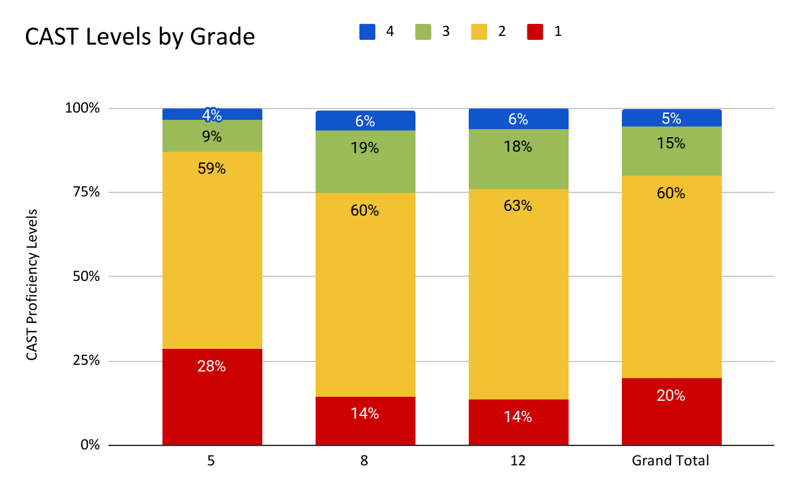
25th Wave
22nd Wave
18thWave
All students
Notes:
(4=Standard Exceeded, 3=Standard Met, 2=Standard Nearly Met; 1=Standard Not Met. 3 or 4 are considered “proficient.”

Slide 26
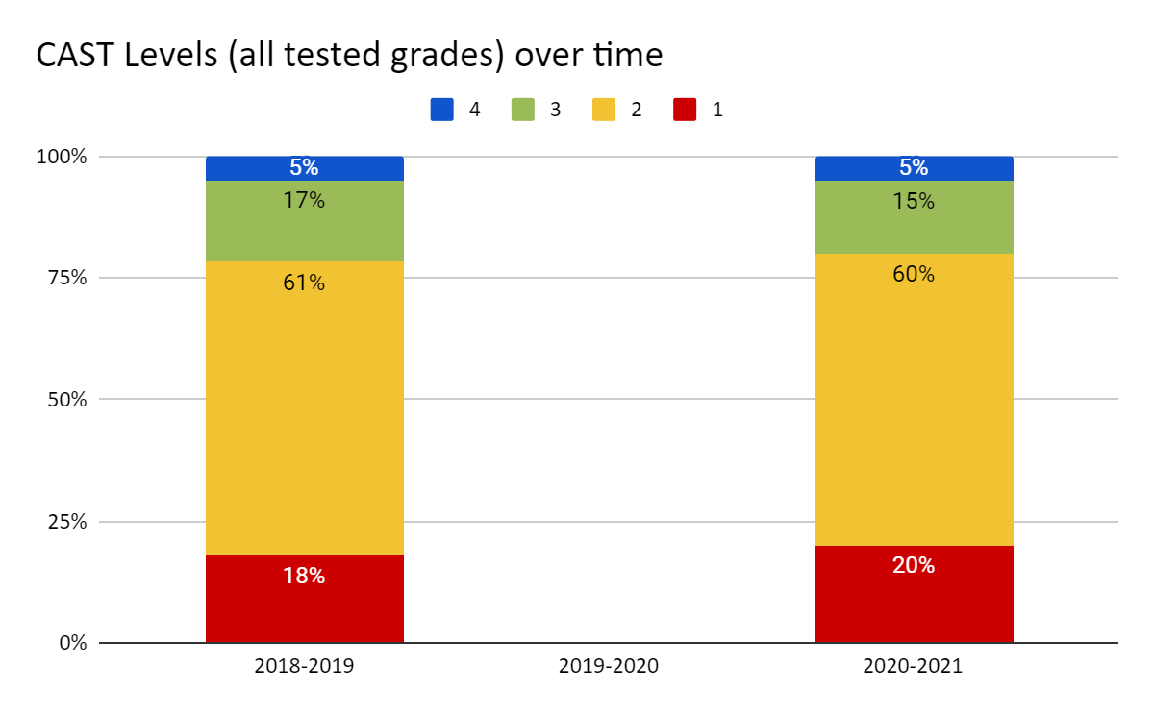

Slide 27
Subgroup comparisons- CAST
 | Standard Not Met (Level 1) | Standard Nearly Met (Level 2) | Standard Met (Level 3) | Standard Exceeded (Level 4)
Overall CAST results | 20% | 60% | 15% | 5%
Black/African American | 19% | 63% | 13% | 6%
Latinx | 21% | 59% | 16% | 5%
English Learners | 38% | 60% | 2% | 0%
Students with Disabilities | 53% | 43% | 3% | 0%

Slide 28
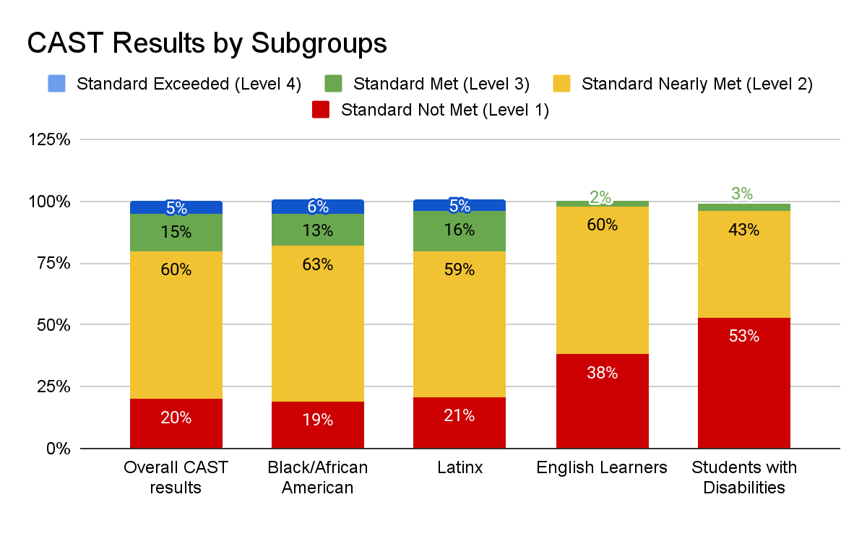

Slide 29
Response to Data-- Questions and Next Steps

Slide 30
How are we using this data to guide instructional programs and planning this year?

Slide 31
How are we using this data to guide instructional programs and planning this year?
 | Academic Support Services Historical | Academic Support Services Additional | Holistic Support Services Expanded
Direct Services | Summer Academy DTI/Marlin Hour Interventionists Case Management* | Acceleration Academy (ELD) Acceleration Academy (Math) Student Success Liaisons Case Management | FPA Psychological Services
Tools | Individualized student support: Lexia or IXL Progress Monitoring Tools STAR Reading and Math IAB | Individualized student support: Lexia (expanded licenses) Progress Monitoring Tools MAP Math Diagnostic | Advisory (PMSC) Curriculum
Professional Development | Intervention Services Professional Development (RTFisher) Intervention Services Coaching (RTFisher) | ACCESS Math Professional Development RTI@Work Institute | Faculty SEL Professional Development

Slide 32
Discussion Questions:
How do the trends identified in our SBAC data support or challenge our approach to addressing the unfinished learning exacerbated by the COVID-19 pandemic?
How can this data serve as a launch pad for our students’ continued and future growth?

Slide 33
Thank you.

