Slide 1
AIT Deep Dive
Micah Stilwell
Thursday, September 9, 2021

Slide 2
AIT Introductions
Returning to Campus!
S1 Instructional Priorities
Moving Forward
Board Member Feedback
Table of
Contents

Slide 3
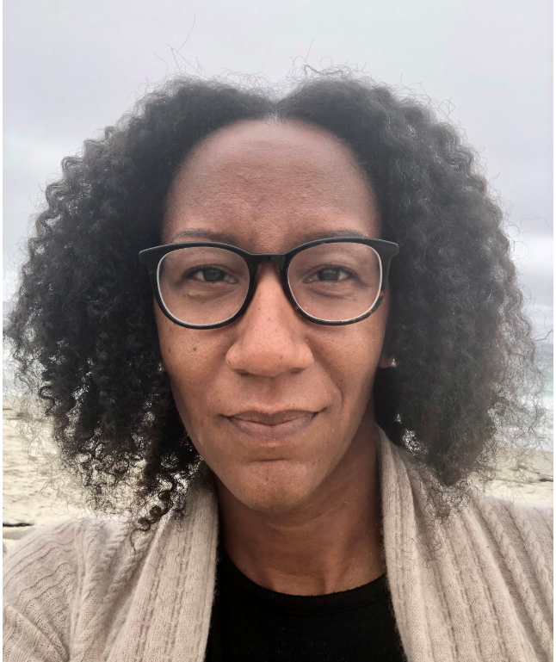
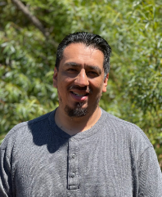
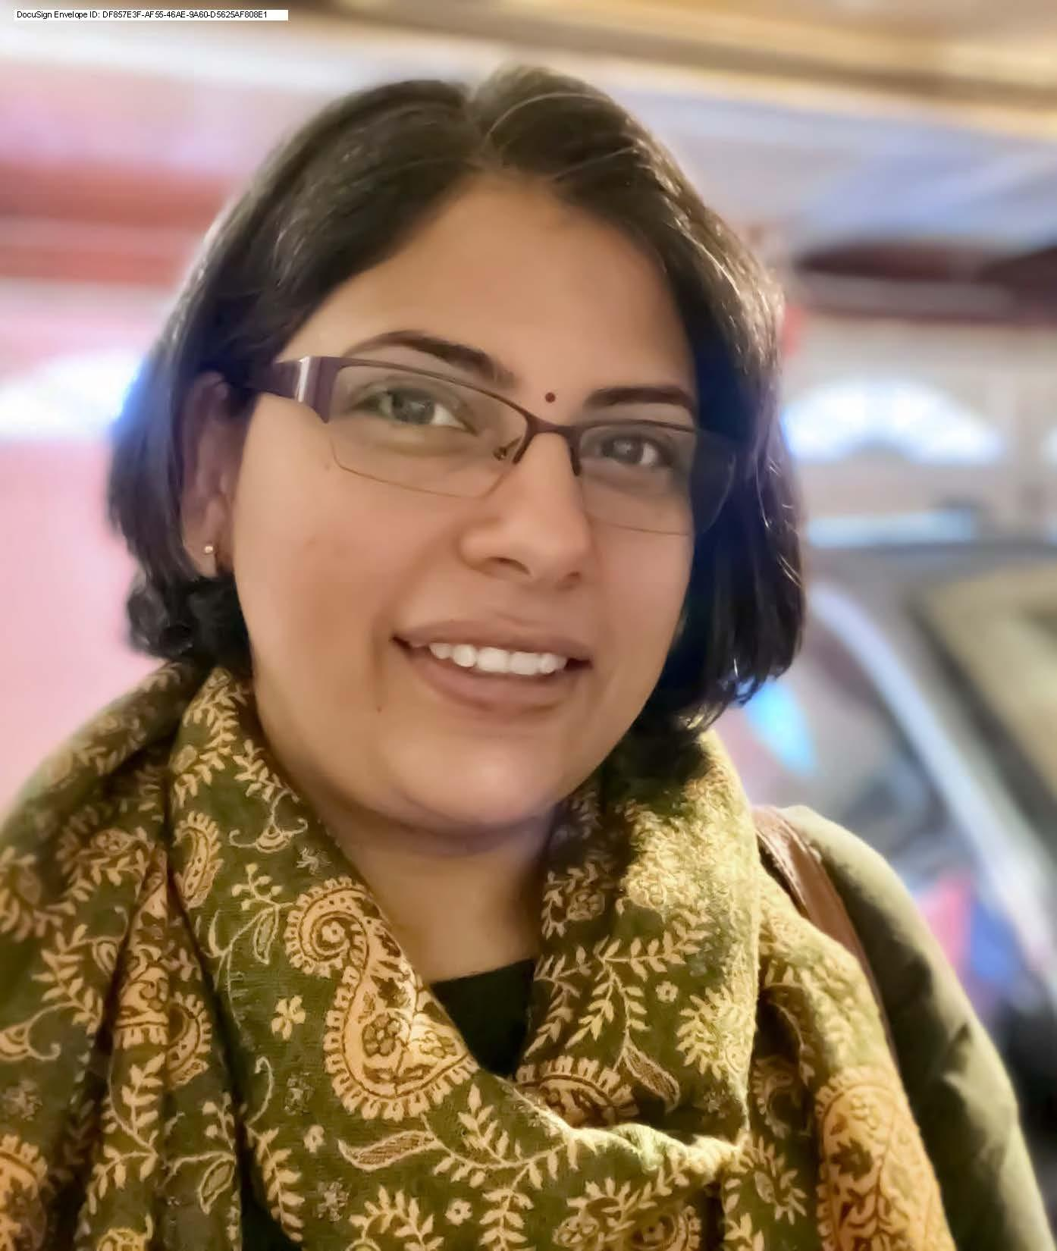
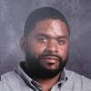
AIT Introductions
Micah Stilwell
Senior Director of
Academic Instruction
Aurelio Garcia
Director of Academic
Support Services
Radhika Kolichina
Director of Academic Instruction Math/Science
Karen Snider
Director of Special Education
Eric Becker
Director of Academic Instruction Humanities
Michael Williams Jr.
Director of Applied Technology

Slide 4
Returning to Campus

Slide 5
August PD (Hybrid)
August PD Objectives
Welcome MWA community to campus utilizing our one school organizational model Develop a shared understanding of MWA's approach to returning to campus: safety, SEL, and rigorous instruction Develop a shared understanding of MWA's approach to instructional planning and vertical collaboration Develop a shared understanding of MWA's approach to social-emotional well-being and our holistic approach to student support services
“It is my first day with MWA , online via zoom, and it is really wonderful to see all my new colleagues and listen to their vision, health and safety guidelines, and backward planning designs.”
“Knowing the priorities leadership has in mind for semester 1 is reassuring and will help my planning.”

Slide 6
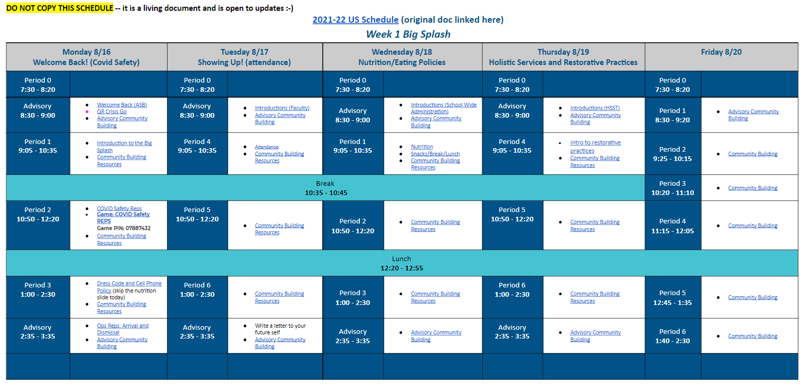
Welcoming Wave-Makers!
The Big Splash
For the first two weeks of school, the academy-wide focus was to ensure Wave-Makers experienced a smooth transition back to campus.
The daily content for The Big Splash included:
Community Building
Relationship Development
REPs Introduction

Slide 7
Semester 1 Priorities

Slide 8
Instructional REPs are the ROOTS!
Build Relationships: Listen & Learn
Utilize & strengthen existing communication structures Foster a collaborative culture of academic excellence Support the development of instructional staff in alignment with MWA Mission & Vision and collaboration across departments
Effectively Support All Teachers
Provide support through coaching and other forms of professional learning Utilize & strengthen existing collaborative structures Support the development of teacher leadership (Content Leads)
Effectively Implement Teaching & Learning Cycle
Create opportunities for alignment of best practices Facilitate opportunities for vertical alignment and collaboration among MS and US teams Observation & coaching in collaboration with teacher leadership and mentors

Slide 9
Semester 1 Outcomes
Overall, MWA Faculty feel that communication is strong within and across all departments (survey)
Teachers feel supported through the observation and coaching cycles conducted by DAIs and Content Leads (survey)
Content Leads engage in instructional observations at least once per quarter
Best practices, differentiated within content areas, are identified and shared out at least once

Slide 10
Moving Forward

Slide 11
Strengths, Challenges, & Next Steps
Strengths | Challenges | Next Steps
Dedicated and collaborative faculty Leadership has implemented an “all hands on deck” approach to covering vacancies and absences, protecting teacher planning and collaboration team Solution orientated Week 1 feedback from faculty Documented key learnings from DL as well as instructional priorities for this year | Managing faculty anxiety due to the shifting guidelines regarding on-campus Covid guidelines Beginning the year with 11 vacancies and the entire instructional leadership team in the classroom, as substitute teachers AIT has brand new leaders, including two who are new to MWA Supporting team members in aggressively prioritizing objectives Supporting team members in understanding that we will not, “return to normal” this academic year | Continue to improve systems based on community member feedback and recommendations Prioritize Content Lead coaching and collaboration to ensure instructional priorities move forward Implement a wide range of teacher recommended sustainability measures

Slide 12
Discussion Prompt
How best can we improve the dexterity within our approach to teaching & learning, to maximize the coherence of instruction for Wave-Makers, during this dynamic year in education?

Slide 13
Contact Information
Micah Stilwell
mstilwell@mwacademy.org
(510) 262-1511

