Slide 1
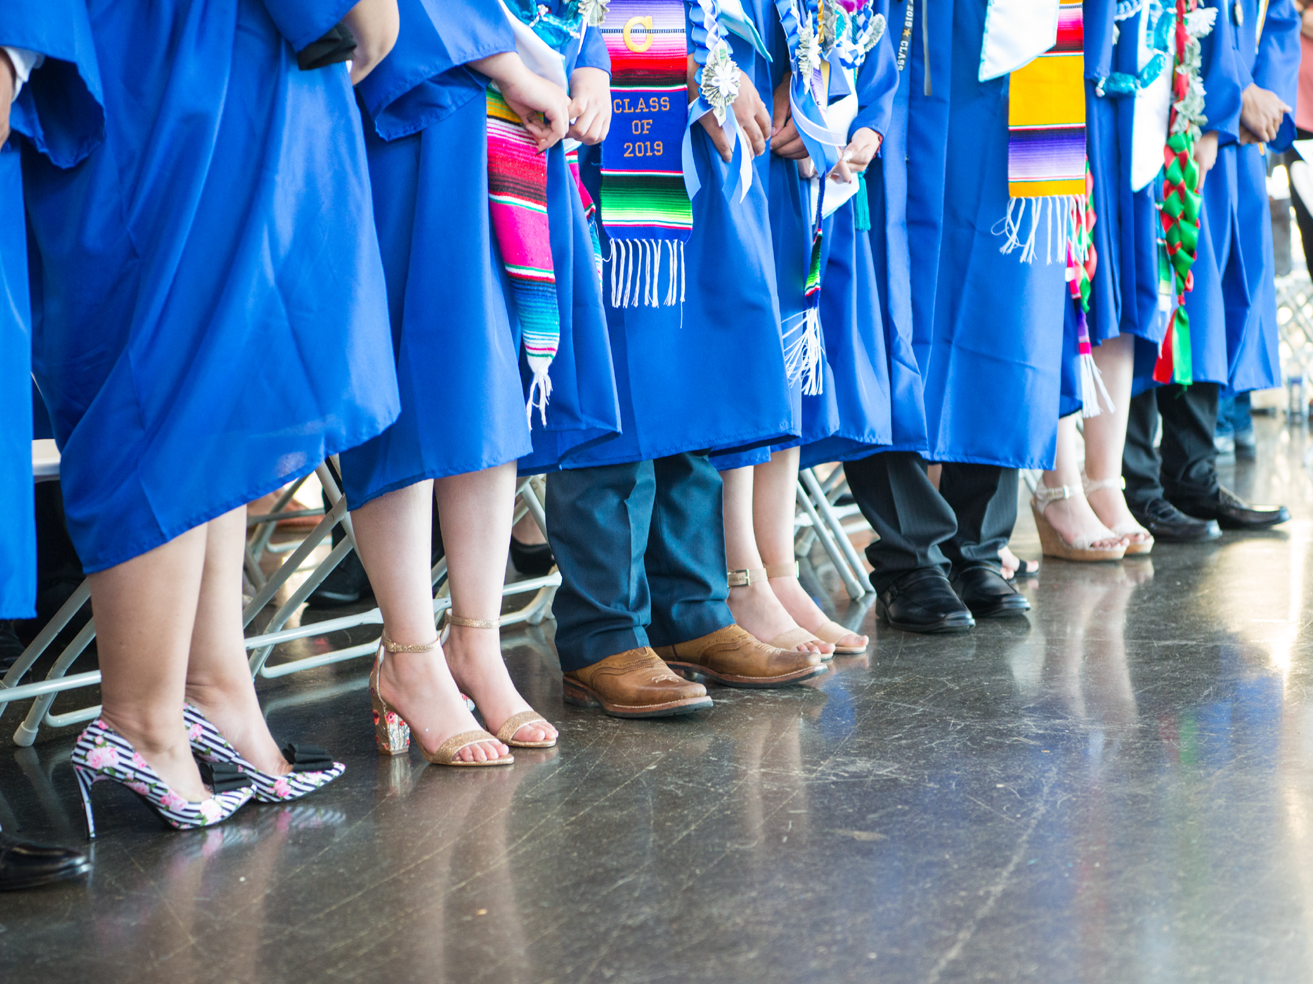
ASB Board Report - June 2021
Melissa Macho

Slide 2
Successes
Challenges
Priorities
Table of
Contents

Slide 3
Successes

Slide 4
2020 - 2021 ASB Successes
The 2020 - 2021 ASB Board of Directors have so much to be proud of...
Student Portal was visualized AND launched
ASB planned 2 virtual Spirit Weeks and Advisory programming
ASB recorded Video Clips throughout the school year to help engage the student body
ASB was able to meet with over 6 MWA leaders, 1 CAP leader and MWA Board Members and Board Fellows
ASB Community Building took a fun turn as they planned their own Friday Fun activities and meetings
2021 - 2022 ASB Elections have been held and we have our incoming Board of Directors
“One piece of advice I would like to leave is to not be shy. It might feel hard to speak up when you have ideas because you feel that your ideas aren't good enough, but we are all a family and will listen and encourage you. <3”
-Jaky ASB Secretary 19th Wave Student

Slide 5
2021-2022 ASB Board of Directors
President: Lizbeth
Vice President: Jaky
Secretary: Stephany
Treasurer: Armando
Marketing Coordinator: Carolina
Student Activities Liaison: Simren
19th Wave Representatives: Estefani & Kevin
20th Wave Representatives: Jenissa & position to be filled in fall
21st Wave Representatives: to be filled in fall
22nd Wave Representatives: Fatima & position to be filled in fall

Slide 6
Challenges

Slide 7
Challenges
ASB found it difficult to engage their peers consistently this school year.
Student participation and engagement was low throughout the school year
Cameras off during zoom classes and club meetings
Students did not show up in opt-in spaces as they did in past years
Communication with the community was harder
Students did not check email with fidelity
Students said it felt harder to get in touch with leaders and teachers in a virtual setting
“Something I am struggling with right now is adjusting to the new process of going to class.” -19th Wave Student
“I have been struggling with being present and trying my best in all the spaces that I am in.” -19th Wave Student

Slide 8
Priorities

Slide 9
Priorities for 2021-2022
To build off of the momentum and creativity ASB discovered this year.
Keep building out the Student Portal
Keep finding new ways to engage the student body
Keep providing video clips as helpful and fun informational guides
Keep encourage community building activities within advisory, clubs, small events and the larger MWA Community
Continue to meet with MWA leaders
Continue to and find new ways to ask for all student input on community wide issues
Find ways to revamp our old in-person events for safety and engagement
Rallies, Dances, All-School Meetings, etc...
“In the fall, I’m excited to get back into normality - or what we call normality at this time. And just getting to be around people, even if it may not be that many, starting to socialize…” -MWA Student

Slide 10
Thank you

