Slide 1
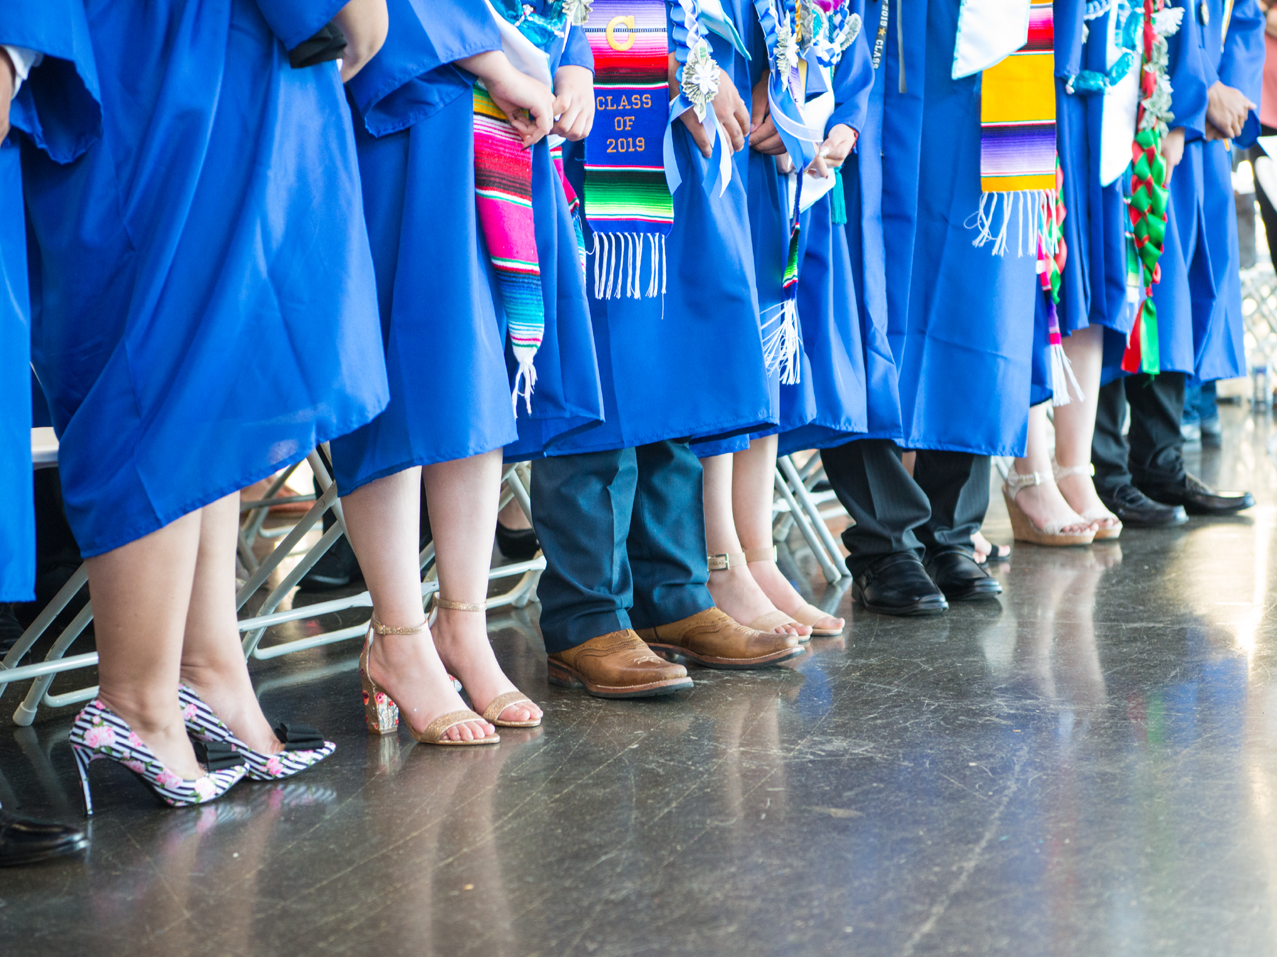
ASB Board Report - May 2021
ASB Members May 6, 2021

Slide 2
Successes
Challenges
Priorities
Questions & Conversation
Table of
Contents

Slide 3
Successes

Slide 4
Successes
Starting ASB Elections
Elections happening week of May 24th
Current ASB Member created flyer and short video clips to help recruit students to run for office
Student Portal went live on Monday, April 26
MWA Community was sent an email and quick video on how to access
Planning new and creative ways to engage students in community building
Hoping to launch end of the year Friday Community Building fun activities for student during some Advisory sessions

Slide 5
Challenges

Slide 6
Challenges
Communication
Students - reminding them to check their emails with fidelity
Student Engagement
Turning cameras on
Participation in extracurricular activities

Slide 7
Priorities

Slide 8
Priorities
Expanding the Student Portal
Finding new and more ways to encourage student engagement in extracurricular activities and synchronous instruction
Finish the 2021-2022 ASB Elections process
Launching fun and community building end of year activities for students

Slide 9
Questions & Conversation

