Slide 1
Blueprint for a Safer Economy Status
As of 3/2/2021, Contra Costa County remains in the Purple Tier (the most restrictive tier in the Blueprint for Safer Economy)
3/2 Contra Costa County Metrics
Adjusted Case rate = 9.5
Positivity rate = 3.5%
Health equity quartile positivity rate = 5.6%

Slide 2
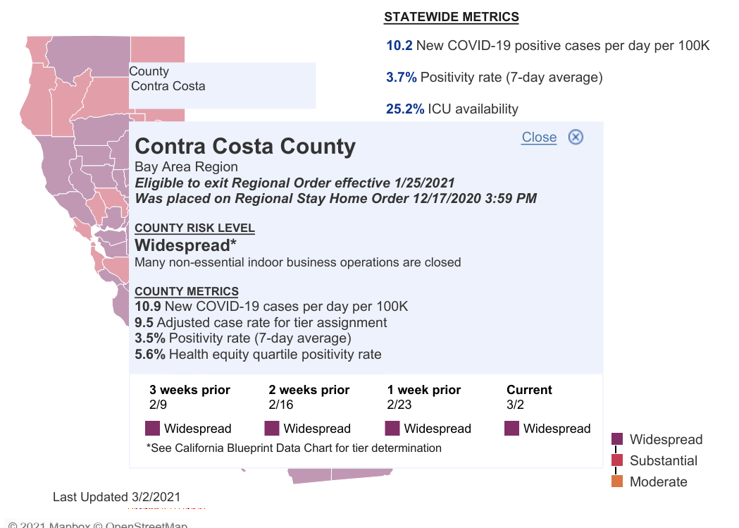
Blueprint for a Safer Economy Status

Slide 3
Planning for Phase 1C and Beyond
What does this mean?
Two out of the three metrics are currently within the range of the Red Tier and the data continues to improve and trend down.
If all three metrics are within the range for the red tier for two consecutive weeks, Contra Costa County would be classified in the Red Tier.

Slide 4
Planning for Phase 1C and Beyond
What does this mean for MWA?
MWA is continuing with the phased approach to reopening.
When Contra Costa is in the Red Tier, Phase 1C with expanded sports offerings and faculty working from campus could begin.
The reopening workgroup is working to make sure that everything is in place for Phase 1C, once Contra Costa is in the Red Tier.

