Slide 1
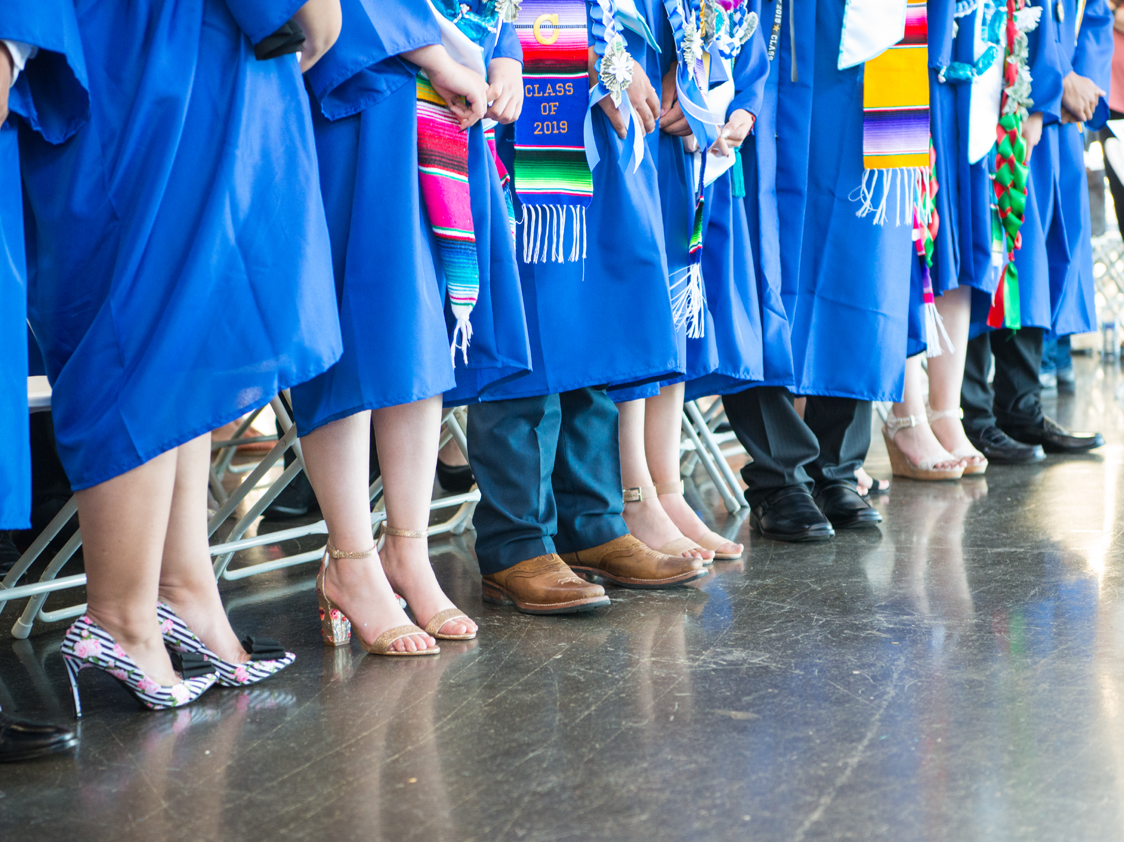
ASB Board Report - March 2021
ASB Members March 11, 2021

Slide 2
Successes
Challenges
Priorities
Questions & Conversation
Table of
Contents

Slide 3
Successes

Slide 4
Successes
ASB meeting with school leaders
Mr. Siapno & Ms. Chavez
Ms. Harper-Cotton
Started the conversation around testing and mental health for all students
Ms. Heather
Spring Spirit Week
Planning and Advisory Materials
Continued progress on the student portal
ASB community building Friday meetings

Slide 5
Challenges

Slide 6
Challenges
Communication
Students - reminding them to check their emails
Teachers and staff - response time
Getting students to engage
Turning cameras on
Opting into student clubs
Responding to surveys
Notes:
Challenges remain the same as last meeting

Slide 7
Priorities

Slide 8
Priorities
Ensuring the Student Portal can go live
Creating informative and creative material to help students feel prepared and engaged for upcoming state testing
Finding new and more ways to encourage student engagement in extracurricular activities and synchronous instruction
Getting ready for the 2021-2022 ASB Elections

Slide 9
Questions & Conversation

