Slide 1
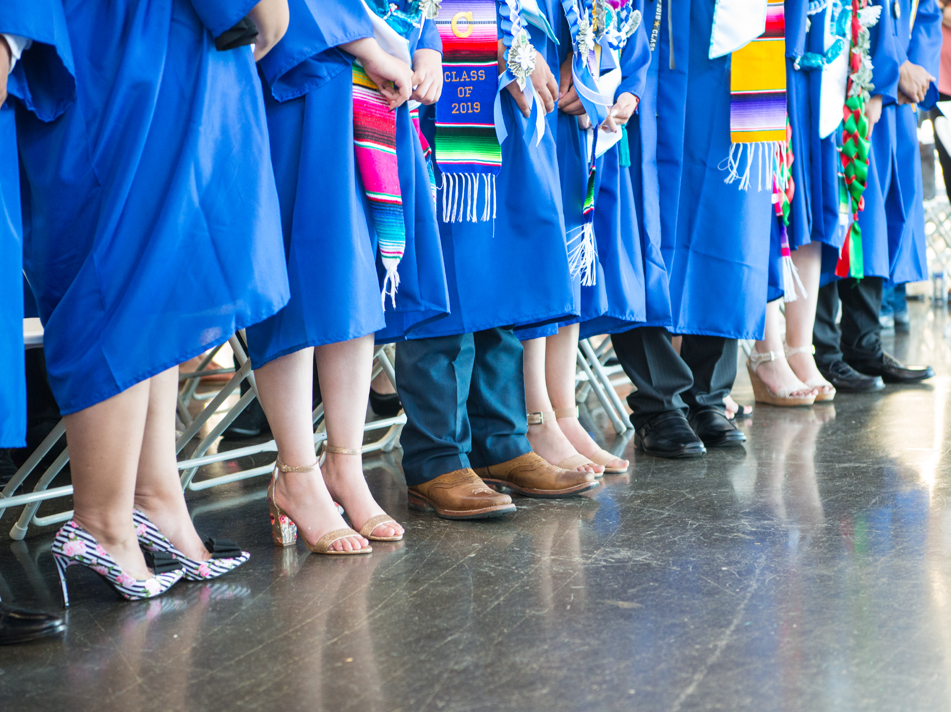
Lottery Application Update
LaMario Sales
January 28, 2021

Slide 2
Overall Application Submission Update
Application Submission by Grade
Applications Submitted by Race/ Ethnicity
Where Do Our Applicants Live?
Commercial Advertisement Results
Community Outreach
Table of
Contents

Slide 3
Application Submission Update:
- 624 applications submitted with MWA being at least one of the schools selected
– Of those 624 applications, 286 only applied to MWA (45.8% of all applications submitted)
– 71 sibling applications (12.9% of all applications submitted)
– 3 employee children applications, (0 qualified for priority)
– 482 applicants eligible for free and reduced lunch (77.2% of all applications submitted)

Slide 4
Applications by Grade | 5th | 6th | 7th | 8th | Total
Applied to MWA and at least one additional school | 185 | 182 | 159 | 88 | 624
Applied to MWA only | 130 | 58 | 52 | 46 | 286
.

Slide 5
Applicants Demographics by Race/ Ethnicity | Targets | Current Results | Applicants
African American | 25% | 13.4% | 83
Asian | 6% | 7.1% | 44
Hawaiian or Pacific Islander | 6% | 0.4% | 3
Hispanic or Latino | 50% | 61.3% | 378
Multiple | 6% | 10.2% | 63
White | 6% | 1.9% | 12
Other | N/A | 2.2% | 14
Unreported | N/A | 3.0% | 19
.

Slide 6
Where Do Our Applicants Live?
(17 Different Cities)
•Richmond-306
•San Pablo-185
•El Sobrante-34
•Hercules-33
•Pinole-25
•Rodeo-22
•Vallejo-6
•Martinez-3
•El Cerrito-2
•Antioch-1
•Pittsburg-1
•Tiburon-1
Sacramento-1
•San Rafael-1
•Suisun City-1
•Emeryville-1
•Concord-1

Slide 7
Commercial Advertisements Results
Direct Mail Campaign
–Sent postcards to MWA’s underrepresented groups during the recruitment process
–Approx. 16,000 homes received an invite to apply for MWA’s Lottery
Signage on Lakeside & Richmond Parkway
–placed just below the “Making Waves Academy” sign
–On the corner of Richmond Parkway and San Pablo Ave
–Placed on Lakeside drive in front of play structure.
–Seen by approx. 792,000 vehicles**
**Number based on traffic study by Caltrans. Approx. 198,000 cars pass MWA West Bound where the sign is most visible in a given month. https://dot.ca.gov/programs/traffic-operations/census/traffic-volumes/2017/route-71-80

Slide 8
Community Outreach
-Sent email reminders about this year’s lottery to the following community partners:
•Yes Families
•All Nations Church
•Ephesians Church of God in Christ
•Building Blocks for Kids
•La Petite Academy (Hilltop)
•KinderCare (El Sobrante)
-Sent email reminders about this year’s lottery to over 700 families on 20-21 waitlist
-Sent Reminder letter to families of all 1088 students currently attending MWA

Slide 9
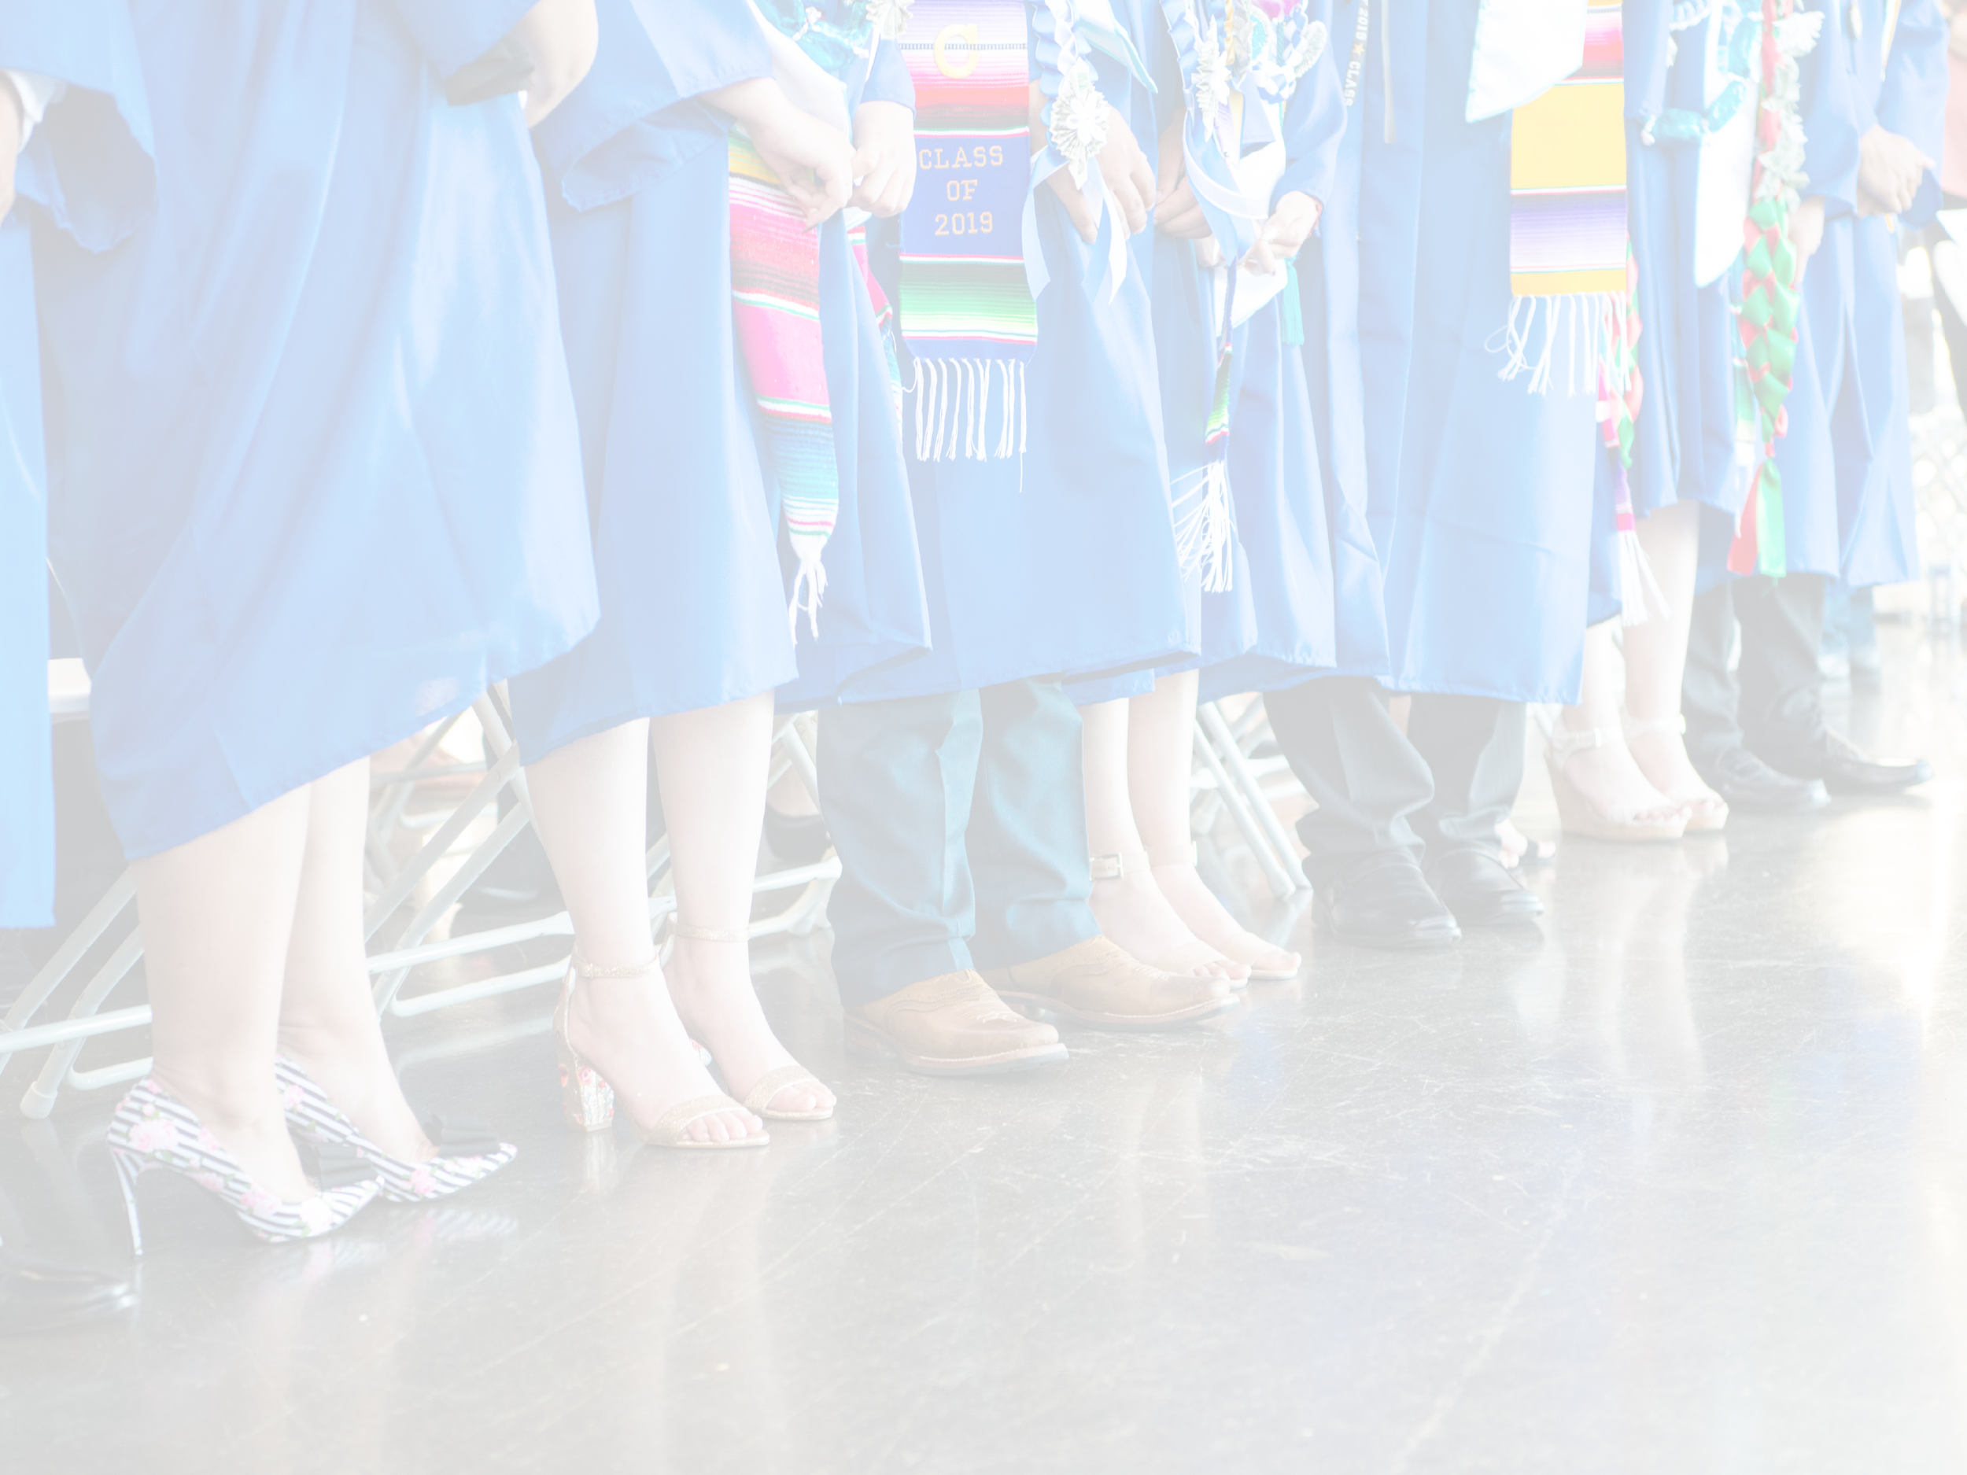
Contact Information
LaMario Sales
Lsales@mwacademy.org

