Slide 1
Parent Education, Empowerment & Engagement
Raynell Crews-Gamez

Slide 2
Parent/Guardian Engagement
Empowerment
Education
Engagement
Vision
To create a thriving MWA culture, driven by intellectual curiosity, personal responsibility , and interconnected
values
Mission
To cultivate habits of
mind that lead to personal, professional, and educational growth, and financial stability

Slide 3
2020-21 Parent/Guardian Wave Representatives

Slide 4
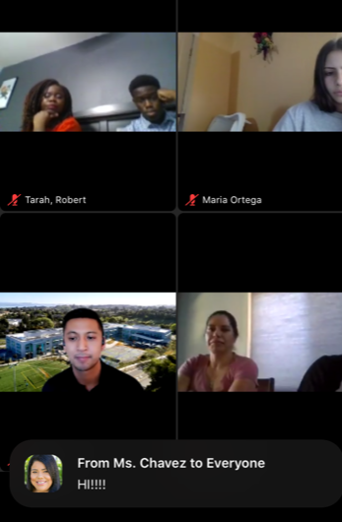
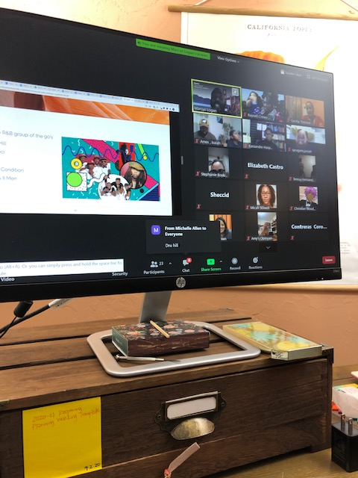
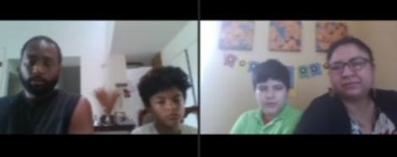
Love in a Time of COVID
BAASAI (Black/African American Student Achievement Initiative) Family Game Night
College & Alumni Program Information Session
Back to School Day – 24th Wave

Slide 5
Parent/Guardian Council

Slide 6
Discussion
What do you believe about the relationship between parent engagement and our Wave-Makers’ ability to live out the MWA mission?
What life experiences influence your beliefs?

Slide 7
Questions
Raynell Crews-Gamez
Director of School Culture & Family Engagement
rcrews@mwacademy.org

