Slide 1
ASB Board Report
December 2020

Slide 2
Successes
ASB videos were sent out via ASM Slides to the Upper School Community
Will be shared with larger community - parent website
ASB Meeting with Mr. Siapno
Fall Spirit Week
Created slides for advisory programming
We were able to collect pictures for the yearbook
Working on Student Portal
Collecting information to share with the student community
Day of Lights planning

Slide 3
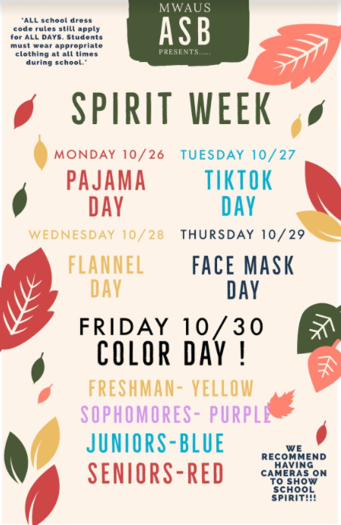
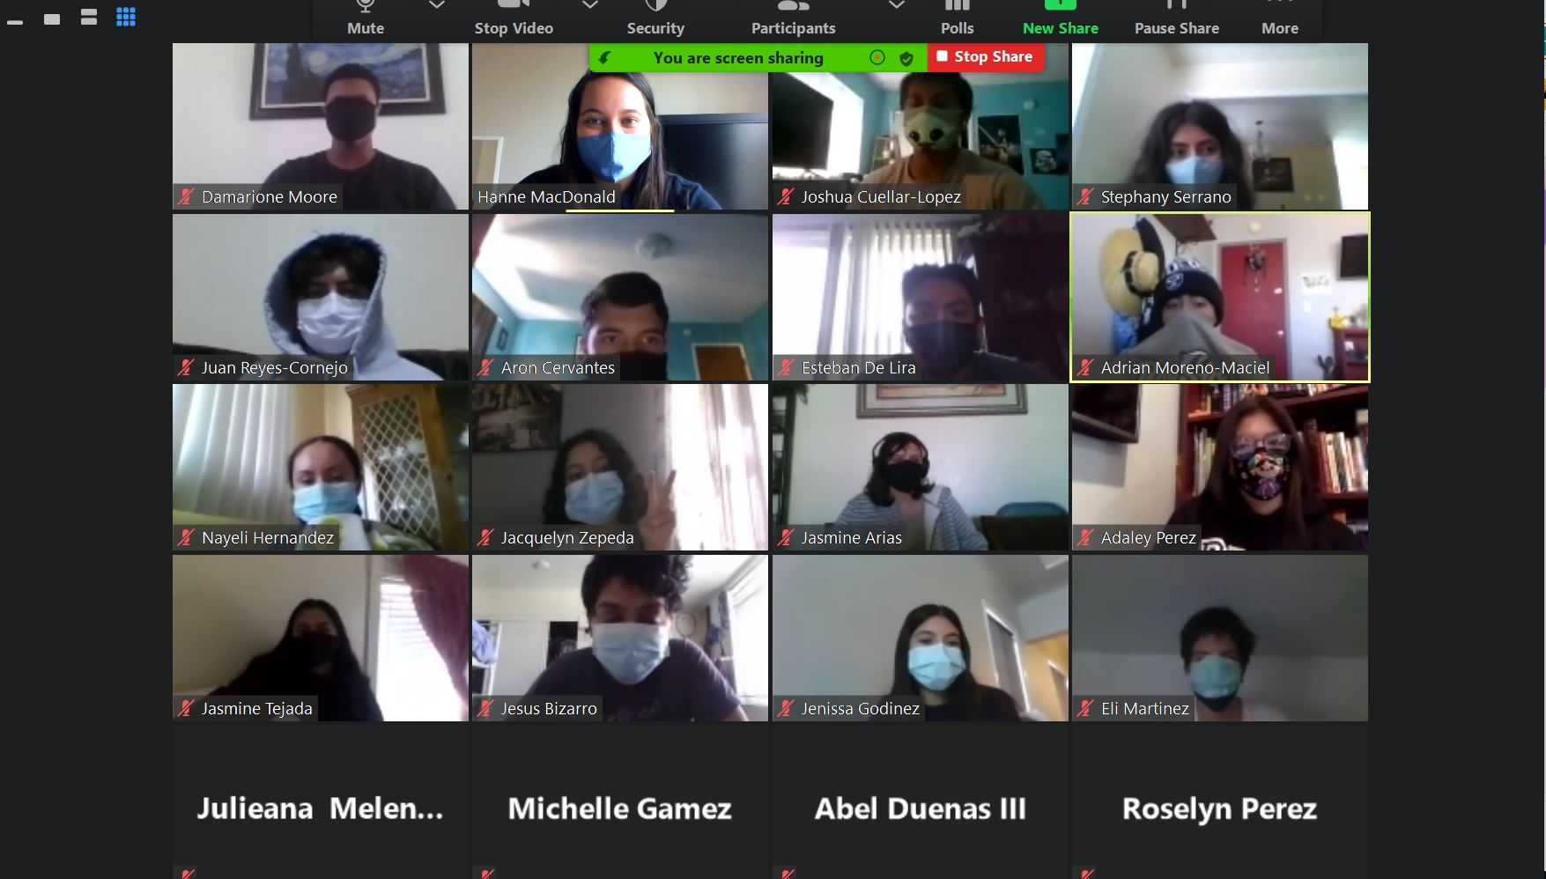
Fall Spirit Week
Ms. MacDonald’s Advisory on Facemask Day Upper School Spirit Week Winning Advisory!

Slide 4
Challenges
Community building while distance learning continues to be a challenge
Students not turning their camera on - no access to virtual backgrounds
Participation and Engagement in general is low
Clubs
Advisory Activities
Getting information to the entire student community
Finding ways other than emailing

Slide 5
Priorities
Student Portal - resource webpage
Finding ways to promote community and togetherness
Encouraging students to turn on their cameras and engage with their peers
Day of Lights programming
Happening December 7-11, 2020

Slide 6
Thank You

