Slide 1
Teaching and Learning Deep Dive
Wednesday, October 15, 2020
Priscilla Mendez
Kassandre Harper-Cotton

Slide 2
Visions and Year 1 Focus (Distance Learning)
Our vision is to facilitate the integration cross interdisciplinary practices, rigorous instruction, academy-wide alignment of best instructional practices through leadership development and instructional coaching to ensure that all students can conceptualized and reach their post-secondary college and career goals.
Building the Foundation for
Instructional Excellence
(Semester 1)
Establish Practices
Teaching and Learning
Cycle
Regular points of contact
Alignment of instructional practices school-wide
Weekly observations and debriefs
Integration of school programs
One School culture
Communication
Data Wise
Establishment of the Academic Instructional Team (AIT)
Instruction
Curriculum
Reflection

Slide 3
Successes
Holistic and instructional partnerships to address Social-Emotional Learning needs
Weekly observations to evaluate school-wide best practices for remote and in-person learning
Informal office hours for real-time coaching, collaborative dilemma solving, and community-building
Leadership and content-specific training help DAIs to assess teacher and student instructional needs and provide leadership development
Content Leaders are paired (5th-12th) to provide a school-wide lens for instructional improvement
Professional development series shifted and clarified grading and its purpose

Slide 4
Challenges
Technology
Instructional transitions
Staff turnover and transition
Scheduling
Mental and emotional fatigue

Slide 5
Opportunities for Innovation
Masquer’s Partnership
Potential coding partnership
Makers Coordinator Collaboration
Professional Learning

Slide 6
Use of Differentiated Asynchronous Time
Small group or one-on-ones with Interventionists
Small group or one-on-ones with Resource Specialists
Individual Grade Conferences
Building community/Connection
Processing and brainstorming
Previewing or reinforcing curriculum
Parent communication
Give and implement feedback
Diagnostic support and make-up work

Slide 7
Window into Break-Out Rooms
Socratic Seminars
Rotating roles
Identifying reporters
Unpacking assessments, assignments, or documents
Providing real-time feedback
Alternative assessments
Additional instruction and reinforcement
Behavior support

Slide 8
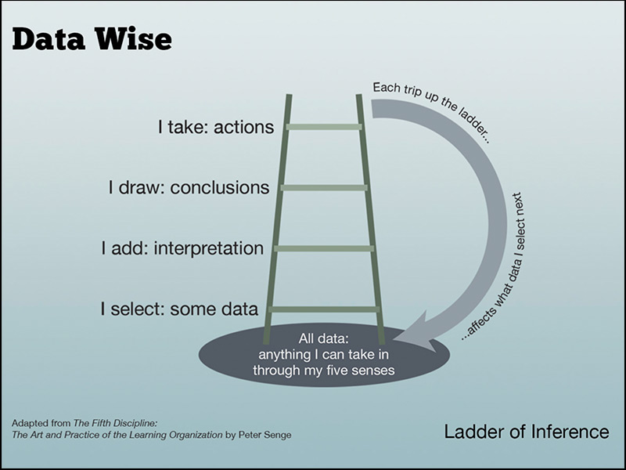
Activity:
You will receive a set of data from IXL (Math) or Star (English). Either in a small group or independently, write three things you wonder or notice.
Driving Questions
Using the questions that you generated, how could you use the tools or practices shared to identify a need?
How would you leverage asynchronous time to support learning outcomes?

