Slide 1
ASB Update
March 19, 2020

Slide 2
Successes
WASC Committee Lunch with ASB
Black History Month Assembly
10th and 11th Grade College Tour Field Trips
Senior Activities - 100 Days to Graduation
March 6th ASM
Spirit Week and Pep Rally Planning

Slide 3
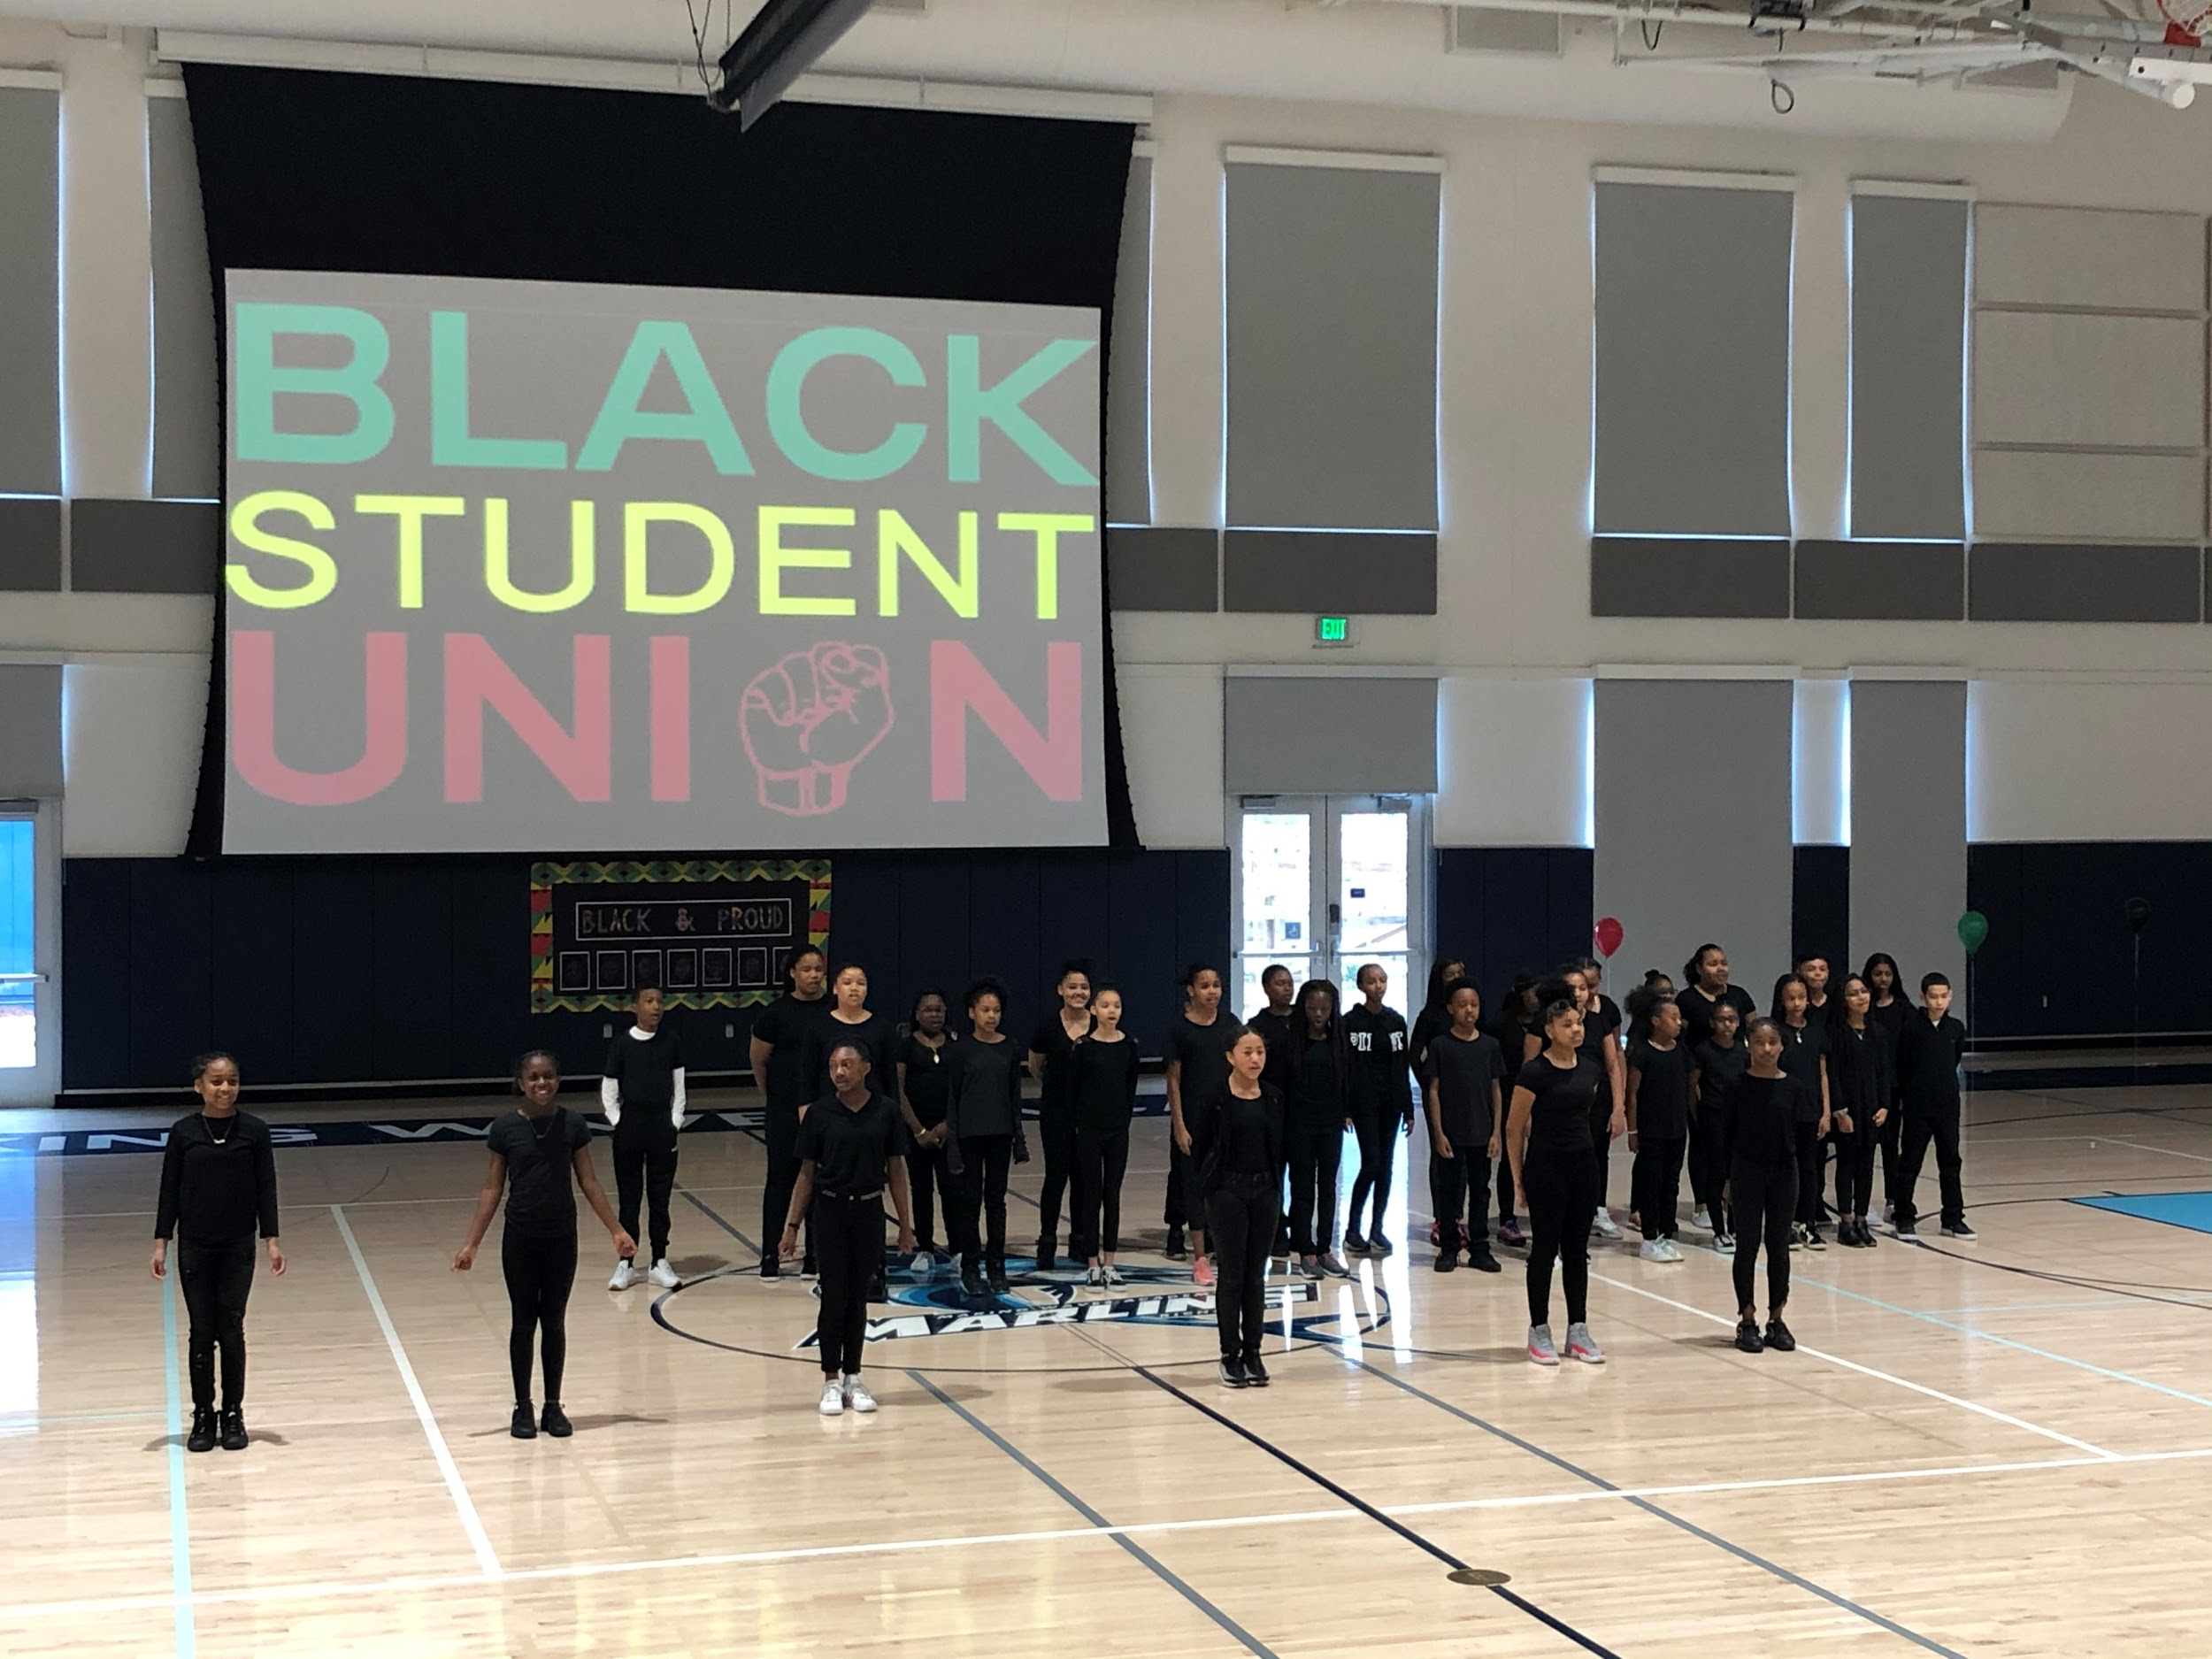
Black History Month Assembly

Slide 4
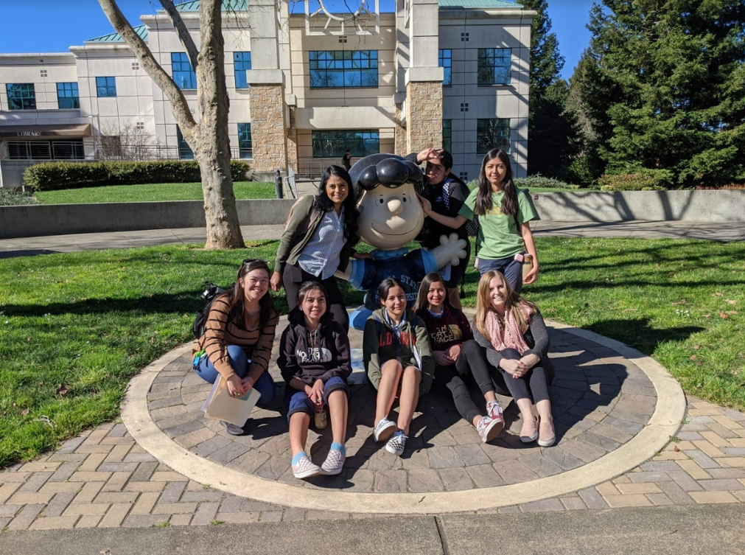
10th Grade College Tour Trip - Sonoma State

Slide 5
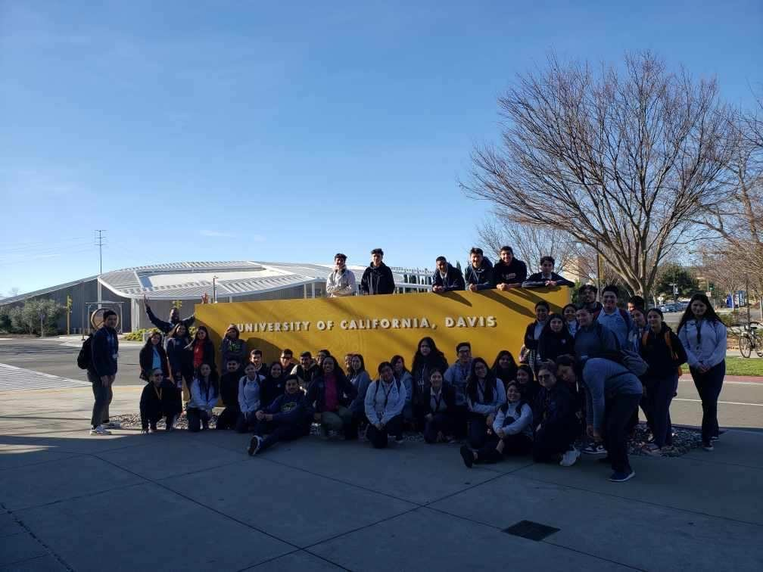
10th Grade College Tour Trip - UC Davis

Slide 6
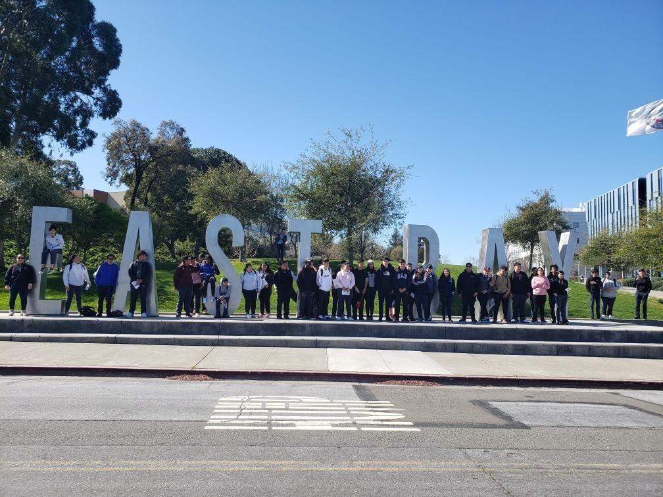
11th Grade College Tour Trip - CSU East Bay

Slide 7
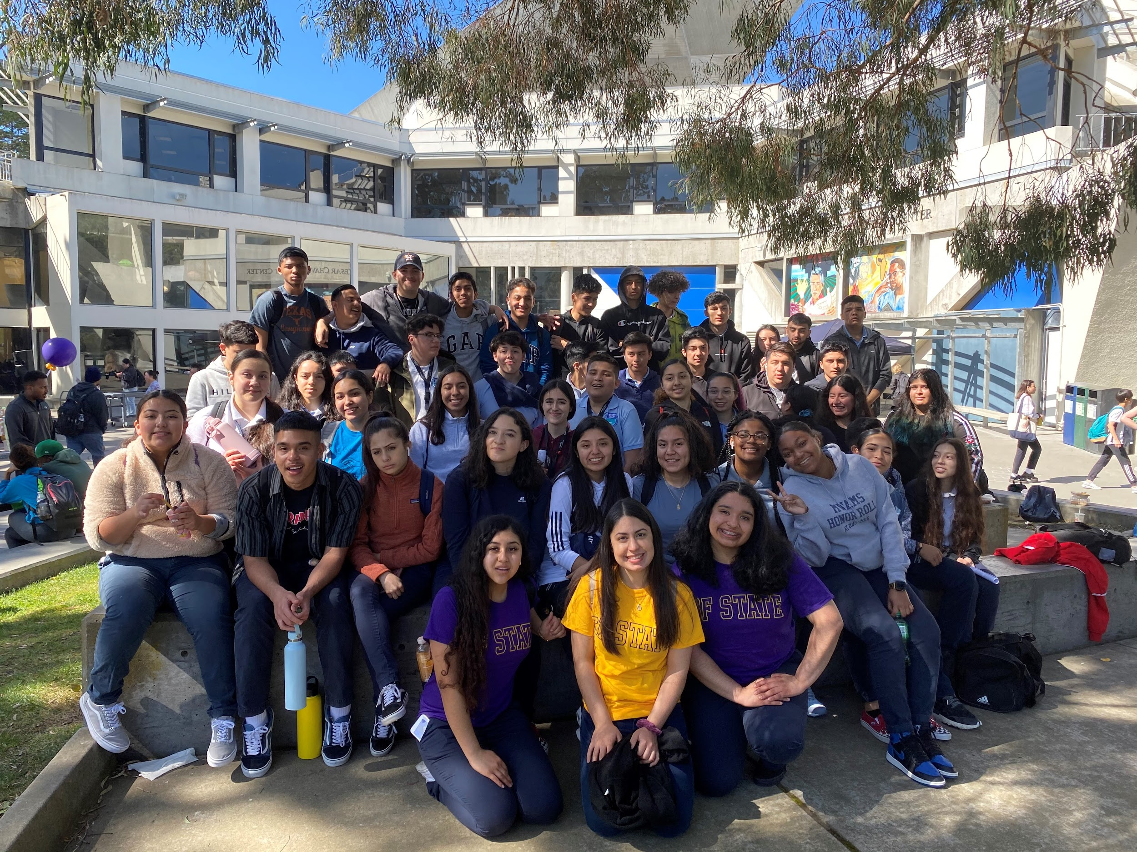
11th Grade College Tour Trip - SF State

Slide 8
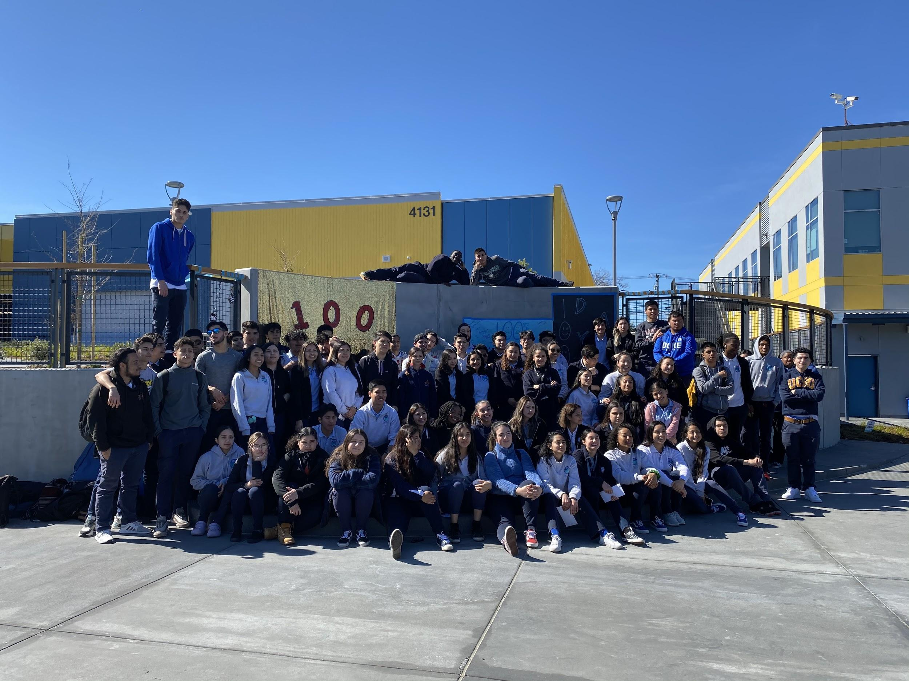
100 Days to Graduation

Slide 9
Challenges
Student participation
Especially in community blocks such as ASM’s and Pep Rallies
Getting new students to volunteer to participate
Time management and juggling school work and extracurriculars

Slide 10
Priorities
Planning and marketing a successful and engaging spirit week and pep rally
Continue to think outside the box when planning events for the community
Continue to be the bridge between students and staff & faculty

Slide 11
Questions?

