Slide 1
CEO & Senior School Director Topics
Nelson
Introduce elements of a proposed new MWA Org structure
Ward-Jackson
Share scope of position launch plan & campaign
Introduce Second Semester Focus Areas

Slide 2
MWA School-Wide Leadership
(Alignment: “Holistic Center” & Content Focus)
Senior School Director
Dir. of College & Career Counseling
Dir. of Holistic Support
Senior Dir. of Curric. & Instruction
Lead Teacher for Math & Sci.
Athletic Director
MWA CEO
DCI for Humanities
DCI for Math & Science
Senior Dean of Students & Deans
Social Workers
Clinical Service Providers
Content Leads for Math & Sci. (Stipend)
Lead Teacher for Humanities
Content Leads for Humanities (Stipend)
Grade Level Leads (Stipend)
Faculty for Math & Sci.
Faculty in Humanities
Maker Space Coordinator
Dir. of Academic Services
DTI Coordinator
Interventionists
Extended Day Coordinator
Tutors
ELD Coord.
GATE Coord.
SPED Director
Dir. of Applied Technology
RSP Teachers
Aides
Service Providers
Parent/Guardian Engagement Director
Sub Coordinator
Dir. of School Operations

Slide 3
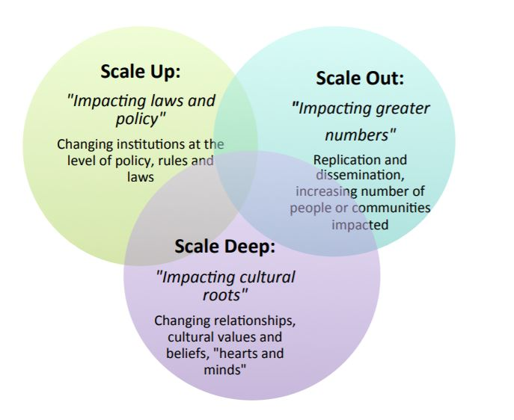
“Scaling Deep for Excellence”
Scaling deep is the most effective way to refresh organizations while:
Recommitting stakeholders to their “why,”
Trusting in organizational changes, and
Building and uncovering areas of exemplary performance

Slide 4
Areas of Focus
Upper School Residency: Physically moving into the Upper School and exercising VAR (Visibility, Accessibility, Responsiveness) for both staff and students
Learning Tour: Host 1:1 meetings and small group Coffee Klatches for the intent of distilling learnings/findings into themes, and themes in to SMART goals that will guide future work
Building Bridges: Align middle school, upper school, and school-site operation systems, protocols, and expectations while also creating channels for engagement and sharing

Slide 5
Questions

