Slide 1
Black/African American Student Achievement Initiative Deep Dive
February 6, 2020

Slide 2
Agenda
Provide B/AASAI calendar and KPI update
Share B/AASAI strengths, challenges, and next steps
Describe B/AASAI academic mentoring framework
Respond Q&A

Slide 3
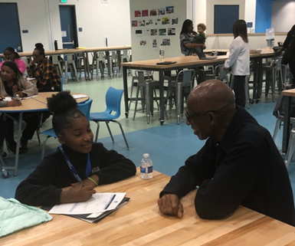
Guiding Question
What recommendations do you have for seamlessly integrating B/AASAI goals and KPIs into MWA core programing and practices?

Slide 4
Where are the Black/African American Students @ MWA?

Slide 5
Urgent Academic Needs

Slide 6
Proposed B/AASAI Academic Achievement Goals & KPIs
Access & Inclusion
KPI: SBAC Results
Opportunities to Excel Academically
Achievement & Outcomes
KPI: Grade Point Averages (GPAs)
KPI: Advanced Placement Course Completion
Goal: 80% of 12 grade students will complete 2 AP courses prior to graduation
MS students will have >3.0;
US students will have >3.5 S1 & S2 GPA
Goal: 80% of 8th graders and 100% of 11th Graders will meet standard in math & ELA

Slide 7
Proposed B/AASAI Culture & Climate
Goals & KPIs
School Climate
KPI: Student Survey Trends
Disciplinary Practices
Community Engagement
KPI: Family Engagement Data
KPI: Suspension Data
Goal: reduce by 75% from 2017-2018 rate
Goal: Increased feelings of inclusion/belonging
60% attendance at events & organized representation at SSC

Slide 8
Big Hairy Audacious
Culture & Climate Goals of B/AASAI
Community Engagement
Disciplinary Practices
School Climate
B/AA families will have an average attendance rate of 60% for Parent Meetings
B/AA families will have an average attendance rate of 60% for MWA Community Events
B/AA families will have organized representative at all School Site Council Meetings

Slide 9
Big Hairy Audacious
Academic Achievement Goals of B/AASAI
Achievement & Outcomes
Opportunities to Excel Academically
Access & Inclusion
5th – 8th Grade B/AA students will have an average S1 & S2 GPA of 3.0 or above.
9th – 12th Grade B/AA students will have an average S1 & S2 GPA of 3.5 or above.

Slide 10
Professional Development Calendar
February 1: AAREA PD Summit
February 7: Bright Spots Symposium
February 14: B/AASAI Workshops
March 13: B/AASAI Workshops

Slide 11
2019-20 B/AASAI
Family Engagement Calendar
September 7: B/AASAI Back To School Day Booth
October 10: B/AASAI Chat & Chew
February 8: Black College Expo
February 28: MWA Excellence & Achievement Dinner
March 19: WCC Charter Black & Brilliant Celebration
April 12: AAREA Student Achievement & Excellence Awards

Slide 12
Academic Mentoring Criteria & Data
Semester 2 Pilot
GPA (S1): 2.0 or less
13 US students (43% of 30)
25 MS students (37% of 68)
Course Failures (S1): 1+ course w/ GPA 2.0+
3 US students (10%)
11 MS students (16%)
Attendance: Chronic Absence
4 US students (13%)
5 MS students (7%)
52 students qualify for academic mentoring
16 US students (53%)
36 MS students (53%)

Slide 13
Who Are the Academic Mentors?
6 Teachers
6
School Leaders
February 2020
BAASAI MWA Board Update
13
Notes:
Alhadeff – Director of Data and Assessment
Crews-Gamez – Middle School Associate Director
Bennett – Director of School Operations
DeBlaw – Technology Teacher
Garcia – Middle School Social Worker
Gil-Garcia – US History Teacher
Harper-Cotton – Lead Teacher
Martin-Chen – Math Teacher
McCoy – Social Studies and GATE Teacher
Mendez – US Director of Curriculum and Instruction
Mingo – Director of Diversity and Inclusion
Moss – Upper School Intervention Services Coordinator
Shelburne – MS Director of Curriculum and Instruction
Stilwell – MS Intervention Services Coordinator
Wells – English Teacher

Slide 14
What do Academic Mentors Talk About?
Data
Biweekly data digs
Track percentages: increase, decrease, and maintained
Identify barriers to academic achievement
Rose, Bud, Thorn
How are you?
What are you proud of?
What are you working on improving?
How can I help?
February 2020
BAASAI MWA Board Update
14

Slide 15
Academic Mentoring Components
Academic History at Making Waves
Discussion of why students were chosen
Family Feedback & Perspective
Academic Goal Setting
Life Dream Exploration (PMSC)
Consistent Academic Check Ins

Slide 16
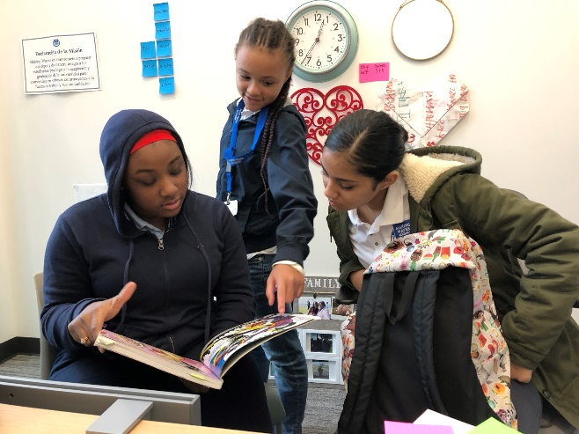
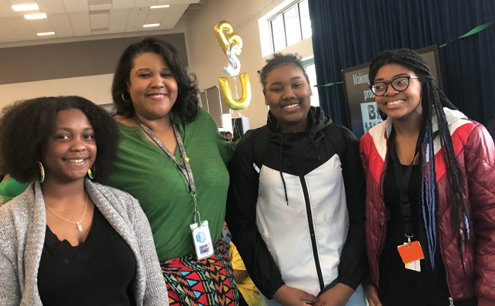
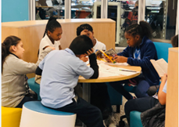
Guiding Question
What recommendations do you have for seamlessly integrating B/AASAI goals and KPIs into MWA core programing and practices?
February 2020
BAASAI MWA Board Update
16

Slide 17
Questions
Micah Stilwell
Intervention Services Coordinator
B/AASAI Coordinator
mstilwell@mwacademy.org

