Slide 1
Annual Update
November 6th, 2019

Slide 2
About Us
We are a public charter school serving grades 5-12 in Richmond, CA founded in 2007.
Mission
Making Waves commits to rigorously and holistically preparing students to gain acceptance to and graduate from college to ultimately become valuable contributors to the workforce and their communities.

Slide 3
Presentation Outline
2018-19 CA School Dashboard
LCAP Goals, Actions, Services & Budget
Governance Proceedings and Process
General Updates
MWA Pittsburg

Slide 4
I. 2017-18 CA School Dashboard
CCCOE Annual Update
4

Slide 5
LCAP/ WASC Alignment
The Dashboard
Local Data
The LCAP
Goal: Improved Student Outcomes
Identifies an LEA’s areas of strength and areas of need.
Provides an LEA with additional data to inform decision-making and planning
Example: WASC Self-Study
The vehicle for an LEA to review its progress, articulate their plans to address the areas of identified need, and communicate its plan to educational stakeholders.
Notes:
AB716 - January 1, 2019

Slide 6
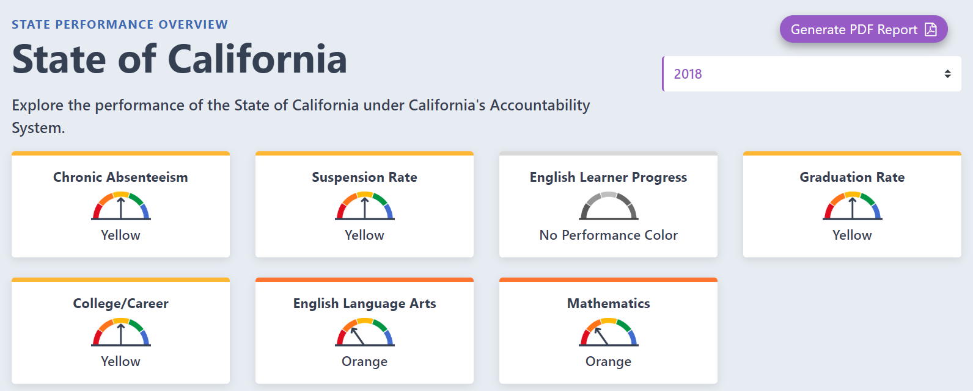
CA School Dashboard – State Indicators
Academic Indicator (includes standardized test results - CAASPP)
Career/ College Readiness
English Learner Progress
Graduation Rate
Suspension Rate
Chronic Absenteeism
CCCOE Annual Update
6

Slide 7
Our Dashboard: State Indicators
Priority 4: Student Achievement (Academic Indicator)
Making Waves Academy English Language Arts
Grades | 2019 Achievement Level | 2018 Achievement Level | Change
5th Grade | Standard Nearly Met | Standard Nearly Met | -4.8
6th Grade | Standard Nearly Met | Standard Nearly Met | +22.2
7th Grade | Standard Nearly Met | Standard Met | -10.4
8th Grade | Standard Met | Standard Nearly Met | +34.5
11th Grade | Standard Met | Standard Met | +21.6
Making Waves Academy Math
Grades | Achievement Level | Achievement Level | Change
5th Grade | Standard Nearly Met | Standard Nearly Met | -13.8
6th Grade | Standard Not Met | Standard Not Met | +22.7
7th Grade | Standard Nearly Met | Standard Nearly Met | -49.4
8th Grade | Standard Nearly Met | Standard Not Met | +38.4
11th Grade | Standard Nearly Met | Standard Nealy Met | +12.2
Notes:
English Language Arts DFS for 2017-2018: -20.8
Prior year (2016-2017) DFS: -27.8
Difference: +7.0
Math DFS for 2017-2018: -66.4
Prior year (2016-2017) DFS: -79.7
Difference: +13.3
DFS - Distance from Standard ( Distance from level 3)
State indicator goes to the State Board of Education in November 2018 (Likely to be approved, however not official)
Students who leave in their

Slide 8
Our Dashboard: State Indicators
State Priority | Indicator | 2019 | 2018 | Change
5: Student Engagement | Chronic Absenteeism (absent 10% or more missed days) | 7.8% | 7.8% | 0%
5: Student Engagement | Graduation Rate (four-year cohort rate anticipated | 98.72% | 94.4% | +4.32%
6: School Climate | Suspension Rate (2018-19) | 6.0% | 6.6% | -.6%
8: Outcomes in a Broad Course of Study | College/ Career Indicator (Projected) | 62% 48 out of 78 graduates are prepared | 70.8% | -8.8%
International Baccalaureate (IB) exams
Grade 11 Smarter Balanced Summative Assessments
Advanced Placement (AP) exams
Career Technical Education (CTE) Pathway Completion
College Credit Course (Previously referenced as dual enrollment)
A-G Completion
State Seal of Biliteracy (SSB)
Leadership/ Military Science

Slide 9
Growth (AY 2019-2020)
Suspension Data based on 2017-18 data and 2018-19 projections
Subgroup | % of Students Suspended 2017-18 | % of Students Suspended 2018-19 | % Change
All students | 6.6 | 6.0 | -0.6
Socioeconomically disadvantaged | 6.7 | 5.5 | -1.2
Students with disabilities | 15.2 | 7.3 | -7.9
African American | 22.4 | 14.7 | -7.7
Hispanic | 5 | 4.4 | -0.6

Slide 10
CA School Dashboard – Local Indicators
Basic Conditions
Implementation of Academic Standards
School Climate Surveys
Parent Involvement and Engagement
Did we measure the data during the year?
Did we report this data to our governing board?
Did we upload it to the dashboard website?
Standards:
Met
Not Met
Not Met for Two Years
CCCOE Annual Update
10

Slide 11
Our Dashboard: Local Indicators 2017-18
Local Indicator | Performance Standard
Priority 1: Basic Services & Conditions at Schools | Met
Priority 2: Implementation of State Academic Standards | Met
Priority 3: Parent Engagement | Met
Priority 6: School Climate | Met
Priority 7: Access to Broad Course of Study | Met
CCCOE Annual Update
11

Slide 12
II. Local Control and Accountability Plan
CCCOE Annual Update
12

Slide 13
Local Control and Accountability Plan
Stakeholder Engagement
Parent Budget Overview
LCAP Highlights
CCCOE Annual Update
13

Slide 14
Local Control & Accountability Plan - Stakeholder Engagement
October
The SSC and ELAC received formal training on the roles and responsibility of the School Site Council, the SPSA and LCAP process. Such training incorporated current legislation updates around AB716 and the integration of the SPSA and LCAP for applicable LEAs.
November
The SSC received formal training on the WASC cycle and how such will be incorporated into the LCAP process beginning summer of 2019. In addition the SSC hosted the textbook public hearing. At this meeting parents, students and teachers were able to ask detailed questions around the textbooks and curriculum set forth in MWA's education program.
December
December 2018 - The SCC was reminded of their role around monitoring and evaluating the SPSA and in the following year, the LCAP. Each SSC member reviewed the components of the evaluation process and was able to ask questions of clarity.
March
March 2019 - The SSC hosted the LCAP Stakeholder Feedback Session. During this time, over 50 attendees were given an overview of the LCAP process, what the LCAP is and the importance and impact of stakeholder feedback.
April
The SSC was given an updated draft the LCAP Annual Update and expenditures to assist with the evaluation process. Members of the public were also included within this process and were able to review the Stakeholder feedback collected during the LCAP stakeholder feedback session. Such feedback provided in both the March and April meetings will also be incorporated into the WASC Self-Study process as the new goals are developed for 2020-2023.
May
The SSC and public stakeholders received a presentation on intervention services offered to all students throughout the year from both the Middle and Upper schools.
In addition to the School Site Council parent stakeholders were able to provide feedback on the current education program through the ELAC and numerous parent meetings held at different times (Saturdays, mornings and after school) allowing for additional feedback opportunities.

Slide 15
LCAP - Parent Budget Overview
AB1808 added EC Section 52064.1- Must be developed in conjunction with, and attached as a cover to, the LCAP for 2019-20.
Funds are broken out as follows:
The LCFF revenue
The LCFF supplemental and concentration grants
All other state funds
All local funds
All federal funds
CCCOE Annual Update
15

Slide 16
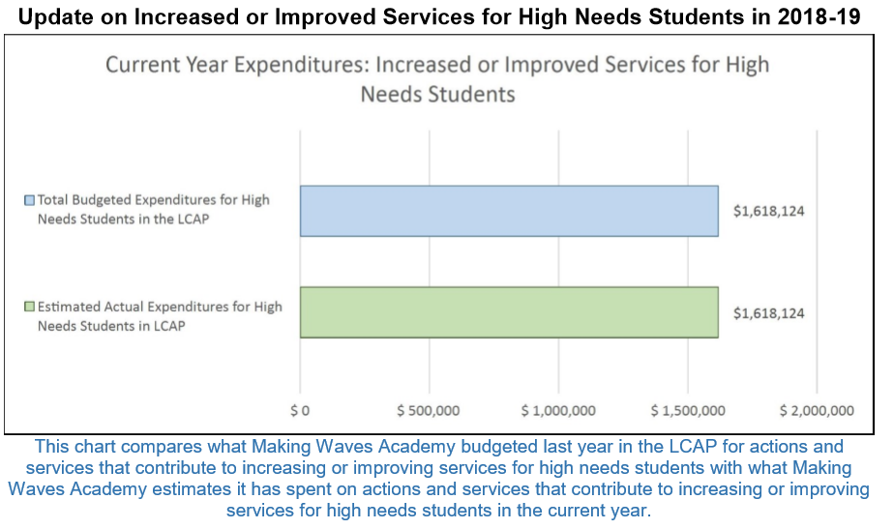
LCAP - Parent Budget Overview
CCCOE Annual Update
16

Slide 17
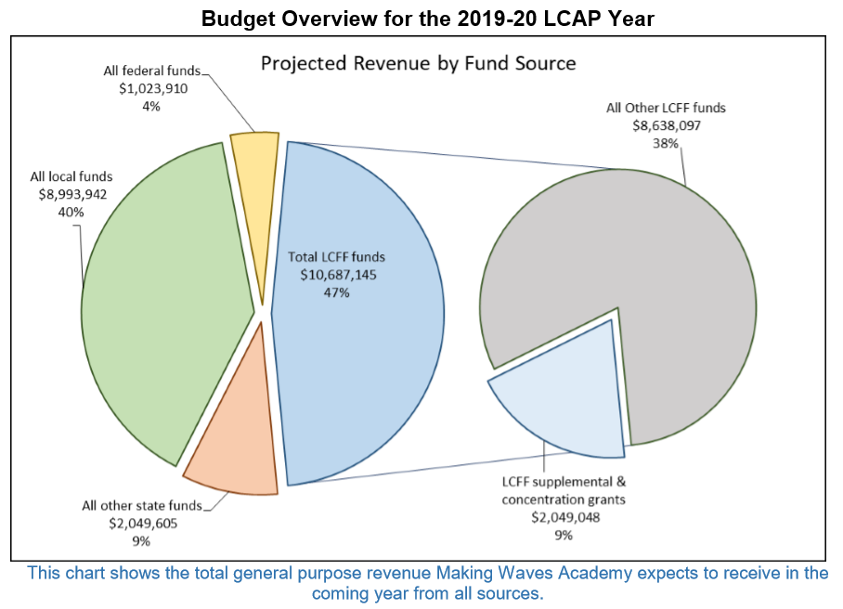
LCAP Budget Overview 2019-20

Slide 18
LCAP - Annual Update
Greatest Progress
Increase in Parent Engagement
Building Capacity with the SSC
Highest number of EL reclassifications (30+)
Expanded course options at the US for CTE
Increased 10 points in mathematics
70.8% of seniors were prepared for college, which was a 6.8% increase bringing MWA into the Blue on College and Career readiness and a graduation rate of 94.4%.
MWA developed and implemented a Black/ African American Student Achievement Initiative (B/AASAI) in the 2018-19 school year.
Greatest Needs
Suspension rates (Students w/disabilities & African American students)
ELA and Math Scores
Chronic Absenteeism
CCCOE Annual Update
18

Slide 19
2019-20 LCAP & Next Steps
Goals will remain the same for 2019-20
LCAP will also serve as the SPSA
Beginning this summer - development of the 2020-2023 LCAP will begin.
Integrated with WASC Self-Study process
CCCOE Annual Update
19

Slide 20
III. Governance Proceedings and Process
CCCOE Annual Update
20

Slide 21
School Site Council
Officer Training on 9/12/19 on positions, member nominations/elections, as well as roles and responsibilities of the SSC in school oversight
Year-long schedule was created to ensure all compliance and oversight functions are completed including review and approval of the LCAP
Elections are happening in the Spring

Slide 22
Board Meetings
Updated Bylaws
removal of sole statutory structure
Updated Practices to increase transparency
Piloting the recording of the meetings
Board is utilizing microphones to support accessibility
Agendas are translated to Spanish
Presentations are included as a part of the board packet ahead of the meetings
Increased participation from members of the public

Slide 23
IV. General Updates
CCCOE Annual Update
23

Slide 24
General Updates
Change in SELPA
WASC Accreditation Year
Visit is scheduled for March 2020
Ribbon Cutting – October 5th, 2019
Material Revision – Fall 19-Spring 20
CCCOE Annual Update
24

Slide 25
V. Pittsburg MWA
CCCOE Annual Update
25

Slide 26
Pittsburg MWA
MWA Pittsburg
On October 17th the MWA Board voted to NOT move forward with MWA Pittsburg and move forward with school closure procedures

