Slide 1
2018 - 19 SBAC Data
Board Meeting
September 5th, 2019
Notes:
EWJ

Slide 2
Objectives
Board and the public will understand how we have interpreted student data, what meaning we take from it and how the 2018 - 19 SBAC data will inform our priorities for the year.
Notes:
EWJ

Slide 3
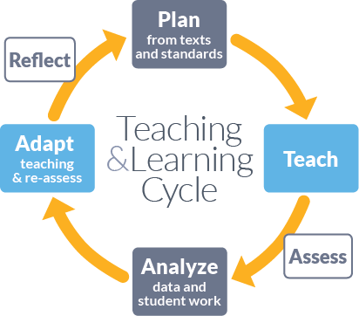
Essential Question
How will the 2018-19 student achievement data inform MWA math instructional shifts and how will we measure our growth?
Notes:
EWJ
..How will we track for success?

Slide 4
Overall Successes
Testing Administration:
Transitioned from 4 to 26 test administrators
Collaborated with faculty to provide designated supports to all students
Instruction:
New Middle School Math Curriculum (year 1)
Fully staffed for ELA classes 5th - 12th grade
Notes:
Builds capacity with 0 test security breaches, moved to classrooms and gym

Slide 5
Overall Challenges
Instruction:
Vacancies in math
Learning a new approach to math instruction
Notes:
Algebra I

Slide 6
Key Terms
SBAC Performance Levels:
Standard Not Met, Standard Nearly Met, Standard Met, Standard Exceeded
Longitudinal Data:
Wave performance over time (Distance From Standard)

Slide 7
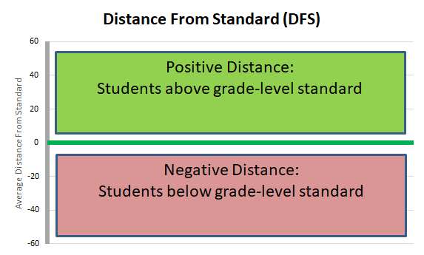
SBAC Measurement of Growth
At grade level standard
Notes:
•Shows how well students are meeting grade-level standards on the SBAC

Slide 8
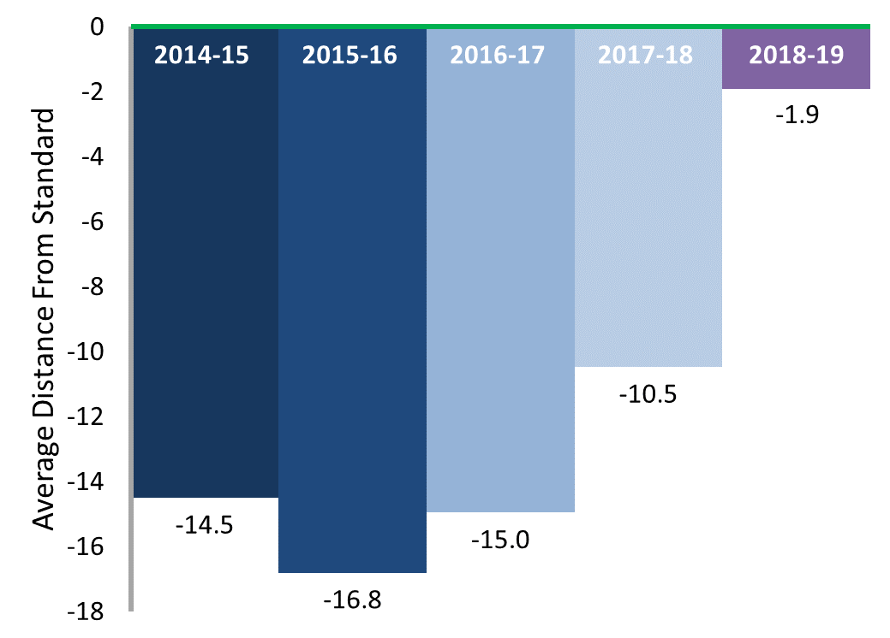
MWA (school-wide) ELA SBAC Historical DFS
At grade level standard
+8.6 points
Notes:
In 2019, the Academy improved it Distance from standard in ELA by 8 points.

Slide 9
Statewide ELA Projections for MWA
Performance: 61st-65th percentile
Growth: 80th-85th percentile

Slide 10
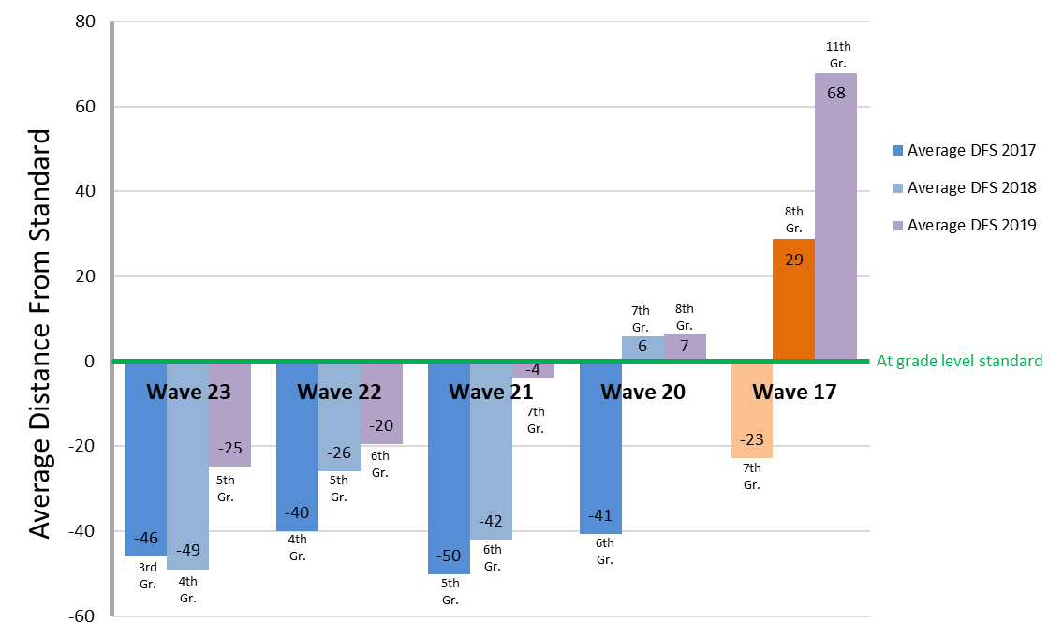
ELA SBAC Longitudinal DFS By Wave

Slide 11
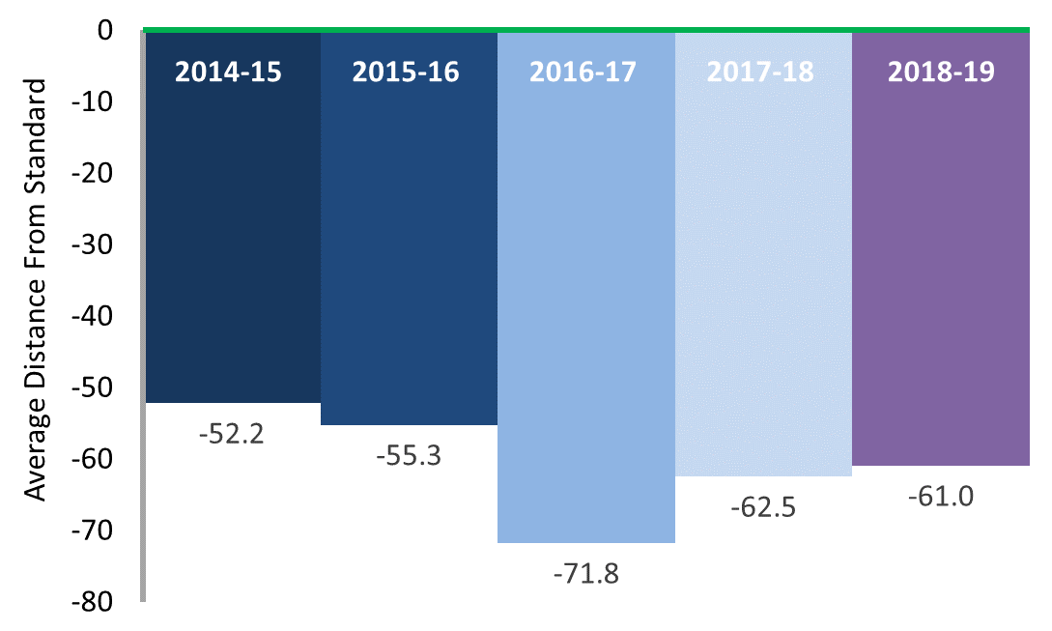
MWA (school-wide) Math SBAC Historical DFS
At grade level standard
+1.5 points
Notes:
KA

Slide 12
Statewide Math Projections for MWA
Performance: 25th-30th percentile
Growth: 55th-60th percentile

Slide 13
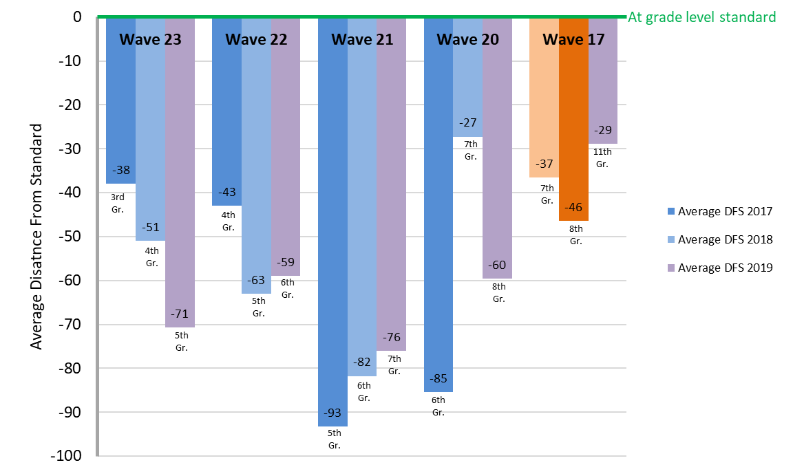
Math SBAC Longitudinal DFS By Wave

Slide 14
Middle School Key Takeaways
ELA: The 18-19 ELA growth demonstrates that the instructional shift (focus on Academic Discourse) yielded success.
Math: Through math model transition, from direct instruction to inquiry based, we were able to maintain our performance level data.
Notes:
As we make a shift from 1 math model to another, there
Through math model transition, we were able to maintain our achievement data scores
We know how to do ela and we are in a place of refining, in math, we had a major model shift in transition--our biggest takeaway is that we are strong in our practices

Slide 15
Upper School Key Takeaways
ELA and Math growth reflects the consistent and intentional use of:
targeted formative assessments and resources that align to standards and summative assessment
strategic re-teaching topics and areas of focus based on highest need
Notes:
Better understanding of IAB structures
Planned IAB use within YAAGs and specific times in PLC where planning, data dives, and reteach planning occurred
Value in being strategic in reteach

Slide 16
Next Steps School-wide
ELA:
Continue to refine practices through academy wide collaboration: calibration around grading
Math:
School Wide: Teachers will understand the vertical progression of standards so that we can tap into prior and future learning in the moment.
Data & Assessments:
Research and recommend a tool to assess and monitor mastery of math content knowledge and foundational skills
Notes:
Maybe we should frame through academy wide, rather than by division??
Bright spots
Conversations and collaboration

Slide 17
Key Questions to Consider
How can we strengthen collaboration across the Academy?
How can we better communicate progress to MWA stakeholders?
How will we assess which initiatives are having an impact on student outcomes?
What updates would you like us to to share with you and Curriculum Review Advisory Committee this year?

