Slide 1
Plan for Improvement
November 25th Board Meeting

Slide 2
Objectives for Today’s Presentation
Seek approval of strategic plan from the Board of Directors:
Vision and Mission Statement
District Values
Theory of Action for Improvement: Transformational Improvement Pillars

Slide 4
Vision (Draft)
All are inspired to lead and succeed
Mission (Draft)
Hogan Preparatory Academy is an exceptional charter school district where students become compassionate leaders who are college and career ready with a competitive advantage.

Slide 5
District’s Common Goal: Purpose
Hogan Graduates are Career and College Ready with a Competitive Advantage which means solid academic and social emotional skills and one or more Market Value Assets:
Internships
Client Projects
9 college credit hours
Industry Certifications
Notes:
Students earn at least 9 college credits and get an early start to their college career.

Slide 6
Our Values
Student Centered - Students are the focus of all our work.
Sense of Urgency - The time to act is now.
High Expectations - Excellence is expected from everyone every day.
Collective Responsibility - Together we are better and accountable to each other.
Results Driven - Meaningful results must be achieved.
Relationships - Quality relationships with all stakeholders is a necessity.

Slide 7
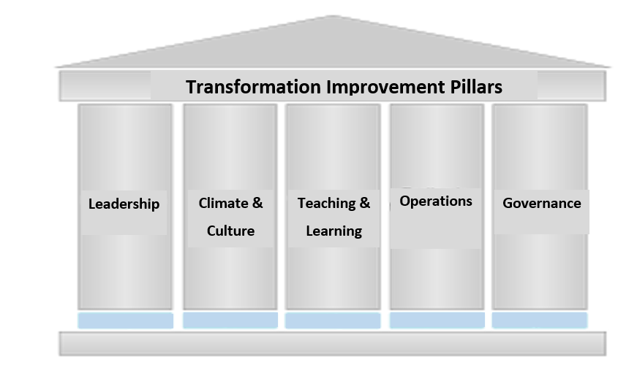
Transformation Improvement Pillars
The Theory of Action to transform the HPA school district will be built on the following pillars.

Slide 8
Improvement Pillars | Desired Outcome
Leadership | All leaders will have clear targets , strategic actions, and progress monitoring mechanisms that work in concert towards the district’s common goal and on-track measures.
Climate & Culture | There will be an educational environment where expectations are high and student centered. And relationships between students, staff, families, and the community will promote high levels of engagement and productive interactions.
Teaching and Learning | Rigorous, relevant, and engaging instruction is consistently implemented and success is increased for all students.
Operations | All operational departments work efficiently and effectively to meet identified standards which support the academic achievement of the district.
Governance | The Board collaborative works with administration to create a clear vision and functions as a quality governing body.
Notes:
Defined = Non-negotiable key performance indicators
Autonomy = Implementation methods of researched-based best practices

