Slide 1
Plan for Improvement
October 28th Board Meeting
Notes:
This is our tentative plan for improvement that is evolving.

Slide 2
Objectives for Today’s Presentation
Will the Board Approve the Strategic Plan for Improvement? (November)
Share and solicit feedback for the new vision and mission statement.
Identify and explain the ultimate purpose for the strategic plan.
Review the core values in the plan.
Review the five pillars of improvement.

Slide 3
Vision (Draft)
All are inspired to lead and succeed
Mission (Draft)
Hogan Preparatory Academy is an exceptional charter school district where students become compassionate leaders who are college and career ready with a competitive advantage

Slide 4
What is the purpose of our new Vision and Mission?
To graduate Hogan Prep students who are college and career ready with a competitive advantage.
Notes:
Students earn at least 9 college credits and get an early start to their college career.

Slide 5
Competitive Advantage
Market Value Assets
Meaningful Work Experiences
College Credits
Industry Recognized Credentials
Entrepreneurial Experiences

Slide 6
What does that mean for our students?
Competitive Advantage
Each student has the necessary academic skills
Each student has the necessary social emotional skills
Each student is on-track and on-time
Notes:
Social Emotion: Manage their own emotions, make responsible decisions, collaborate and create with others

Slide 7
How are we going to do this?
9th Grade
5th Grade
8th Grade
3rd Grade
A²BC
Individual Plans of Study
A²BC
Literacy Scores
A²BC
Career Exposure
A²BC
Literacy Scores
Attendance
Achievement Data
Behavior
Courses Passed
Student College &
Career Profiles
Attendance
Achievement Data
Behavior
STAR Reading Scores
Attendance
Achievement Data
Behavior
Courses Passed
Attendance
Achievement Data
Behavior
STAR Reading Scores

Slide 8
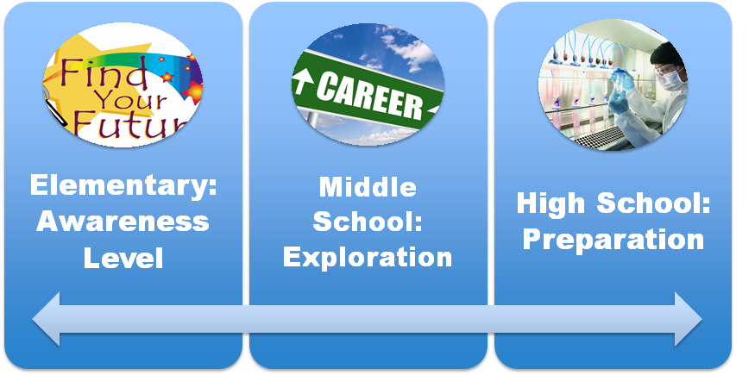
How are we going to do this from a Career Ready Lens?

Slide 9
Preparing for Real World Learning
Elementary School – Career Awareness
Guest Speakers
Career Fairs
Career Exploration Field Trips
Middle School – Career Exploration
Job Shadowing Experiences
Mock Interviews
Career Jumping Experiences
High School – Career Preparation
Internships
College Hours
Real World Learning Projects
Notes:
Sports Lens: Team Work, Dependability, Grit and Perseverance, Competitive Edge
Sports- 11 guys on the field or the 5 on the court… behind the scenes who are is needed for that event.

Slide 10
Multiple pathways are necessary
Only half of all jobs requiring a postsecondary credential require a four-year degree.
44% of the workforce does not have a postsecondary credential of any kind.
The majority of high school graduates in Kansas and Missouri do not complete at least one year of college.
College degree option
Non-degree and hybrid options
Degree options, non-degree credentials, licenses, and guidance should be available for all students.
© 2019 Ewing Marion Kauffman Foundation

Slide 11
Objectives for Today’s Presentation
Will the Board Approve the Strategic Plan for Improvement? (November)
Share and solicit feedback for the new vision and mission statement.
Identify and explain the ultimate purpose for the strategic plan.
Review the core values in the plan.
Review the five pillars of improvement.

Slide 12
Our Values
Student Centered - Students are the focus of all our work.
Sense of Urgency - The time to act is now.
High Expectations - Excellence is expected from everyone every day.
Collective Responsibility - Together we are better and accountable to each other.
Results Driven - Meaningful results must be achieved.
Relationships - Quality relationships with all stakeholders is a necessity.

Slide 13
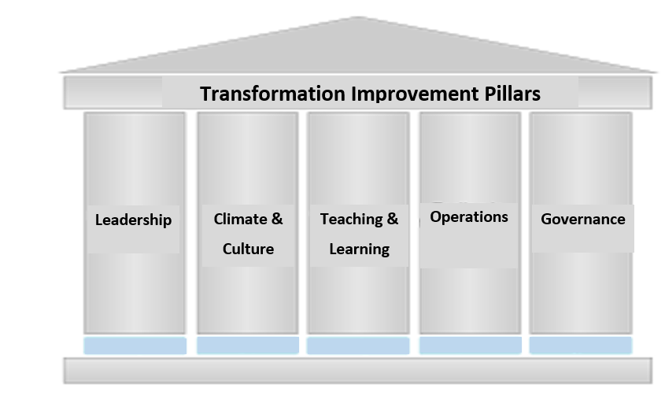
Transformation Improvement Pillars
The plan to transform the HPA school district will be built on the following pillars.

Slide 14
Improvement Pillars | Desired Outcome
Leadership | All leaders will have clear targets , strategic actions, and progress monitoring mechanisms that work in concert towards the district’s common goal and on-track measures.
Climate & Culture | There will be an educational environment where expectations are high and student centered. And relationships between students, staff, families, and the community will promote high levels of engagement and productive interactions.
Teaching and Learning | Rigorous, relevant, and engaging instruction is consistently implemented and success is increased for all students.
Operations | All operational departments work efficiently and effectively to meet identified standards which support the academic achievement of the district.
Governance | The Board collaborative works with administration to create a clear vision and functions as a quality governing body.
Notes:
Defined = Non-negotiable key performance indicators
Autonomy = Implementation methods of researched-based best practices

Slide 15
Summary
What - Graduate each student with a competitive edge
Why - Success in college, career, and life
How - Core Values, Transformational Improvement Pillars, and Real World Learning Experiences

Slide 16
Questions or Feedback
What do like about our plan?
What is missing in our plan?

Slide 17
Objectives for Today’s Presentation
Will the Board Approve the Strategic Plan for Improvement? (November)
Share and solicit feedback for the new vision and mission statement.
Identify and explain the ultimate purpose for the strategic plan.
Review the core values in the plan.
Review the five pillars of improvement.

