Slide 1
21-22 Governor’s Budget
Presented by Stacie Ivery
January 20, 2021

Slide 2
Agenda
20-21 Funding vs 21-22 Funding
LCFF Funding
One-time Funding
ADA Assumptions
Baseline FTE assumptions & ratios
Deferrals

Slide 3
LCFF Funding

Slide 4
Funding Comparison
Due to the reduced ADA at the Middle School (projected at a loss of 51 ADA), there is a loss of $293K in LCFF funding
Currently, these numbers do not include the expanded or targeted academic instruction grant ($4.6B in the budget) or any fee based after-school revenue
The 2nd round of stimulus funds (ESSER II) were included in the assumptions above.
LCFF Funding

Slide 5
LCFF Funding Overview
The Governor’s Budget proposes a 3.84% compounded COLA for 2021-22, which is applied to the LCFF base grants for each grade span
Grade K-3 receive a grade span adjustment (GSA) of 10.4% of the base grant for small class sizes of 24:1
LCFF Funding

Slide 6
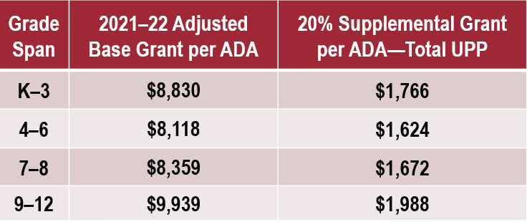
LCFF Funding - Supplemental
Supplemental Grant Funding assumed in current projections:
Middle School: $391K (263 Unduplicated Students / 425 Enrollment)
Elem School: $262K (163 Unduplicated Students / 296 Enrollment)
LCFF Funding

Slide 7
Possible New Restrictions: Supplemental $
New legislation and/or the Governor’s approved budget may require the school to show dollar for dollar spending of supplemental funds. Currently, these funds are unrestricted in nature.
LCFF Funding

Slide 8
Currently not in the budget
COVID-19 liability coverage for LEAs
UPP hold harmless for LEAs seeing a drop in numbers
Charter School ADA hold harmless for 21-22
Additional CalSTRS reductions
Back-filling any of the 0% COLA for 20-21
Eliminating any of the 20-21 deferrals
MORE DISCRETIONARY $$$...lots of restrictive programs
LCFF Funding

Slide 9
One-Time Funding

Slide 10
One-Time Funds 20-21 & 21-22
Funding | Spending Timeline | Middle School | Elementary School
ESSER I (Res. 3210) | 3/13/20 - 9/30/22 | $63,693 | $30,417
GEER (Res. 3215) | 3/13/20 - 9/30/22 | $24,841 | $10,580
CRF (Res. 3220) | 3/13/20 - 12/31/21 | $209,468 | $121,684
SB 117 (Res. 7388) | n/a | $7,970 | $4,967
LLM (Res. 7420) | 3/13/20 - 6/30/21 | $33,899 | $22,062
ESSER II (Res. ???) | 3/13/20 - 9/30/23 | $228,488 | $78,068
IPIG (Res. ???) | 2/16/21 - 12/31/21 | $224,735 | $147,510
LLM II - Extended (Res. ???) | ??? | ??? | ???
TOTAL |  | $793,094 | $415,288
One-Time Funding

Slide 11
Other Restricted Funding
Program | Uses
Special Education | SPED Services
Educationally Related Mental Health Services (ERMHS) | Mental health and SEL services for SPED students and GenEd students
Title I | Services for FRE students
Title II | Professional development
Title III | Services for ELL students
Title IV | Flexible, including mental health services
ASES | MS After School services
Supplemental LCFF Funding | Services for UPP students
One-Time Funding

Slide 12
One-Time Funds Strategy
Due to the decrease in funding during the 21-22 fiscal year, the Director of Finance is recommending the following:
Use the ESSER II funds during the 21-22 fiscal year
Apply for the IPIG funds that can be used up until 12/31/21
Apply for the LLM II funds that can be used for extended and expanded learning opportunities
The CRF funds were all spent by the 12/31/20 deadline, although it was extended at the last minute to 12/31/21 with the passage of the Coronavirus Response and Relief Supplemental Appropriations (CRRSA). CA will require spending by 5/31/21.
One-Time Funding

Slide 13
ADA Assumptions

Slide 14
21-22 ADA Assumptions
Reminder: for 2020-21, AoA was held harmless for any ADA loss and funded off of 2019-20 ADA.
This was advantageous for the middle school that was experiencing declining enrollment and did not affect the elementary school, which had relatively stable enrollment
 | 21-22 Enrollment | 21-22 ADA
K | 48 | 45.6
1 | 48 | 45.6
2 | 48 | 45.6
3 | 48 | 45.6
4 | 52 | 49.4
5 | 52 | 49.4
 | 296 | 281.2
 | 21-22 Enrollment | 21-22 ADA
6 | 145 | 137.75
7 | 140 | 133.0
8 | 140 | 133.0
 | 425 | 403.75
19-20 ADA = 454.63
ADA
19-20 ADA = 284.45

Slide 15
Baseline FTE Assumptions

Slide 16
Baseline FTE Assumptions for Budgeting
Disclaimer:
The following assumptions are not a recommendation. These assumptions are a starting point to begin conversation for budget and LCAP development to ensure that there are staples of the organization that are automatically included, while also allowing for programmatic flexibility for positions based on school site leadership’s recommendations in the LCAP. The positions listed as “Other Positions at AoA” are not intended to be exhaustive and are not being presented as cuts, this is only a list for informational purposes.
Baseline FTE

Slide 17
DRAFT - Baseline LCFF FTE Assumptions
Position | Assumption Student : FTE | Total FTE | Notes
Home Office Leadership |  | 3.0 FTE | ED, Dir of HR, & Dir of Finance
School Site Leadership |  | 2.0 FTE | MS & ES Principal
Support Leadership |  |  | Director of Student Support Services
Home Office |  | 3.0 FTE | Data Manager, HR/Ops Manager, ED Assistant
School Office |  | 3.0 FTE | Receptionist, Ops Manager, Office Manager
ES Teachers (K-3) | 24:1 | 8.0 FTE | Current FTE = 8.0
ES Teachers (4-5) | 26:1 | 4.0 FTE | Current FTE = 4.0
ES PE Teacher (K-5) | 300:1 | 1.0 FTE | Current FTE = 1.0
MS Teachers (6-8) | 28:1 | 18.2 FTE | Current FTE = 20.0 MS FTE formula is: (enrollment / 28) x 1.2
Baseline FTE
*based on enrollment assumptions listed on slide 14

Slide 18
DRAFT - Baseline SPED FTE Assumptions
Position | Assumption Student : FTE | Total FTE | Notes
Director of SPED
Psychologist | 750:1 (All Students) | 1.0 FTE | Current FTE = 1.5 (+a part-time intern)
Mental Health Counselor | 750:1 (All Students) | 1.0 FTE | Current FTE = 0.4
MS Ed Specialist | 25:1 (SPED Students) | 2.0 FTE | Current FTE = 3.0
ES Ed Specialist | 25:1 (SPED Students) | 1.0 FTE | Current FTE = 1.0
SPED IAs | 25:1 (SPED Students) | 3.0 FTE | Current FTE = 4.0 @ MS & 1.0 @ ES
Speech Contractors | $xxx/student (All Students) | n/a
Other Contractors | $xxx/student (All Students) | n/a
Baseline FTE
*based on enrollment assumptions listed on slide 14 & SPED student assumptions (MS = 50, ES = 24)

Slide 19
Other positions at AoA
1.0 FTE Counselor (K-8)
2.0 FTE Technology Support (K-8)
1.0 FTE Dean of Students (MS)
1.0 FTE Restorative Justice Coordinator (MS)
1.0 FTE Coordinator of Student Culture (ES)
1.0 FTE Instructional Coach (MS)
1.0 FTE Instructional Coach (ES)
.75 FTE Reading Coach (ES)
1.0 FTE After School Coordinator (ES)
1.0 FTE After School Coordinator (MS)
1.0 FTE Spanish Elective Instructor (ES)
0.4 FTE Music Elective Instructor (ES)
2.0 FTE Kinder Aides (ES)
Varies After School Instructors & Yard Supervision (MS & ES)
These positions should be funded in the LCAP using supplemental or restricted funding sources since they are above and beyond the general “baseline” program. Additional FTE for teachers would fall into this category as well.
Baseline FTE

Slide 20
Deferrals

Slide 21
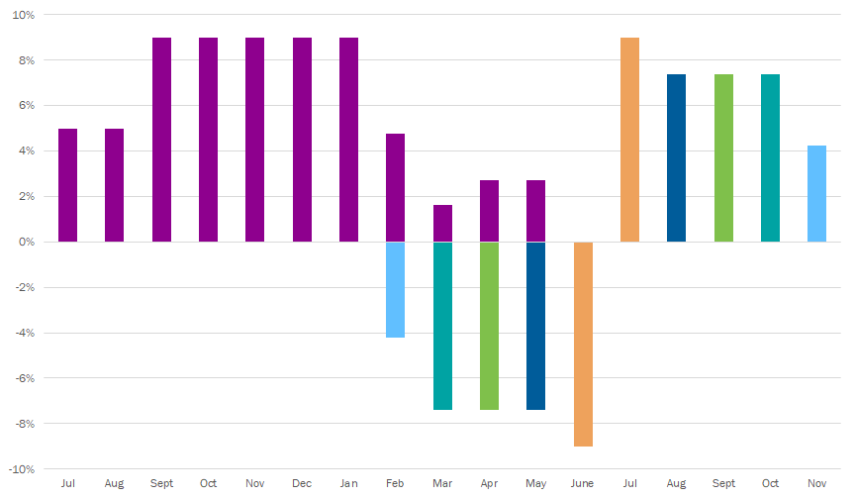
Deferrals
The 21-22 budget proposal eliminates apportionment deferrals for 21-22, but does not propose paying off 20-21 deferrals early.
The June to July deferral will most likely be ongoing, but is not a great concern to AoA.
Reminder: the current 20-21 deferrals below will result in 45% of AoA’s state aide arriving after June 30, 2021. (approx $1.54M)
Deferrals

Slide 22
Cashflow
LAIF - current investment is $1,479,169
December yield at 0.54%
Interest is paid quarterly
Coming up on the first round of deferrals in February
Per the 1st Interim, estimated YE cash is projected at $1.74M
PPP Loan is still in the forgiveness process and $1.18M of the $1.74M mentioned above.
Deferrals

