Slide 1
Fitchburg State University Strength and Conditioning Center
Department of Exercise and Sports Science
Department of Athletics
Jeff Godin, Ph.D., CSCS
Associate Professor, Head Strength Coach

Slide 2
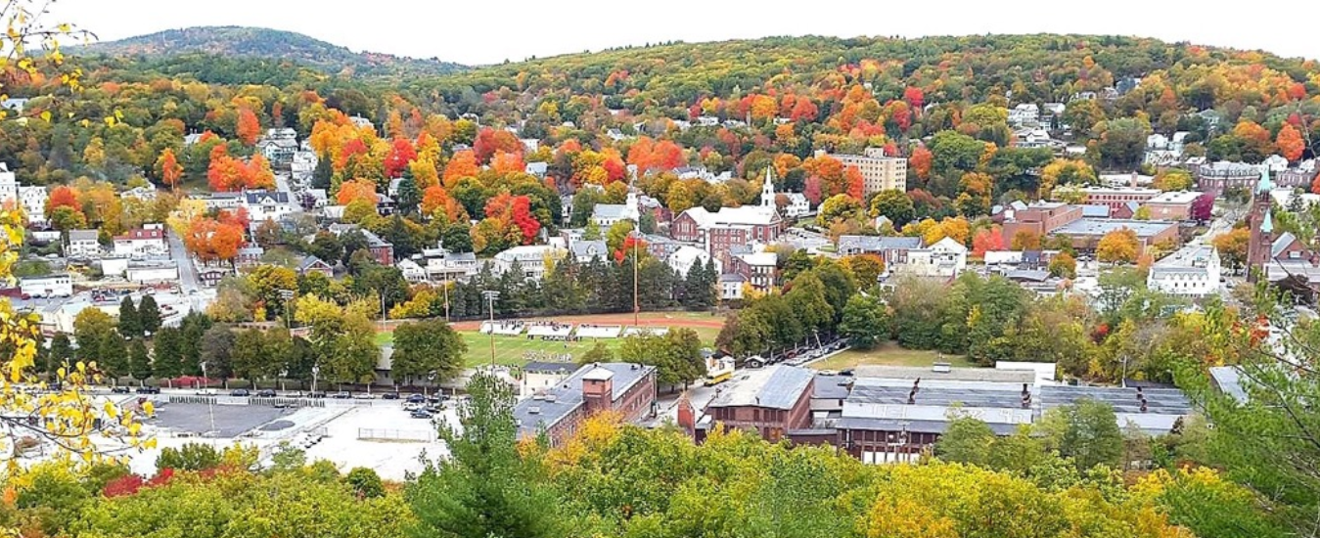
I found myself here….

Slide 3
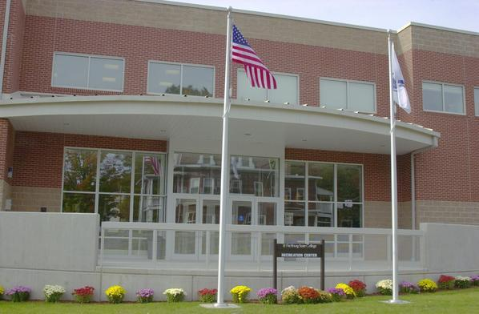
Then this happened Summer/ Fall 2000

Slide 4
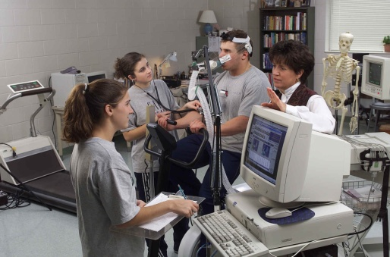
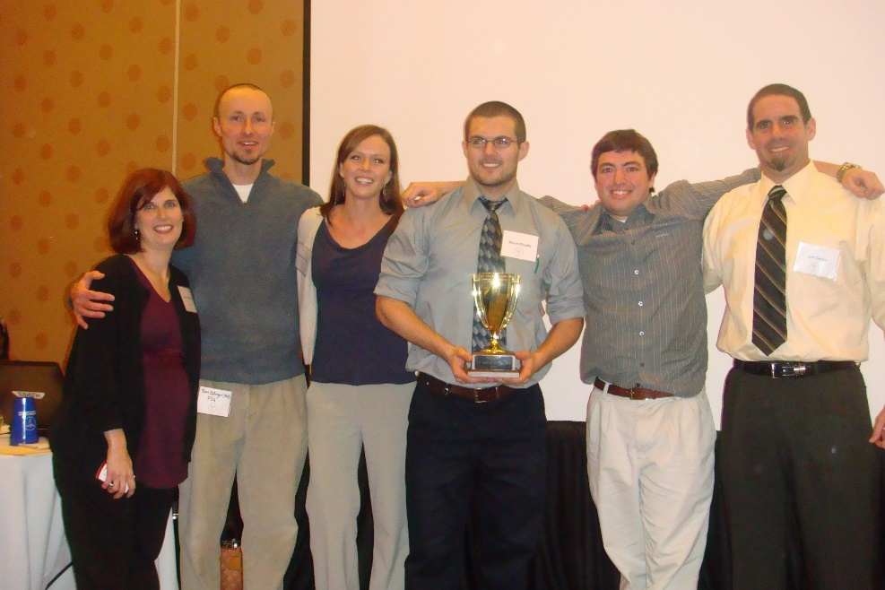
Exercise and Sports Science Major
Established in Fall 2002

Slide 5
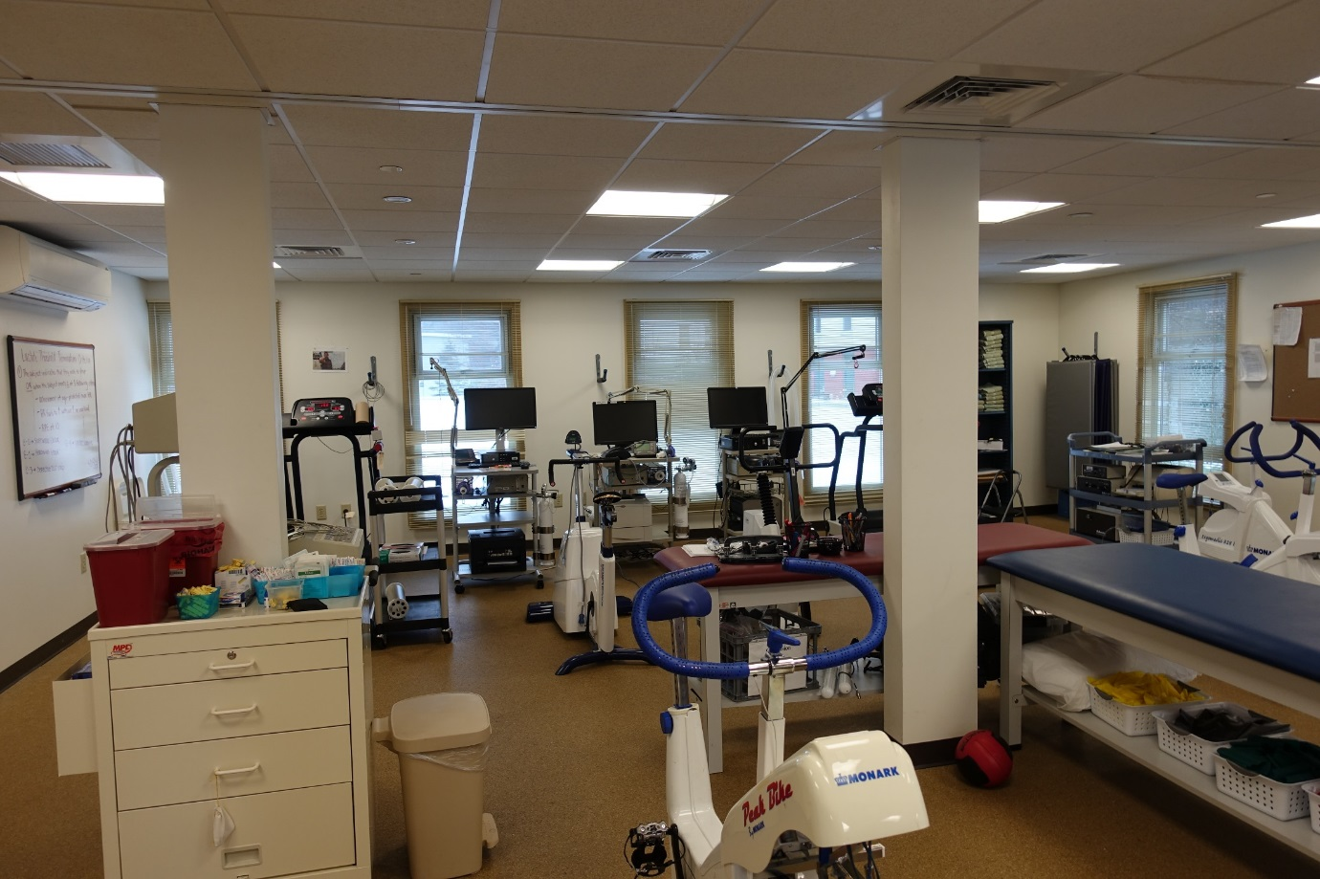
Exercise and Sports Science Major
155 North Street Renovation, Fall 2012

Slide 6
What are they up to today?

Slide 7
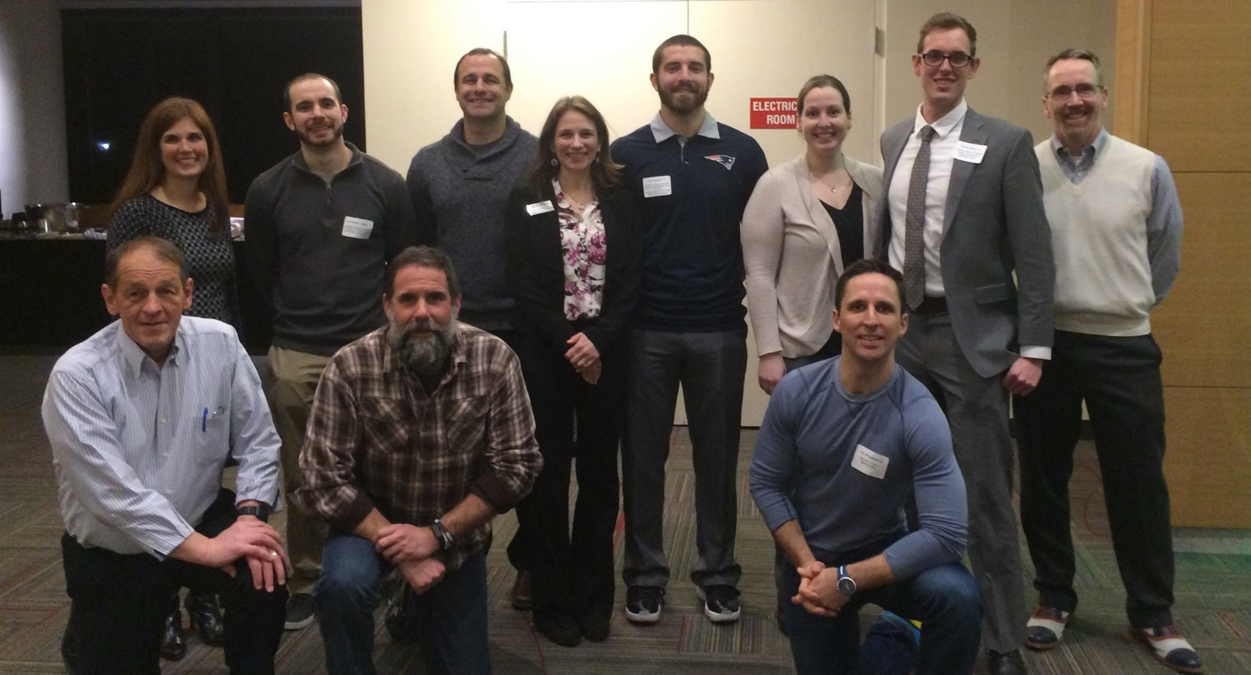
What are they up to today?

Slide 8
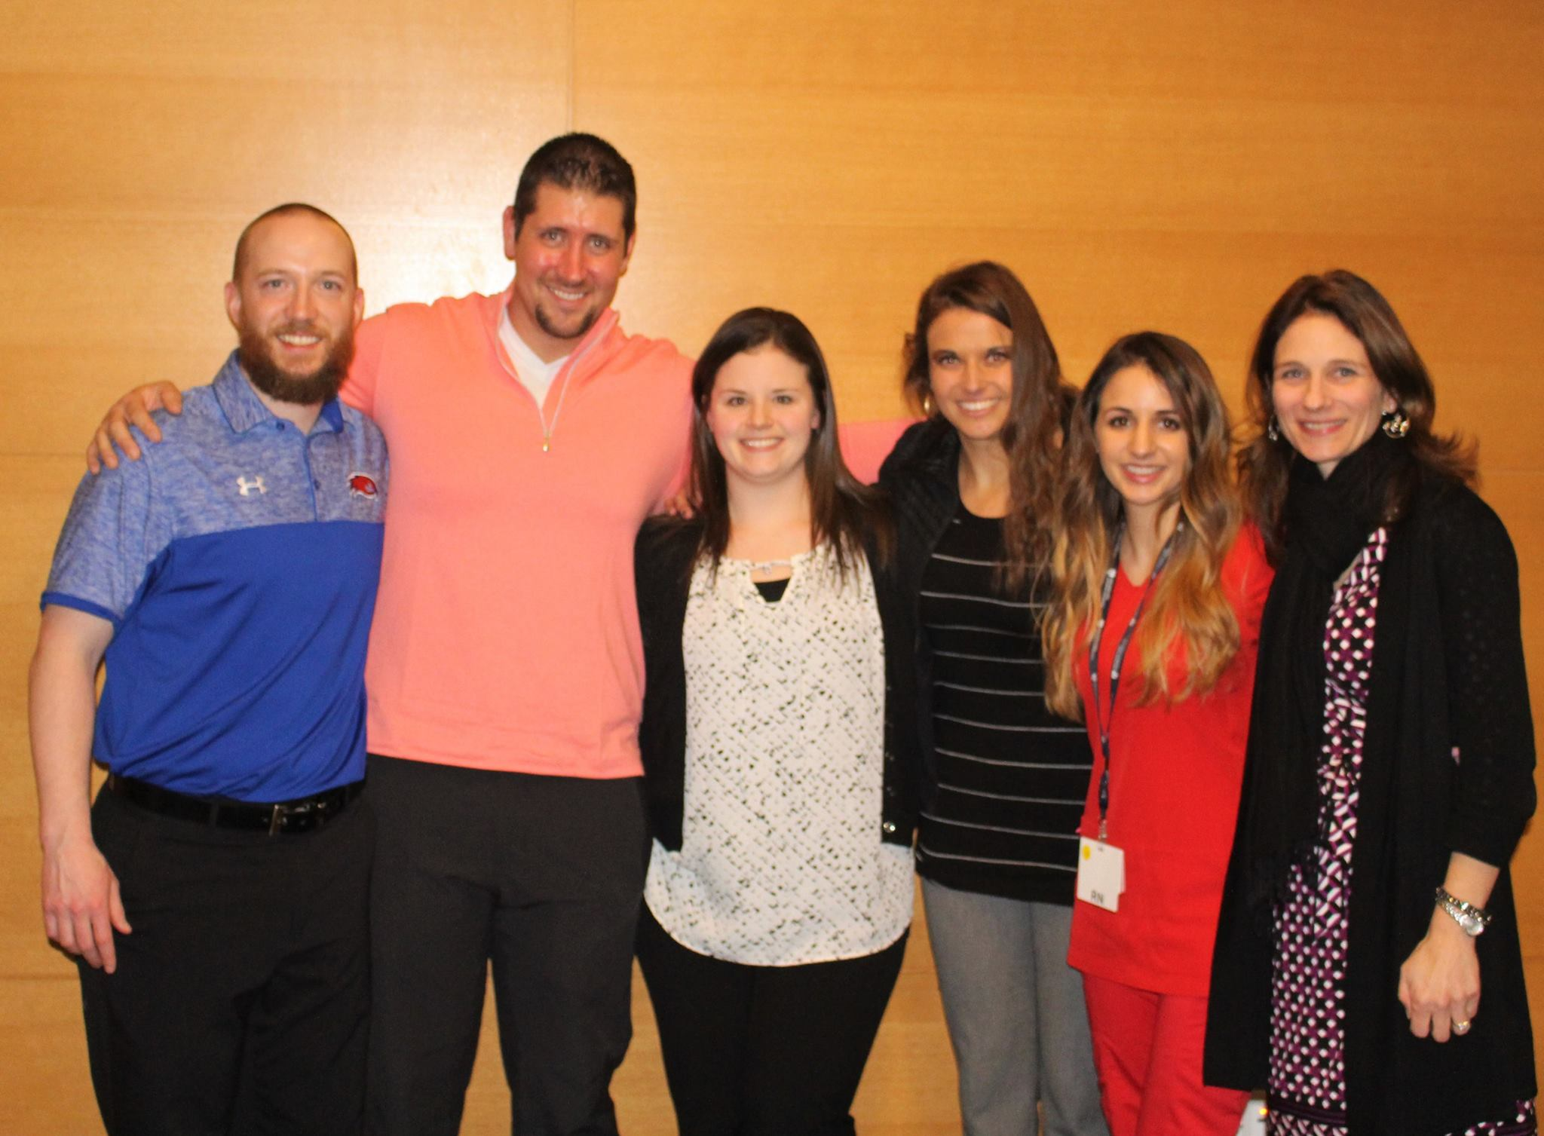
What are they up to today?

Slide 9
15 Years Later

Slide 10
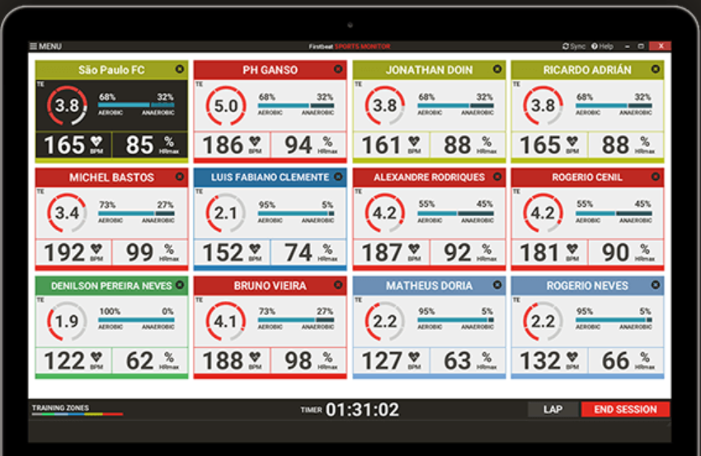
15 Years Later

Slide 11
Strength and Conditioning Center: Academic Mission Statement
The Academic Mission of the Strength and Conditioning Department is to foster an inclusive environment that promotes student, faculty, and professional staff engagement in a culture of learning and service. To provide learning experiences that extend beyond the classroom and prepares students to lead and serve in the profession of “Strength and Conditioning”.

Slide 12
Thank you! This is the end, but really, we are just getting started.

