Slide 1
An Overview of Emergency Preparedness and
Personal Safety Course Offerings
November 14, 2017
Notes:
Last updated for the BOT was in April of 2015.
Focus is from April 2015 forward.

Slide 2
Overview
Composition of the Emergency Management Team
Emergency Management Trainings
Status of the Emergency Management Plan
Drills & Exercises
Incidents & Events
Personal Safety Course Offerings
Opportunities

Slide 3
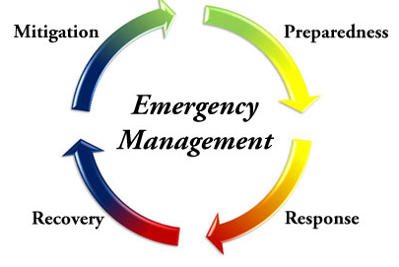
Preparedness defined by DHS/FEMA
“A continuous cycle of planning, organizing, training, equipping, exercising, evaluating, and taking corrective action in an effort to ensure effective coordination during incident response."

Slide 4
Emergency Management Team
Preparedness

Slide 5
Emergency Management Team
Internal Team Members:
Student Affairs
  Student & Academic Life
  University Police
  Housing and Residential Services
  Student Development
  Counseling & Disability Services
Capital Planning and Maintenance
  Environmental Health and Safety
Technology
Human Resources
Public Relations
Staff and Faculty Representatives
International Office
External Team Members:
Fitchburg Fire Department
City Emergency Management Director
Fitchburg Police Department
Leominster Hospital
MEMA Region IV Representative
28 Team Members
Notes:
Expanded since 2015.
Currently has 28 members.

Slide 6
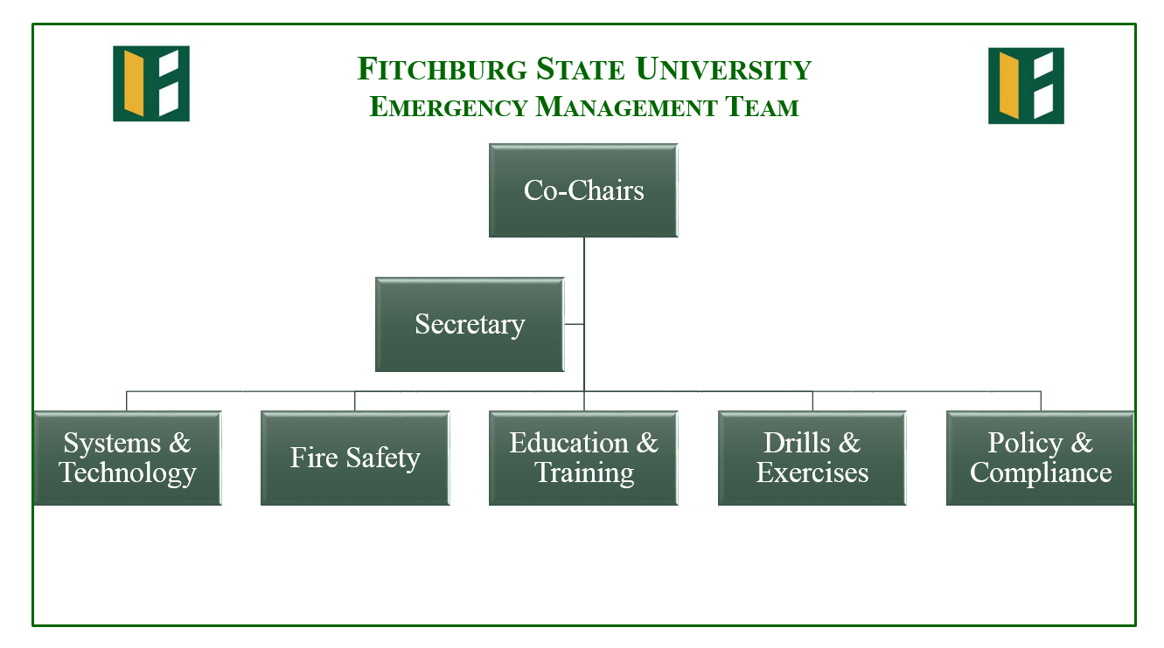

Slide 7
Training
Preparedness

Slide 8
Emergency Management Trainings
December 2015: TEEX – Managing Critical Incidents for Higher Education Institutions: A Multi-Disciplinary Community Approach
January 2016: MSP – Bomb Threat Response
August 2016: TEEX – Managing Critical Incidents for Higher Education (Executive Overview)
December 2016: New England Higher Education Emergency Managers Symposium (Babson College)
March 2017: MEMA – Emergency Operations Center Management and Operations
Notes:
As well as some on-line training programs:

Slide 9
Emergency Management Trainings
March 2017: TEEX – Sports and Special Events Incident Management (Assumption College)
May 2017: MEMA – WEBEOC Training
October 2017: IACLEA – Extremism & Violent Protests
November 2017: MEMA – All Hazards Emergency Preparedness Conference (DCU Center)
November 2017: MEMA – Incident Command System (ICS) Overview for Executives
Notes:
As well as some on-line training programs:

Slide 10
Emergency Management Plan
Preparedness

Slide 11
Emergency Management Plan
The current plan
  Was developed in 2015
  Is currently being revised by the Emergency Management Team
    Policy & Compliance subcommittee
Draft of the updated plan
  Scheduled for January 2018
  MEMA has offered to review the plan as necessary.

Slide 12
Drills & Exercises
Preparedness

Slide 13
Drills & Exercises
Tabletop Exercises:
Residence Hall Fire
Active Shooter
Fire in the City – impact to the campus
Hazmat Incident
Measles Outbreak
Drills:
Mass Notification System
Fire Drills
Hazmat Incident with FFD
Active Shooter with FFD and FPD (Spring 2018)
Notes:
Since April 2015

Slide 14
Incidents & Events
Response & Recovery

Slide 15
Incidents & Events
Incidents (IAP’s):
  Armed individual, shots fired, near campus
  Bomb Threat at McKay (X2)
  Smoke in the Server Room
  Network outage (severed fiber optic line)
  Student Injured in a Motor Vehicle Accident
  Power Outage
Planned Events (EAP’s):
  Commencement Exercises
  Dances
  Athletic events
  Special Olympics
  Homecoming
Notes:
Not a comprehensive list.

Slide 16
Personal Safety Offerings
Preparedness & Mitigation

Slide 17
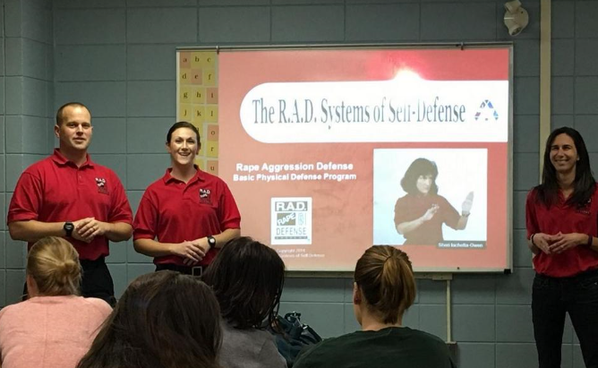
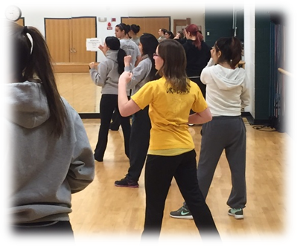
The course includes lecture, discussion and hands on self-defense techniques suitable for women of all ages and abilities.
The class ends with a simulation scenario where the student is able to employ self defense techniques in the training environment.
Notes:
12 Hour program
Since February 2016: 55

Slide 18
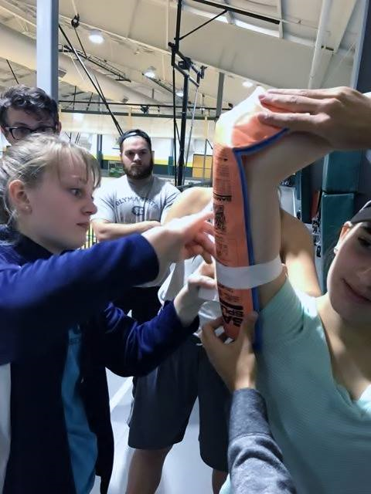
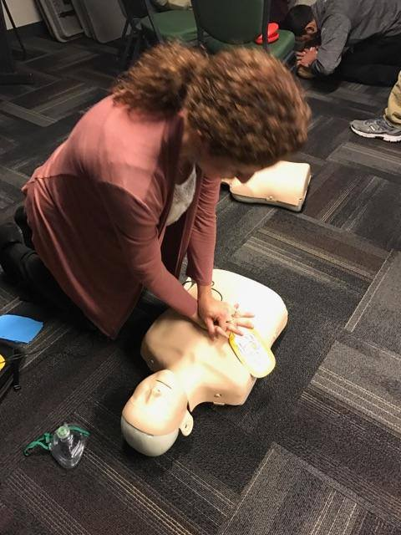
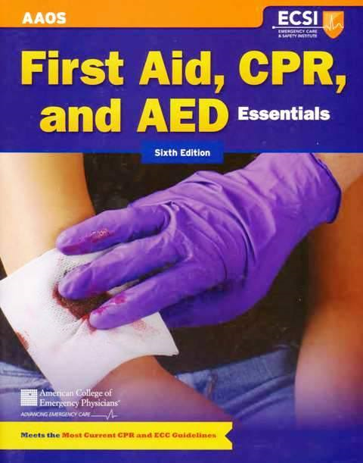
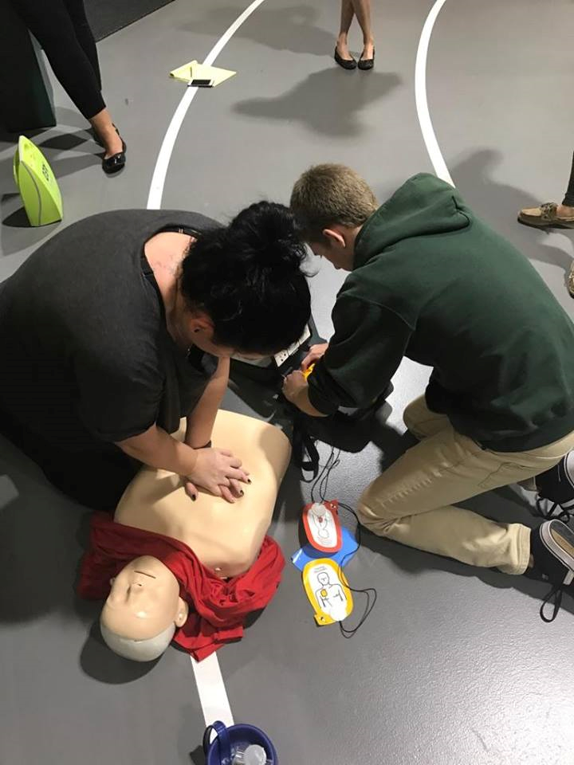
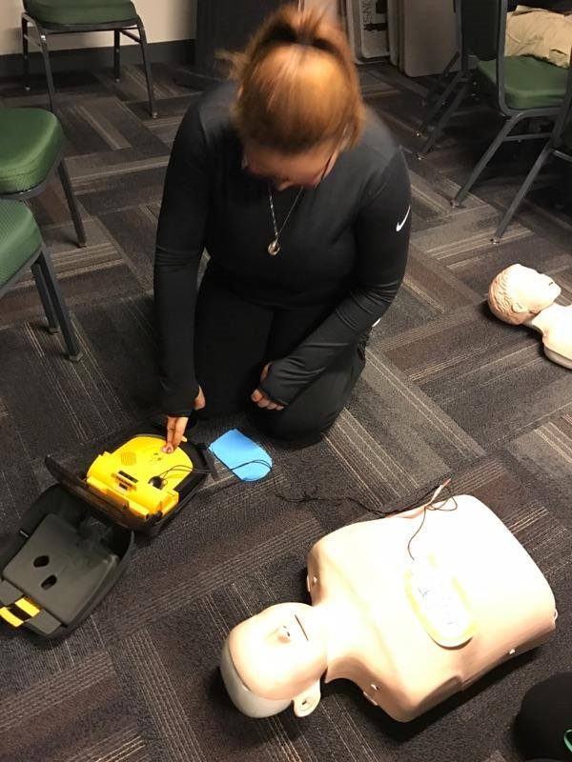
First Aid, CPR & AED
Notes:
4 hour program
Since September 2016: 60

Slide 19
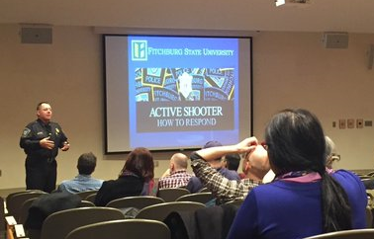
Community Response to an Active Shooter Event (C.R.A.S.E.)
Using guidelines developed by the U.S. Department of Homeland Security, the Fitchburg State University Police Department delivers an hour long training session for the Fitchburg State University community.
Response Options:
GET OUT
HIDE OUT
TAKE OUT
http://www.fitchburgstate.edu/offices/campus-safety/campus-police/active-shooter/
Notes:
1.5 hour program
90 minute program
Since Winter of 2015: 1,200

Slide 20

Violence Identification, Prevention and Reporting (V.I.P.R.)
Violence Identification, Prevention and Reporting (V.I.P.R.) was created to enable trained individuals to spot suspicious behavior before criminal acts occur. The methodology is based upon a behavioral observation recognition awareness course for law enforcement.
Participants will:
  Develop an enhanced level of awareness
  Learn how to identify suspicious behaviors
  Learn how to report their observations to authorities
Notes:
2 hour program
2 Tracks:
Those who have direct student involvement
Others who are part of the University Community
Submitted by Dr. Bayless for national recognition
Since August 2017: 105

Slide 21
In Development
Preparedness & Mitigation

Slide 22
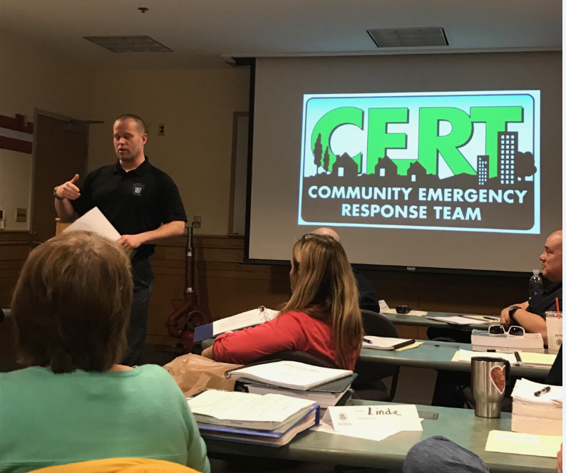

Campus Community Emergency Response Team (c-cert)
C-CERT educates faculty, staff, and students about disaster preparedness for hazards that may impact their environment.
Provides training in basic disaster response skills such as fire safety, light search and rescue, team organization and disaster medical operations.

Slide 23


Until Help Arrives
Course Outline
  You make a difference
  Call 911
  Stay safe
  Stop the bleeding
  Position the injured
  Provide comfort

Slide 24
Opportunities
Collaboration with the International Office
  Emergency Protocols for International and Study Abroad students
College & University Consortium
  MEMA Region IV (Worcester County)
Collaboration with the Department of Nursing
  Personal Safety Trainings (CRASE and Narcan)
  Tabletop Exercise
  Boston Marathon Presentation
Collaborations with the Fitchburg School District and the Police Department on Active Shooter Response at McKay
Hosting additional MEMA Trainings

Slide 25
Thank you…
…for your time and continued support of
Fitchburg State University.

