Slide 1

Student
Notes:
Let me thank you for being here this morning and welcoming you back, its nice to see the campus come back to life .
So today we are tackling I think a topic in higher education that is of continued discussion and which really I think has limited pre-established blueprints and that is DE and online learning. While I know there are best practices out there, I think every institution has to find its way through this component of higher ed.
Its also an area that Fitchburg state has done very well in and has positioned itself to grow even stronger over the next few years. But one of the components that I think is important to do, and which you though was important to do because it was in the strategic plan is to have discussions on the role of DE and OL at an institution. And that is what we would like to do again.
And under the coordination of Cathy Canney I think we have put together a very good day concluding with an open forum at the end of the day to dicuss some of the sisues that arise throughout the day. So I ask you to stick around for that last session.
But before we get on with the day’s topic I wanted to catch you up with what we have been able to accomplish this past year and what we plan to move forward on this coming year.

Slide 2
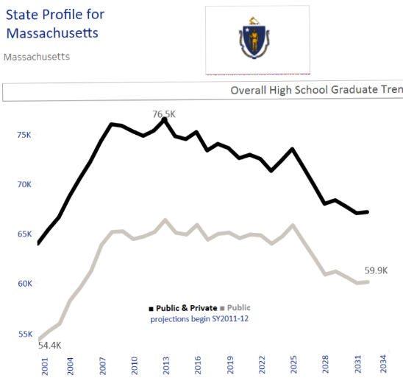

Slide 4
Recruitment vs. Retention
Notes:
First was the development of the academic affairs and for us that meant the hiring of four new deans
John Schlaumlofell
France Barracelli
Becky Coper-Glenz
Its also meant hiring new director of assessment – Merri
A new director of tutoring - Chris Coffin
A new coordinator of accelerated online programs Nicle Chemis
19 faculty searches
We continue with this process this year with a search for admissons director, director of the DE office, executive director of the library and a Dean for Business and Tech. and about 5-7 faculty searches.

Slide 5

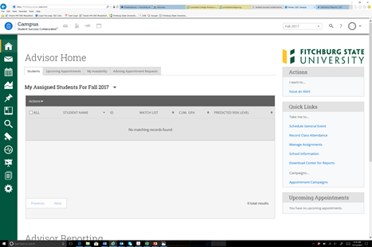


Institutional Level Initiatives
Student Success Taskforce

Slide 6


Slide 7
Pre-registering freshmen for 15 credits.
Four-year plans of study.
Encouraging advisors to focus on 15 credits.

Slide 8
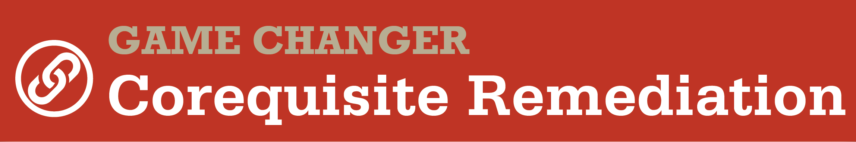

Slide 9
Math Co-Requisite
In the fall of 2015 Fitchburg State allowed students to enroll in college-level math courses with a supplemental instruction that was a co-requisite. The data shows that students in the pilot have sustained higher retention as compared to the overall cohort and those students entering basic math.

Slide 10
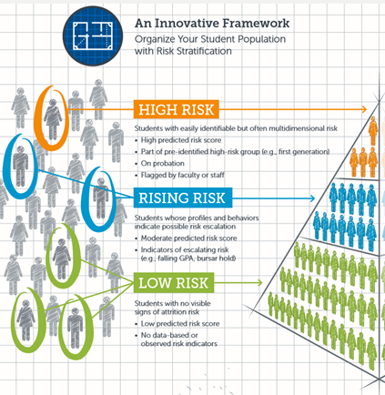

Slide 12
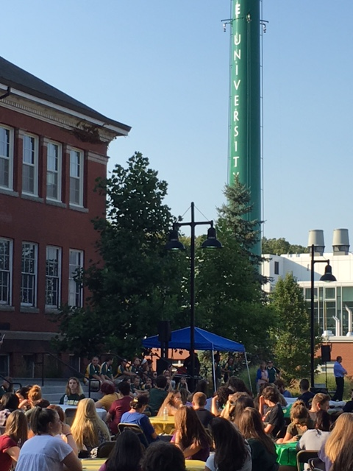
Notes:
So for this incoming class, this is a picture of them here yesterday at the end of the day yesterday as they checked in. This group is more diverse than there predecessors and 42% are first generation

