Slide 1
Board of Trustees Academic Affairs Update
October 17, 2023

Slide 2
Establishing Priorities AY (2023-2024): Process
Provost Council Retreat (June 2023): Establish priorities and timelines
Chairs Workshop (August): Share priorities and solicit feedback from department chairs. Incorporate Chairs’ feedback.
Development Day (September): Share PPT from BOT retreat, academic affairs priorities shared with chairs, and solicit feedback from department chairs. Incorporate feedback from faculty.

Slide 3
Short-Term
AY 23-24
Long-Term
AY 23-26
Medium Term
AY 23-25
Institutional Learning Priorities (ILP’s)
Committees & Charges
NECHE Projections
Departmental Policies &
Procedures
Classroom Inventory & Scheduling
Faculty/Librarian Hiring Plan
Internship Manual
First-year Experience (FYE)
Pre-Registration & Orientation
Faculty and Librarian
Work/Workload
Examining Academic Program
Array
Academic Integrity
Internationalization Plan
General Education
Better Integration with SGOCE
Modality
Morale
Diversifying Faculty/Librarians

Slide 4
How are decisions made about hiring faculty and librarians?
Enrollment data (discipline specific and institutional)
Student credit hour generation
Areas of specialization within a department
Delivery of a high-quality curriculum
Demographic composition of our faculty be rank
Close consultation with academic deans and department chairs

Slide 5
What information do we request?
Department Goals: How will the position advance program goals?
Teaching Responsibilities: What courses will be taught?
Strategic Priorities: Connection to Mission and Strategic/
Academic Plan
Supporting Data: Course demand, seat utilization, class size, medican SCH per instructor, trend data

Slide 7
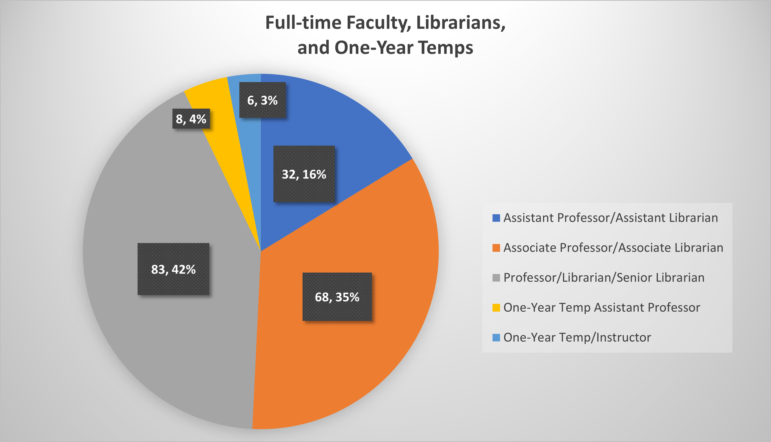

Slide 8
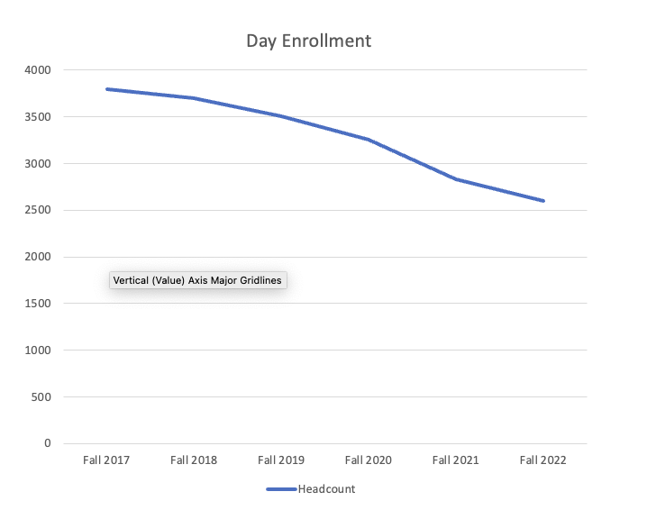

Slide 9
AY 2022-2023 (Searches in AY 2023-2024): Faculty Request Process Results
Requests
2 failed Searches (2022-2023)
12 New Requests
Provost’s Recommendations
4 to VP’s
3 Extension current one-year temps
5 Denied (eliminate or staff with adjuncts)
Track Searches (2023-24)
2 failed searches (2022-2023)
3 new requests

Slide 10
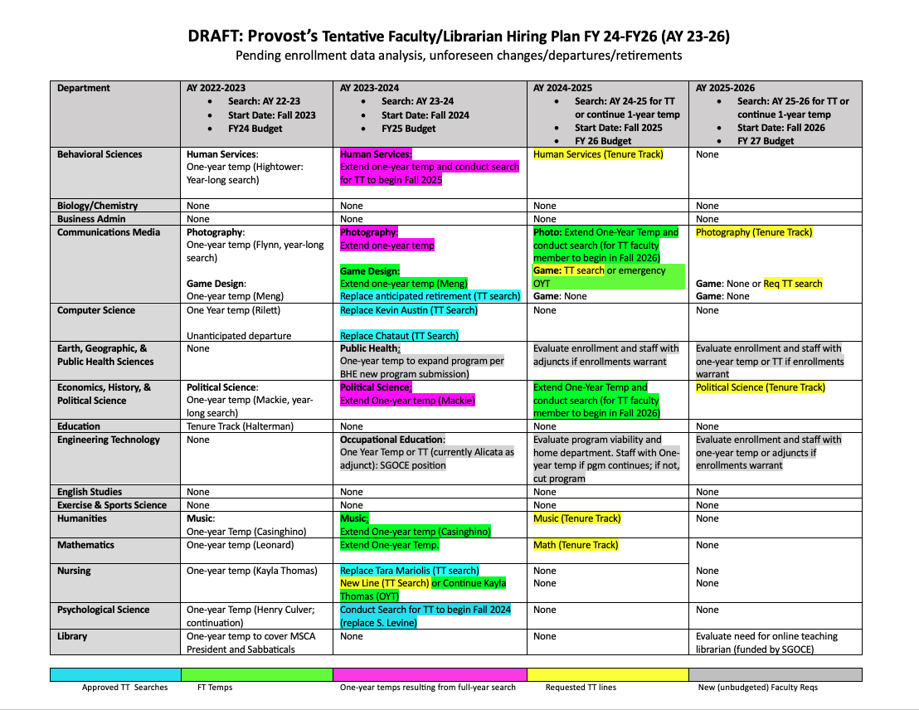
As of 10/3/2023

