Slide 1
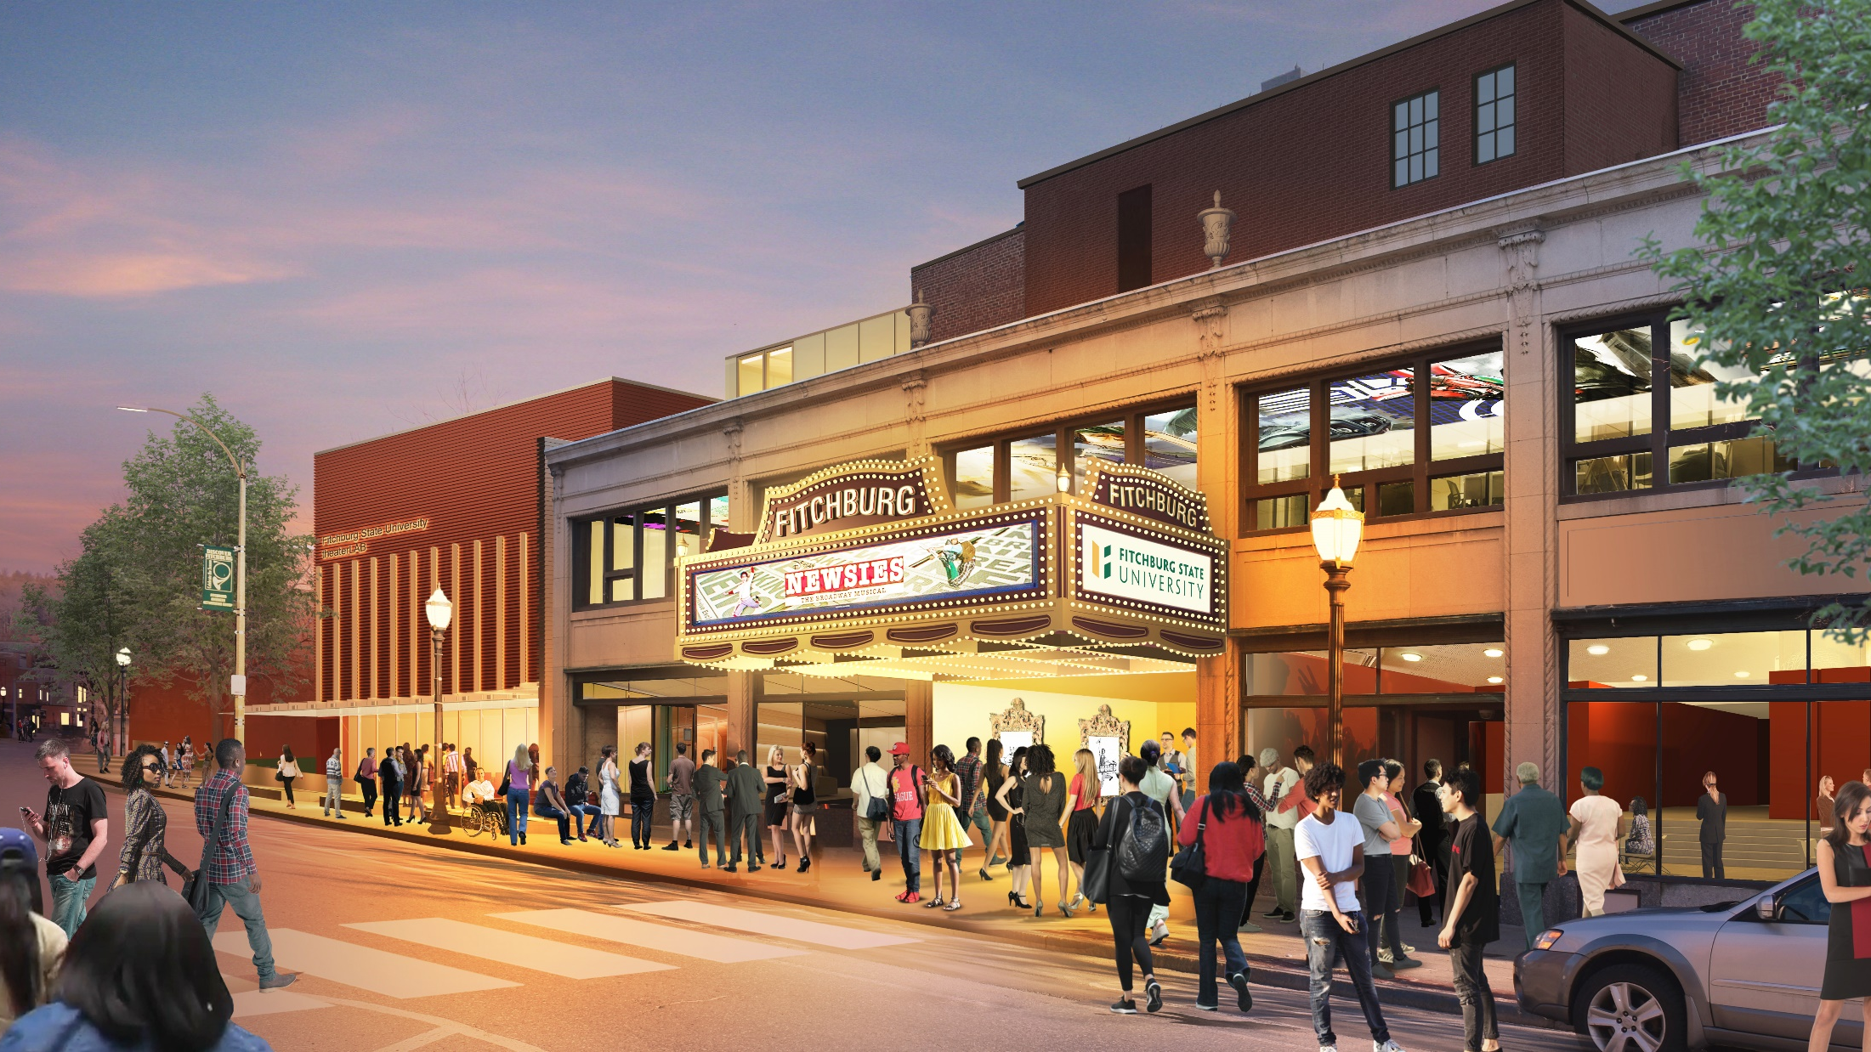
Fitchburg State University
Board of Trustees Meeting
February 7, 2023

Slide 2
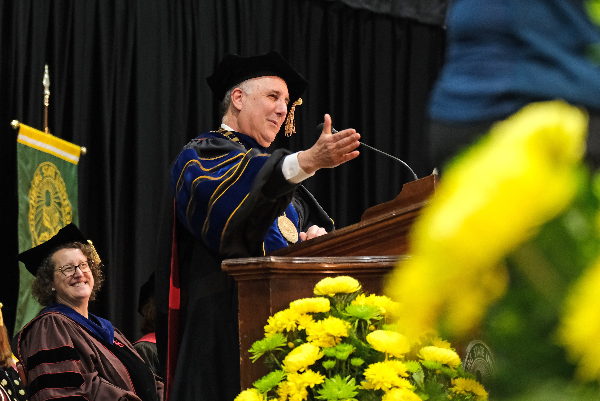
“ The university does not, and should not, operate in a vacuum. Surrounding this beautiful campus is an important part of our history, character and success: the city of Fitchburg. Public universities are inextricably linked with the communities that surround them and possess a unique opportunity to both serve them and benefit them. We understand that we cannot be a great university without a strong and lasting connection to the city and region we serve”
From President Richard S. Lapidus’ Inaugural Address
October 12, 2016

Slide 3
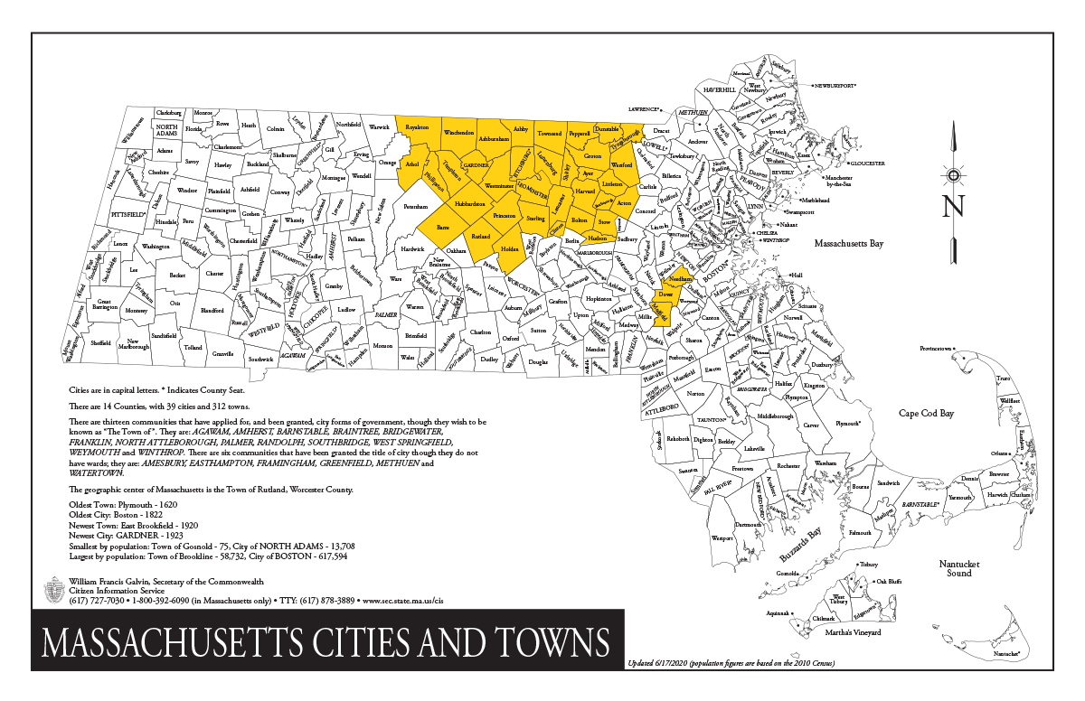
A Regional Institution:
FY 22 Enrollments, Regionally:
Undergraduate: 1,704 students
Graduate: 804 students
Total: 2,591 students
Alumni, Regionally
12,725 Alumni
Total Enrollment:
Undergraduate: 3168
Graduate: 3388
40,000 alums throughout MA
40% of students are first generation
85% of students come from within 50-miles of Fitchburg

Slide 4
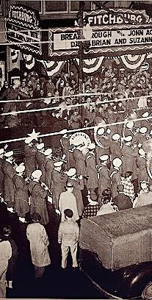
Setting the Stage
2015 Campus Listening Tour
Upgrade Curricular Innovation, Creativity & Entrepreneurship
Vibrancy on Campus
Steward of Place: Locally and Regionally
2015 City Listening Tour
Creative Economy
Regional Destination
Geographic Density of Interesting Things
2016 Kresge Foundation
Collaborate, the importance of a community to share and tell the same story
Creating synergies with the creative economy

Slide 5
Institutional, Community & Regional Advancement
Arts and Cultures, Vision
Town and Gown, Collaboration
Regional Ecosystem, The Berkshires of North Central
"Many universities insist that simply by their presence, they provide an economic engine for their host communities. Other institutions of higher learning, such as Fitchburg State and UMass Lowell, provide direct investment that generates tax dollars and business opportunities. That’s the type of mutually beneficial relationship that most college towns aspire to."
-Sentinel & Enterprise, 2023 Editorial

Slide 6
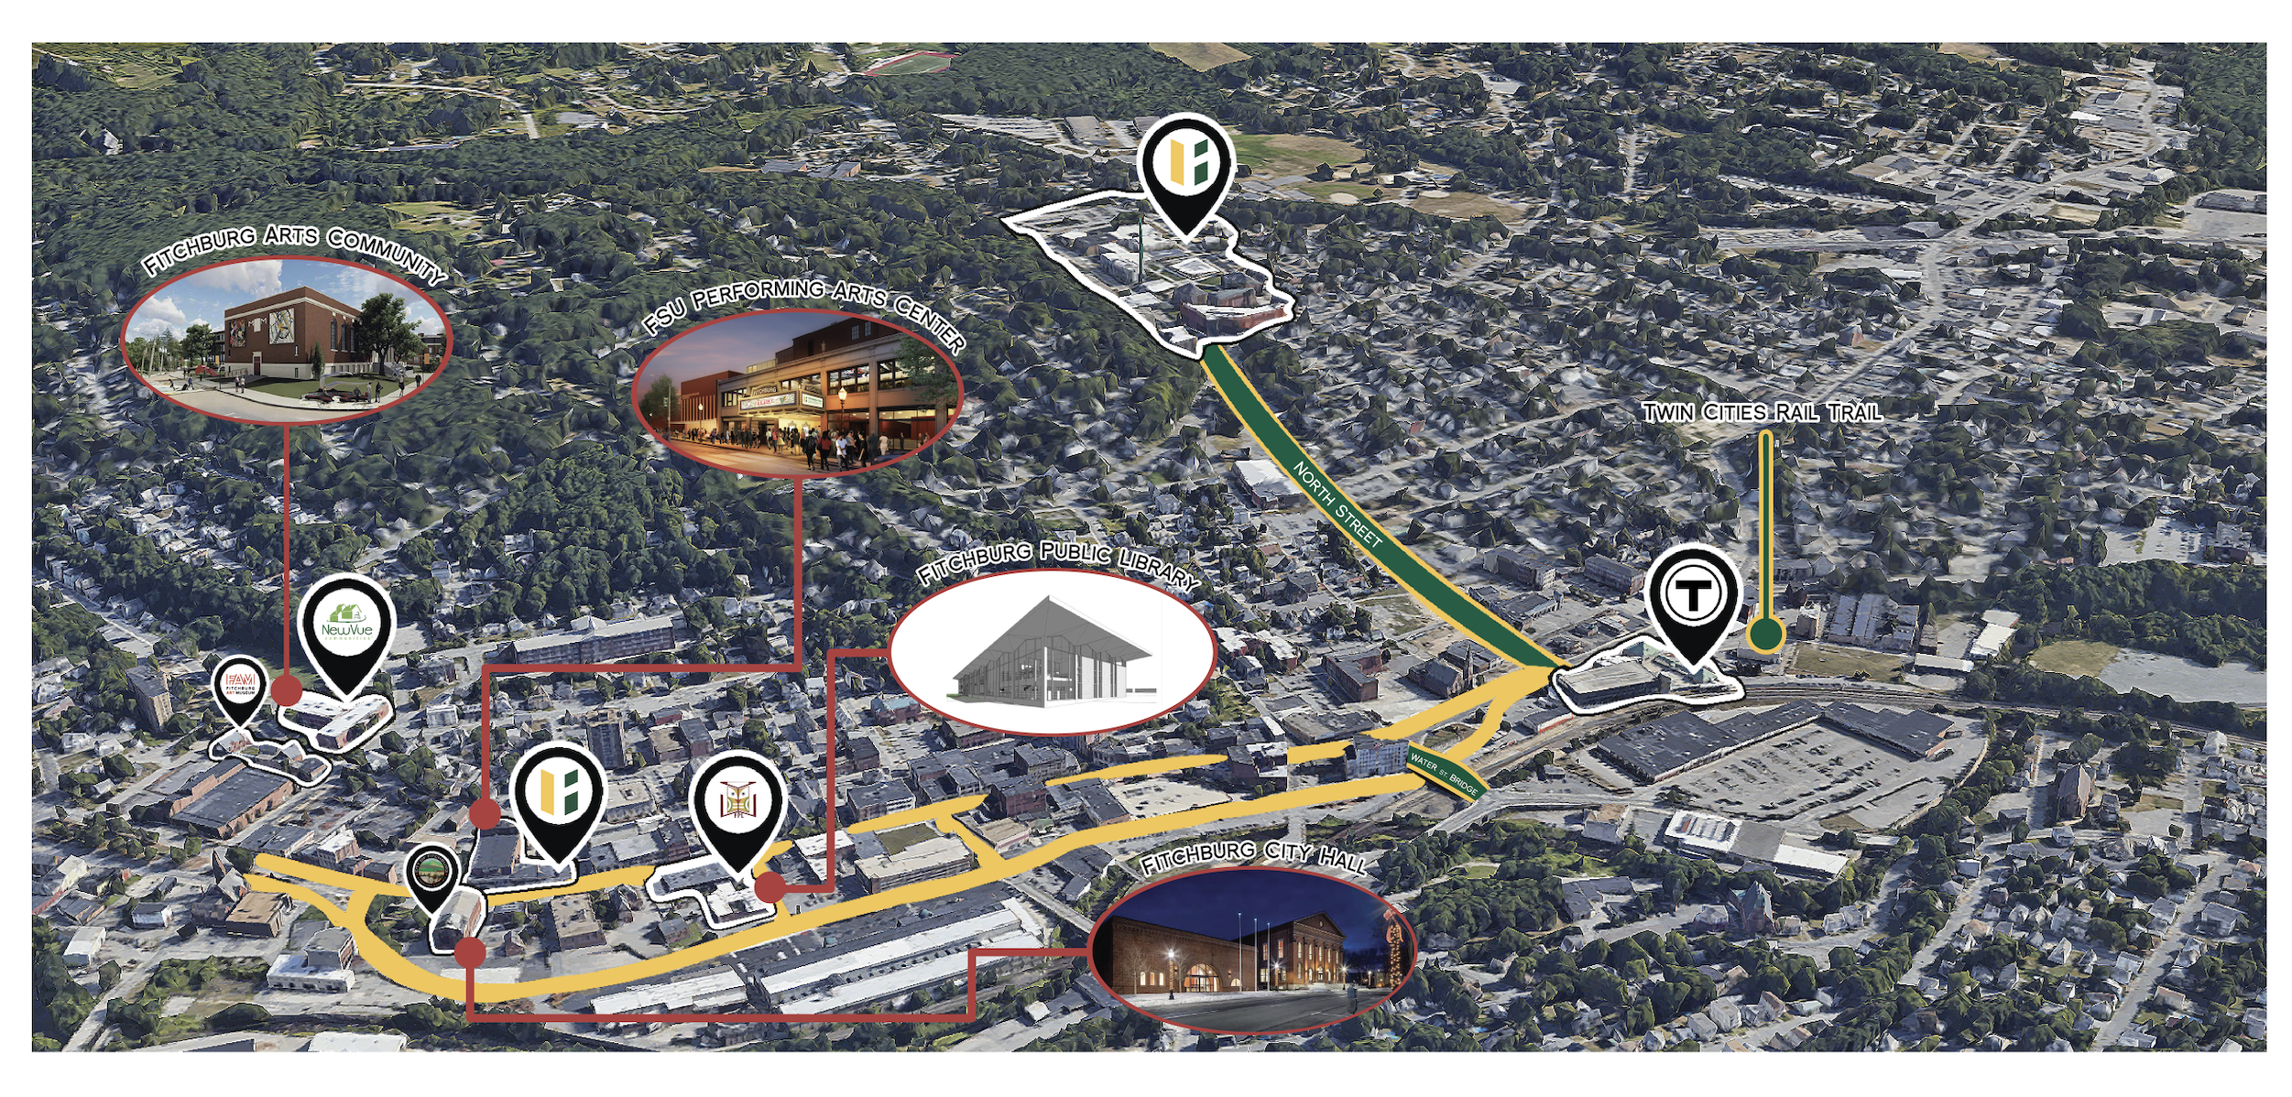

Slide 7
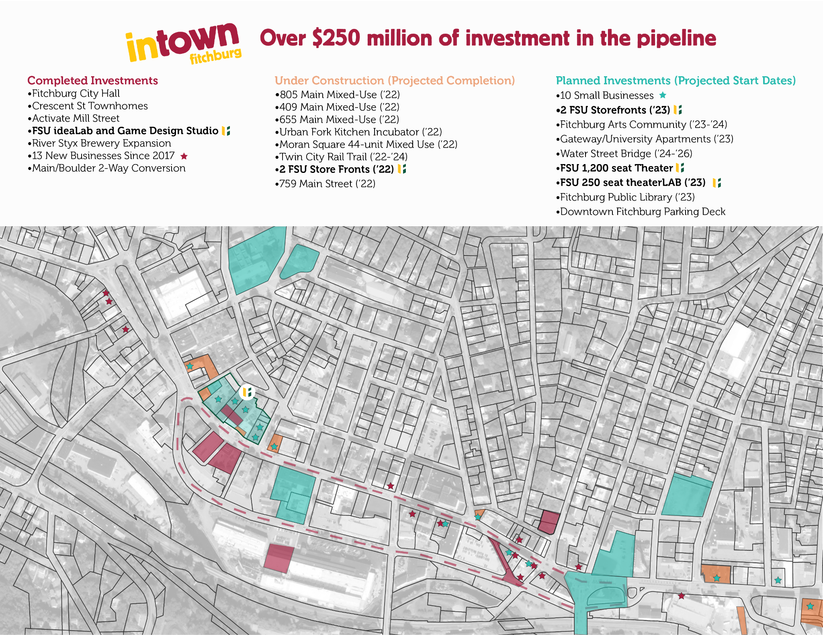
Leveraging $96M
Since FY17 the City, University, and other local partners have leveraged $96million in state resources to create over $250 million in private and public development within the downtown corridor.

Slide 8
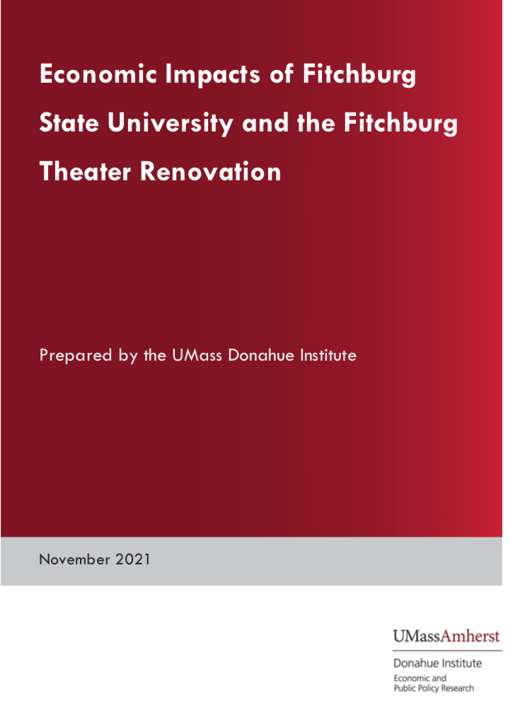
Research Review & Planning
Webb Management Services: Market Analysis
UMass Amherst Donahue Institute: Economic Impact Study
Broad-Based Support: City, State, and Congressional Leadership
Notes:
Thank/recognize:
-Tsongas
-Trahan's Office
- Cronin and Kushmerek

Slide 9
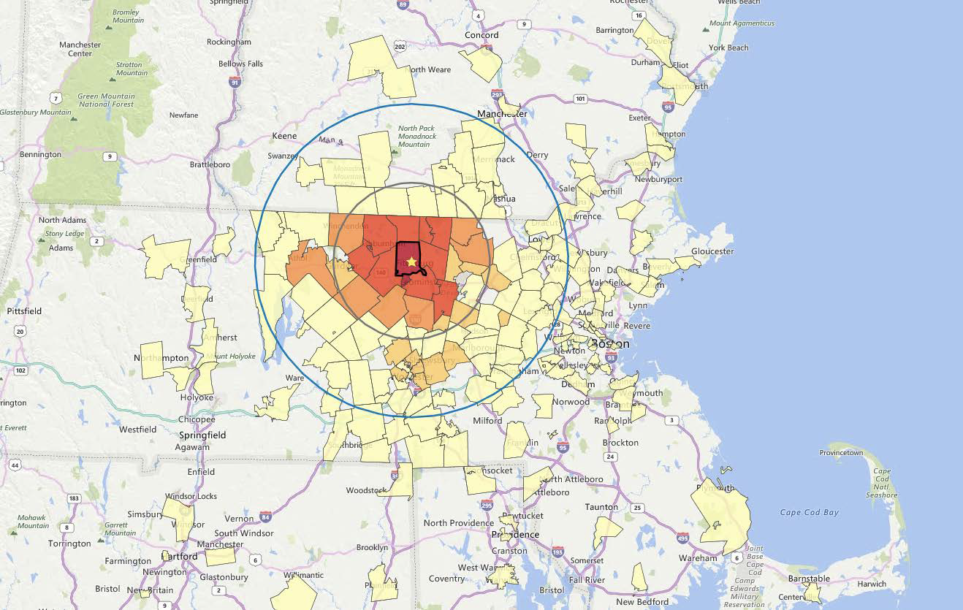
Webb Market Analysis, Defining the Region
The Market:
City of Fitchburg
15-mile radius surrounding Theater Block
30-mile radius surrounding Theater Block (also corresponds with the NewVue and North Central Massachusetts Chamber of Commerce service areas)
National data used for comparison

Slide 10
Webb Market Analysis, Highlights
Trends: The Theatre Block project reflects current trends in the development of performing arts facilities, including the combination of active and passive participation opportunities, the inclusion of flexible and technology-rich spaces, and the direct connection to economic and community development goals.
Market: The market for the arts in and around Fitchburg is strong and broad-based in terms of age, income, and race & ethnicity. Programming should reflect this diversity and offer accessible programs to a wide variety of groups.
Venue: There are gaps in the market for high-quality performance venues that offer touring productions and film exhibitions, with strong food & beverage options.

Slide 11
Webb Market Analysis, Highlights Cont.
Demand: University and regional users are in need of state-of-the-art sound, lighting, and projection equipment broadly for the performing arts. Promoters, presenters, and facility managers believe there is an opportunity to attract touring productions and successfully draw a diverse set of patrons.
University and Community Impact: Advances Fitchburg State’s goals around academic learning and being a strong community development partner. Supports community planning goals, and the development of downtown Fitchburg.
Regional Impacts: This project aligns with the Montachusett region objectives, including but not limited to regional promotion; local business creation and support; workforce attraction and retention; redevelopment and reuse; and most importantly job creation.

Slide 12
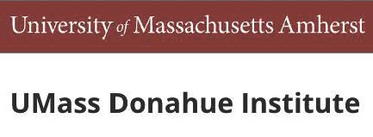
Summary of Economic Contributions of Fitchburg State University
There are approximately 3,300 students that are active on campus per year of which 1,000 reside in the residence halls.
Fitchburg State University directly employs a total of 568 regular faculty and staff in Massachusetts, who earned a total payroll sum of more than $37 million and an additional $14 million in fringe benefits.
Including multiplier effects, produced by the IMPLAN econometric model, Fitchburg State generated a total of $283 million in economic activity as well as 1,776 jobs in FY2019.
There are approximately 23,000 Fitchburg State alumni currently working in Massachusetts, earning a total of approximately $1.6 billion in wages, for an average wage of $56,314 annually.
Including multiplier effects, the economic activity of Fitchburg State alumni is associated with just under 55,000 jobs in the Commonwealth, as well as $4.6 billion in contribution to the state’s gross domestic product (GDP).

Slide 13
Regional Institution making Regional Impact
Theater renovation spending estimates result in a total of $36 million in output and 175 jobs around the Commonwealth in a single year.
Assuming the renovation process takes place over the course of 3 years, estimated theater renovation spending will result in a total of $108 million in economic output and 525 jobs around the Commonwealth.
Once the theater renovation is complete, it will continue to generate economic activity, potentially supporting 43 jobs and $5.3 million in output around the Commonwealth on an annual basis. This is assuming an annual attendance of 55,000 patrons.

Slide 14
Economic Impact of Future Theater Operations
Estimated Spending by Theater-goers:
Restaurants $1,070,232
General merchandise $257,588
Gasoline $173,251
Hotels and motels. $162,790
Performing arts companies $1,234,750
TOTAL $2,898,611
A report from the Americans for the Arts (AFA) estimated that theater patrons in Massachusetts spend $30.25 aside from the cost of admission
The key components associated with this estimate include restaurants, general merchandise, gas, and lodging

Slide 15
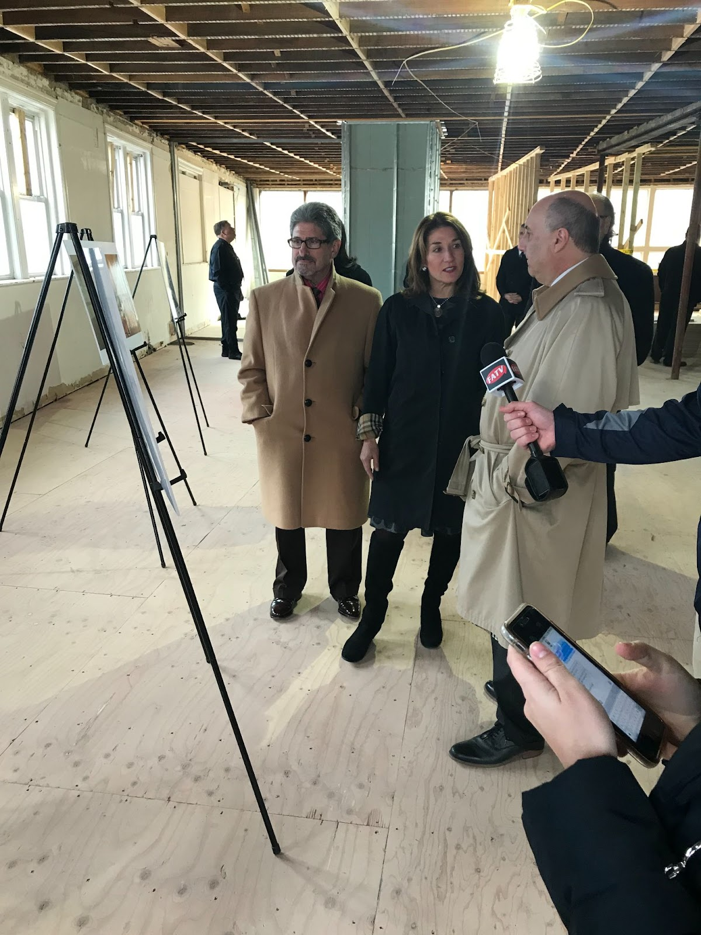
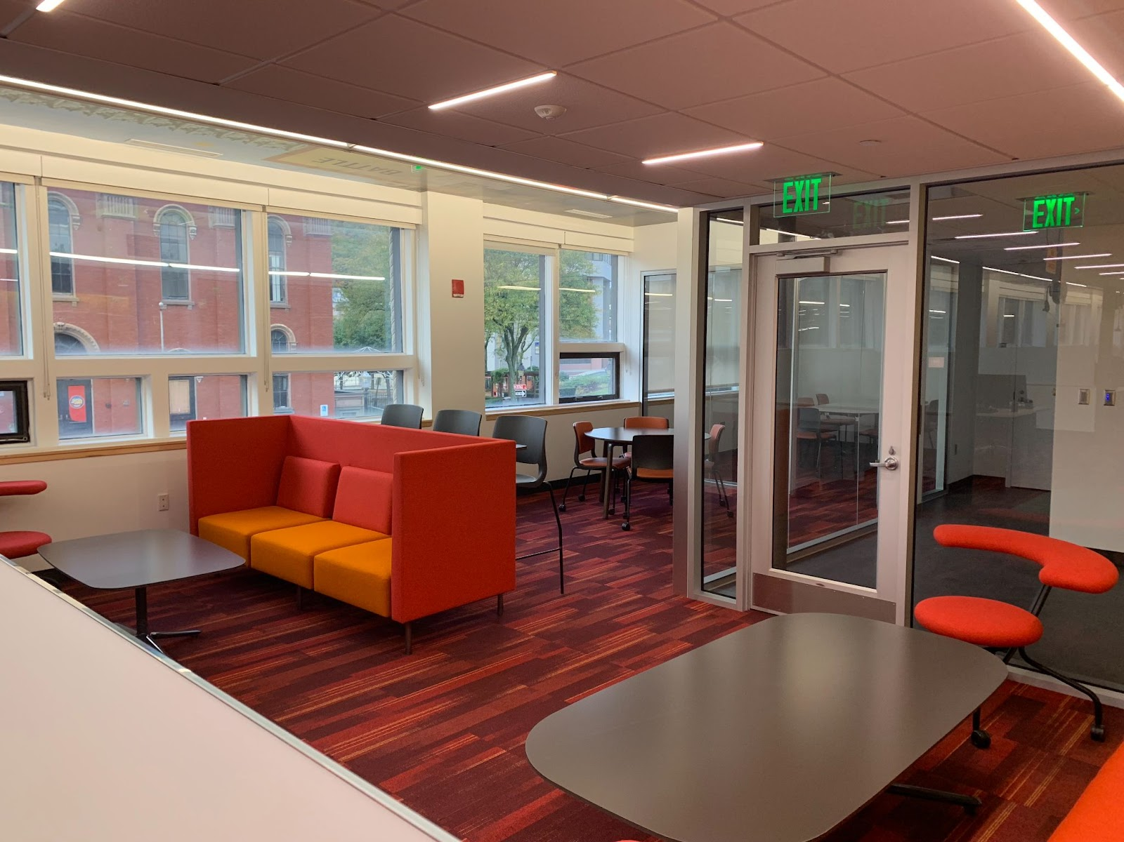
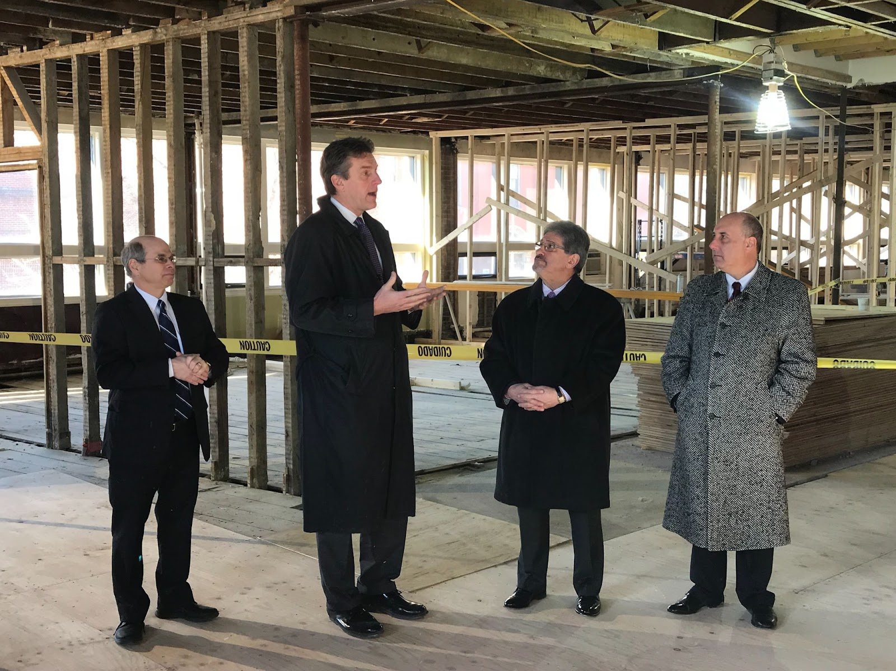
Phase 1: ideaLab & Game Design Studio
Notes:
Phase 1, completed in August 2018, was a $4 million transformation of the Block’s 7,500-square foot second floor into a state-of-the-art game design studio for FSU’s Game Design Program. Phase 1 also includes a University/community coworking IdeaLab designed to foster creativity and entrepreneurial innovation for local small business start-ups and owners. Since its inception, it has provided grants and loans totaling $3.37 million and served 257 businesses including 150 Low-Moderate Income (LMI) owners, 115 women owners, and 88 immigrant/ESL owners.

Slide 16
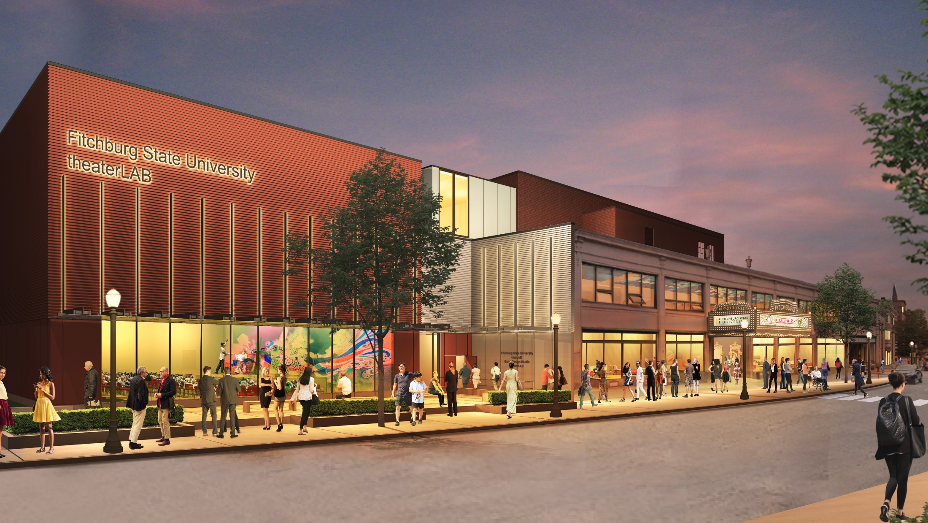

Slide 17
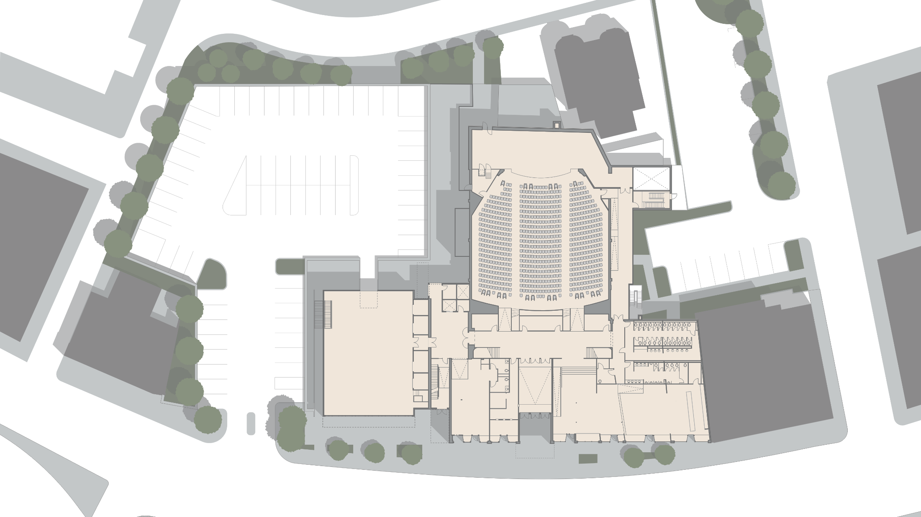
FITCHBURG THEATER BLOCK SITE PLAN
Stage Loading Dock
UPPER PARKING DECK
BLACK
BOX
THEATER
MAIN STREET THEATER

Slide 18
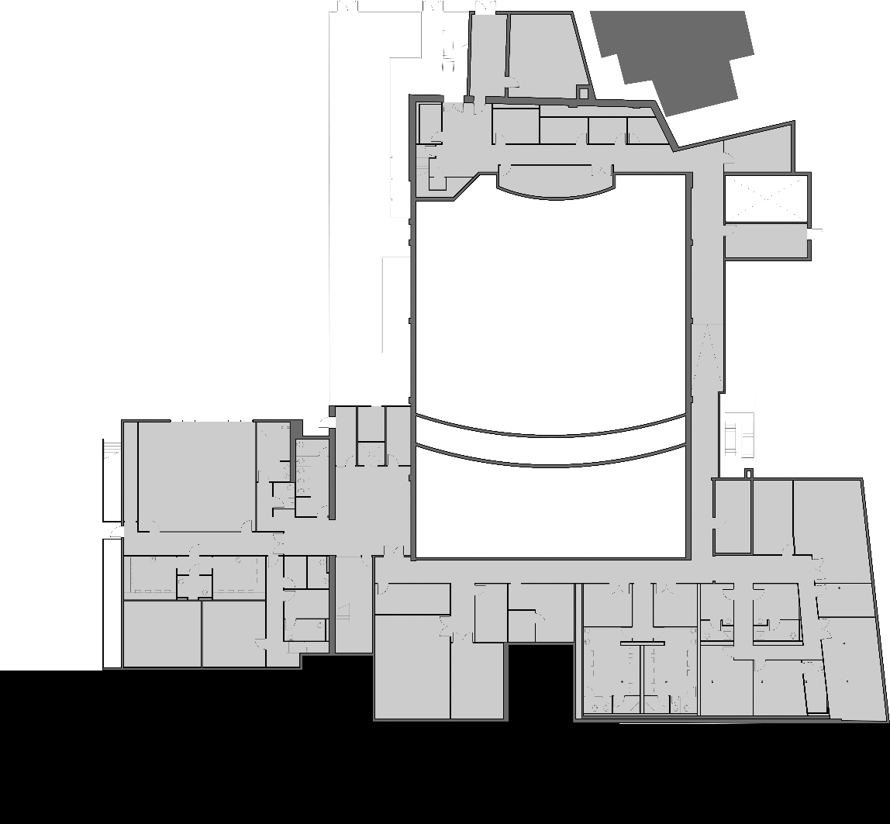
PHASE 2
PHASE 3

Slide 19
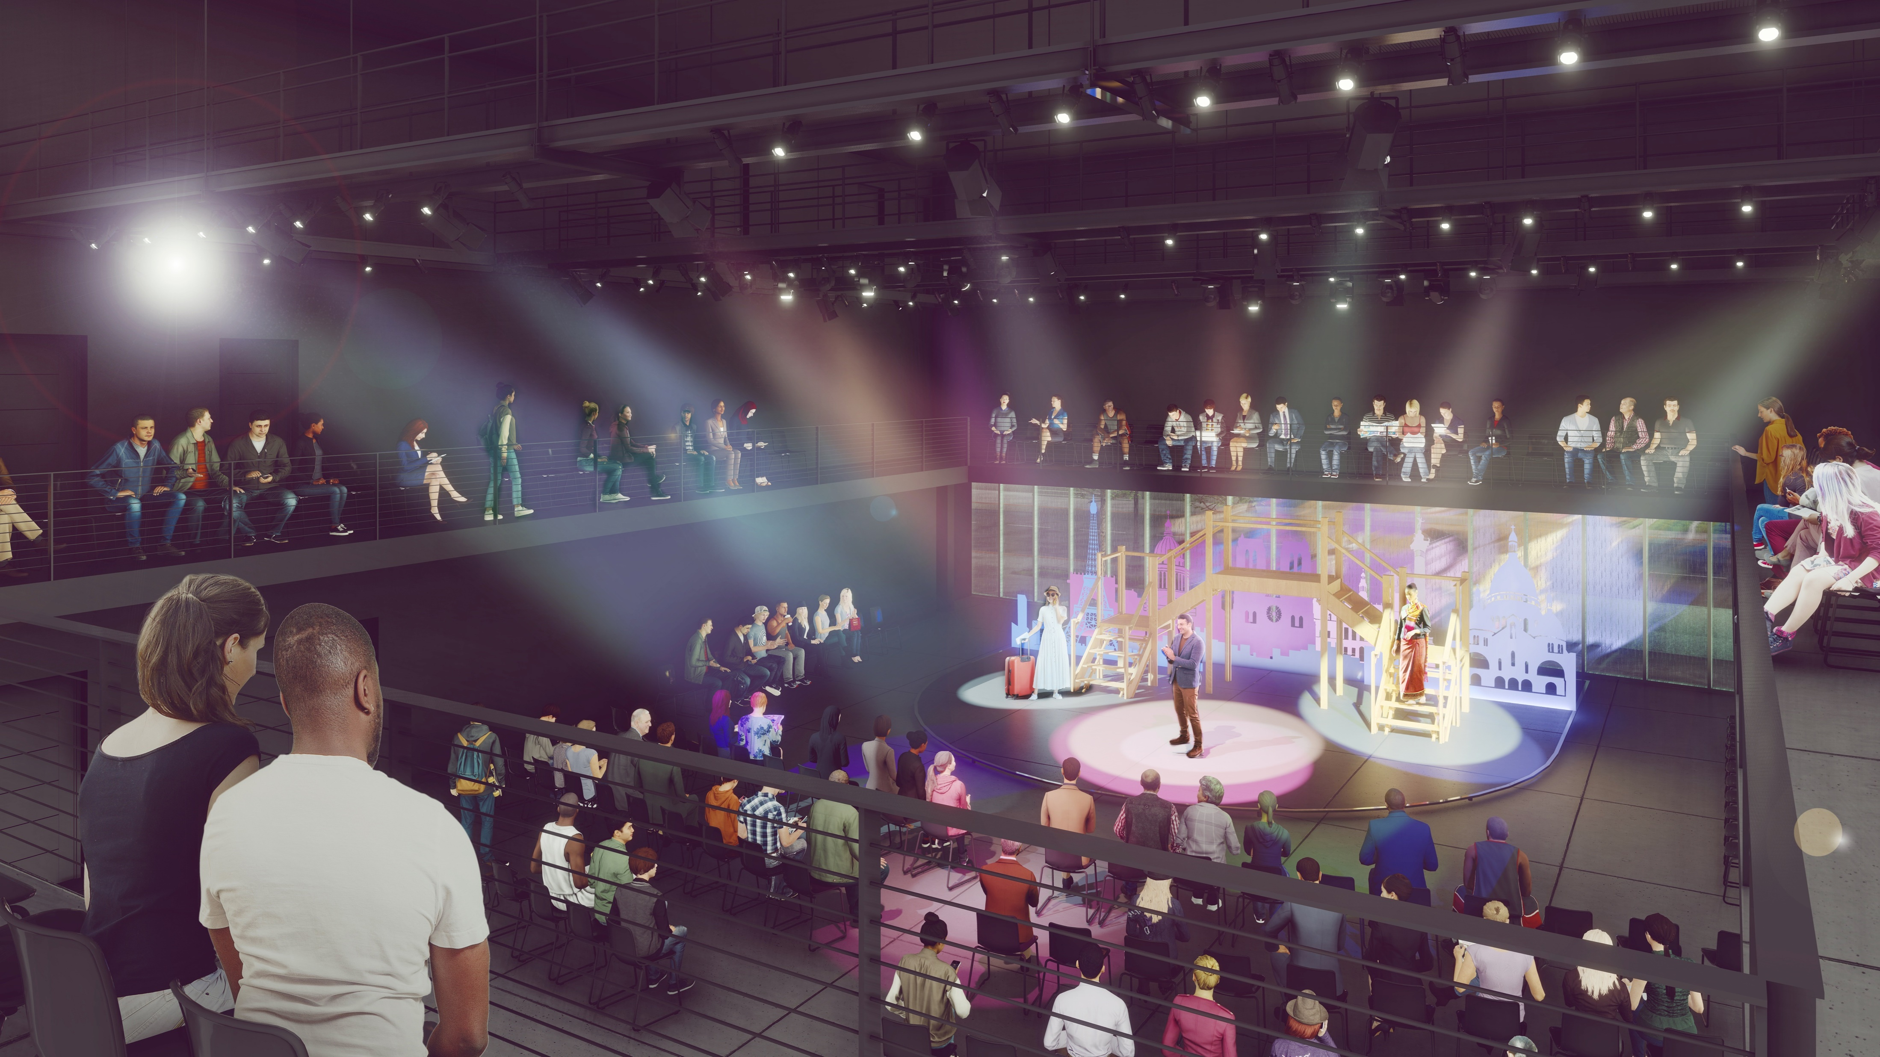
Phase 2, The theaterLab
17,983 square-feet of new construction adjacent to the main historic theater designed to seat up to 250 people.
Modern, four-story structure will serve as a teaching facility for students in the performing arts and humanities.
Equipped with a state-of-the-art media infrastructure, lighting grid, and flexible pedagogical and performance space to encourage the creative training of students, performers, and technicians alike.
Will strengthen learning opportunities for students and community members by supporting a wide range of performances, academic experiences, and speaking events.
Will serve as the connecting tower to the historic theater, providing ADA-compliant access to all components of the Theater Block complex.

Slide 20
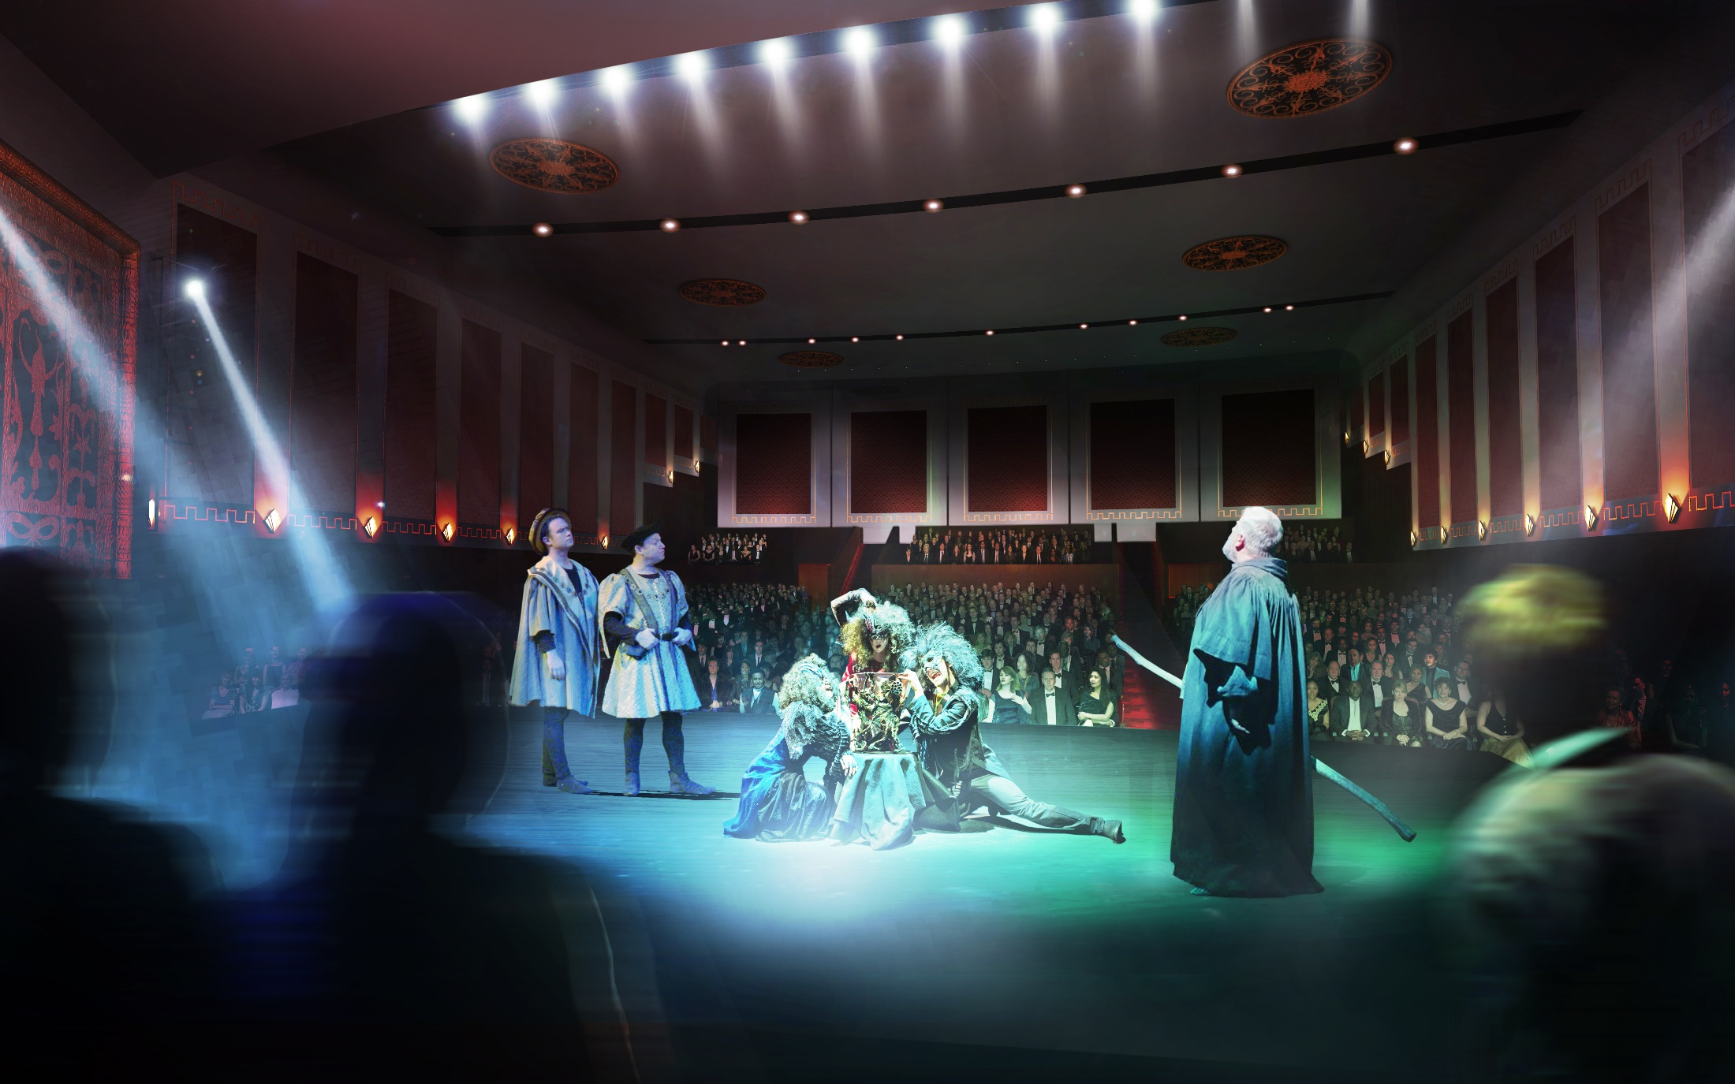
Phase 3, Historic Theater Restoration
Preservation of the Historic 1929 Vaudeville Theater
46,250 square feet of historic preservation adjacent to the theaterLab, to seat up to 1,200 people.
Full proscenium stage, backstage, a 1920 Wurlitzer style pipe organ, and orchestra pit
Complimentary to other Performing Arts Centers
Complimentary to University Infrastructure

Slide 21
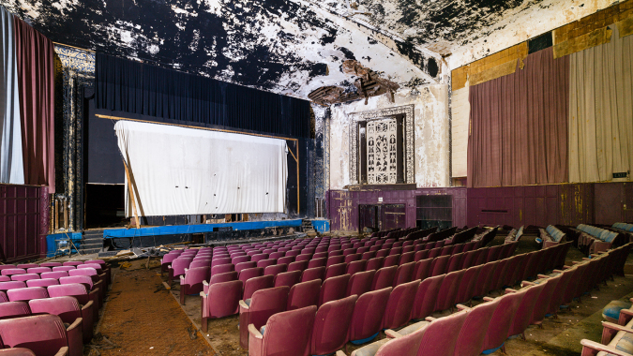

Slide 22
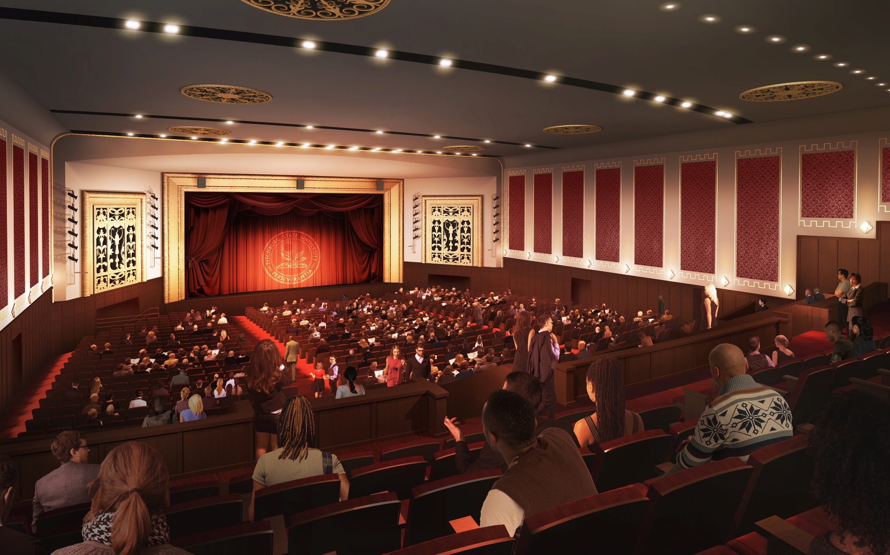
Notes:
Funding:
As the largest and most ambitious public-private project in North Central Massachusetts, it has been a local, state, and federal effort to make this project possible:
State and Federal Historic Tax Credits – working on finding this number now
New Market Tax Credits
Community Project Funding: $2 million – Thank Congresswoman Trahan for cheerleading this funding, and support by Senator Markey and Warren
American Rescue Plan Act: $3 million - Thank Senator Cronin, Representative Kushmerek, and the entire state delegation for their support.
Community Development Block Grant
Capital Campaign: Received $600,000 in commitments
Revenue Bonds
Granting Opportunities
National Endowment for the Humanities
Massachusetts Cultural Council, Facilities Grant
Federal Economic Development Administration
Local Partners (Fitchburg Redevelopment Authority)

Slide 23
Project Team
FSU Foundation Supporting Organization, Owner
Fort Point Project Management, Owner’s Representative
Anser Advisory, Development Consultant and Owners Project Manager
ICON Architecture, Lead Design Firm
Walsh Brothers, Construction Manager

Slide 25
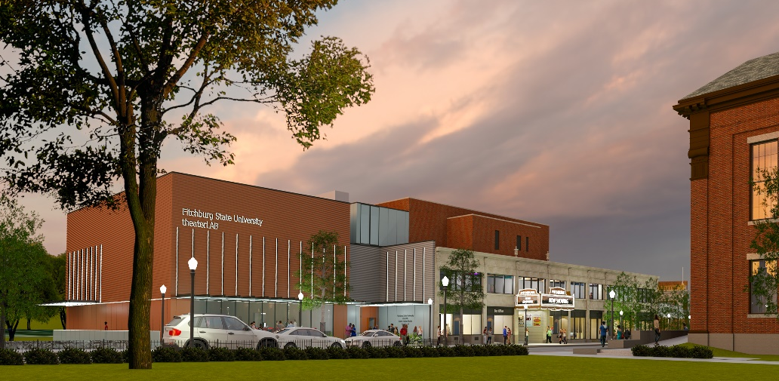
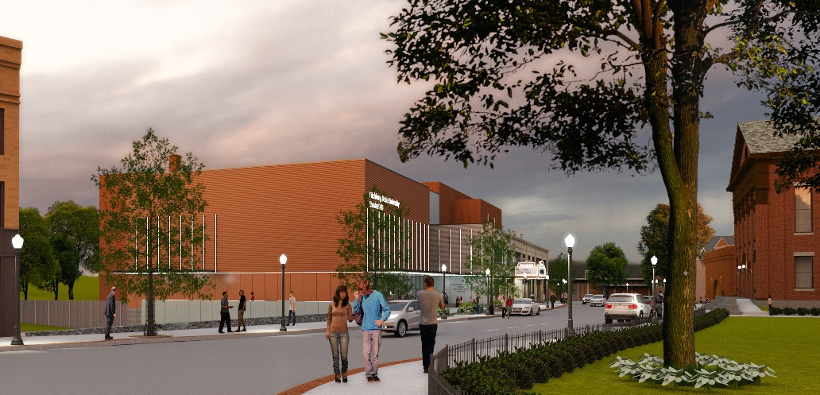
Funding
State and Federal Historic Tax Credits
New Market Tax Credits
Community Project Funding
American Rescue Plan Act
Community Development Block Grant
Capital Campaign
Revenue Bonds
Granting Opportunities
Notes:
=

