Slide 1
Finance Update
Spring 2023

Slide 2
Agenda
Open Forum Follow Up
MSCA Follow Up Questions
Listening Session
Closing Comments
Notes:
Enrollment
Sector Share
FA/SP Updates
Personnel
NUP 42 vs 36/37 CThru

Slide 3
Undergraduate Enrollment* Trends by Institution
comparative analysis.xlsx | Year of Year
Institution | 2013 | 2014 | 2015 | 2016 | 2017 | 2018 | 2019 | 2020 | 2021 | 2022 | Grand Total
Bridgewater | 9,615 | 9,628 | 9,608 | 9,562 | 9,558 | 9,504 | 9,463 | 9,028 | 8,369 | 8,141 | 92,476
Fitchburg | 4,245 | 4,212 | 4,270 | 4,162 | 4,117 | 4,163 | 4,044 | 3,815 | 3,349 | 3,155 | 39,532
Framingham | 4,584 | 4,609 | 4,478 | 4,337 | 4,126 | 3,937 | 3,864 | 3,520 | 3,213 | 2,964 | 39,632
Mass Maritime | 1,376 | 1,401 | 1,571 | 1,677 | 1,688 | 1,709 | 1,695 | 1,538 | 1,433 | 1,335 | 15,423
MassArt | 2,120 | 1,967 | 1,873 | 1,835 | 1,923 | 1,947 | 1,955 | 1,769 | 1,778 | 1,835 | 19,002
MCLA | 1,538 | 1,562 | 1,457 | 1,444 | 1,407 | 1,277 | 1,345 | 1,076 | 870 | 838 | 12,814
Salem | 7,664 | 7,600 | 7,499 | 7,346 | 7,110 | 6,811 | 6,273 | 5,716 | 5,555 | 5,107 | 66,681
Westfield | 5,692 | 5,590 | 5,616 | 5,596 | 5,552 | 5,350 | 5,071 | 4,633 | 4,239 | 4,054 | 51,393
Worcester | 5,556 | 5,563 | 5,514 | 5,381 | 5,495 | 5,380 | 5,332 | 4,958 | 4,640 | 4,477 | 52,296
Grand Total | 42,390 | 42,132 | 41,886 | 41,340 | 40,976 | 40,078 | 39,042 | 36,053 | 33,446 | 31,906 | 389,249
Fitchburg State Share of Sector | 10.0% | 10.0% | 10.2% | 10.1% | 10.0% | 10.4% | 10.4% | 10.6% | 10.0% | 9.9% | 10.2%
* Day and Evening UG
Notes:
Continue to get roughly same % of UG
MASS DHE Data
https://tableaupub.mass.edu/t/MassachusettsDHE/views/Fall2022EnrollmentEstimates/Story?%3Adisplay_count=n&%3Aembed=y&%3AisGuestRedirectFromVizportal=y&%3Aorigin=viz_share_link&%3AshowAppBanner=false&%3AshowVizHome=n

Slide 4
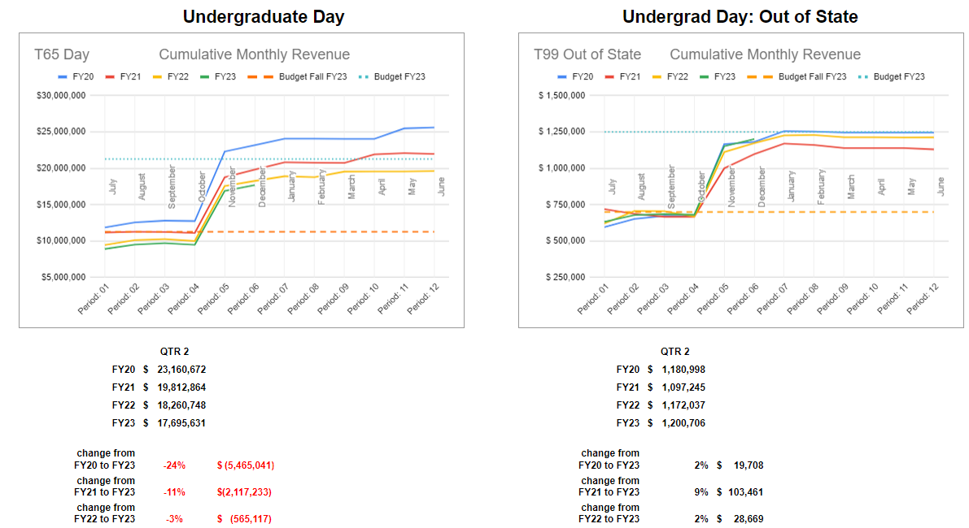
End of Q2 FY23: Tuition + Fees - Waivers & Exemptions Banner Financials
Notes:
Another way to look at current enrollment and impact on revenue
While getting same % of the UG pool it is smaller therefore translating to fewer UG Day Dollars
UG Out of State holding - benefit is every dollar of out-of-state tuition is worth $1.40

Slide 5
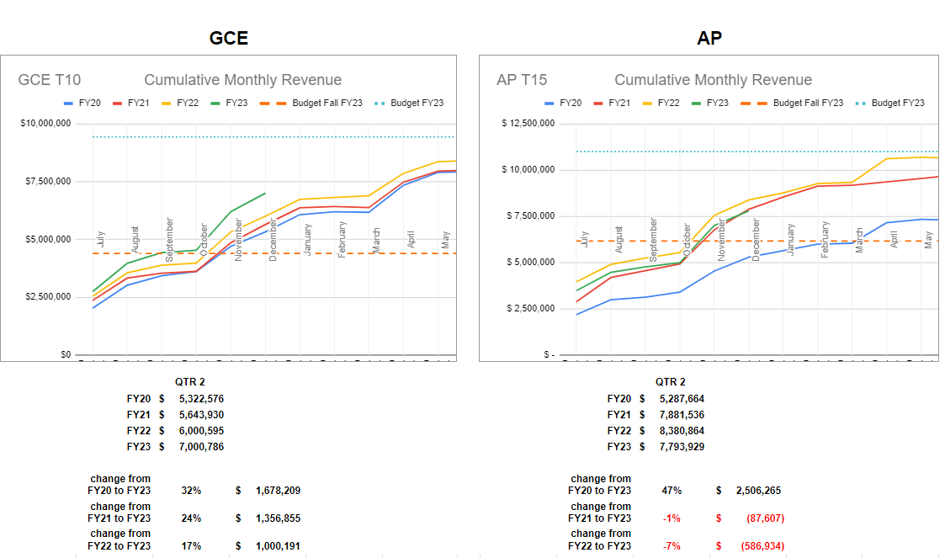
End of Q2 FY23: Tuition + Fees - Waivers & Exemptions Banner Financials
Notes:
GCE showing modest growth in revenue, however their expenses are also increasing. But continues to be significant contributor to overall university financial health
AP - showing slight decline from growth we saw during COVID but well ahead of FY20. Also a significant contributor to overall university financial health
Diversification is helpful when one particular sector is not doing well - ie UG.

Slide 6
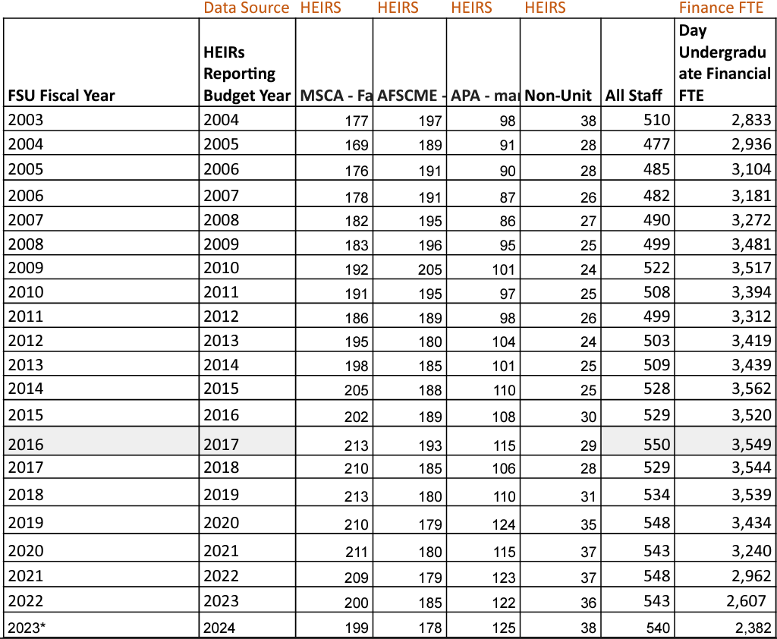
HEIRs FTE by Unit from 2003 to 2023
Notes:
MSCA reporting 42 NUP based on CThru data for 2021. CThru data is calendar year, not fiscal year and can have duplicates like two Provost, or faculty who then took NUP Dean position
Following are the actual list of of NUPS that would cover either part of calendar year 2021
Note: Reminder NUPS does not necessarily mean they are all high level administrator positions but simply positions deemed to be exempt because of the nature of work they are involved with. non-high level NUPs would include Chief of Police, Payroll Director, HR Director and support positions, and staff assistants.
MSCA reported 17 unfilled faculty positions. HighData Sources : DHE-HEIRS; BANNER
* unoffical HEIRS not finalized for FY23

Slide 7
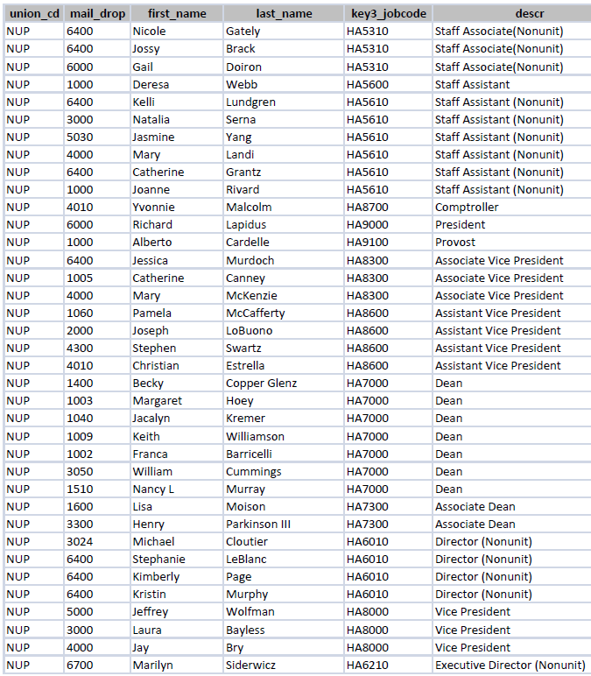
Fiscal Year FY21: Snapshot Fall 2020
Notes:
37 Total positions
14 Dir or lower

Slide 8
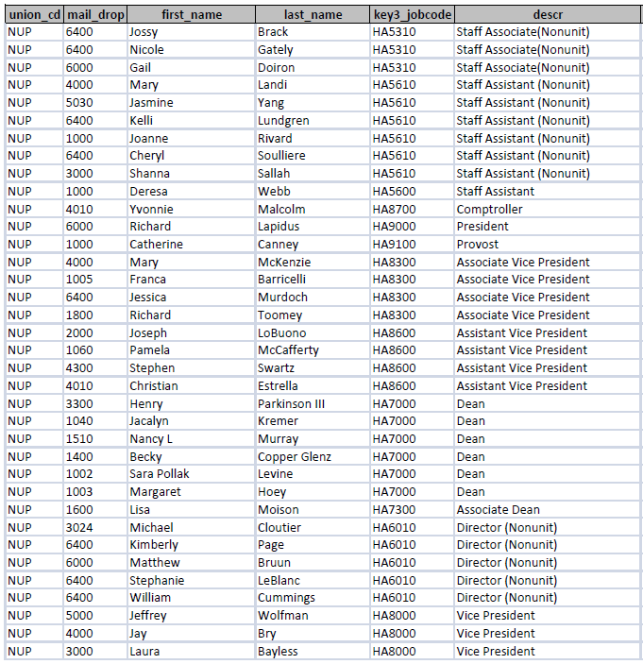
Fiscal Year FY22: Snapshot Fall 2021
Notes:
36 total
15 Dir or lower

Slide 9
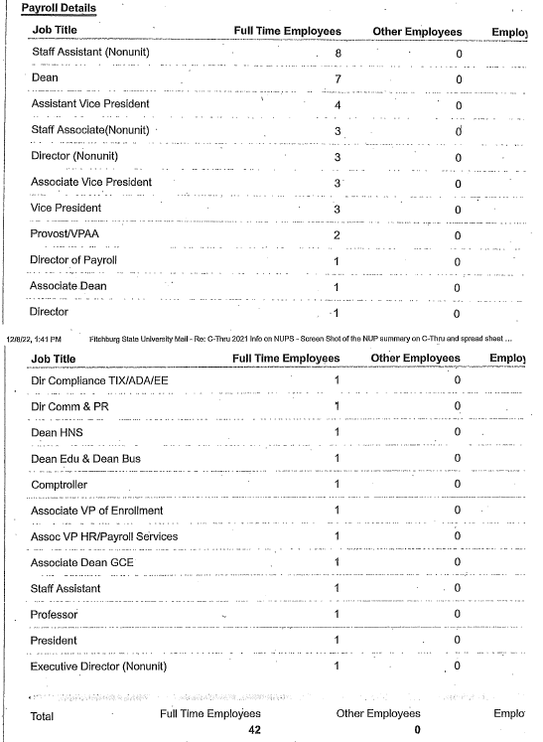
Cthru Data

Slide 10
MSCA Follow Up Questions
1) If the financial health of the institution is good, why has the faculty travel budget not been brought back to pre-covid levels? Travel has become more expensive and salaries have not kept up.
2) If the revenue stream of FSU decreases because of lowered enrollments, what is the plan to make up these revenues, or where does management believe that efficiencies can be carried out to balance the budget?
3). Please explain the rationale for the creation of new positions, promotions to higher rank, and large raises in salary for Non-Unit personnel, in a period of austerity, when faculty and librarians have seen only minimal raises, and 16 retired faculty have not been replaced.
4. The chart below was drawn from IPEDs data, and shows that Fitchburg State plant-related debt in 2020 (see number 6, the 6th set of columns from the left) is exponentially greater than the AVERAGE plant related debt of the other eight state universities. Please explain.
5. I have attached a MSCA presentation on the financial state of our institution, as of Nov. 1, 2022. In that, you might wish to respond to the debt ratio of 7.7, the CFI of 2.2, and the concern that the investments and borrowing for the Theatre Block may be an unwise use of our limited resources, considering our current enrollment crisis.
Notes:
FY 21 Travel reductions at AA level, $60K, were restored. Department cuts in B,F, J were permanent reductions but departments could reallocated their fund. FY22 Mid-Year budget cuts were restored which included travel. Cuts were restored at divisional level other than AA which was restored at department level.
Work was beginning on this just as COVID hit. Will be resuming that work this term. Our hope is to develop a plan as a campus community. Will share more during closing comments regarding a Financial Sustainability Task Force

Slide 11
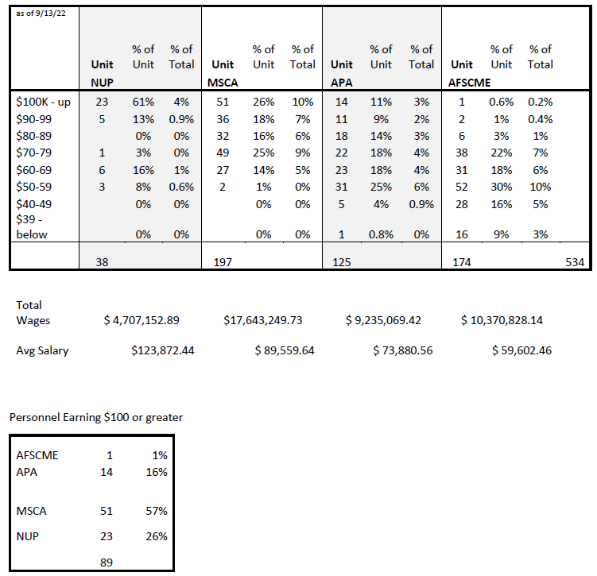
MSCA Question #3
Notes:
Note - this data was pulled prior to FY23 HEIRS hence slight differences
Partially answered with update on number of NUP from prior slide
Again, NUPS does not necessarily mean they are all high level administrator positions but simply positions deemed to be exempt because of the nature of work they are involved with. non-high level NUPs would include Chief of Police, Payroll Director, HR Director and support positions, and staff assistants.
Not all were “new” positions but rather reclassifications as result of roles and responsibilities changing that warrant position being reclassified.
I am not going to address individual raises as that is a personnel matter.
Regarding faculty FTE - down 14 from highpoint of 213 in FY 16 & 18.

Slide 12
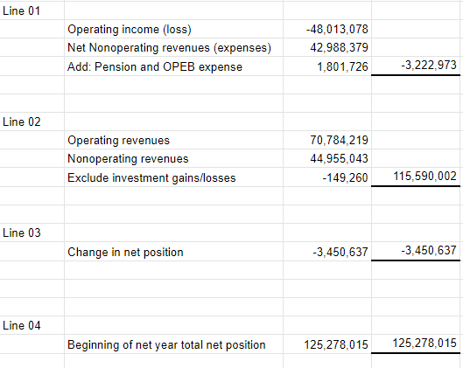
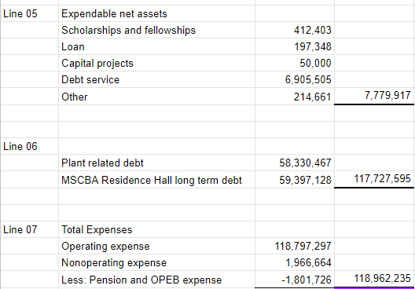
MSCA Question #4
The chart below was drawn from IPEDs data, and shows that Fitchburg State plant-related debt in 2020 (see number 6, the 6th set of columns from the left) is exponentially greater than the AVERAGE plant related debt of the other eight state universities. Please explain.
IPEDS Survey
6/30/2020
Notes:
ANSWERS MSC IPEDS Question - the difference has more to do with how each institution reports their numbers. It is why have to be very careful and cautious when comparing IPEDS, financial statements and ratios.
In this case show much higher as we have historically reported MSCBA Housing debt, now part of GASB 87.
MSCA IPEDS Slide had Line 06 @ $117,727,595 which is above minus Foundation debt
Apples to Apples comparison would be “Plant Related Debt”. As of this IPEDS was at 58,330,487 which is about $20M more than sisters which is mainly related to the renovation of Hammond. AVG of those with debt $31M.
Talk more about debt later
Do NOT include net pension or net other postemployment benefits (OPEB) liabilities/assets in this section.
https://docs.google.com/spreadsheets/d/16pXFu1YZzQ_o8ny4g4zbqeqaD5fEu330ciMdj6EbHIc/edit#gid=0

Slide 13
MSCA Question #5
I have attached a MSCA presentation on the financial state of our institution, as of Nov. 1, 2022. In that, you might wish to respond to the debt ratio of 7.7, the CFI of 2.2, and the concern that the investments and borrowing for the Theatre Block may be an unwise use of our limited resources, considering our current enrollment crisis.
Notes:
7.7% reference was calculated including MSCBA Res Hall debt (GASB 87). Government Accounting Standards Board
So we incorrectly represented in the Draft Financial Statement which was noted during the presentation to BOT. Hence why both 7.7% and 6.3% are showing different in final FS as prior year had also been adjusted to include MSCBA Res Hall debt (GASB 87) for comparison purpose.

Slide 14
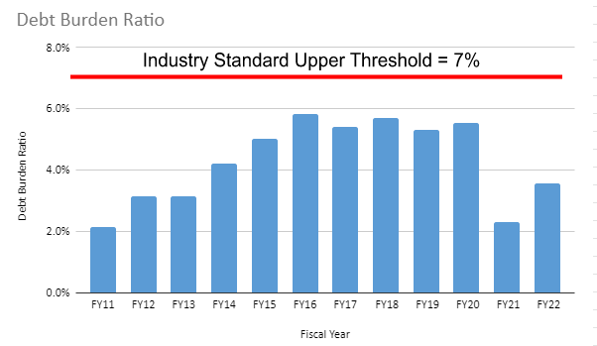
Debt Burden & Capital Debt Ratio
represents debt at start of fiscal year
These calculations exclude the impact of GASB 68 (Pensions) and GASB 75 (OPEB) and GASB 87(Leases)
Notes:
UNIVERSITY debt burden is well below the %7 standard.
More importantly is actual outstanding debt as shown in right hand graph which represents the debt on the dorms. The university cannot take on its own debt by issuing bonds. Only through MSCBA
Key takeaway is debt is going down - Starting in FY 25 starts going down fairly rapidly.
Have adequate dedicated revenue and dedicated reserves to pay debt
Use of debt vs cash. Interest rate range from 2.5-4% versus average return on investment portfolio
Failing to invest in facilities has impact both on overall financial health as the value of assets continue to depreciate with no reinvestment, but more importantly for those who been here more than 15 years now how it came impact enrollment, the teach and learning environment and living conditions.
Capital Debt Ratio : Adequate reserves to cover existing debt
N91 HEFA: Last payment of $400k in FY23.
Fund starts to accumulate $600k a year
Debt Burden: Measures an institution's dependence on borrowed funds by comparing the level of debt service to total expenditures. In order to effectively manage resources, including debt, industry standards sets the upper threshold for institutional debt burden at 7%.

Slide 15
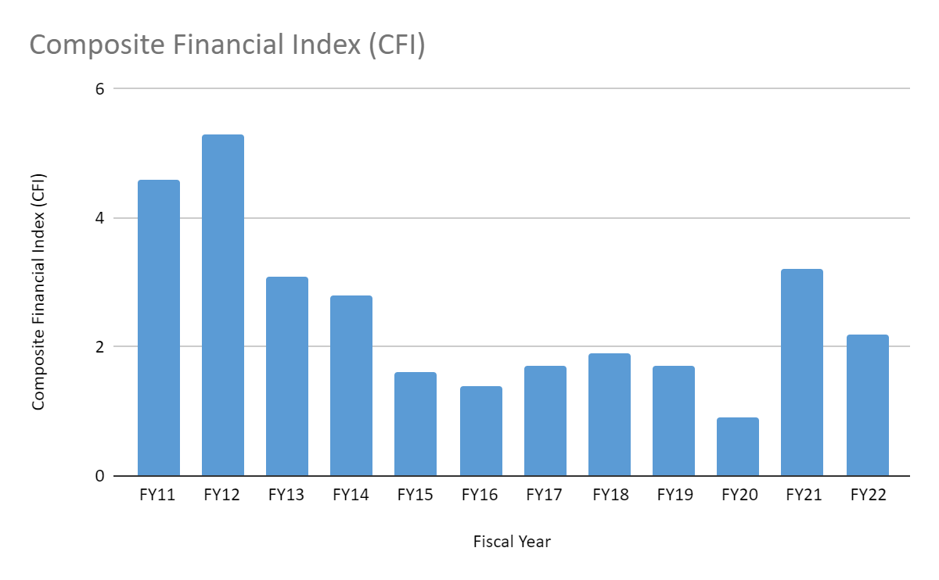
Composite Financial Index (CFI)
The CFI reflects a picture of the financial health of the institution at a point in time. It is built with the values of its four component ratios; 1) Primary Reserve, 2) Net Operating Revenue, 3) Return on Net Assets, and 4) Viability Ratio.
3.0 represents a relatively healthy financial position;
Note: Public institutions can often operate effectively at lower ratios pending the relationship with the supporting government agency.
3.0 is benchmark
These calculations exclude the impact of GASB 68 (Pensions) and GASB 75 (OPEB) and GASB 87(Leases)
Notes:
Note - BHE no longer uses CFI as a measurement but rather the individual components.
The Composite Financial Index (CFI) is built with the values of its four component ratios; 1) Primary Reserve, 2) Net Operating Revenue, 3) Return on Net Assets, and 4) Viability Ratio. Once each of the four ratios is calculated, further weighting is conducted to measure the relative strength of the score and its importance in the composite score. The CFI combines the four core ratios identified above into a single score. The combination, using a prescribed weighting plan, allows a weakness or strength in one ratio to be offset by another ratio result. The CFI reflects a picture of the financial health of the institution at a point in time. A negative CFI is indicative of a university that may be struggling financially. A score of 1.0 indicates very little financial health; 3.0 is the low benchmark and represents a relatively stronger financial position; a 10.0 is the highest benchmark. A ratio of 3.0 or above is preferred.
NACUBO Handbook:
The measure is established by first answering four key questions concerning the financial health of an institution and calculating a financial measure that addresses the overall question of whether an institution is financially healthy:
• Are resources sufficient and flexible enough to support the mission? – Primary Reserve Ratio
• Are debt resources managed strategically to advance the mission? – Viability Ratio
• Does asset performance and management support the strategic direction? – Return on Net Assets Ratio
• Do operating results indicate the institution is living within available resources? – Net Operating Revenues Ratio

Slide 16
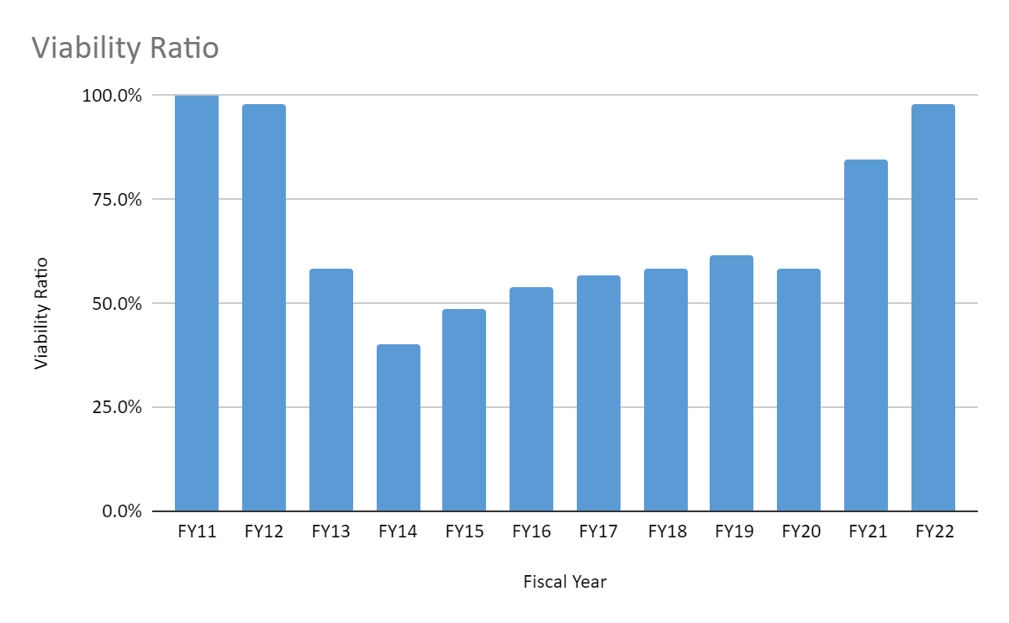
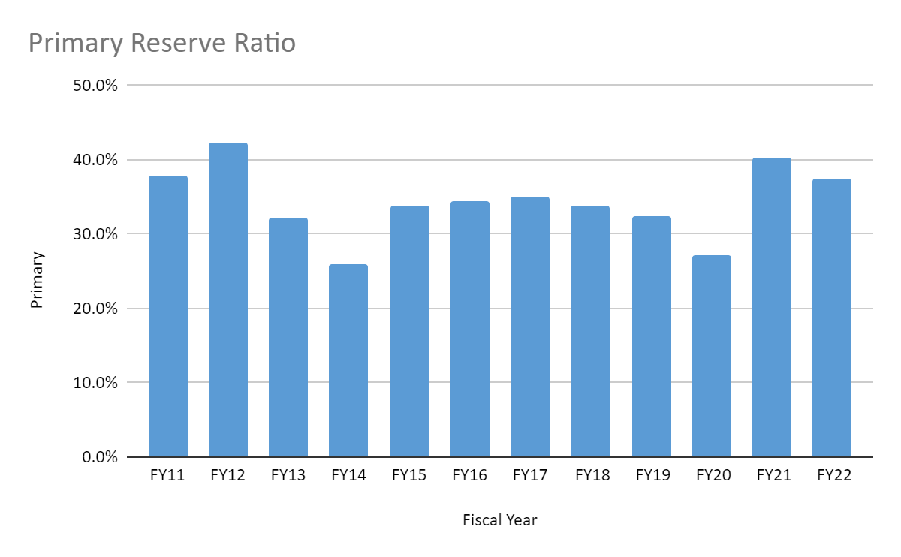
Viability vs Primary Reserve Ratio
Goal
Note: Public Institutions can operate effectively at a lower Viability Ratio as state support is not reflected. These calculations exclude the impact of GASB 68 (Pensions) and GASB 75 (OPEB) and GASB 87(Leases)
Notes:
Primary Reserve Ratio asks, Are resources sufficient and flexible enough to support the mission? This ratio indicates how long the University could function using its expendable reserves without relying on additional net position generated by operations. A primary reserve ratio of .40 is advisable, implying that the university has the ability to cover nearly 5 months of expenses. EYP Liquidity Stress Test had us at 5.9 months - another method to calculate sufficient reserve
GASB 75 OPEB: Healthcare benefits for retirees
Interested parties can use ratios to gain an understanding of the institution’s financial health, particularly if developed over time.
The Primary Reserve Ratio measures the financial strength of the institution by comparing expendable net assets to total expenses. Expendable net assets represent those assets the institution can access quickly and spend to meet its operating and capital requirements. The Primary Reserve Ratio serves as a counterpoint to the Viability Ratio discussed below. An institution may have insignificant expendable net assets and little or no debt and therefore produce an acceptable value for the Viability Ratio. But low expendable net assets in relation to operating size signals a weak financial condition. In these cases, the Primary Reserve Ratio will be a much more valid measure of financial strength
chrome-extension://efaidnbmnnnibpcajpcglclefindmkaj/https://emp.nacubo.org/wp-content/uploads/2017/10/NSS_Handbook.pdf
Viability Ratio answers, “Are debt resources managed strategically to advance the mission? The availability of expendable net assets to cover debt (the viability ratio) is a basic determinant of financial health. Expendable net assets are those assets not required to be retained in perpetuity, i.e., those assets available for use for operations.
A ratio of 1:1 or greater would indicate, as of the balance sheet date, an institution has sufficient expandable net assets to satisfy debt obligations.
From NACUBO Handbook:
“Viability Ratio The Viability Ratio measures one of the most basic determinants of clear financial health- the availability of expendable net assets to cover debt should the institution need to settle its obligations as of the balance sheet date.
Although a ratio of 1:1 or greater indicates that, as of the balance sheet date, an institution has sufficient expendable net assets to satisfy these obligations, this value should not serve as an objective. Many public institutions can operate effectively at a ratio far less than 1:1 since the debt may be reported by a state agency and not the institution, or the institution enjoys the credit rating of the state for its borrowing purposes. Institutions with a ratio of less than 1:1 are, similar to those with a low Primary Reserve Ratio, less self-reliant and have significantly less operating flexibility but can function, and often function well. The level that is “right” for the Viability Ratio is institution-specific

Slide 17
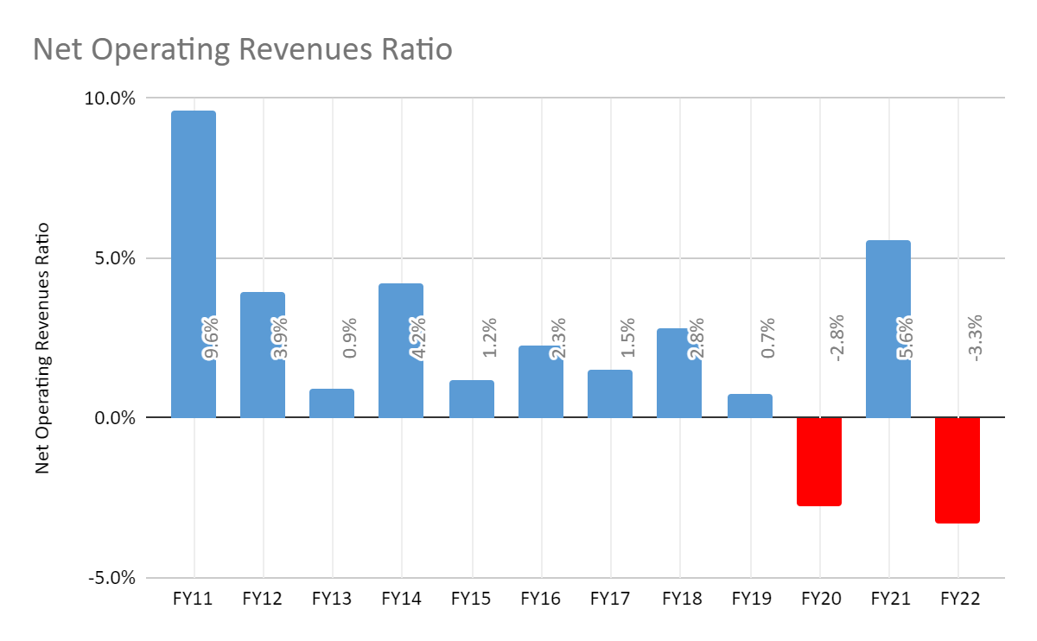
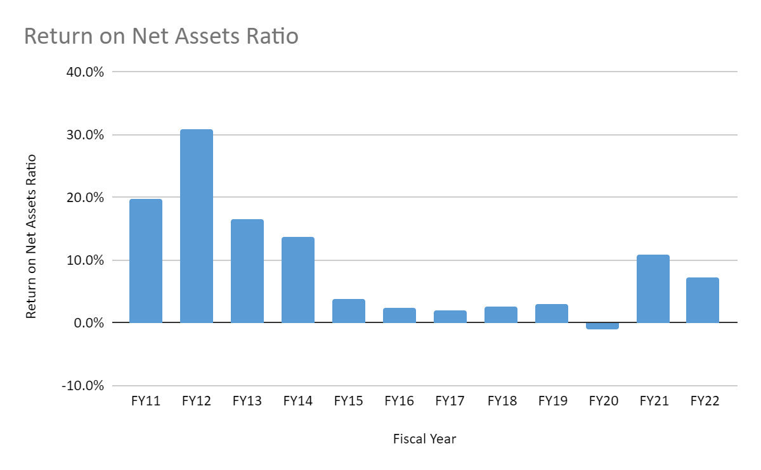
Net Operating Revenues &
Return on Net Assets Ratios
These calculations exclude the impact of GASB 68 (Pensions) and GASB 75 (OPEB) and GASB 87(Leases)
Notes:
Net Operating Revenues Ratio was -3.3% indicating operating activities experiences a loss. (This means to me that the budget deficit is real. Results indicate the institution is not living within available resources). This ratio indicates whether total operating activities resulted in a surplus or deficit. The decrease in 2020 return on net position ratio is primarily the result of the increase in expenses relating to COVID-19 and a slight decrease in tuition income from the on-ground program along with significant refunds as result of shutting down the residence halls and dining operations.
But at the same time, we can have a positive Net Position. Return on Net Assets Ratio asks, “is the University is financially better off than in previous years.”
Total operating, non-operating, and gift revenue for fiscal 2022 was $138 million, while expenses totaled $126 million, resulting in an increase to net position of $12 million.
The increase in 2021 was primarily the result of state funded on campus capital appropriation projects, HEERF federal grant expense reimbursements and loss revenue income, and a reduction in operating expenses.
The increase in 2022 return on net position ratio is mainly caused by the federal government HEERF grant loss income recovery amount.
From NACUBO Handbook “Return on Net Assets Ratio This ratio determines whether the institution is financially better off than in previous years by measuring total economic return. A decline in this ratio may be appropriate and even warranted if it reflects a strategy to better fulfill the institution’s mission. On the other hand, an improving trend in this ratio indicates that the institution is increasing its net assets and is likely to be able to set aside financial resources to strengthen its future financial flexibility. The Return on Net Assets Ratio, like all the others, is better applied over an extended period so that the results of long-term plans are measured.

Slide 18
Perceived Budgetary Hardship?
vs
Actual Budgetary Crisis?

Slide 19
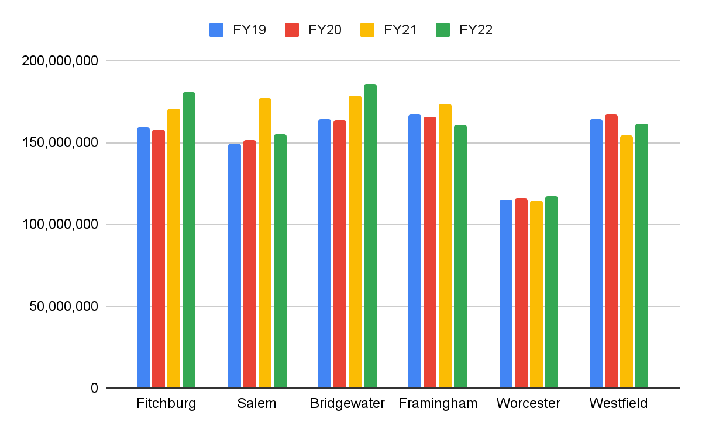
MA State U’s Net Positions FY19-FY22
Net Position before GASB 68 and 75
Notes:
The next two slides show the
* The assets and deferred outflows of resources, liabilities and deferred inflows of resources,
and net assets for the year ended June 30, 2021 do not reflect the implementation of GASB 87,
Leases, which was adopted as of July 1, 2021.

Slide 20
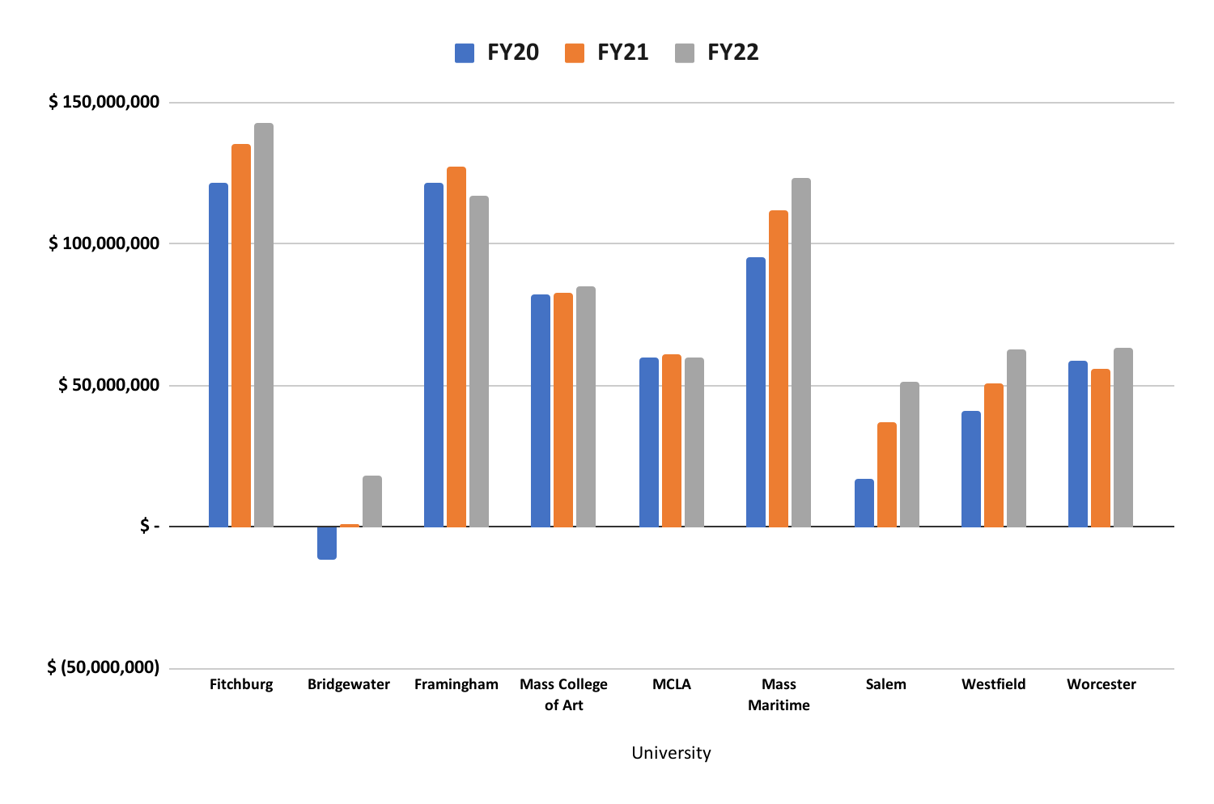
MA State U’s Net Positions FY20-FY22
Inclusive of GASB 68 and GASB 75
Notes:
* The assets and deferred outflows of resources, liabilities and deferred inflows of resources, This has GASB 68 and 75
and net assets for the year ended June 30, 2021 do not reflect the implementation of GASB 87,
Leases, which was adopted as of July 1, 2021.

Slide 21
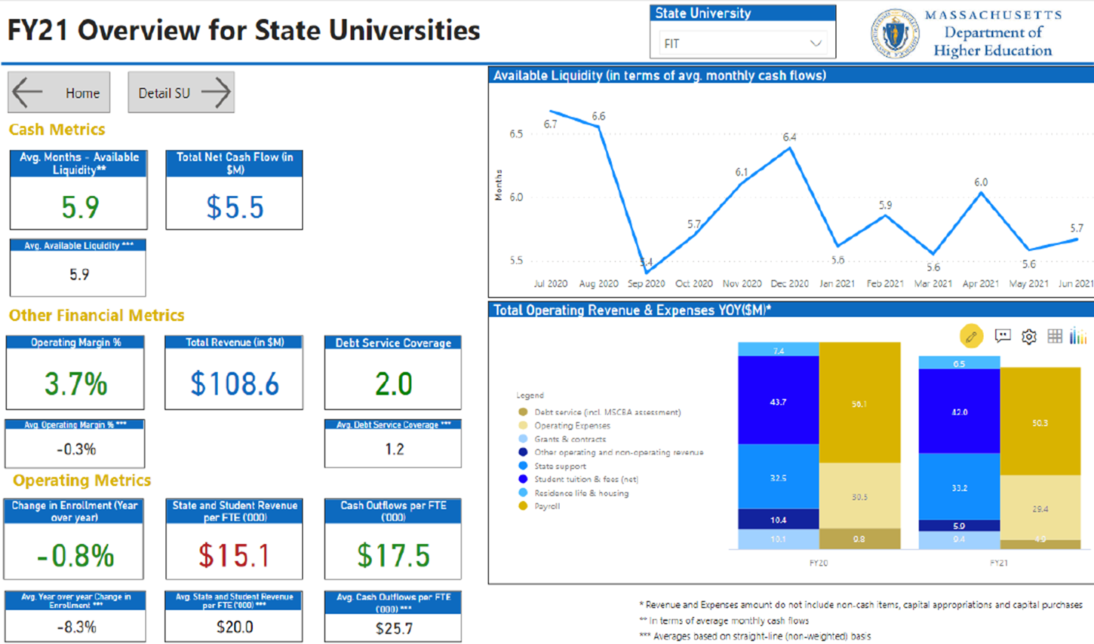
EY Parthenon’s Key Metrics for FSU
Notes:
EY Parthenon, a consulting firm, evaluated all the State Universities during COVID to find out how healthy we were financially.
We had just under 6 months of liquidity before we would run out of money (with no income coming in).

Slide 22
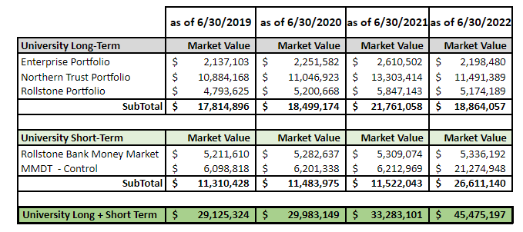
Liquidity - Cash & Investments
University Cash | Market Value | Market Value | Market Value | Market Value
Enterprise Bank 0983 | $ 16,250,891 | $ 11,986,725 | $ 17,637,583 | $ 8,759,106
Cash held by State Treasury | $ 849,416 | $ 2,643,802 | $ 2,130,085 | $ 3,567,333
Webster Bank | $ 97,149 | $ 97,328 | $ 97,383 | $ 97,402
Total | $ 17,197,456 | $ 14,727,855 | $ 19,865,051 | $ 12,423,841
Total Reserves | $46,322,780 | $44,711,004 | $53,148,152 | $57,899,038
Notes:
End with this. That we are not in CRISIS. We have adequate reserves to allow for planning but must begin to make some tough decisions particular as it relates to the UG Division and Housing

Slide 23
End of Presentation
Listen Session

