Slide 1
Board of Trustees Meeting
March 30, 2021
Notes:
1

Slide 2
Admissions Strategies and Initiatives
Presented by:
Jinawa McNeil, Dr. Becky Copper-Glenz and Erin Turchetta

Slide 4
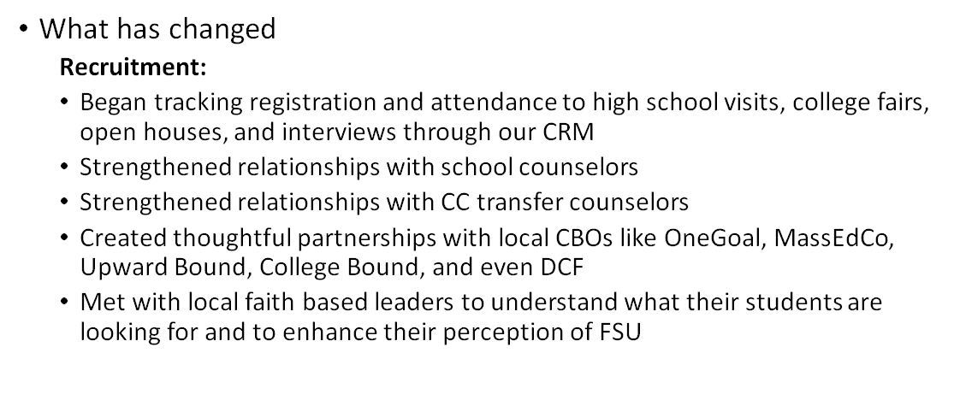

Slide 6
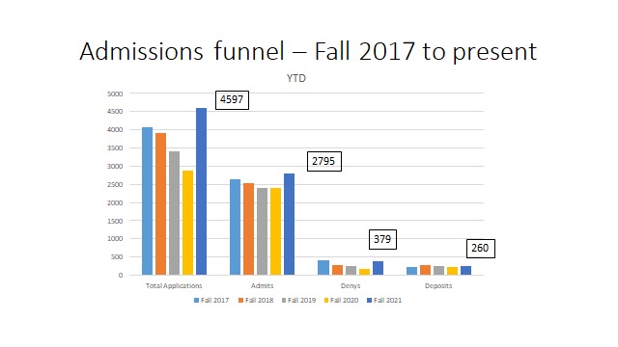

Slide 7
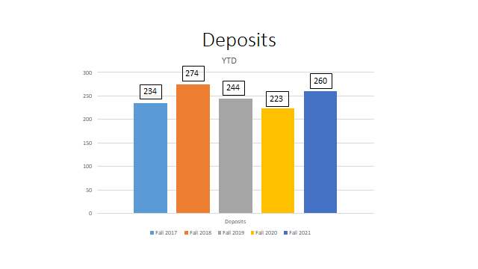

Slide 8
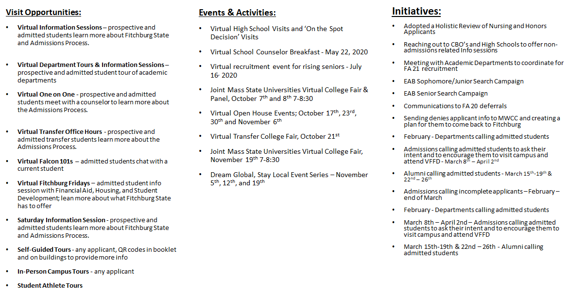

Slide 9
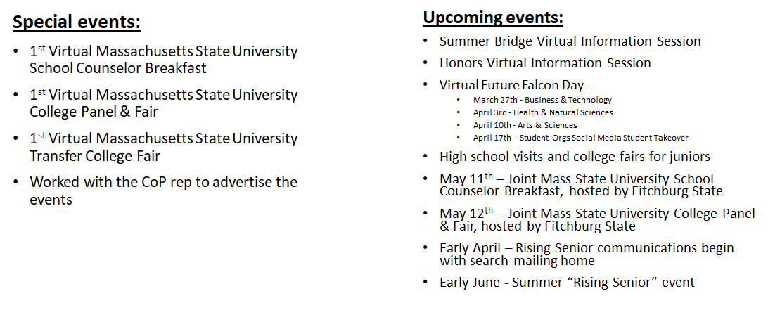

Slide 10
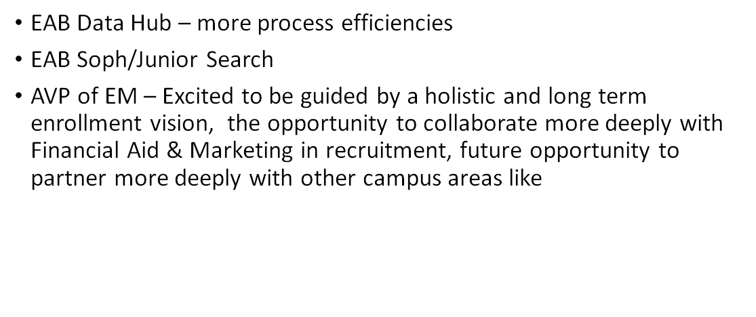

Slide 11
School of Graduate, Online and Continuing Education (SGOCE)
Brief Overview
Realignment of SGOCE Division Beginning 2017
Academic Partnerships service structure and business processes prompted a shift in SGOCE division work
Increased competition with graduate and adult programming required new strategies
Prospective students and industry/ communities of practice seeking more online options
Programming | Structure | Service
Utilized existing Curriculum to create new program options: 4+1 Programs, Certificates and Dual Concentrations | Changed our school name | Updated services to allow for 7 week accelerated program growth
Assisted the academic departments with changes in program offerings and modalities | Aligned staff to new roles/ focused on recruitment | Developed and implemented a communication plan for prospective students
Assisted departments in exploring program options | Moved graduate admissions to SGOCE | Developed and implemented a service assessment process

Slide 12
School of Graduate, Online and Continuing Education (SGOCE)
Program Updates - Since 2017
Online Accelerated Programs Additions | Other SGOCE Programs
Three MBA Concentrations Dual Concentrations Available Five New Certificate Programs in Each MBA Concentration Area | Three programs changed modality to 100% online (Applied Communication Studies, M.Ed. and BS in Occupational Education) One program added a 100% online option (Computer Science) One programs moved to a hybrid program model (English) Two new online masters program were added in (Special Education Guided Studies -Applied Behavior Analysis and Criminal Justice) Three new online graduate certificates were developed (One in Counseling and two in Education) Two programs moved to 7 week hybrid models (M.Ed. in Educational Leadership and M.Ed. 5-12 Education) B.S. Business Administration - Moved to 7 week online model

Slide 13
School of Graduate, Online and Continuing Education (SGOCE)
Looking Forward - FY 22 and Beyond
Programming | Structure | Student Service
Innovation and Promoting New Ideas | Align staffing with changing needs | Retention and Service
Diversity Equity and Inclusion | Diversity Equity and Inclusion | Diversity Equity and Inclusion
Online Delivery Remains Important | Connections for Lifelong Learning | Collaborate with Community Colleges and Other Partners
Programming and Workforce/Student Connections | Review/Support Online Services | Include the student voice in data gathering/decision making
Understanding employer/student needs | Utilize Data Informed Practice | Plan for quality service and assessment

Slide 14
New SGOCE Recruitment Strategies for FY 22 and Beyond
Increase # of inquiries at the top of the funnel
Improve onboarding for new students
Personalized communication
Events for FY 22 and Beyond
Application Workshop
Virtual Open House
Online Orientation

Slide 15
Impact of Strategy on SGOCE Enrollment
Recruitment events - 200 attendees out of 389 registrations (51% show rate)
Yield events - 82 attendees out of 140 registrations (59 % show rate)
Nearly 20% of the Spring 2021 applicant and new enrollment pool attended a virtual fall event
Nearly half of the new SGOCE students attended a spring online orientation
Increases in Spring 2021 applications and enrollment compared to Spring 2020

