Slide 1
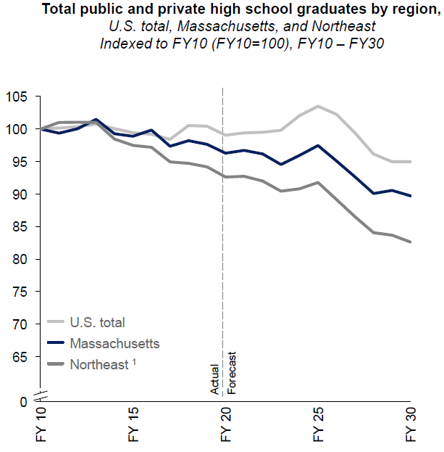
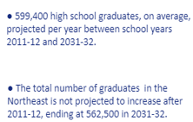
WHAT DOES THE FUTURE LOOK LIKE? Northeast High School Graduate Trends

Slide 2
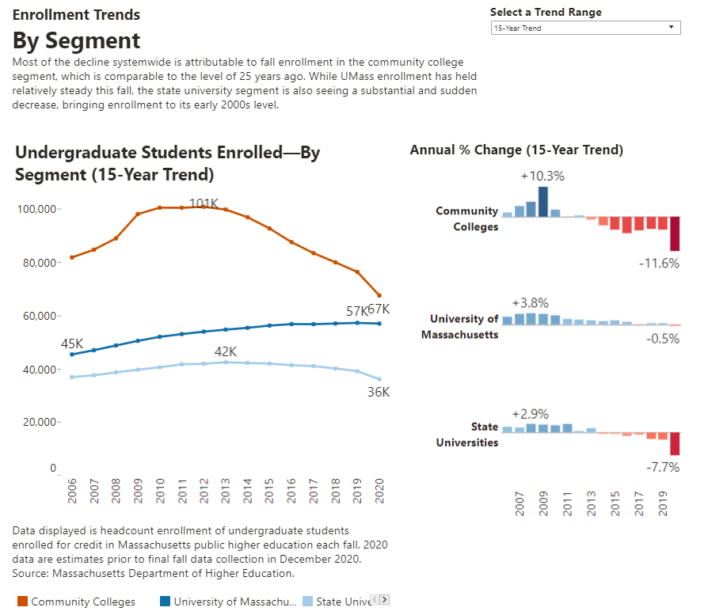

Slide 3
FSU Undergraduate Enrollment Trend: Actual & Projected
Data from "Knocking at the College Door" September 2017
Notes:
Where did we pull project data from?
Data from "Knocking at the College Door" September 2017
Based on trend in Demographics for state of Mass…. Used the percentage change year-to-year to see how it would change from our Actual.

Slide 4
5 Year FTE Enrollment
Notes:
Numbers from IR

Slide 5
What fiscal realities are different now than five years ago?
5 Years ago
Day Undergraduate & GCE enrollments stable
Current (FY21)
9.4% decline in Fall day enrollment
299 less full time day students compared to FY20
565 fewer full time day students compared to FY15 (16.4% decline)
GCE traditional enrollment flat
All growth in accelerate online division
COVID impact on Higher Education
Notes:
Current data as of 10/12/2020 (IR FTE Data)

Slide 6
Future fiscal realities?
Next 5 Years (FY22-27)
Increasing competition
(more supply than demand; increased discounting; NE preference for privates)
Declining enrollments
(traditional college age population is declining)
% State Appropriations continue to decline
Reducing operating expenses
Prioritize academic portfolio
Accelerated Online Division – growth???
Long Term Impacts of COVID on Higher Education

Slide 7
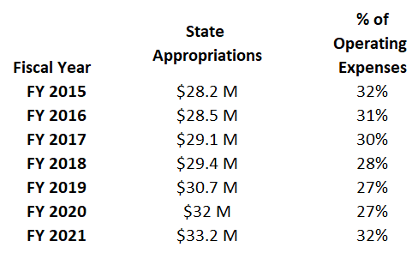
% of Operating Budget covered by State Appropriations
FY2001 = 61% FY2020 = 27%
“…our state appropriation of $33.2 million still falls short of the $38.5 million needed to fully fund our payroll. This shortfall is further compounded because every payroll dollar not covered by the state appropriation adds an additional 38% percent to cover employee fringe benefits – or an additional $4 million.”

Slide 8
Funding Sources

Slide 9
What are the Biggest Drivers?
Functional Areas
Expense Categories

Slide 10
Investment Account Balances
 | 6/30/2019 | 6/30/2020
University Long-Term – retirement account | Market Value | Market Value
Enterprise Portfolio | $ 2,137,103 | $ 2,251,582
Northern Trust Portfolio | $ 10,884,168 | $ 11,046,923
Rollstone Portfolio | $ 4,793,625 | $ 5,200,668
Long-Term Total | $ 17,814,897 | $ 18,499,174
University Short-Term – saving account | Market Value | Market Value
Rollstone Bank Money Market | $ 5,211,610 | $ 5,282,637
MMDT - Control | $ 6,098,818 | $ 6,201,338
Short-Term Total | $ 11,310,428 | $ 11,483,975
University Cash – checking account | Market Value | Market Value
Enterprise Bank | $ 16,250,891 | $ 11,986,725
Webster Bank | $ 97,149 | $ 97,328
Cash Total | $ 16,348,040 | $ 12,084,053

Slide 11
AVERAGE MONTHLY SPEND FY17 through FY20 no Payroll $3.5 Million FY17 through FY20 With Payroll $7.6 Million
Notes:
Without payroll = 12 months
With payroll = 5.5 months

Slide 12
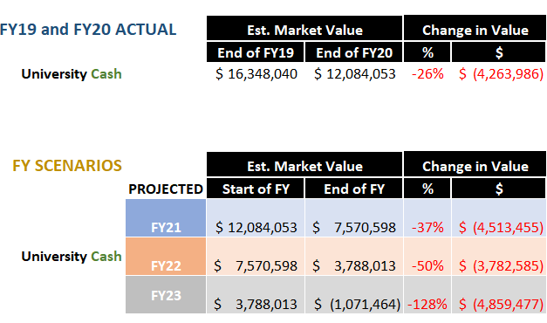
FSU CASH ANALYSIS
* Projection figures Undergrad Revenue 5% decline from FY21 ACTUAL, 2% decline FY22, 2% decline FY23; 2% Increase year-over-year GCE & AP revenue

Slide 13
FSU Undergraduate Enrollment Trend: Actual & Projected
Data from "Knocking at the College Door" September 2017

Slide 14
Where do we go from here?
Enrollment
Increase Revenue
Decrease Expenses

