Slide 1
LCAP Mid-Year Update
ARISE High School
February 8, 2022

Slide 2
Agenda
Overview of Requirements
Updated Budget Overview for Parents and LCAP Mid-Year Expenditures
LCAP Actions Implementation, Expenditures, and Outcomes Update
Educational Partner Input

Slide 3
Local Control Accountability Plan (LCAP)
What is it?
Focus Area
A comprehensive state plan required of districts and charter schools that details key goals, actions, and budgeted expenditures.
Explaining how additional funds for higher need student groups (Low Income, English Learner, and Foster Youth) are utilized.
Notes:
Use or hide slide depending on background knowledge of group.

Slide 4
LCAP Components 2022-23
LCAP Supplement describing how additional funds are being utilized
Mid-Year 2021 Annual Update Board Presentation
LCAP Supplement
Outcomes
LCFF Financial Expenditures YTD
LCAP Actions Implementation Update
One-time addition to LCAP for this year
Traditional LCAP Components
3. 2022 LCAP
Budget Overview for Parents
Highlights, Successes and Needs, Education Partner Engagement
2021-22 Annual Update Actions and Expenditures
2022-23 Goals, Outcomes, Actions, Expenditures
Increased and Improved Services Requirement

Slide 5
One-time Supplement to the LCAP
The Supplement is a one-time mid-year report to the local governing board and educational partners related to engagement on, and implementation of, the actions associated with the additional state and federal funding received to support recovery from COVID-19 and address the impact of lost instructional time.
Notes:
Refer to copy of Supplement in meeting materials, describe contents, and respond to any questions.

Slide 6
Updated Budget Overview for Parents
A concise summary of revenues and expenditures for this year.

Slide 7
Updated Budget Overview for Parents

Slide 8
YTD Expenditures by LCAP Goal as of 12/31/21

Slide 9
Contributing Expenditures for Increased or Improved Services
Funding expended for services for higher need student groups

Slide 10
Increased/Improved Services for English Learners, Low Income, and Foster/Homeless Youth
Professional Development
Enrichment
Data Driven Instruction
Social Emotional Learning
English Language Development
College & Career Counseling
Response to Intervention
Notes:
These are the actions that the LCFF Supplemental and Concentration Funding is allocated to for 21-22.

Slide 11
LCAP Actions Implementation, Expenditures, and Outcomes Update

Slide 12
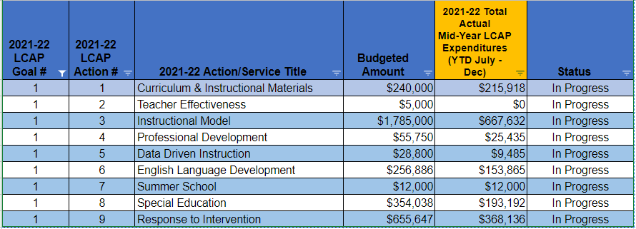
Goal 1: Academic Achievement
LCAP Actions Mid-Year Implementation Update
Notes:
Add Legend

Slide 13
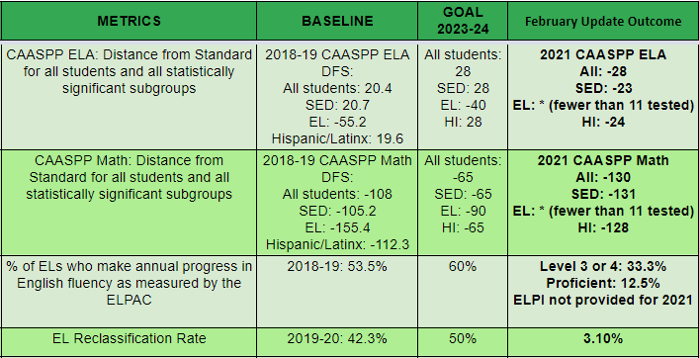
Goal 1: Academic Achievement
LCAP Actions Mid-Year Outcomes Update
Mid-Year NWEA MAP data not yet available

Slide 14
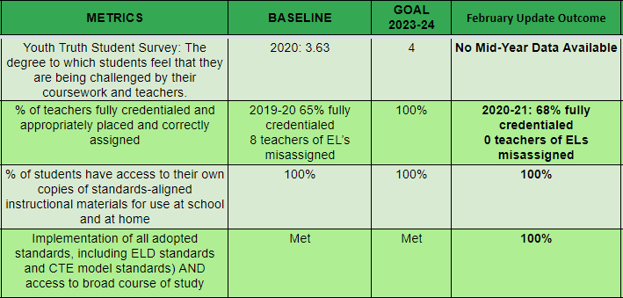
Goal 1: Academic Achievement
LCAP Actions Mid-Year Outcomes Update

Slide 15
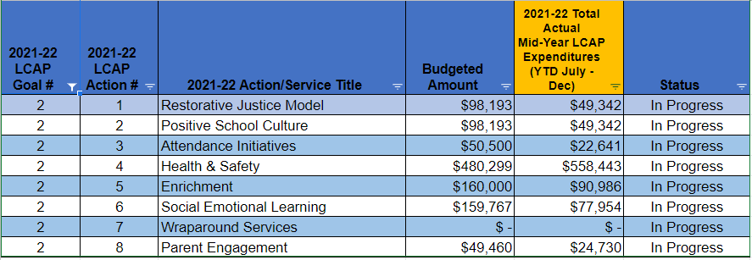
Goal 2: School Culture
LCAP Actions Mid-Year Implementation Update

Slide 16
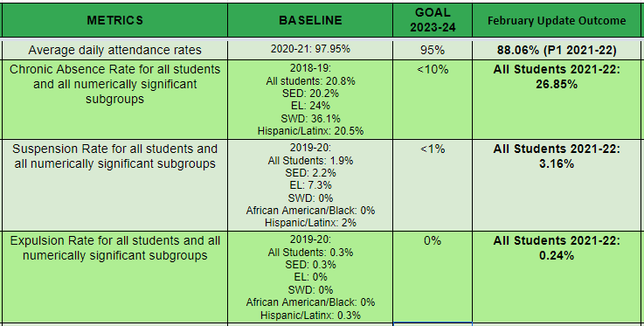
Goal 2: School Culture
LCAP Actions Mid-Year Outcomes Update
Notes:
Add Legend

Slide 17
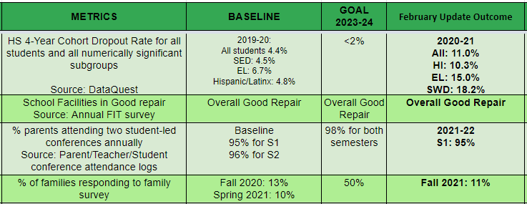
Goal 2: School Culture
LCAP Actions Mid-Year Outcomes Update
Mid-Year Survey data not available
Notes:
Add Legend

Slide 18
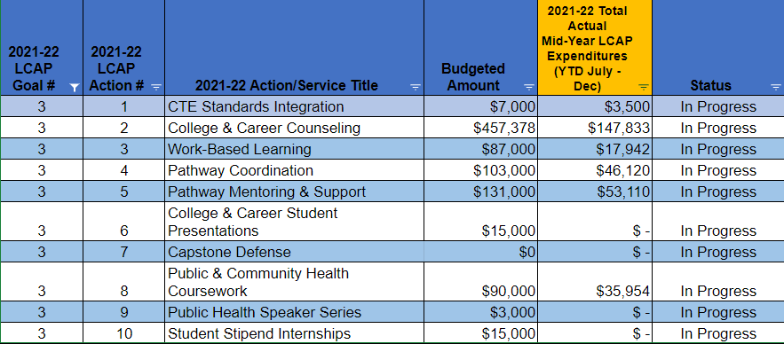
Goal 3: College & Career Readiness
LCAP Actions Mid-Year Implementation Update

Slide 19
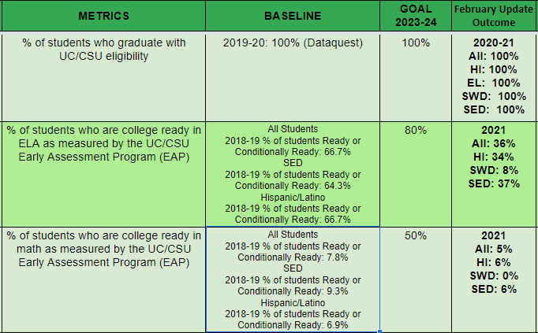
Goal 3: College & Career Readiness
LCAP Actions Mid-Year Outcomes Update
Notes:
Add Legend

Slide 20
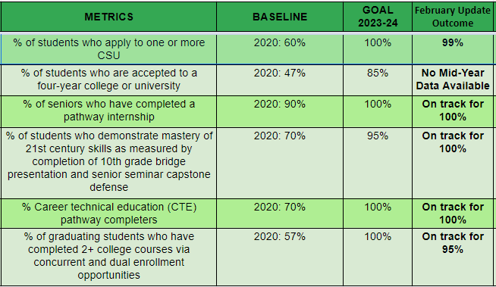
Goal 3: College & Career Readiness
LCAP Actions Mid-Year Outcomes Update

