Slide 1
Board Recruitment and Professional Development
December 2021

Slide 2
Objectives of today’s discussion
Review current board roster
Align on our vision and areas of growth for the Board going forward
Share proposed timeline and next steps

Slide 3
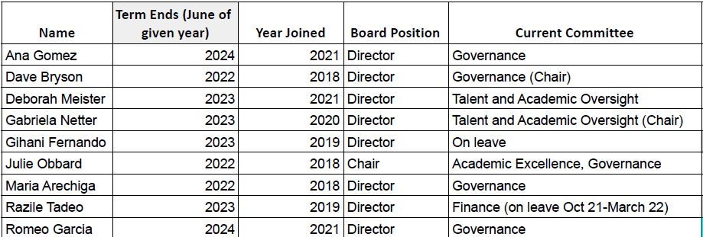
Current Board

Slide 4
Vision for the Board going forward
Increase diversity of the board to reflect:
ARISE student culture
Expand fundraising and finance expertise
What additional diversity and experience can the board benefit from?

Slide 5
Implications for areas of focus
Governance
Continued investment in compliance measures as needed
Increased focus on capacity-building with the goal of being more strategic, efficient, and impactful (can use BoardOnTrack growth areas to inform)
Partnership to identify supports required to address any learning loss due to pandemic
Increased focus on academic rigor and improving student learning outcomes
Ensure leadership creates and implements talent strategy plan (e.g., teacher diversity)
Talent and Academics
Finance
Greater focus on long-term planning and budgeting (including more clarity for full Board around linkage between strategy and resource allocation)
Support for any efforts to bridge near-term financing gaps as needed
Community Engagement
Support for charter renewal process
Increased investment in overall PR / marketing efforts and positive positioning of ARISE within the community
Notes:
karla

Slide 6
Resulting priorities for Board recruitment
Priority capabilities / characteristics | Potential profiles
Fundraising | Foundations Professors Charter school advocates
Finance expertise | Charter school / district finance staff School finance consultants Facilities / leasing experts
Community voice | Community members Community organizers with deep connections to Black/Filipinx/Latinx communities Alumni Elected officials / people with political connections
Seeking to grow board 2-3 members by end of school year
Notes:
karla

Slide 7
Proposed timeline and next steps
Timing | Owner(s) | Activity
By mid-December | AG Full Board | Create initial plan and confirm proposed areas of focus with full Board at 12/7 meeting Confirm extent to which current Board members intend to continue in SY22-23
January - February | KG/AG AG Full Board | Develop candidate slate aligned with target capabilities / characteristics (with input from full Board) Develop interview guide Review candidate slate at 2/8/22 meeting
February - March | KG / AG Full Board AG | Conduct interviews with potential Board members Continue adding candidates to slate as needed Share feedback on interviews and proposed candidates to extend offers to at 3/8/22 meeting
April - May | AG | Extend offers to potential candidates Share onboarding plan Introduce new Board members at 4/12 meeting

