Slide 1
FEBRUARY 2023
Notes:
Jenell

Slide 2
Our charters seek to develop the individual gifts of students to become critical thinkers, responsible citizens, and innovative leaders prepared for academic and real-life success in the 21st century.
A Shared Vision
Notes:
Jenell

Slide 3
What We Value
Building Relationships
Respecting Staff
Valuing Parents
Choice in Education
The Homeschool Heart
Notes:
Jenell

Slide 4
Vista Ordering System
Brought back our previous ordering system, with new and improved features
Orders processed in record time
Simplified the process for service requests
Streamlined the onboarding of new Community Partners
Lots of positive feedback from families and staff
Notes:
Jenell

Slide 5
Sequoia Sign Up
Second year of building
New programming to accommodate Adventure Academy class sign ups by parents- no more google surveys!!!
Field Trip sign ups
Linked Sequoia Sign up to Vista
Ability for private pay
Parent logins connected with Vista
Looking to add new functions next year
Notes:
Shannon

Slide 6
SG has its own board of directors & Board Members are placed on the SG Board by the school boards
Board meets monthly- open to public
Goal is to have a unified identity and provide the best services for the schools at the lowest cost
Charter Service Organization
Three schools are members
2nd year of existence, still learning and growing
Created by the schools, for the schools
Notes:
Shannon

Slide 7
Services Provided by Sequoia Grove
Community Partners (Vendors)
Ordering
Curriculum Services
Library Services
Enrollment
Records
Compliance
Student Information Services
Business Services
Payroll
Medical Benefits
Tech Services
Notes:
Shannon

Slide 8
Instructional Materials Update
Total number of orders processed to date
57,000
Last Year at this time was 29,550
Distributed 1400+ chromebooks in response to staff & family feedback for no charge to student funds
Notes:
Shannon

Slide 9
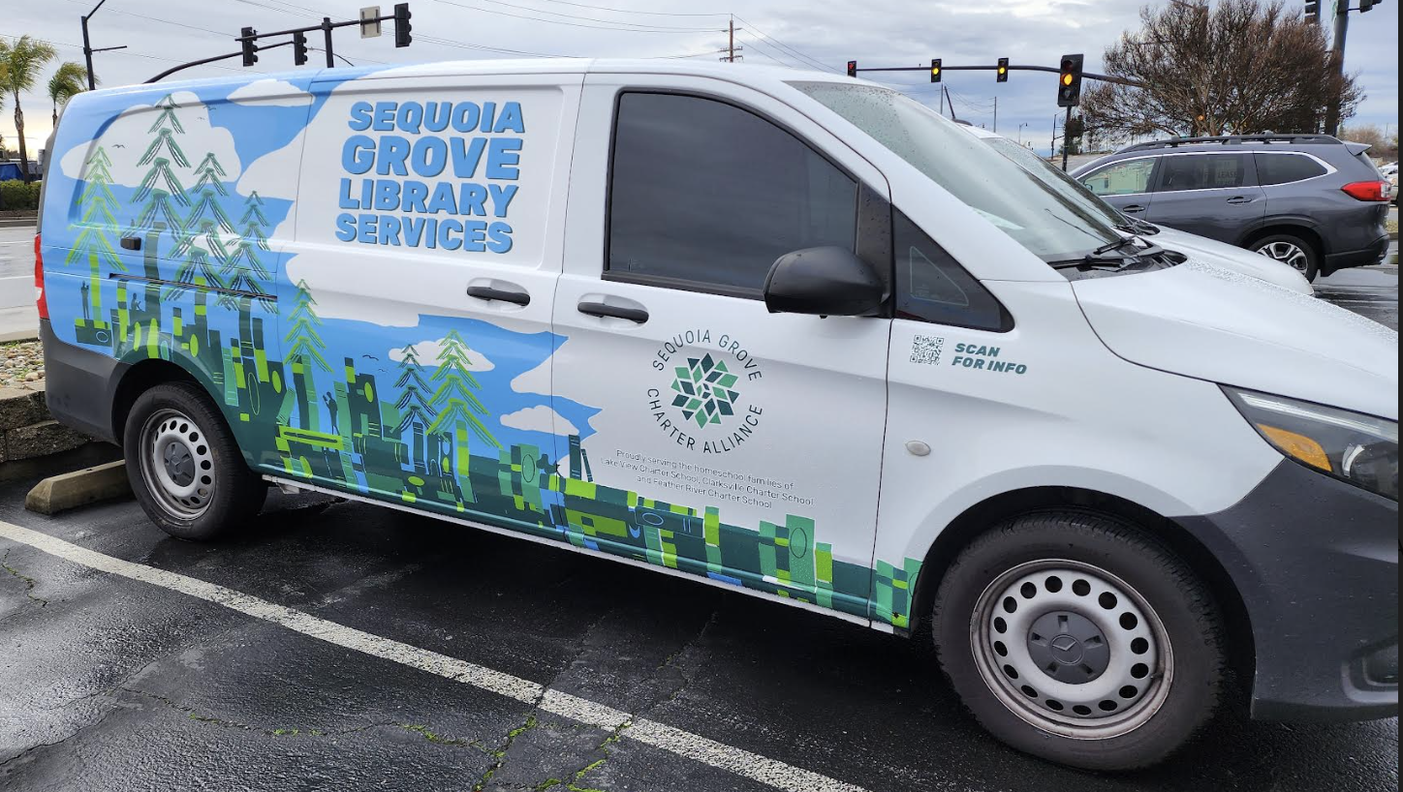
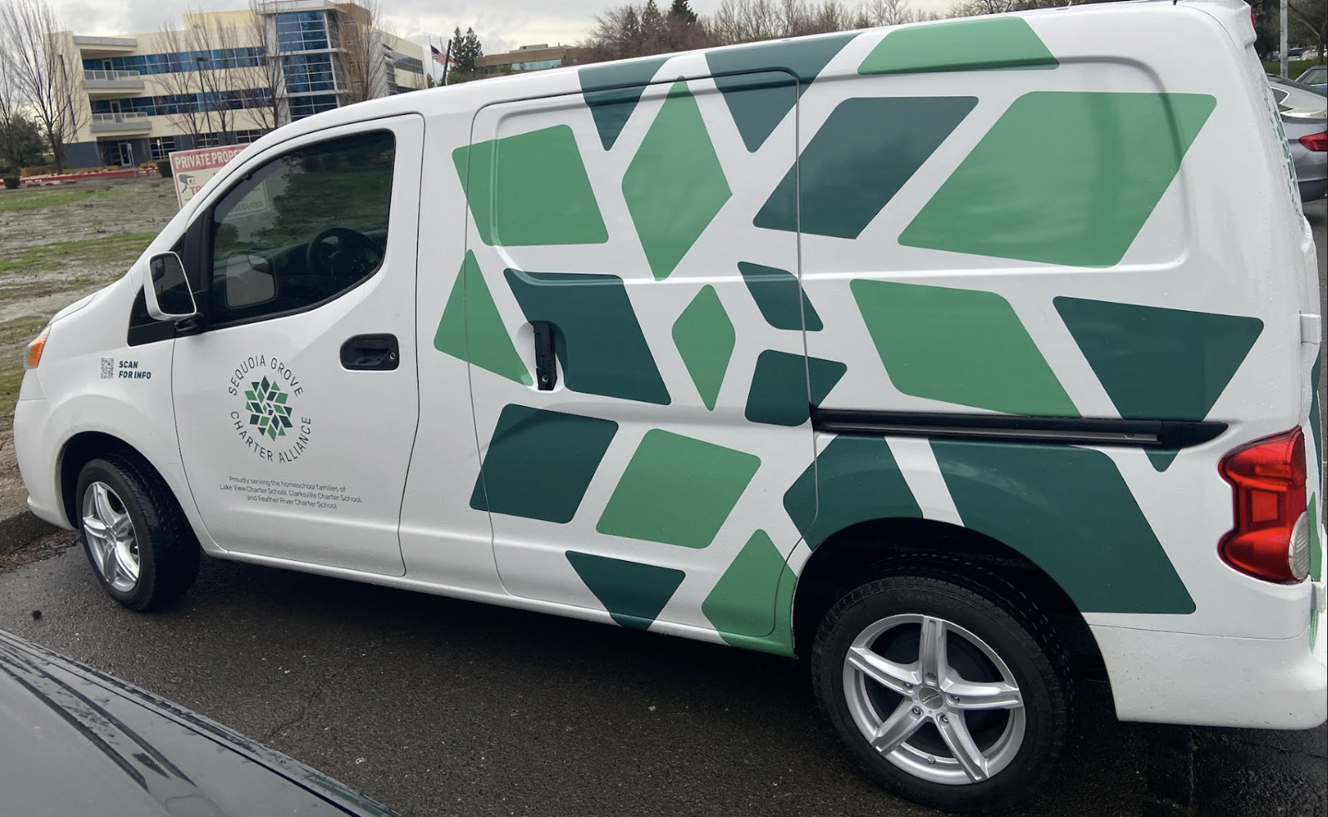
Library
Department
Total Park Day Locations
in 2023
17
(3 additional since last year)
Added locations based on family & staff feedback
Added New Parks & Crafts
Added Shipping Option
Total Amount of Library Inventory
24,836
Notes:
Shannon

Slide 10
Growth of Our Schools
School | Enrollment January 2021 | Enrollment January 2022 | Enrollment March 1, 2023 | Increase in Students 22-23
Clarksville | 1172 | 1585 | 1966 | 381
Feather River | 1088 | 1840 | 2393 | 553
Lake View | 465 | 645 | 716 | 71
Winship | 110 | 280 | 0 | NA- most to FR
Total Increase of Students between the 3 Schools from 21-22 to 22-23:
1003

Slide 11
We have the BEST Staff!!!
Staffing
School | # Staff 21-22 | # Staff 22-23
Feather River | 97 | 128
Clarksville | 87 | 106
Lake View | 39 | 43
Total Schools | 223 | 277
CSO | 37 | 43
Total | 260 | 320
New for 22-23
Feedback from Staff has helped leadership stay connected to how staff are feeling and make beneficial changes!
Schools have a Memorandum of Understanding in place to allow for staff sharing between the schools
Serving 1000+ more students than last year
Notes:
Jenell

Slide 12
Exciting Changes 22-23
Salary schedule increase & one time COLA bonus spread over the year
Staff stipends for office supplies, mileage, phone & utilities
Increased student funds:
Staff and Students are valued!
TK |  | K-8 |  | 9-12
21-22 | 22-23 | 21-22 | 22-23 | 21-22 | 22-23
1000 | 2400 | 2600 | 2800 | 3000 | 3200
Notes:
Jenell

Slide 13
Staff Wellness
New for the 22-23 School Year
Staff is providing Staff Wellness support
Weekly meeting opportunities
Wellness tips in the Weekly Bulletin
Notes:
Jenell

Slide 14
Curriculum Resources
Sync-Up
Updates
22-23: Can be “a” vs “the” teacher of record
Dedicated time each day to spend with students
Teams working together to make sync-up more efficient
Resources and ideas to
support HSTs
NEW THIS YEAR
Hired a Curriculum Resource Specialist
HST Curriculum Resource Site

Slide 15
Special Education
Number of SPED Students Per School
Clarksville | 219
Feather River | 187
Lake View | 60
Focused on overall staffing to support lower caseload numbers so that better support can be provided
Added a new position, Student Compliance Coordinator to ensure student IEPs are being implemented and significantly improved our overall IEP implementation
Lake View has been accepted to move from LACOE Selpa to EDCOE Selpa
Clarksville and Feather River are already part of EDCOE Selpa
Goal to continue fostering relationships between SPED and General Education
New Staff
9 new case managers
2 Compliance Coordinators
2 Assessment Program Specialists
2 Teacher Program Specialists
1 additional School Nurse
Speech Language Assessor
Notes:
Jenell

Slide 16
Student
Support
Highlights:
40 live SEL group counseling seats
367 seats for live academic interventions…
(this cycle alone we have 154 seats filled for live academic interventions!)
140 students are signed up for NESSY (asynchronous reading)
55 students are signed up for Centervention (Asynchronous SEL K-8)
3 Students are signed up for EverFi (Asynchronous SEL HS)
SEL Drop Ins: 80 for 2 cycles
The Student Support Department
is going strong.
101 SST meetings have been held
120 504 meetings have been held
Notes:
Jenell

Slide 17
English Learners
57 English Learners qualified for reclassification
Offering 9 ELD Live classes that meet 2-5 times weekly
Bootcamp offered M-F for all grades in January- great attendance!
School | # EL Students
Clarksville | 46
Feather River | 180
Lake View | 5
Summative testing team
14 teachers competing 231 student assessments

Slide 18
High School Growth
* New Course Outlines
* Course Catalog Clean-up
* Curriculum Resources
* Added a 3rd Counselor
* CAAP Program - Helping over 40 unduplicated students reach their
college dreams, including live university tours
* Career Planning Emphasis for All
Students
* Friday Focus
* Partnership with CCGI
* Plans to offer the ASVAB
New CTE Business Pathways in Edmentum and 5 through SCOE
Notes:
Shannon

Slide 19
High School Opportunities
College Level
Dual Enrollment program
6 fall classes
5 spring classes
Over 100 students each semester
Concurrent Enrollment
Over 329 unique college courses taken in the fall (DE + CE)
Total Participants in 21-22: 35
Total Participants in 22-23: 67
Notes:
Shannon

Slide 20
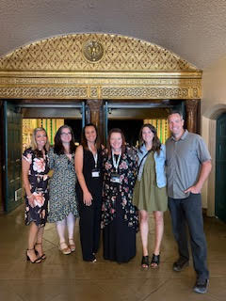
High School Goals- Met!
* Offering AP and PSAT tests this year
* May 2022- 1st live graduation ceremony at Memorial Auditorium
* First year of the the College Awareness & Advancement program (CAAP)
* JHVA & HSVA programs serving just Sequoia Grove students
Notes:
Shannon

Slide 21
High School Virtual Academy
Unique Students Enrolled Per School
Did you know HSVA students score better on the CAASPP?
The team consists of 14 single-subject credentialed teachers
School | 21-22 | 22-23
Clarksville | 100 | 118
Feather River | 178 | 208
Lake View | 19 | 22
Total | 297 | 348
Year 3 of HSVA Program
Year 1 of All SG students
This year we offered at least one section of every a-g required course for a-g completion.
We also have students in Academic Decathlon, Leadership, and Military Science.
Notes:
Shannon

Slide 22
Junior High Virtual Academy
Unique Students Enrolled Per School
Offered 2 sections of each core 7th & 8th grade class
Offered Algebra 1 & Spanish 1 for HS credit
Offered Academic Pentathlon, Art & Military Science
School | Students
Clarksville | 65
Feather River | 107
Lake View | 28
Total | 200
JHVA was transitioned this year to join with HSVA and have subject-matter qualified teachers
JHVA teachers providing all instruction and work samples!
Notes:
Shannon

Slide 23
All-Access Subscriptions
New 22-23
Reading Eggs
Grammarly (3-12)
Tutor Me (9-12)
TTRS (TK-5*)
Gizmo (9-12)
Math Seeds
Prodigy
Moby Max (TK-8)
Freckle Math (all)
Accelerated Reader (all)
All ordering now through Vista!
Additional trainings
Brain Pop
Notes:
Shannon

Slide 24
Diversity, Inclusion & Growth
Highlighting Diversity
Lifting marginalized voices
Providing diverse perspectives
Celebrating various cultures and history
Creating spaces for understanding and inclusion
Inviting staff and families into action steps for growth
DIG Coffee and Conversations held monthly
Global Family Day Art Contest
Monthly updates on the Homeschool Helper DIG page, Sync-up lessons, and other learning resources shared through the Sequoia Scoop and Weekly Bulletin.
Field Trips
The Diversity and Inclusion Advisor attended a 2-day professional development Diversity Conference in San Diego. She came back and facilitated a Professional Learning Community during the ITA leadership meeting about redefining success to be more inclusive and accessible.
Resources were shared on the Homeschool Helper DIG page for Black History Month (Feb.) and Women’s History Month (Mar.), as well as, updated Sync-up lessons that are optional for HSTs to use.
3 Asynchronous PD learning modules shared in the HST Google Classroom focusing on “Uncovering Bias” training.
Notes:
Shannon

Slide 25
Family Resources
Title 1 Specialist to strongly support our most at-risk students, including
Foster/Homeless Youth
ELD students
Any student at risk of failing out of school due to circumstances beyond their control
Building relationships with counties to provide resources to our families
Created a Family Resources Website
Notes:
Shannon

Slide 26
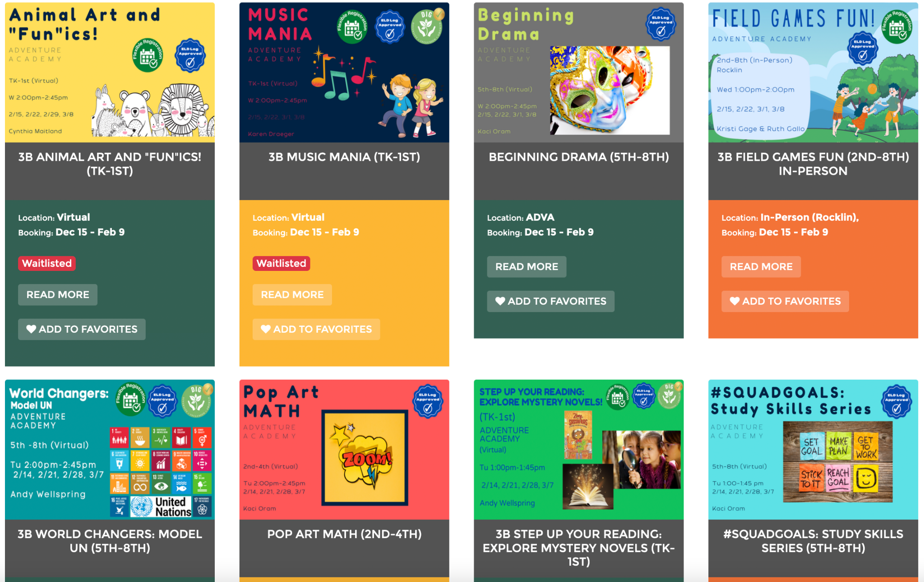
Adventure Academy
New for 2022/2023 year:
4 & 8 week sessions
Flexible Scheduling
Parent registration through
Sequoia Sign Up
Series Classes
Year 2 of Adventure Academy
Notes:
Jenell

Slide 27
Session 1 | 2021/2022 | 2022/2023
Enrollment | 105 | 472
Unique Students | 88 | 244
Classes | 6 | 55
Look at that growth!
So many opportunities for our students!
Session 2 | 2021/2022 | 2022/2023
Enrollment | 305 | 880
Unique Students | 234 | 415
Classes | 18 | 76
Session 3 | 2021/2022 | 2022/2023
Enrollment | 215 | 678
Unique Students | 178 | 288
Classes | 14
*Data includes Session 3A only (1st 4 weeks)
Notes:
Jenell

Slide 28
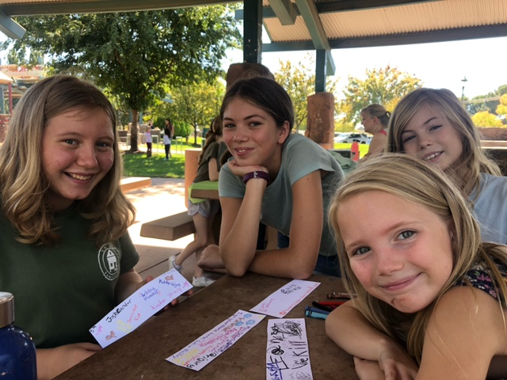
Clubs
Highlights
Fewer club offerings due to more in person events & field trips
Increased attendance
Repeated attendance
CREATIVE CLUBS - WOW!
Session | 1 | 2 | 3 | 4 | 5 | 6
# of Clubs | 5 | 9 | 5 | 9 | 7 | TBD
Students Served | 114 | 176 | 75 | Info Coming soon | Info Coming soon | Info Coming soon
Year 2 of Clubs
Notes:
Jenell

Slide 29
Field Trips
Launched Sequoia Sign Up
Spring 2022
Hired Field Trip Coordinator & Field Trip Processors
Developed Field Trip Program
New processes in place
Equitable & increased offerings for students/families
2022/2023 Field Trips *still adding trips
 | SEP | OCT | NOV | DEC | JAN | FEB | MAR* | APR* | MAY*
# of trips | 15 | 35 | 20 | 23 | 15 | 24 | 12* | 6* | 8*
# of students | 800 | 1,649 | 776 | 1,623 | 982 | 1,501 | 1,102 | 464 | 486
Notes:
Jenell

Slide 30
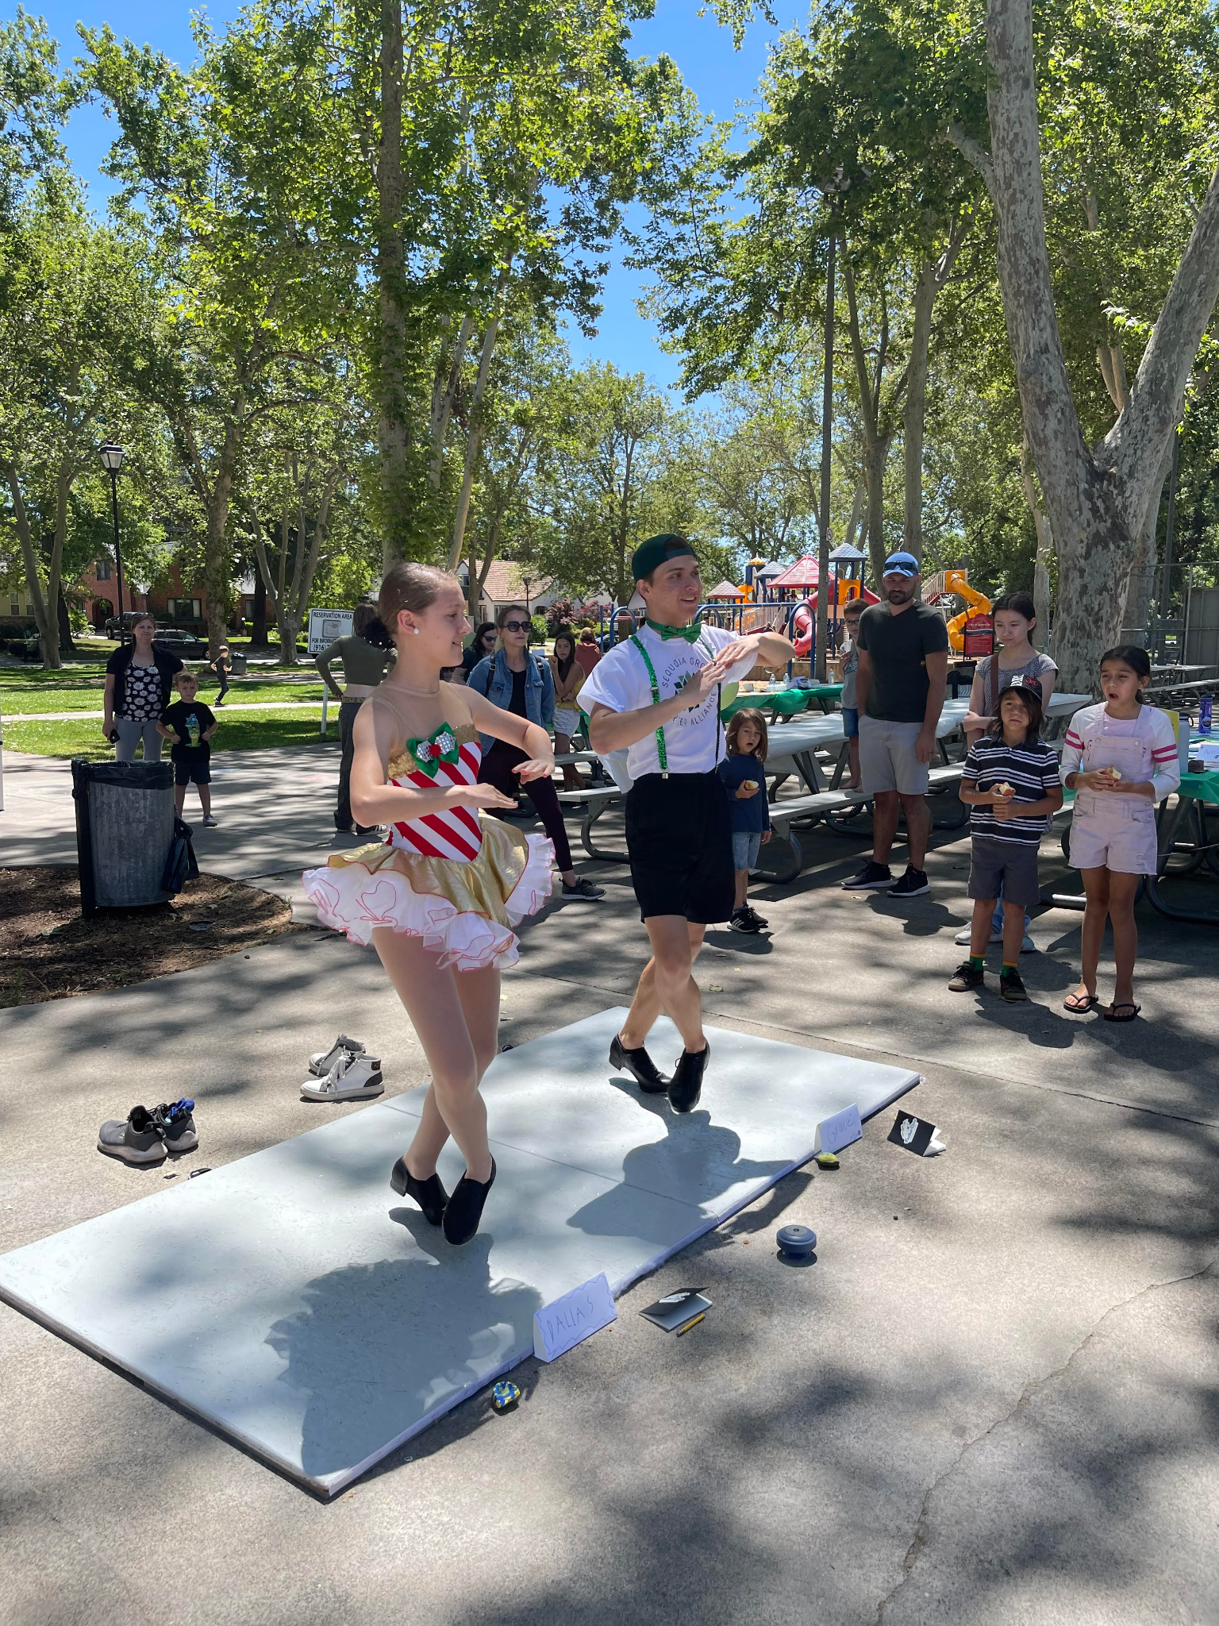
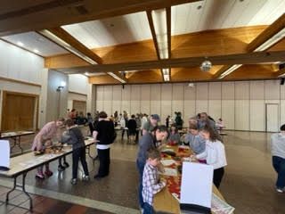
Schoolwide Events
Showcases Year 2!
2021/2022 - 1st major event post-COVID
2022/2023 - Bigger & Better
7 Locations
Student & Family Display Tables
School Program Tables
And more….
Added Event Section to Sequoia Sign Up
Advertisement
Registration
Math Festivals- NEW this year!
4 Locations, Great Attendance
Elk Grove | Folsom | Chico | Roseville
79 | 55 | 56 | 88
Spelling Bee- NEW this year!
Virtual Event for 3rd-8th grades
February 15th/16th
Notes:
Jenell

Slide 31
First Annual Sequoia Grove
Virtual Spelling Bee Winners
3rd Grade - Laila Kamel
4th Grade - Rayos Sutherland-Metter
5th Grade - Nolan Eicher
6th Grade - Brooklyn Handley
7th Grade - Kailyn Kelly
8th Grade - Timothy Ryzhenkov

Slide 32
Assessment Celebrations
Last spring was the first CAASPP post COVID
All three schools reached 95% participation
Fall STAR testing- 95% participation!
Added two amazing Testing Coordinators to the team this year
Notes:
Jenell

Slide 33
Achievement Overview
 | Feather River | Clarksville | Lake View
Dashboard | Increases in ELA & Math | Increases in ELA & Math | No comparison data
EL Progress | Increase of +4.3% | 62.5% of students making progress | Not a big enough cohort to score
Graduation Rate | 84.8%, slight decline from 2019 | 95.3%, increase of +7.6% | 75%, declined, room for growth
Sub-group Progress | All groups increased in Math | All groups increased in Math | All groups increased in Math
Distance from Standard | Improvement in both ELA & Math; Math increased by 29.8 points! | Improvement in both ELA & Math; Math increased by 25.7 points | No comparison data, however Math remains a critical area of focus
Participation Rate* | 95% | 95% | 97%
* As reported on the CA Dashboard
Notes:
Jenell

Slide 34
Schoolwide Areas for Academic Focus
Continued support for all students in Math and ELA instruction
Continued support for instructional coaches in Math and ELA
Continued support for Long-Term EL students
Continued high school support to improve graduation rates, especially in Lake View and Feather River
Continue to positively refine testing dialogue with families
While we have areas for improvement, the academic growth that our schools have made, even through a pandemic, is something we should be very proud of.
Notes:
Jenell

Slide 35
WASC Updates
Lake View Self-Study
March 20th-22nd, 2023
Virtual Visit
Feather River Mid-Cycle Review
April 19, 2023
Virtual Visit
Clarksville Mid-Cycle Review
23-24 School Year
New WASC Specialist Position
Notes:
Shannon

Slide 36
Making our schools the best that they can be….
Continue collaboration with CSO to meet the needs of the schools
Evaluate and strengthen departments, programs, practices and systems
Identify & hire needed positions to best serve our students
Budget wisely & keep schools financially sound
Long term strategic planning, legal compliance
Improve student achievement and our Dashboards
Increase awareness and support for mental health and self-care for staff and students
Stay innovative
Improve web presence and tools
Stay focused on students and the heart of homeschooling

Slide 37
Thank you for being a part of our journey!

